Slide 1
Hierarchical Clustering

Slide 2
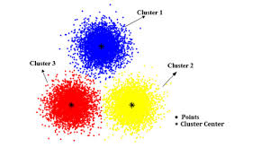
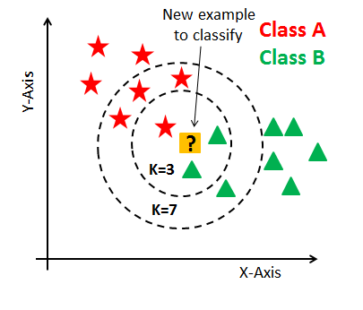

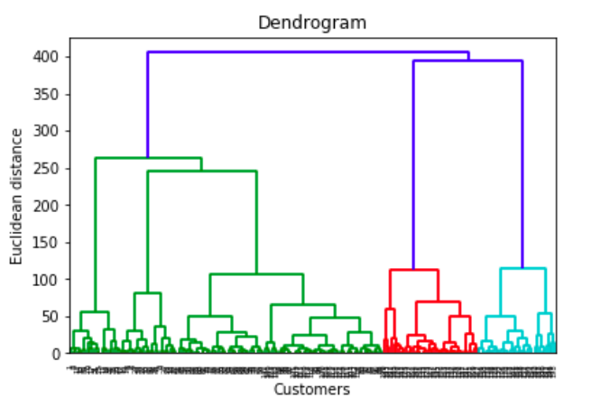
Clustering Overview
K-Means
Good if you have a lot of data
Estimates the underlying group structure of the population
DBSCAN
Good for non-spherical clusters with similar density
Good for cases with noise/outliers
Hierarchical
Clusters don’t have to be the same size or density

Slide 3

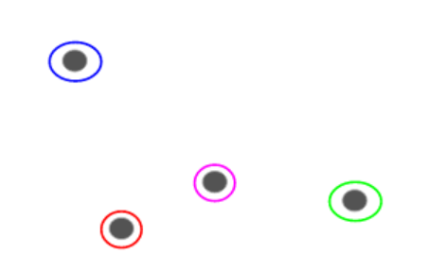
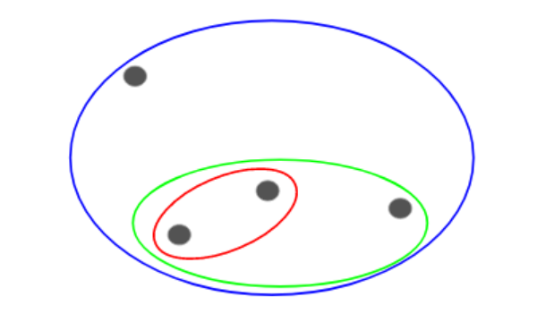
Hierarchical Clustering - Overview
Iteratively merge closest clusters until we have one
Start with data in some feature space
Assign a single cluster to each point

Slide 4
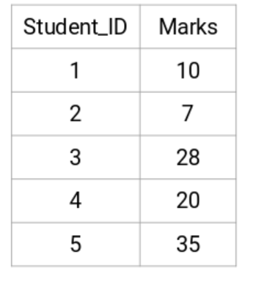
Hierarchical Clustering - Example
A teacher wants to assign students to groups based on their grades on an assignment
There’s no fixed target on how many groups there should be
The teacher doesn’t know what type of student should be in which group (unsupervised learning problem)

Slide 5
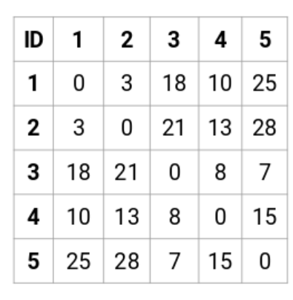

Example – Create a Proximity matrix

Slide 6
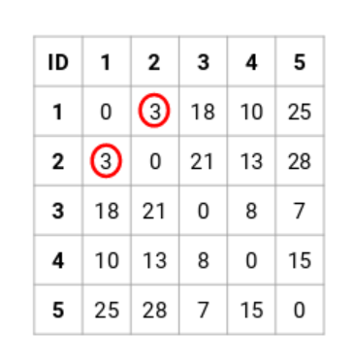
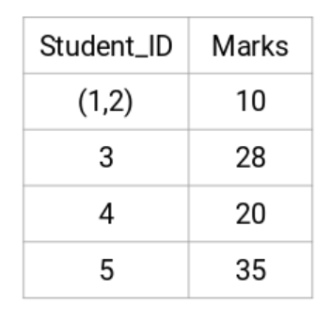
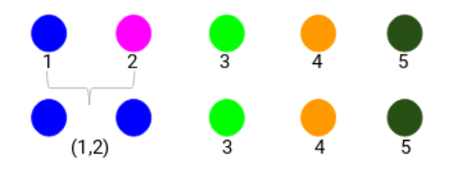
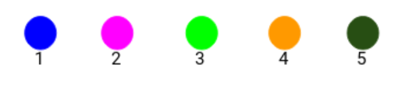
Example – Clustering Process
Find closest two clusters and merge them

Slide 7
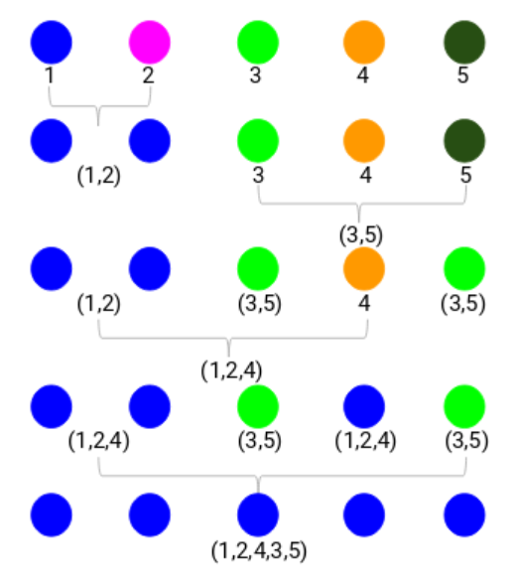
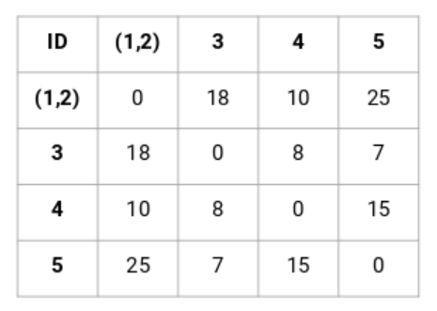
Example – What Number of Clusters?
Keep iterating until you have one cluster

Slide 8
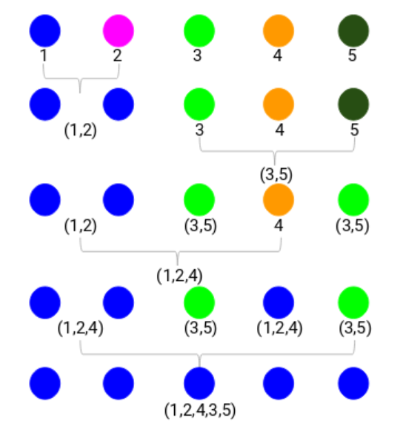
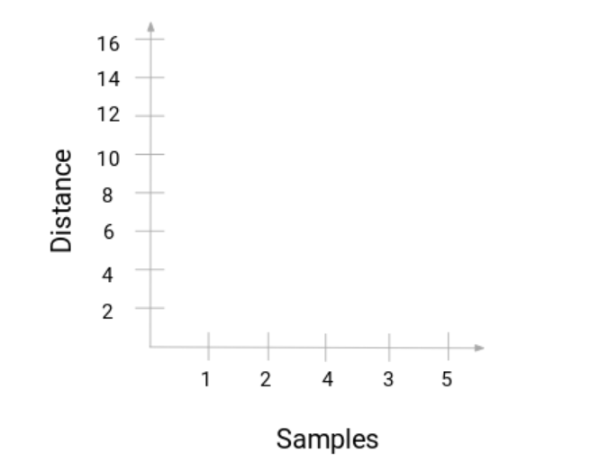
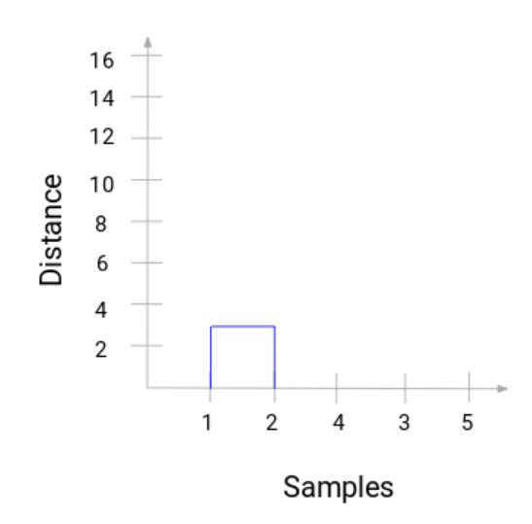
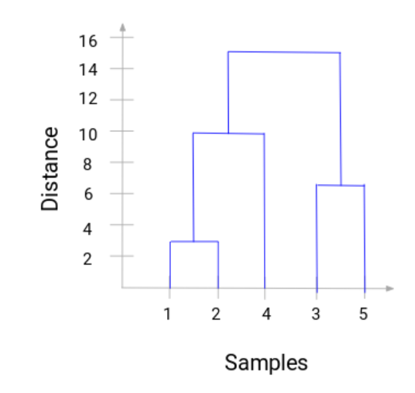
Example – Iteration
Dendogram
– Horizontal lines indicate the distance at where clusters were merged
– The more distance of the vertical lines, the more distance between those clusters

Slide 9
Example – Setting the Threshold
Dendogram
The number of clusters will be the number of vertical lines intersected by the line drawn using the threshold
Example on right shows a threshold of 12 which results in 2 clusters
Rule of thumb – threshold is placed where the longest vertical gap between clusters resides

