Slide 1
K Nearest Neighbors

Slide 2
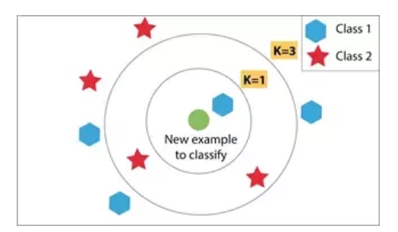

K Nearest Neighbors
K Nearest Neighbors is typically considered a supervised learning technique that can be used for classification or regression.
We will talk about it in this context first.

Slide 3
K Nearest Neighbors
The closeness/ proximity amongst samples of data determines their neighborhood.
Generally, neighbors share similar characteristics and behavior that's why they can be treated as they belong to the same group.
The K in KNN represents the K-Nearest Neighbors of the unknown data we want to classify and assign it the group appearing majorly in those K neighbors.
For K=1, the unknown/unlabeled data will be assigned the class of its closest neighbor.

Slide 4
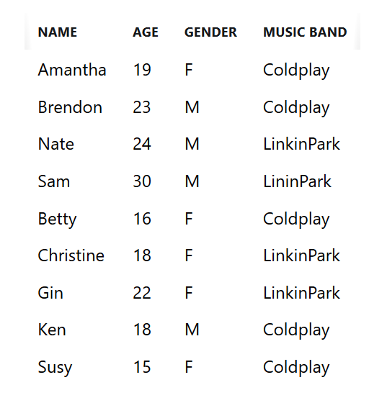
Predicting Music Taste
We have a person named Gary who is a 23 year male and we want to predict which band he will like. Here's how we can use the KNN algorithm
We'll have to translate gender to some numbers for the distance/ proximity relation needed for finding neighbors.

Slide 5
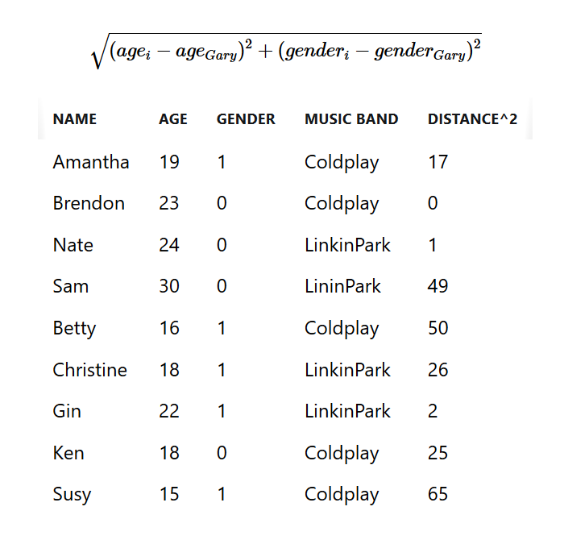
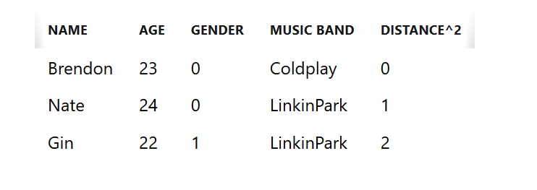
Calculating the Nearest Neighbors
Gary is Male (0) and is 23 years old
K=3 then the K-Nearest Neighbors are
LinkinPark is followed more by Gary's Neighbors so we predict that Gary will also like LinkinPark more than Coldplay

Slide 6
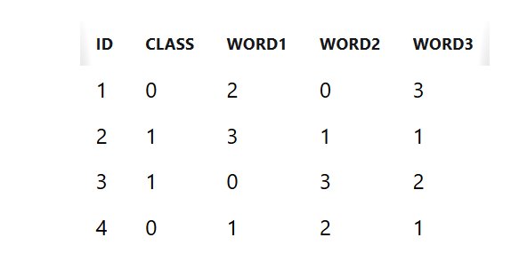
How Does This Work With Text?
Same idea but the distances calculated are the distances between word/sentence vectors
K-Nearest word/sentence vectors will be selected and the class having maximum frequency will be labeled to the unlabeled data.

Slide 7
What if We Don’t Have Classes?
If our text data are unlabelled (as is often the case in NLP), we can use KNN to identify documents that are similar to a given document.
We could also use a clustering algorithm to group together similar documents (we will talk about this later on).

