Slide 1
Deep Learning

Slide 2
What is Deep Learning?
Artificial Intelligence (AI)
The development of a machine that can simulate human behavior.
Machine Learning (ML)
The process of a machine learning from data and making decisions without explicit programming.
Deep Learning (DL)
A term associated with a ML algorithm involving artificial neural networks that work to mimic neurons in the brain.
Data Science (DS)
The process of using data analytics, statistics, and programming to solve business problems.
AI
ML
DS
DL

Slide 3
Video
Top 5 Uses of Neural Networks! (A.I.) | ColdFusion
https://www.youtube.com/watch?v=i9MfT_7R_4w

Slide 4
Pros & Cons of Deep Learning
Pros
Deep learning automates much of the feature extraction process, which can be particularly useful for things like image recognition.
Deep learning is flexible and can be applied to many different datasets.
Deep learning models can generally outperform than other types of machine learning models.
Cons
Deep learning requires large datasets to train the model.
Deep learning can be very computationally expensive to train.
There are many modeling decisions that need to be made.
Results from a deep learning model are often uninterpretable. It is often difficult to understand why it is making its prediction.

Slide 5
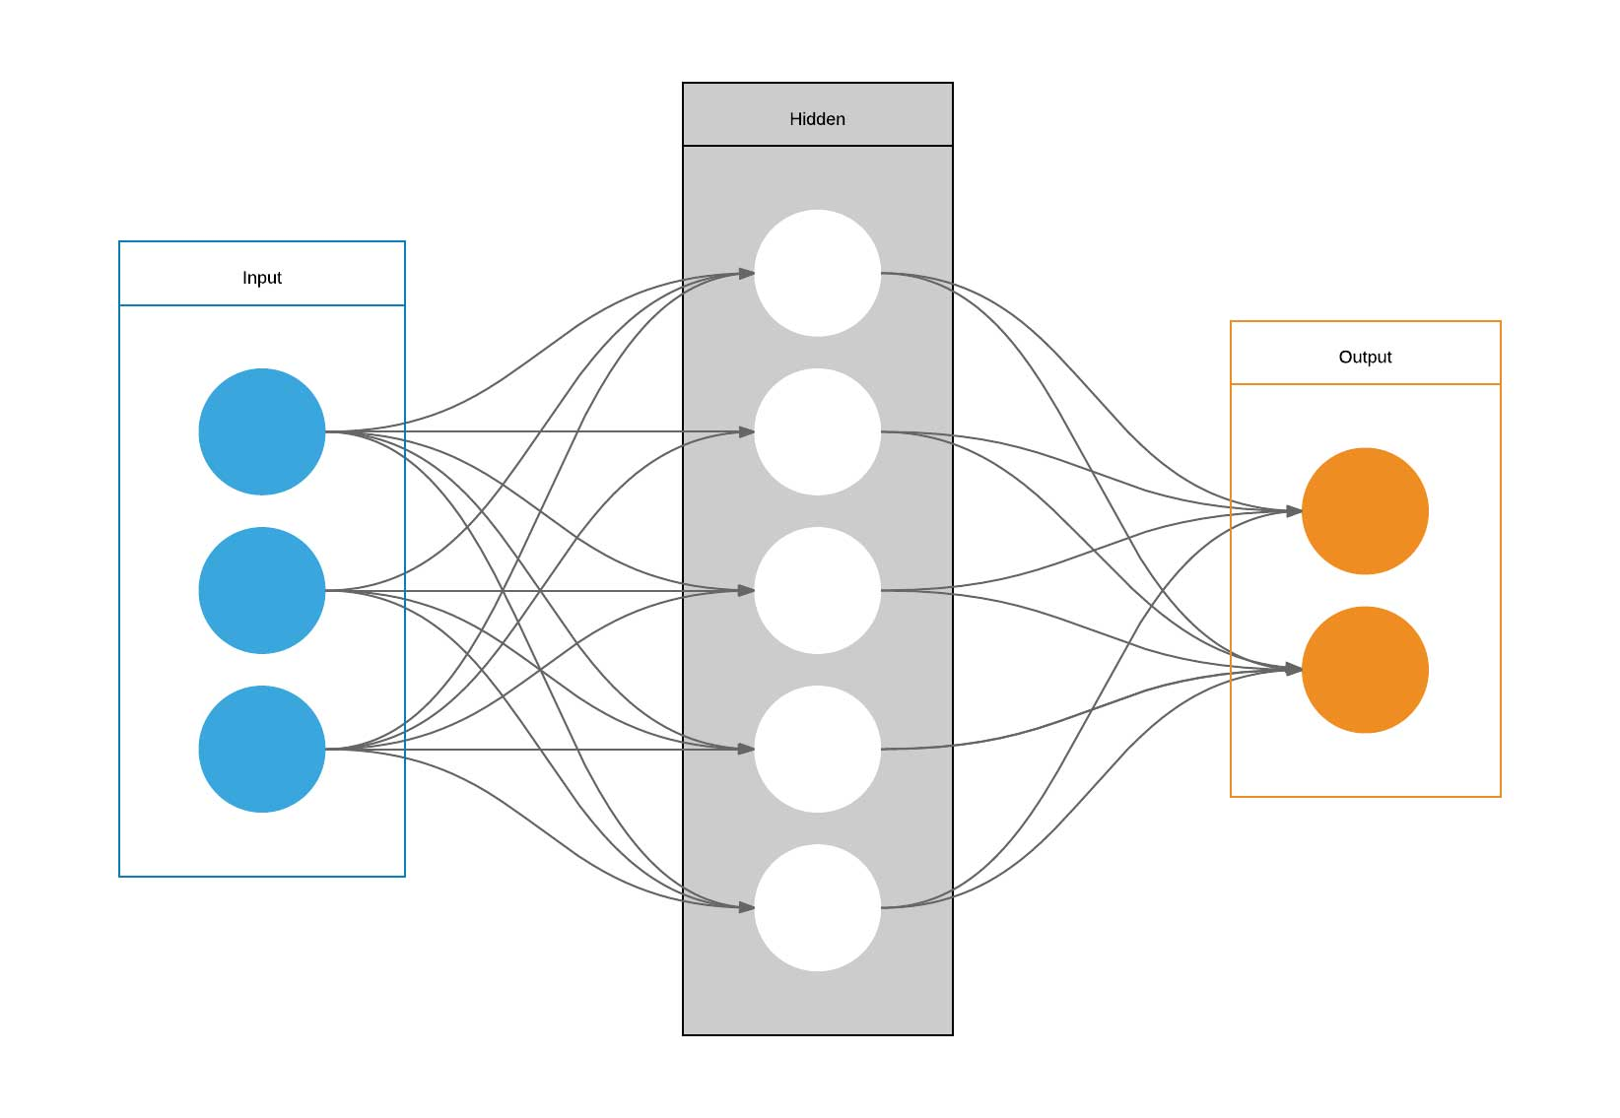
Deep Learning & Neural Networks
Deep learning is a subfield of machine learning.
Neural networks are the foundation of deep learning algorithms. The “deep” in deep learning refers to the number of layers in the neural network (we will discuss this shortly).
Neural networks mimic the brain through the use of algorithms.

Slide 6
Video
Neural Network In 5 Minutes | What Is A Neural Network? | How Neural Networks Work | Simplilearn
https://www.youtube.com/watch?v=bfmFfD2RIcg

Slide 7
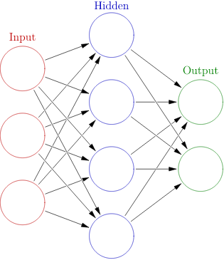
Artificial Neural Networks
Artificial Neural Networks (ANNs) are a system made up of a collection of connected neurons (also called nodes).
Neurons are able transmit a signal to each other through connections.
Neurons are organized into layers. There are three types of layers
1) Input
2) Hidden
3) Output
Different layers perform different transformations on the data.
Nodes
Connections

Slide 8
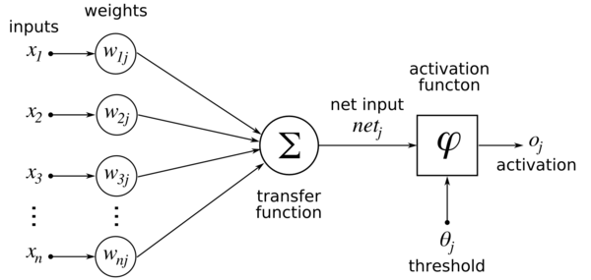
Perceptron
The most basic neural network is called a perceptron. It is broken up into the following pieces:
Weights - each input has a weight associated with it (can be any real number)
Transfer Function - inputs and weights are combined, usually as a weighted sum
Activation Function - defines the output of the neuron given the result from the transfer function
Inputs - the data (in numerical form)

Slide 9
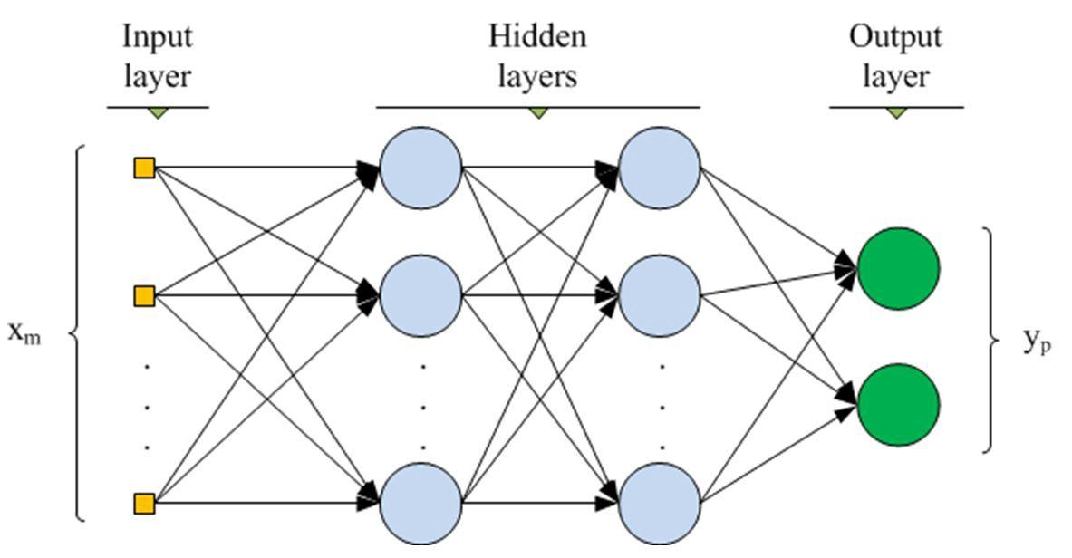

Multi-Layer Perceptron aka ANN
Input layer = the data (numerical form)
Output layer = probability that each class is the correct class
Hidden layer = layer of “neurons” each outputting a result based on a sum of the inputs
The “magic” lies in tuning all the weights (w) so that the network classifies input data correctly
w
w
w
w
w
w
w
w
Each path between layers has a weight w associated with it

Slide 10

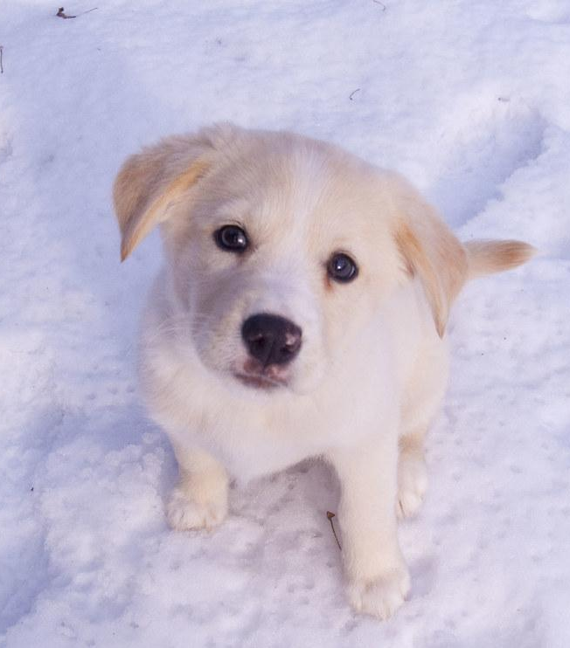
How does a Neural Network Learn?
W₁ = .2
.25
W₂ = .5
W₃ = .4
.75

Slide 11
How does a Neural Network Learn?
W₁ = .4
.65
W₂ = .3
W₃ = .7
.35

Slide 12
How does a Neural Network Learn?
W₁ = .6
.95
W₂ = .2
W₃ = .8
.05

Slide 13
Types of Neural Networks
There are many types of neural networks, each used in different circumstances. We will focus on three common types:
Artificial Neural Networks (ANNs) - also known as feed-forward neural network. Does not account for sequential nature of data and can result in a large number of predictors in image classification.
Recurrent Neural Network (RNN) - captures sequential nature of data. Usually used for time series and text data.
Convolutional Neural Networks (CNNs) - uses kernels to extract relevant features from the input. Also captures spatial features of the data. Usually used for image classification.

Slide 14
How to Create Neural Network?
When fitting a neural network, you have to decide on several things:
The number of layers
The number of nodes in each layer
The type of layers (see next slide)
The activation function in each layer (see later slides)
How do you decide on the number of layers and nodes? The most common way is just experimentation (trial and error). There is no simple way to determine the best number of layers or nodes for your problem. You will likely need to just try different options and see what gives you the best model performance.

Slide 15
Types of Layers
There are several types of layers that can be used in a neural network. We will focus on two common types:
Dense Layers - Dense layers are used when connections can exist among any feature to any other feature in a data set. This corresponds to an ANN.
Convolutional Layers - Convolutional layers can be used to detect patterns in an image. Early convolutional layers can detect things like edges or geometric shapes. Deeper convolutional layers can detect more sophisticated patterns like eyes, noses, etc. Convolutional layers are used when nearby connections among the features are important, but farther connections are not. This corresponds to a CNN.

Slide 16
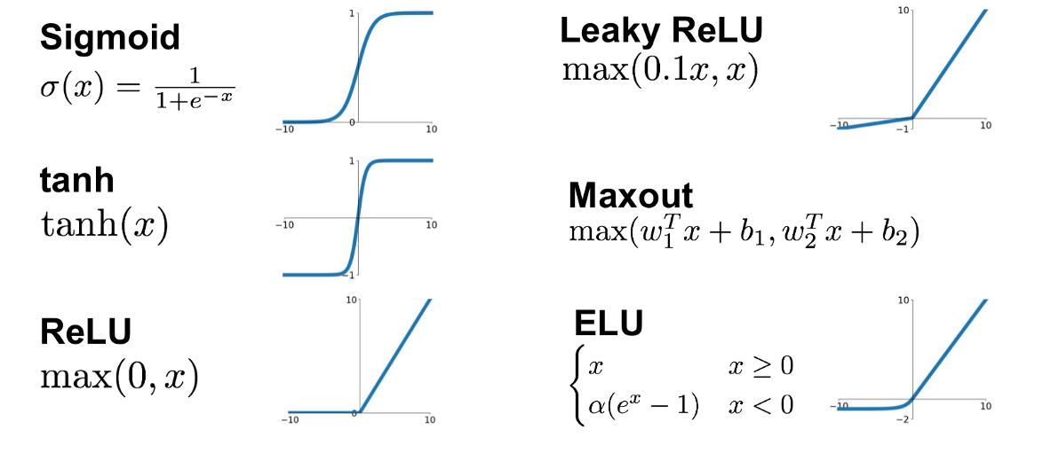
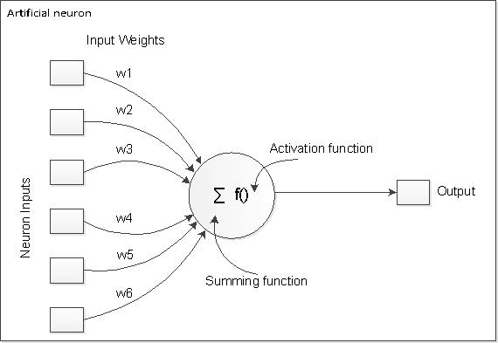
Activation Functions
All weighted input values are summed and then processed with an activation function
That output is then passed along to the next layer or to the output
Activation functions are inspired by neurons in our brain that fire based on different stimuli.
Common Activation Functions

Slide 17
Common Activation Functions
One thing in common to activation functions is that they are nonlinear.
The baseline function we will use is the ReLU. Sigmoid is often used for binary classification.
Other activation functions can easily be swapped in to examine if performance is increased.
https://towardsdatascience.com/a-quick-guide-to-activation-functions-in-deep-learning-4042e7addd5b

Slide 18
Fitting a NN in Keras
Keras is a Python library that is used to fit neural networks.
The following are the common steps you want to take when fitting a neural network using keras:
Load data
Define keras model
Compile model
Fit model
Evaluate model
Use model for prediction

Slide 19
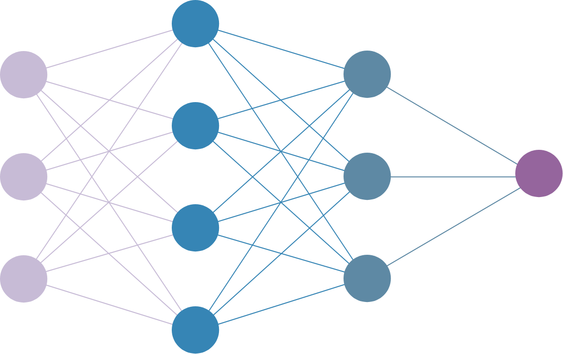
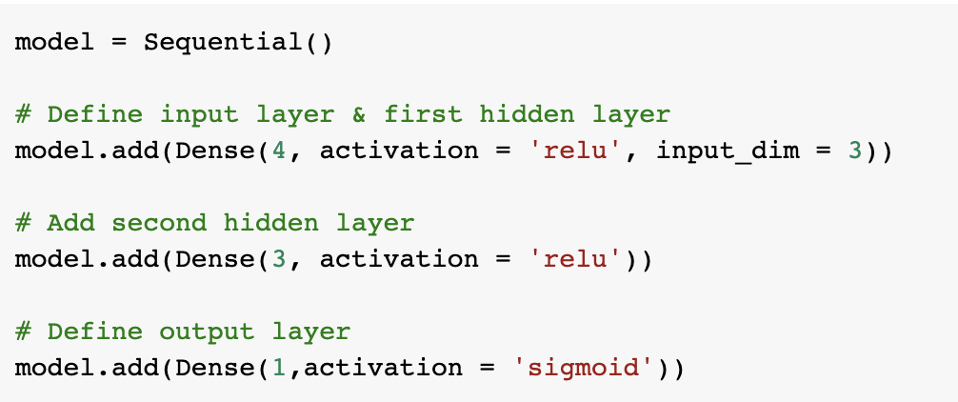
Define Keras Model - ANN

Slide 20
Compile & Fit Keras Model - ANN
Optimizer - Algorithm used to minimize the loss function (we will use ‘adam’ for this class).
Loss - Loss function we are trying to minimize. Depends on the type of problem. Functions are listed here.
Metrics - Metric(s) you want to print out.
Epochs - Number of times you want the data to pass through the model.

Slide 21
Resources
Deep Lizard tutorials - https://deeplizard.com/learn/video/gZmobeGL0Yg
Neural Network Example - https://playground.tensorflow.org
Keras - https://keras.io/
Tensorflow - https://www.tensorflow.org/

