Slide 1
Random Forests

Slide 2
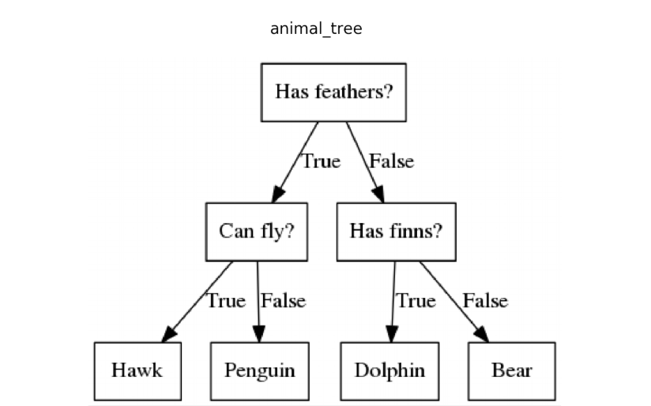

Basic Decision Tree
Recall that basic decision trees have high variance - the results are sensitive to the data we have in the training set.
By creating multiple decision trees and aggregating the results, we can reduce the variance. This is the idea behind random forests.

Slide 3
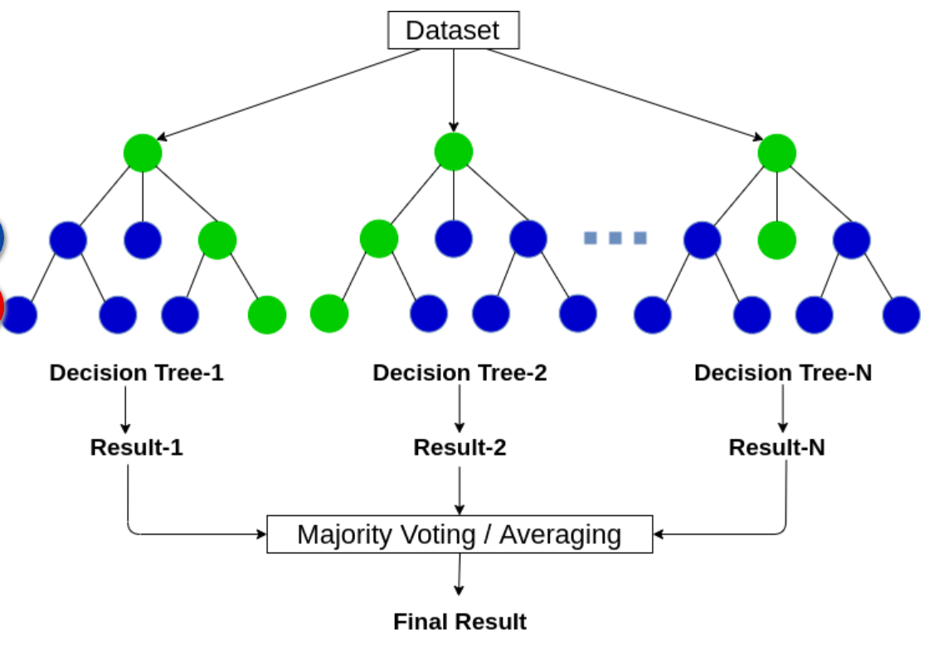
Random Forest
Creates multiple decision trees – each taking a different subset of the data
When a data instance is presented to be predicted each tree is followed to a terminal node
Then the results are found by:
Voting for classification
Averaging for regression

Slide 4
How Do Random Forests Work?
Draw a random bootstrap sample of size n, where n is the sample size of your training data.
For each split in the tree, randomly select m predictors to be split candidates. m is typically chosen to be the square root of the total number of predictors.
Repeat steps 1-2 multiple times.
Aggregate results to get the prediction.

Slide 5
What is Bootstrapping?
Bootstrapping is a very popular technique in data science and statistics. It works by simply taking a sample of size n (where n is the size of your original sample) with replacement.
Original Data
Bootstrap Sample 1
Bootstrap Sample 2
Bootstrap Sample 3
Decision Tree 1
Decision Tree 2
Decision Tree 3

Slide 6
Pros and Cons
Pros
Cons
Same benefits as decision trees - can be used with:
Continuous & categorical predictors
Continuous & categorical response
Robust to outliers.
Works well with non-linear data.
Lower risk of overfitting.
Runs efficiently on a large dataset.
Good accuracy generally.
Can get feature importance.
Takes longer to run
Not as easily interpretable as decision trees or linear regression
Considered more of a ‘black box’ approach.
https://towardsdatascience.com/pros-and-cons-of-various-classification-ml-algorithms-3b5bfb3c87d6

