Slide 1
XGBoost

Slide 2
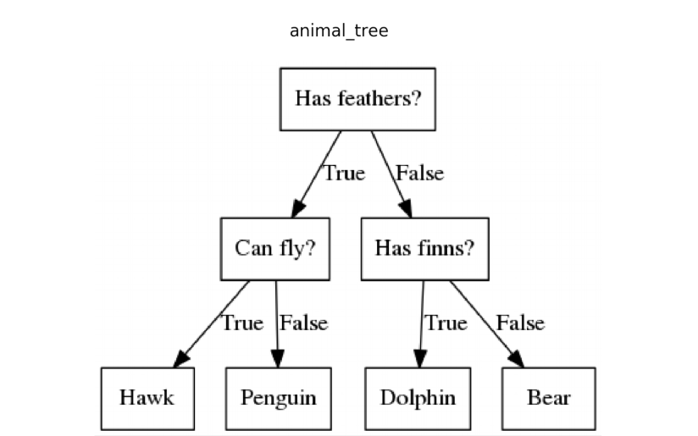

Basic Decision Tree
Decision tree is a flow chart-type structure
Each node represents a “test” which decide which direction the flow takes for a given data instance
Can think of it as a sort of “20 questions” type of flow
When you hit the terminal node at bottom – that is the predicted result

Slide 3
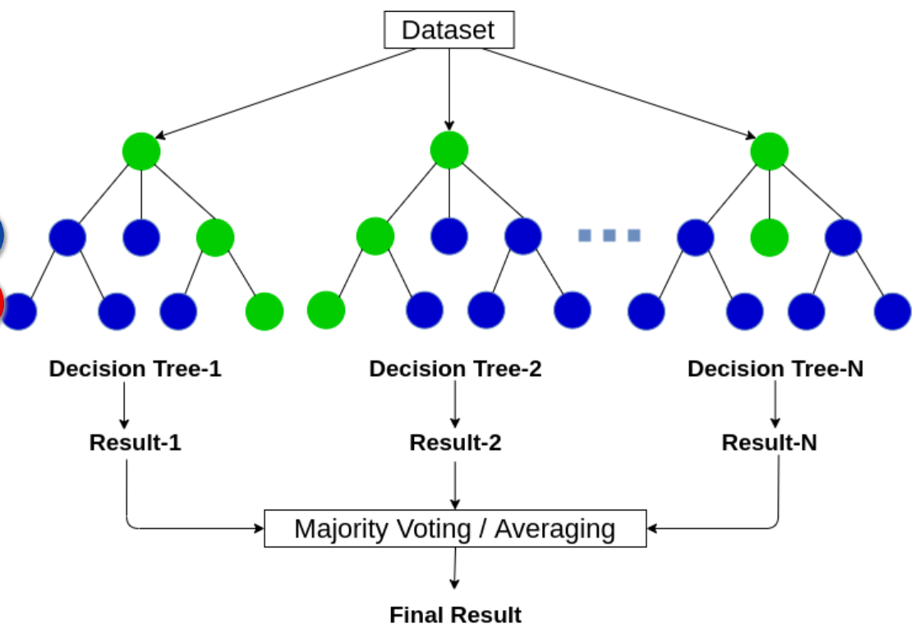
Random Forest
Creates multiple decision trees – each taking a different subset of the data
When a data instance is presented to be predicted each tree is followed to a terminal node
Then the results are found by:
Voting for classification
Averaging for regression

Slide 4
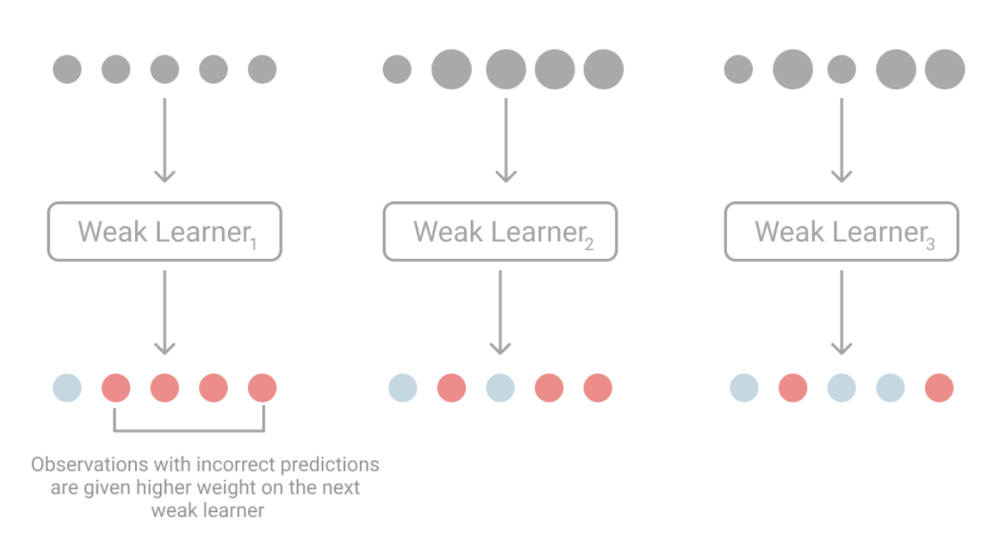
Boosting
Boosting is based on the assumption that it’s much easier to find several simple rules to make a prediction than it is to find the one rule that is applicable to all data and generates the best possible prediction.
In boosting, you train the same weak learner, a model with simple rules, several times. Then combine its weak predictions into a single, more accurate result.
Predictions that were previously misclassified will have more weight on the next weak learner, so each weak learner focuses on the hardest observations.
Source

Slide 5
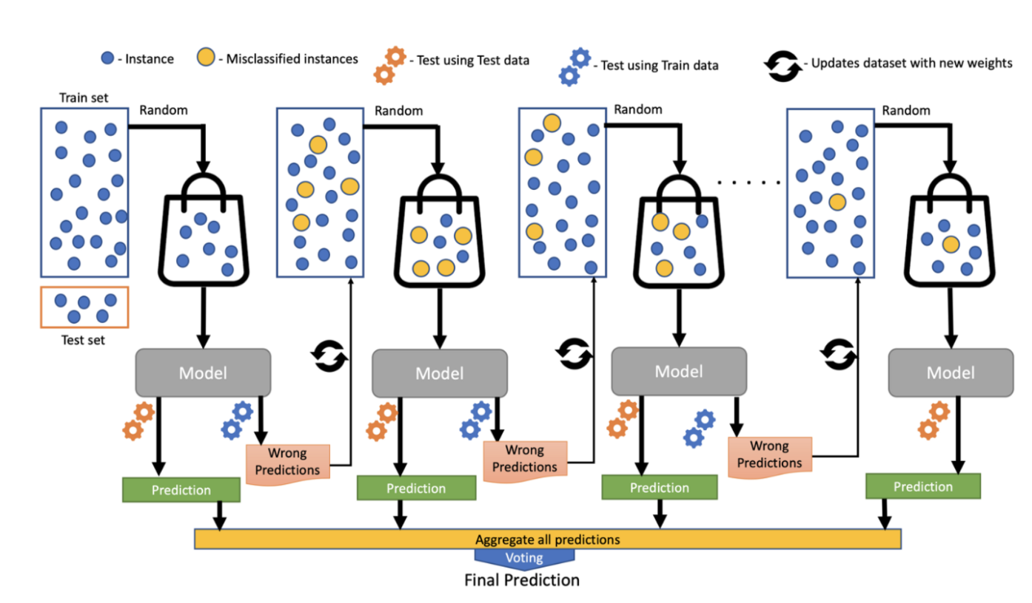
XGBoost
XGBoost, which stands for Extreme Gradient Boosting, is a tree-based ensemble method that uses an ensemble of basic decision trees (weak learners) to make its prediction.

Slide 6

Tree Based Method Analogy
Decision Tree: Every hiring manager has a set of criteria such as education level, number of years of experience, interview performance. A decision tree is analogous to a hiring manager interviewing candidates based on his or her own criteria.
Random Forest: Now there is an interview panel where every interviewer has a vote. Every interviewer will only test the interviewee on certain randomly selected criteria.
XGBoost: This is an alternative approach where each interviewer alters the evaluation criteria based on feedback from the previous interviewer. This ‘boosts’ the efficiency of the interview process by deploying a more dynamic evaluation process.
Source

Slide 7
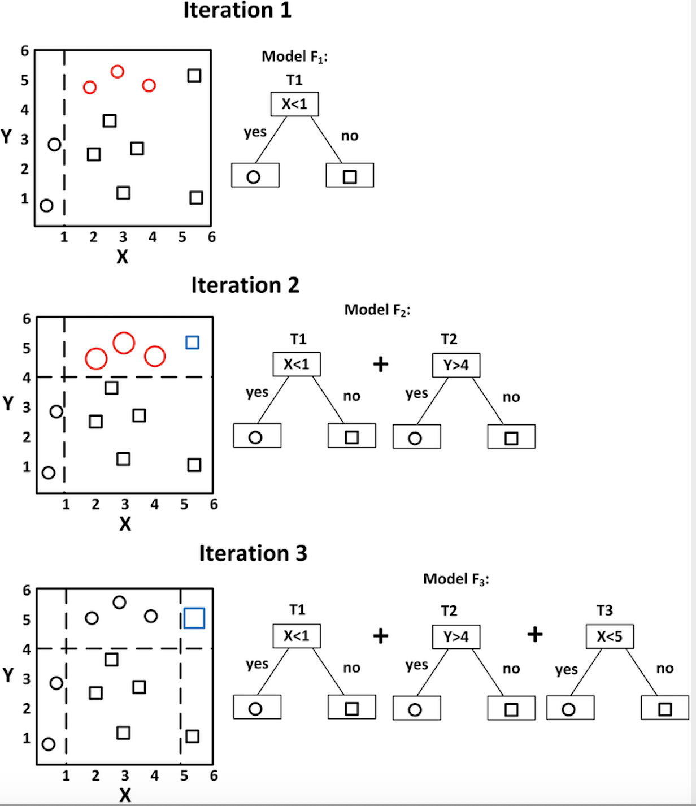
Example

Slide 8
Hyperparameters
XGBoost has numerous hyperparameters that can be set by the user. Some of the most common are given below:
learning_rate - Shrinks the weight of new features in each boosting step. Must be between 0 and 1. Default is 0.3.
max_depth - Maximum number of tree splits. Remember - the more splits, the more complex the tree. Can be any value greater than 0. Default is 6.
n_estimators - Number of trees. Remember - generally, more trees improves performance but it also increases run time.
lambda - L2 regularization on the weights. Can be any value. Default is 1.
alpha - L1 regularization on the weights. Can be any value. Default is 0.

Slide 9
Pros & Cons
Pros
Cons
Allows you to see feature importance
Robust to outliers
Helps to reduce overfitting
Works well with large datasets
Good model performance
Harder to interpret than decision trees
Many hyperparameters that can be tuned

