Slide 1
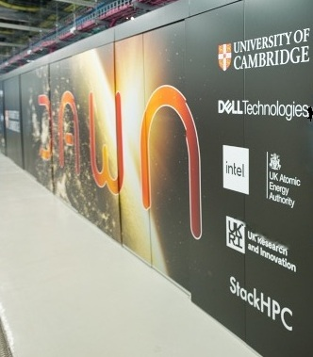
Visual Studio Code on Dawn
RSE DAWN TEAM

Slide 2
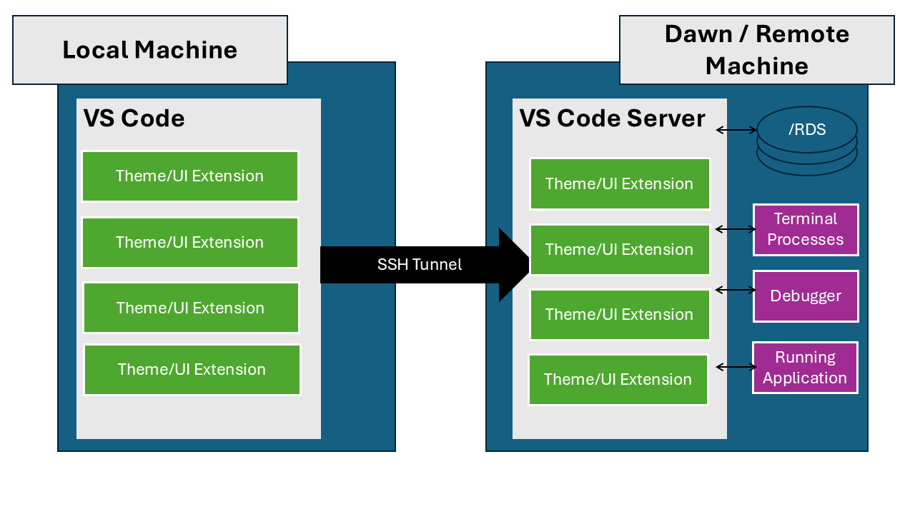

My WorkFlow on DAWN
The Visual Studio Code Remote-SSH extension allows you to open a remote folder on any remote machine, virtual machine, or container with a running SSH server and take full advantage of VS Code’s feature set. Once connected to a VS Code server, you can interact with files and folders anywhere on the remote filesystem.

Slide 3
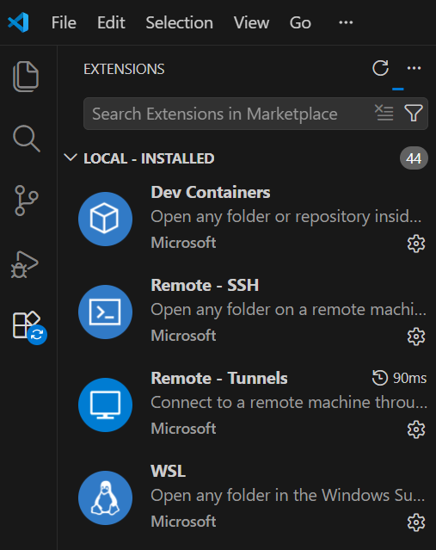
1. Remote Development Extension on DAWN
Install the Microsoft VS Code extension found at Remote Development to get started with using VS Code Remote-SSH. This extension pack includes the Remote-SSH extension as well as other useful extensions for remote development.

Slide 4
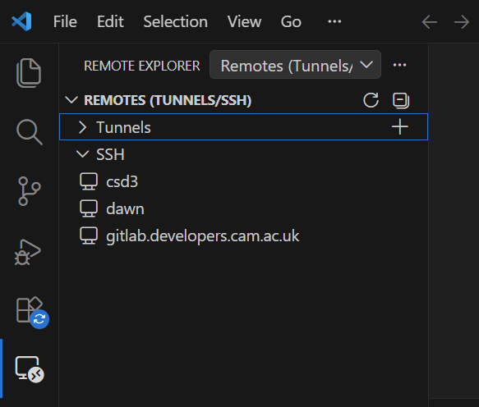
2. Creating a ssh config file
#DAWN
Host dawn
HostName login-dawn.hpc.cam.ac.uk
User <<FIXME>>
PreferredAuthentications publickey
IdentityFile ~/.ssh/<<FIXME_KEY>>
ForwardAgent yes
ForwardX11 yes
ForwardX11Trusted yes
# Verbosity level (QUIET, INFO, DEBUG)
LogLevel DEBUG
Host pvc-s-*
HostName %h
ProxyJump dawn
User <<FIXME>>
ForwardAgent yes
ForwardX11 yes
ForwardX11Trusted yes

Slide 5
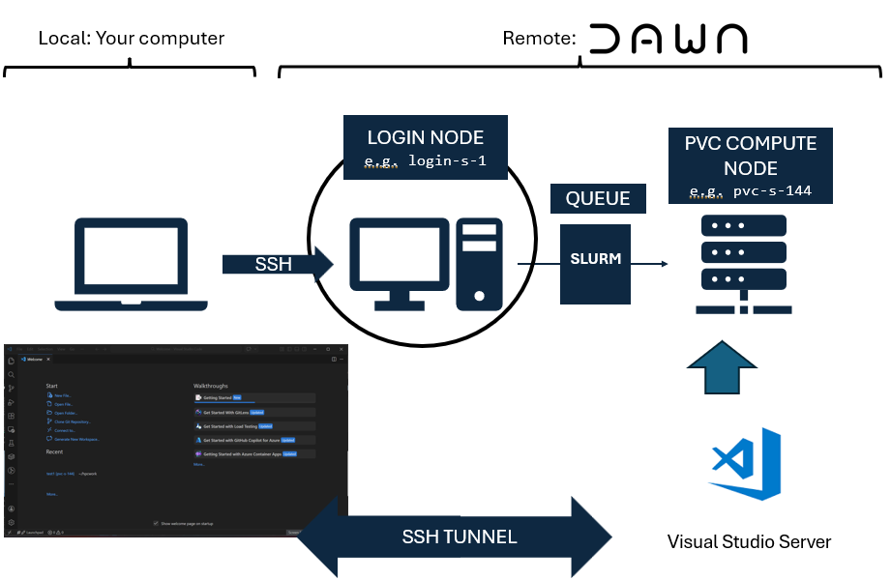
3. Creating a SSH Tunnel

Slide 6
3. SHH Tunnel to DAWN Compute
SSH into the Dawn cluster using the Remote-SSH extension.
Once connected, you are on a login node. From here, you can start an interactive job and then connect to a compute node (PVC) using the Remote server feature by running the following command in the login node terminal:

Slide 7
Interactive Job for Vscode Server
#! /bin/bash
# --- account ------------------------------------------------------
#SBATCH --account=<<FIXME>> # if you are a member of more than one Dawn project
#SBATCH --partition=pvc9
#SBATCH --qos=<<FIXME>> # upon signing-up to Dawn you will be assigned a qos
# --- resources ------------------------------------------------------
#SBATCH --nodes=1
#SBATCH --ntasks-per-node=1
#SBATCH --cpus-per-task=24
#SBATCH --gres=gpu:1
#SBATCH --time=01:00:00
#SBATCH --job-name="CodeServer-1n1gpu"
set -eux # exit on error
# --- environment ----------------------------------------------------
module purge;
module load rhel9/default-dawn
CLI_PATH="${HOME}/vscode_cli"
# Install the VS Code CLI command if it doesn't exist
if [[ ! -e ${CLI_PATH}/code ]]; then
echo "Downloading and installing the VS Code CLI command"
mkdir -p "${HOME}/vscode_cli"
pushd "${HOME}/vscode_cli"
# Process from: https://code.visualstudio.com/docs/remote/tunnels#_using-the-code-cli
curl -Lk 'https://code.visualstudio.com/sha/download?build=stable&os=cli-alpine-x64' --output vscode_cli.tar.gz
# unpack the code binary file
tar -xf vscode_cli.tar.gz
# clean-up
rm vscode_cli.tar.gz
popd
fi
# run the code tunnel command and accept the license
${CLI_PATH}/code tunnel --accept-server-license-terms
File at
https://github.com/RSE-Cambridge/Intro-to-Dawn/Part3-PythonEnvironments/Examples/vscode_server.sh
Just Change FIXME to your Account

Slide 8
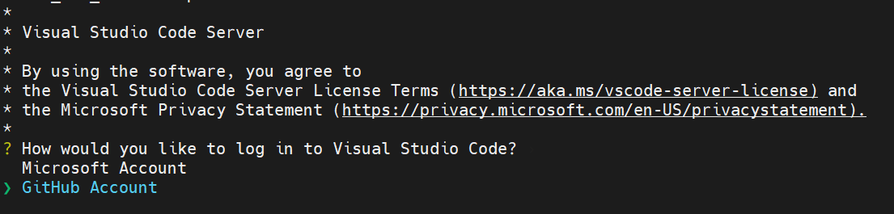
4&5. SHH Tunnel to DAWN Compute
Once the command is executed, it will ask you to choose an account to sign in to.
After signing in, it will output a URL and Code that you can use to connect.

Slide 9
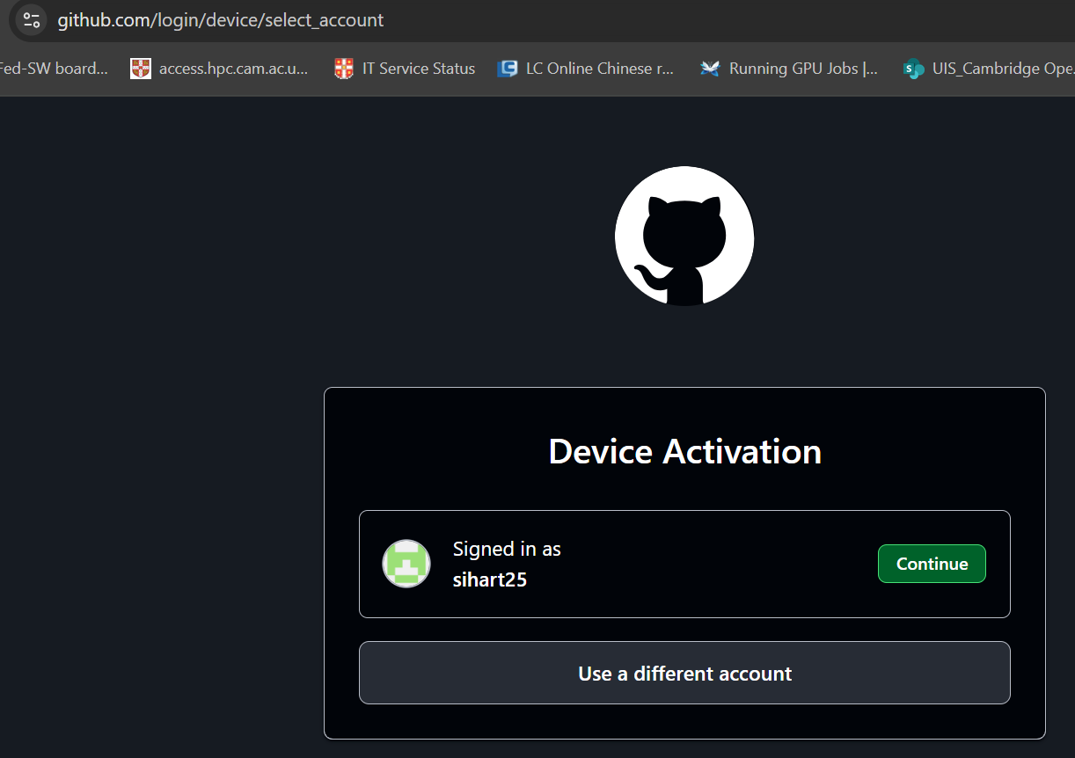
6. Device Activation
Copy the URL and open it in your web browser. You will be prompted to sign in with your github.com account to allow the device.
.

Slide 10
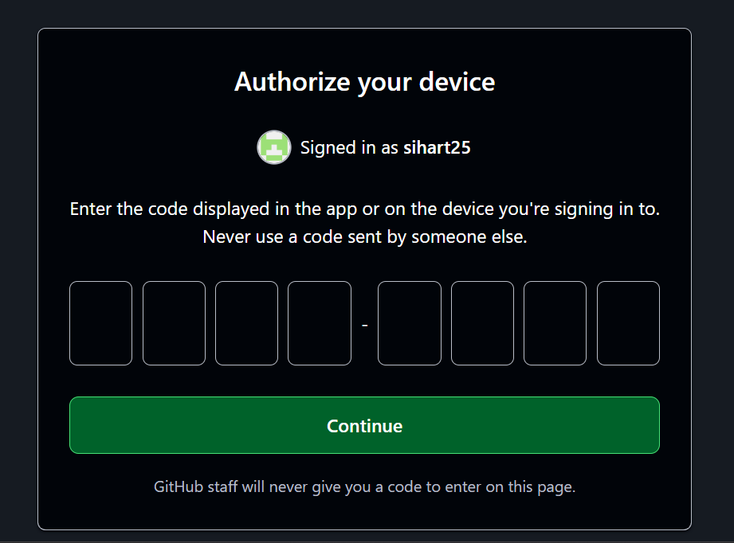
7. Authorize device
The browser will ask for the code that was output in the terminal. Enter the code to allow the device.

Slide 11
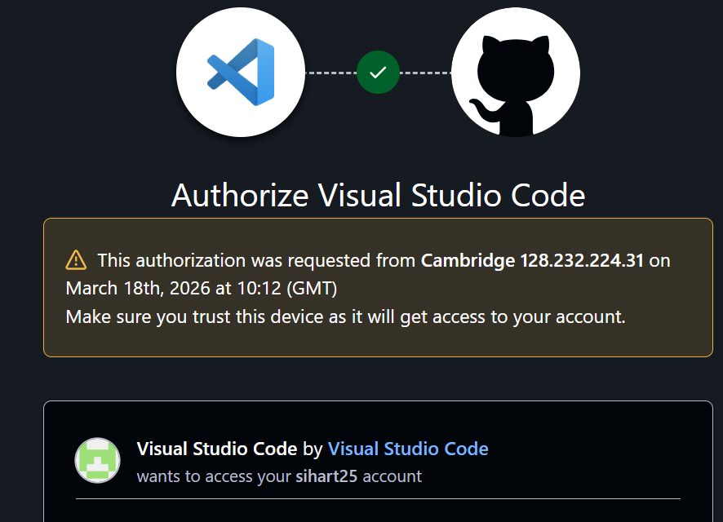
8. Connecting to DAWN
After Entering the code, the browser will show Information about the request and access you are granting.
.

Slide 12
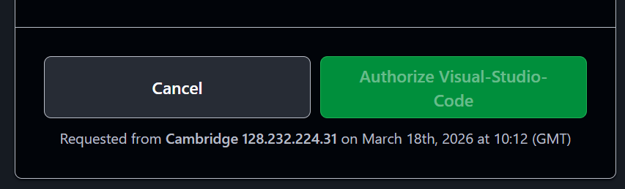
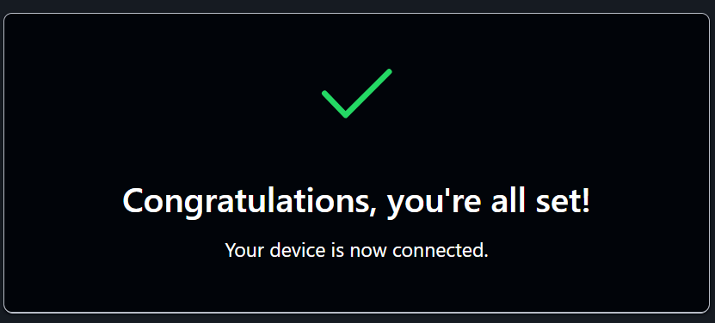
9. Authorize VS Code
The.

Slide 13
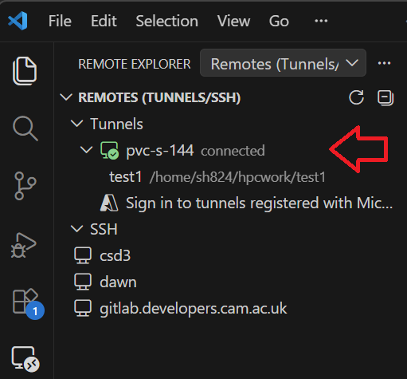
10. Use VS Code on your machine
Now you can open VS Code on your local machine, log in to your github.com account, and use the “Remote - Tunnels” extension to connect to the tunnel you just created. You should see the remote environment in VS Code and be able to work on it as if you were directly connected to the Dawn cluster.

Slide 14
Thank You
When looking for answers try these pages:
dawn-intel-gpu-pvc-nodes
support@HPC.cam.ac.uk

