Slide 1

Intro to Dawn
RSE DAWN TEAM

Slide 2
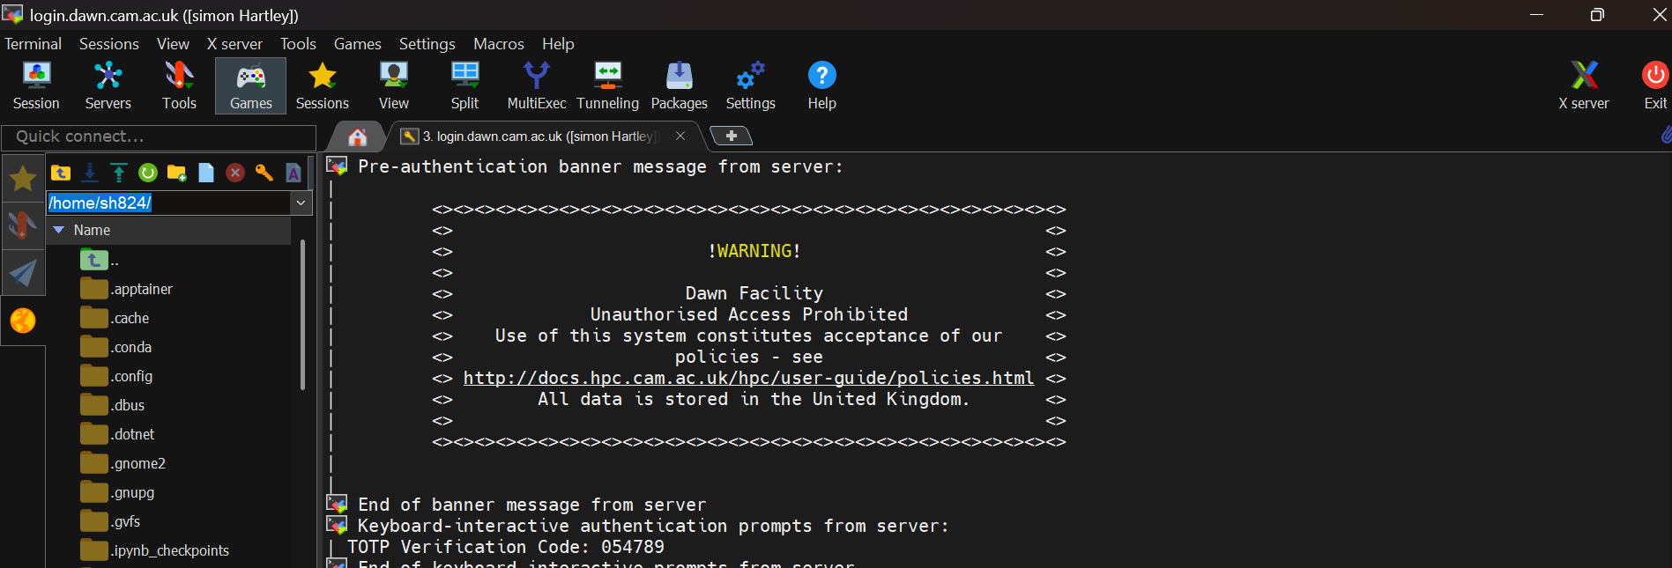

2. Connecting to DAWN
Connect using an SSH Client.
Windows: PuTTY | MobaXterm | Windows Subsystem for Linux
MacOS or Linux: Terminal

Slide 3

Projects and QoS
Once you are connected to a login node, run mybalance
to see information about your DAWN projects and available QoS.
This information is more detailed at https://access.hpc.cam.ac.uk/projects/

Slide 4






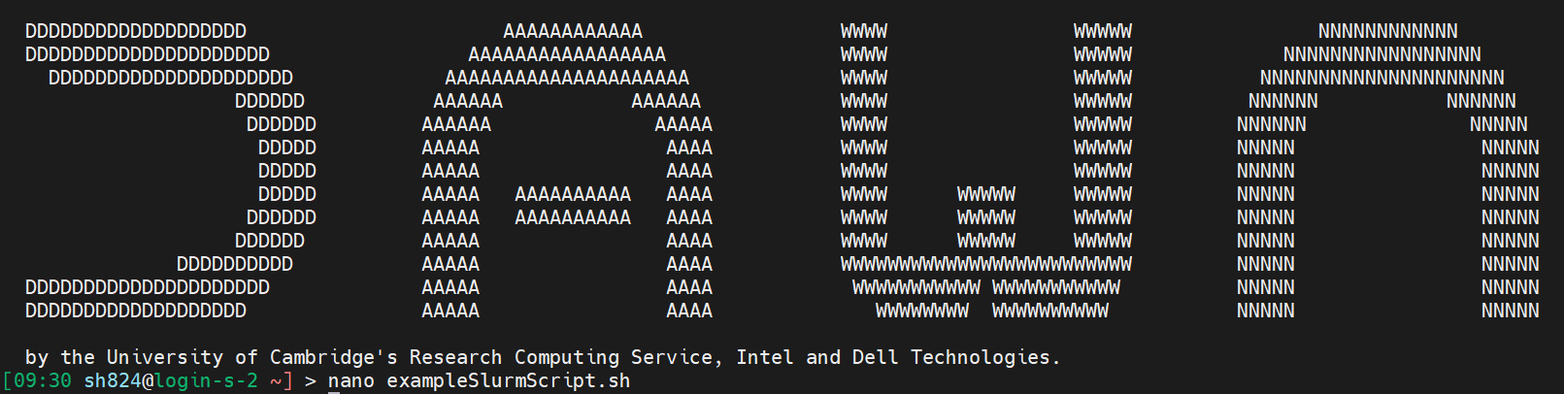


System Overview
Local: Your computer
Remote: DAWN SUPERCOMPUTER
LOGIN NODE
e.g. login-s-1
PVC COMPUTE NODE
e.g. pvc-s-144
QUEUE
SSH
SLURM
you are here
RDS STORAGE
e.g. ~/rds

Slide 5
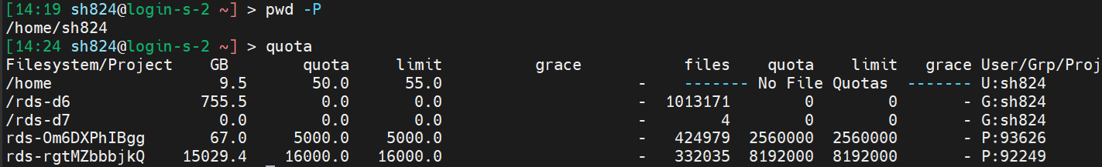
Your Home folder:50GB
Once you are connected to a login node, run quota

Slide 6
Your Project folder: 2TB>
Once you are connected to a login node, run quota

Slide 7
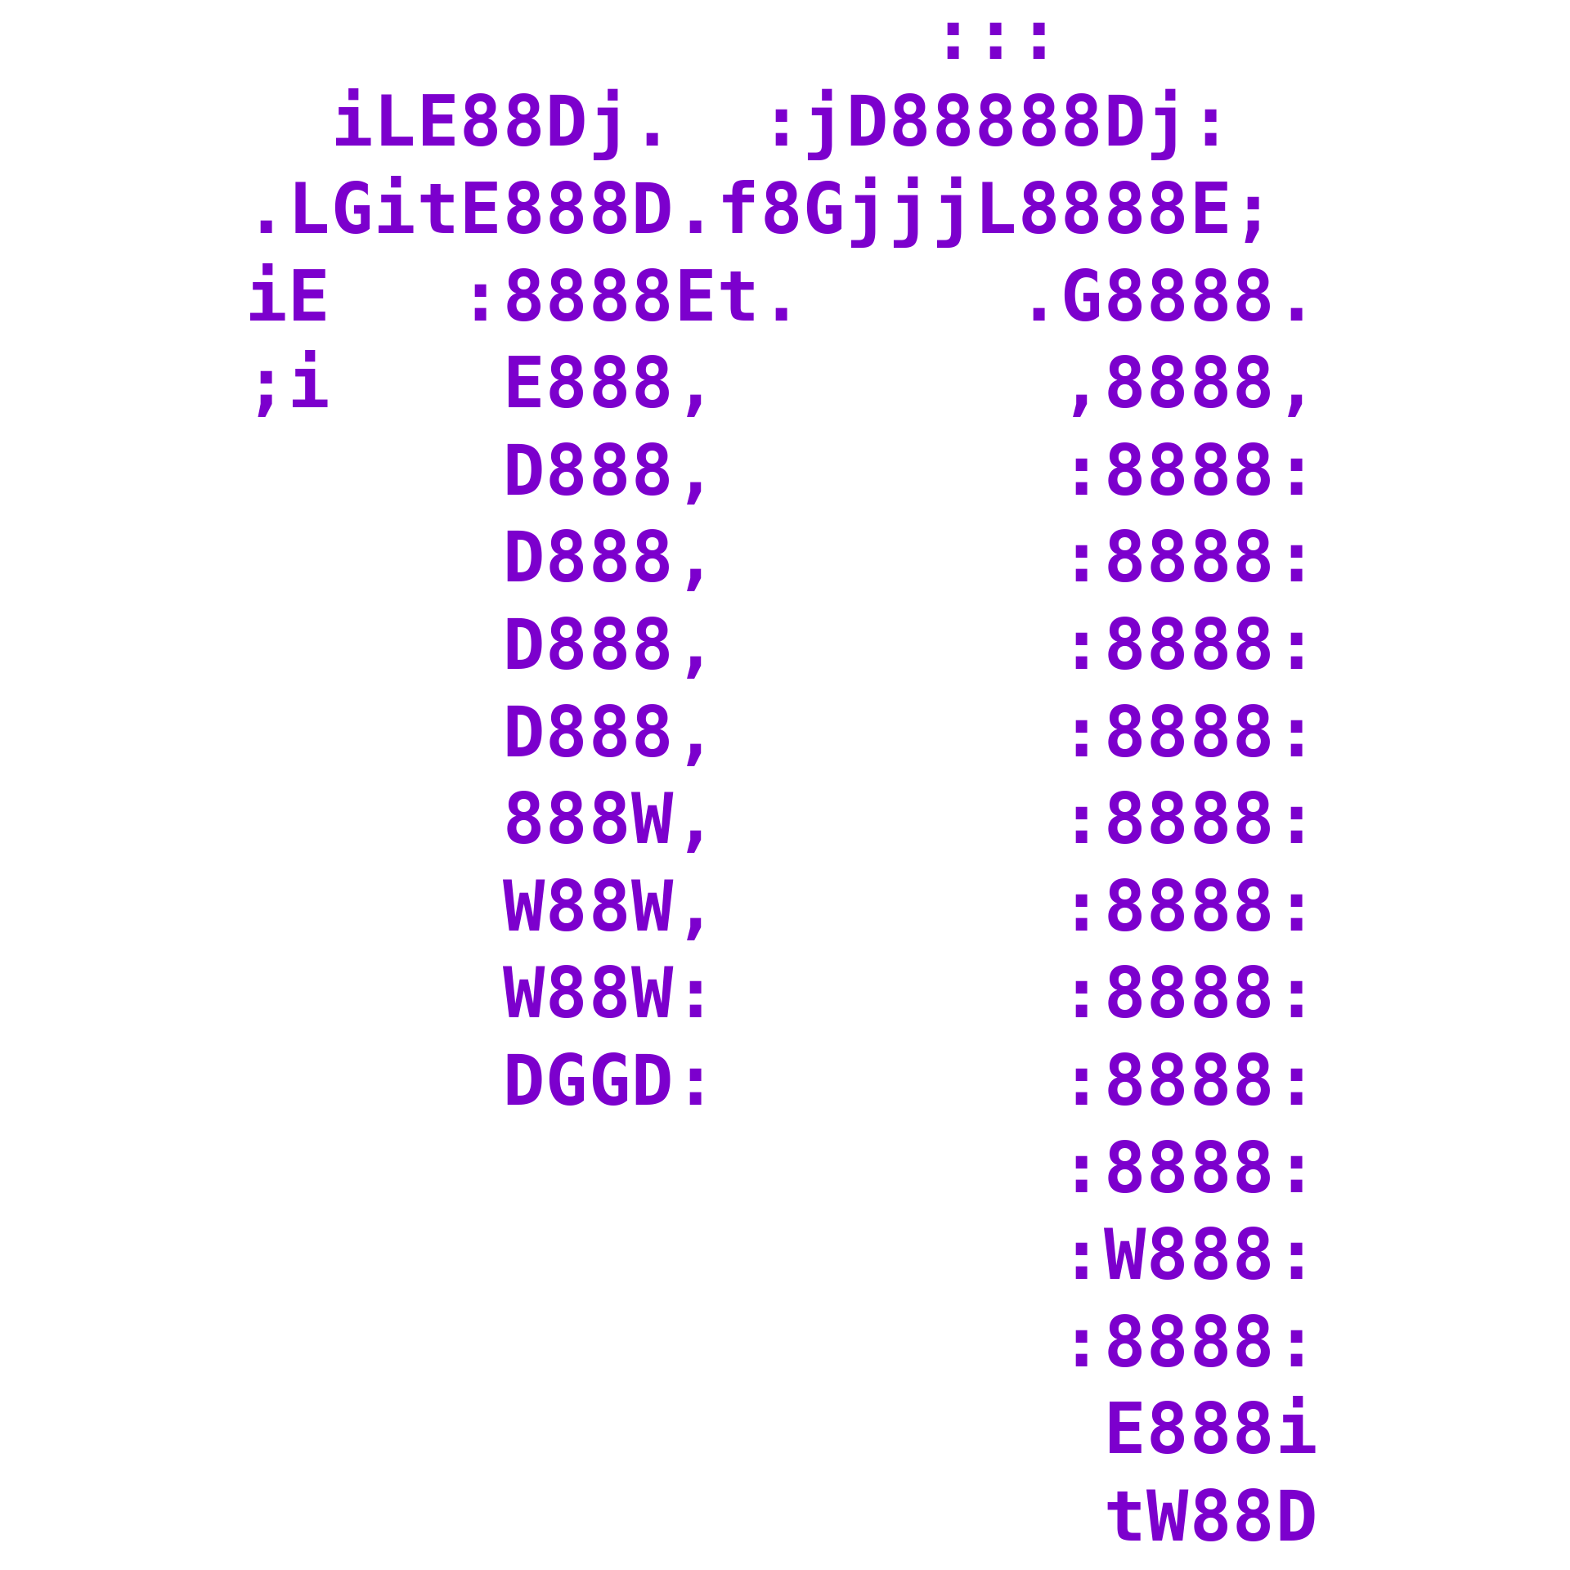

Choose your editor
Once you are connected to a login node, run your editor
nano
vim

Slide 8
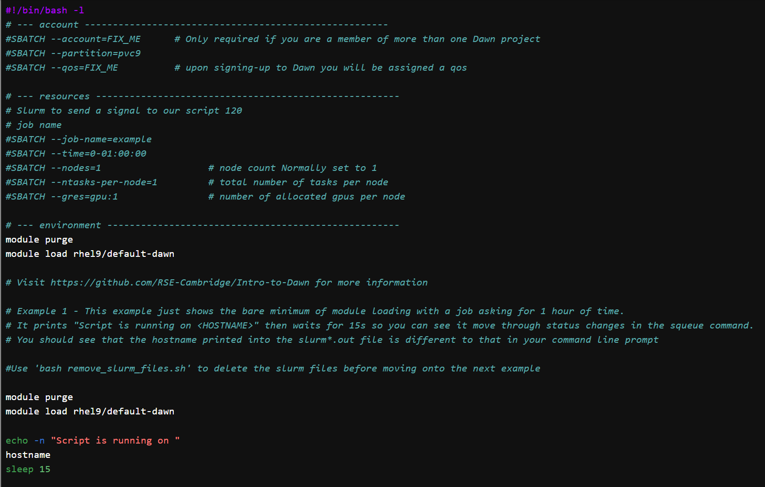
Create your job script

Slide 9
Submit your job script
Check your job status with squeue

Slide 10
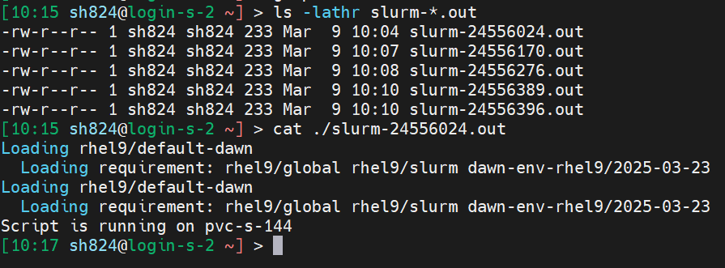
Check your job outputs

Slide 11
Experiment with your job
Add the line sleep 5h before the echo in your job script and submit your job. How do you cancel the job? Hint: use the command scancel <jobid>
What happens if you request a wall-time job of 1 minute and sleep 120 ?
https://github.com/RSE-Cambridge/Intro-to-Dawn

Slide 12
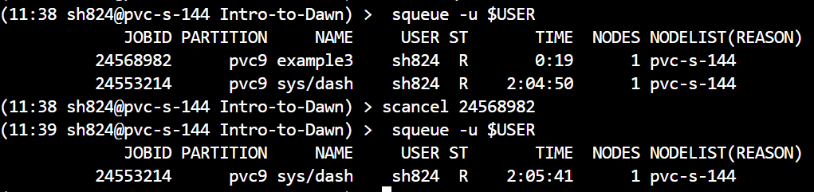
Experiment with your job
https://github.com/RSE-Cambridge/Intro-to-Dawn

Slide 13
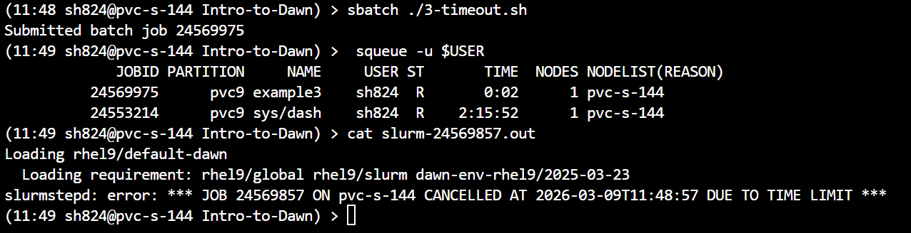
Experiment with your job
What happens if you sleep 120 and request a wall-time job of 1 minute?
https://github.com/RSE-Cambridge/Intro-to-Dawn

Slide 14
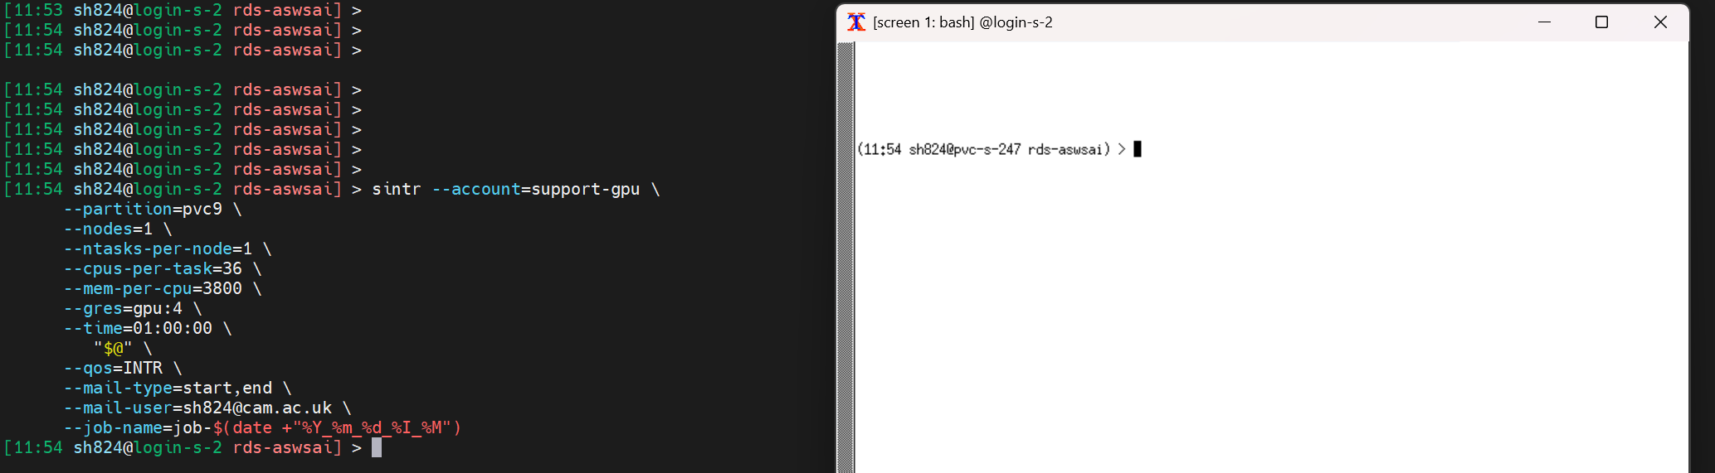
Interactive Jobs
The command sinter is a shortcut for interactive jobs:
https://github.com/RSE-Cambridge/Intro-to-Dawn

Slide 15
Interactive Jobs
https://github.com/RSE-Cambridge/Intro-to-Dawn

Slide 16
Interactive Jobs
The command sinter is a shortcut for interactive jobs:
sintr --account=FIX_ME --partition=pvc9 --nodes=1 --ntasks-per-node=1 --cpus-per-task=36 --mem-per-cpu=3800 --gres=gpu:4 \
--time=01:00:00 \
"$@" \
--qos=INTR \
--mail-type=start,end \
--mail-user=<your_email> \
--job-name=job-$(date +"%Y_%m_%d_%I_%M")
https://github.com/RSE-Cambridge/Intro-to-Dawn

Slide 17

Accessing Software Applictions
The Look at your Launch Script 1-basicSlurm.sh:
Here we load default software
https://github.com/RSE-Cambridge/Intro-to-Dawn

Slide 18
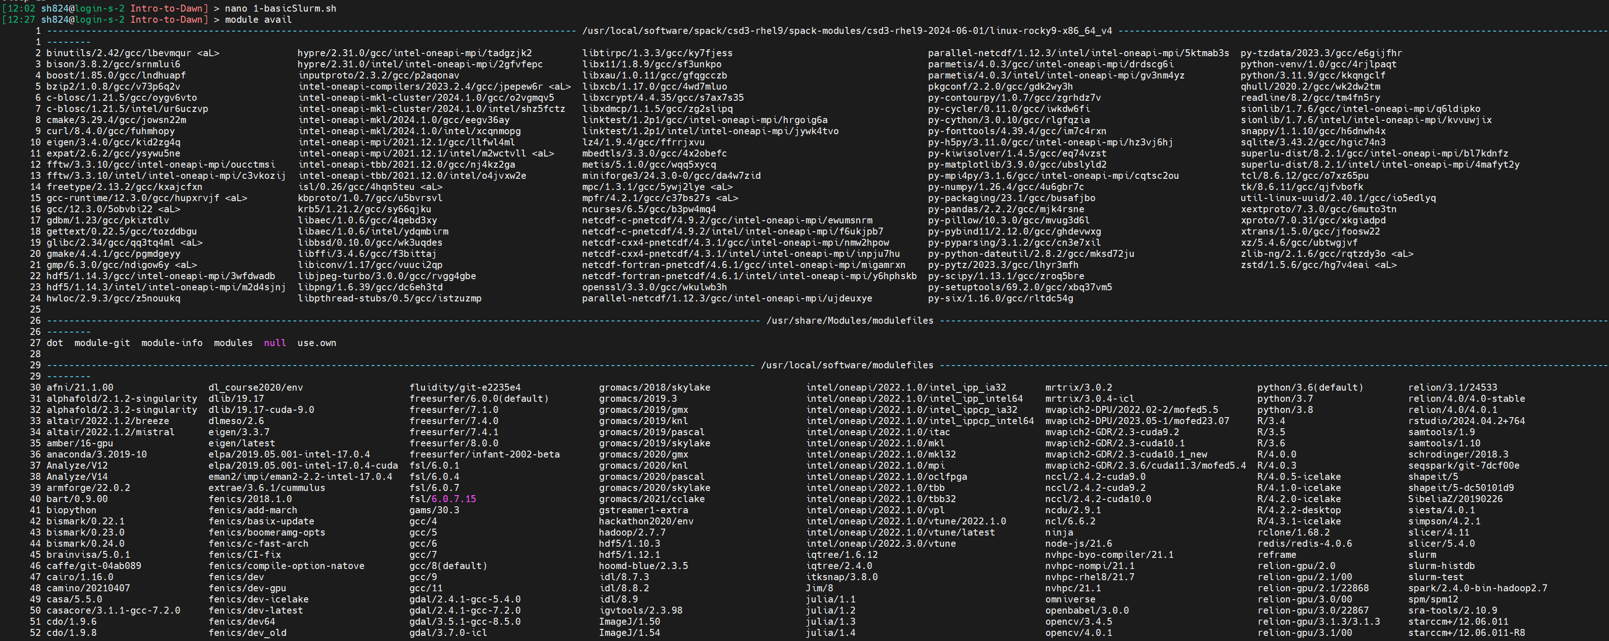
Accessing Software Applictions
The Look for software on the system:
https://github.com/RSE-Cambridge/Intro-to-Dawn

Slide 19
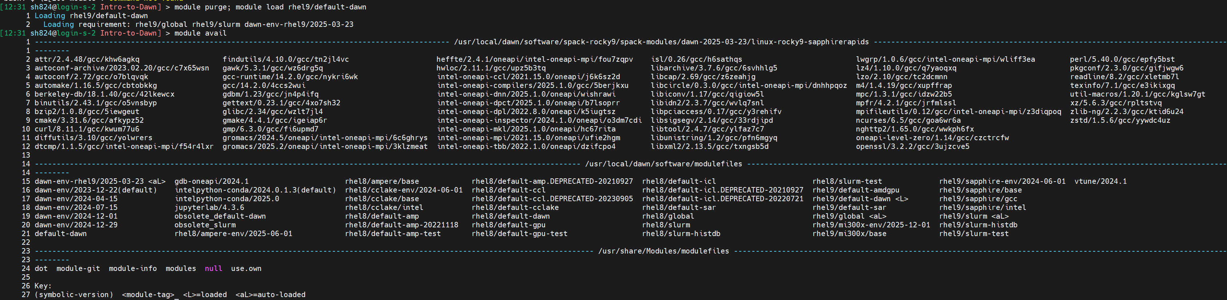
Accessing Software Applictions
Filter for software on the system:
https://github.com/RSE-Cambridge/Intro-to-Dawn

Slide 20
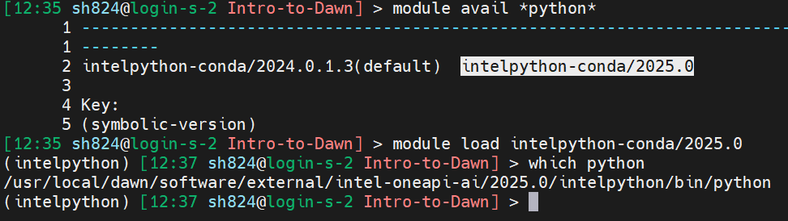
Accessing Software Applictions
Filter for Python software on the system:
https://github.com/RSE-Cambridge/Intro-to-Dawn

Slide 21
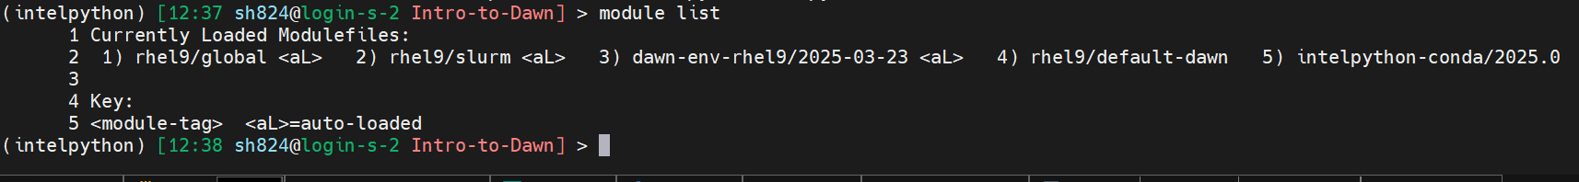
View loaded Modules
Modules Loaded on the system:
https://github.com/RSE-Cambridge/Intro-to-Dawn

Slide 22
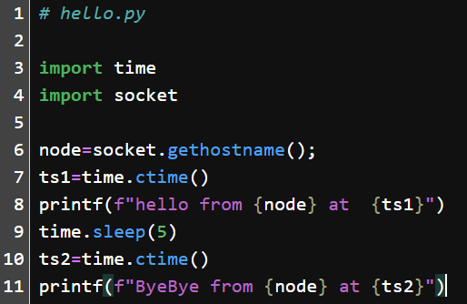
Your turn
Create a Python script called hello.py that contains:
https://github.com/RSE-Cambridge/Intro-to-Dawn

Slide 23

Your turn
hello.py Outputs:
https://github.com/RSE-Cambridge/Intro-to-Dawn

Slide 24
Slurm Array Jobs
Run many jobs from one Slurm file
#SBATCH --array=1-10%2
Adding this will run the script 10 times with 2 jobs running simultaneously
Need to use with environment variables to make it useful.
SLURM_JOB_ID - Full job number for each array job
SLURM_ARRAY_JOB_ID - Job id of the array itself
SLURM_ARRAY_TASK_ID - Index of the job in the array, e.g. a value between 1 and 10 from above.
To track these jobs, use the sacct -j <Job id> command or the squeue command.
https://github.com/RSE-Cambridge/Intro-to-Dawn

Slide 25
Slurm Array Jobs
+ How do I give different values to each job?
- Use the SLURM_ARRAY_TASK_ID as a lookup to the information you want to use.
+ How do I make a Slurm array bigger than MaxArraySize?
- Set to 4000 on DAWN, defaults to 1001.
- Use a script to repeatedly launch a slurm job with an increasing offset each time 1,2,3.....
* Slurm scripts can take command line arguments
* Add this to SLURM_ARRAY_TASK_ID before doing the lookup.
https://github.com/RSE-Cambridge/Intro-to-Dawn

Slide 26
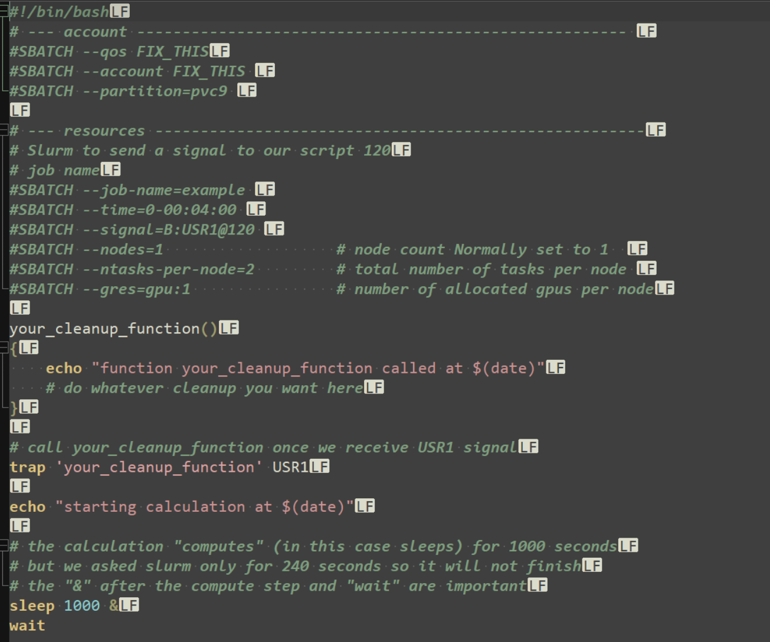
Slurm signal
+ How do I save my job before it jets killed?
https://github.com/RSE-Cambridge/Intro-to-Dawn

Slide 27
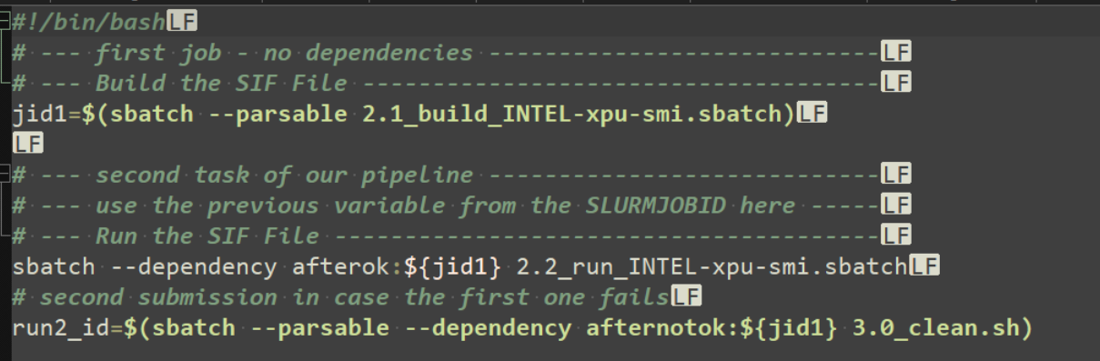
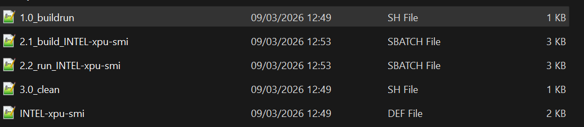
Slurm Job Dependancies Jobs
+ How do I set one job to depend on another?
https://github.com/RSE-Cambridge/Intro-to-Dawn

Slide 28
Thank You
When looking for answers try these pages:
dawn-intel-gpu-pvc-nodes
support@HPC.cam.ac.uk

