Slide 1
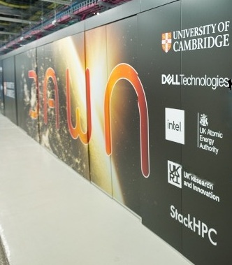
Python Environments on Dawn
RSE DAWN TEAM

Slide 2

Common pip commands
View the help menu:
The help menu for the install command:
Search the Python Package Index PyPI for a given package (e.g., jax):
List all installed packages:
Install pairtools and pyblast for version 3.5 of Python
$pip -h
$pip install --help
$pip search jax
$pip list
$pip install python==3.5 pairtools pyblast

Slide 3
Common pip commands
Install a set of packages listed in a text file
To see detailed information about an installed package such as sphinx:
Upgrade the sphinx package:
Uninstall the pairtools package:
$pip install -r requirements.txt
$pip show sphinx
$pip install --upgrade sphinx
$pip uninstall pairtools

Slide 4
Common pip commands
We provide some Python software. To install your own Python software on top of these we recommend using a virtual environment. To create this:
Load the required modules
In a suitable directory, create a virtual environment:
Activate the virtual environment.
Install your Python software, for example:
A guide to using virtualenv can be found here :
https://pypi.Python.org/pypi/virtualenv
python -m venv --system-site-packages venvname
source venvname/bin/activate
pip install packagename

Slide 5
Common pip commands
In short, you can create a sandboxed version, in the directory of your choice (and if does not exist you must create one first) e.g. YOUR_PYTHON, of Python via:
Then activate this via:
and deactivate via:
You can get it to inherit the central packages via:
virtualenv YOUR_PYTHON
source YOUR_PYTHON/bin/activate
deactivate
virtualenv --system-site-packages YOUR_PYTHON

Slide 6
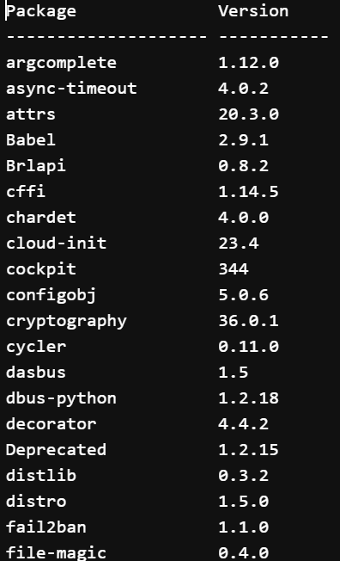
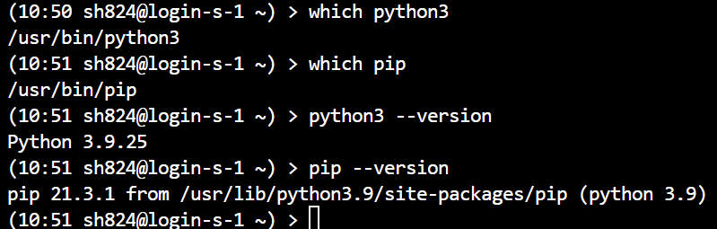
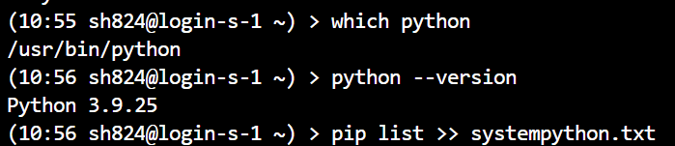
System Python on Login DAWN
The login nodes have python:

Slide 7
ModuleNotFoundError
Python users can encounter the situation where a module is not found. For example:
$python
>>> import bigCell
Traceback (most recent call last):
File "<stdin>", line 1, in <module>
ModuleNotFoundError: No module named ‘bigCell'

Slide 8
ModuleNotFoundError
To see where Python is looking for modules, run the following commands:
$ python
>>> import sys
>>> print(sys.path)

Slide 9
ModuleNotFoundError
The search paths are stored in sys.path. If your module is not found in those paths then you will encounter a ModuleNotFoundError. The first entry in the list above (i.e., ' ') corresponds to the current directory. The most relevant path usually ends with "site-packages".
Note that sys.path is a Python list that can be modified to include an additional path:
>>> sys.path.append("/home/aturing/mymodules")

Slide 10
Environment variables
PYTHONUSERBASE
PYTHONPATH
PATH
LIBPATH

Slide 11
ModuleNotFoundError
One can also remove paths from sys.path if conflicting modules are being found in different directories.
The PYTHONPATH environment variable can also be used to modify the Python search paths.
>>> sys.path.remove("/home/aturing/mymodulesbad")

Slide 12



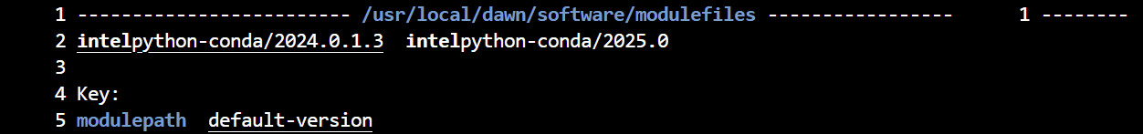

Dawn Modules Environments
The Module files on Dawn provide a series of premade environments.
These are available through the module load command.

Slide 13
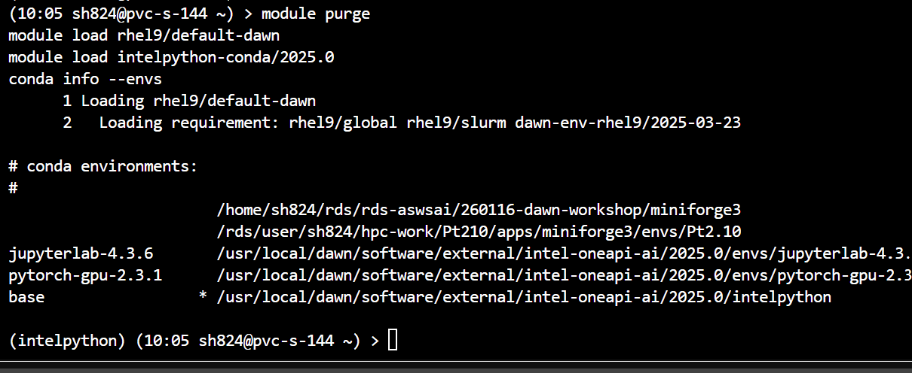
1. Dawn Modules Environments
The.

Slide 14
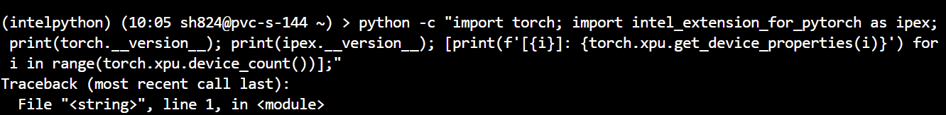
1. Dawn Modules Environments
The `base` environment does not have pytorch.

Slide 15
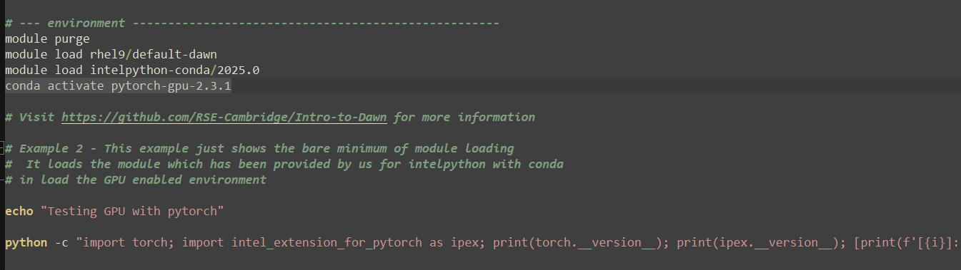
1. Dawn Modules Environments
The `pytorch-gpu-2.3.1` environment does have PyTorch. In `2-PytorchGPU.sh` we load this prepared environment. And test it with a single line:

Slide 16
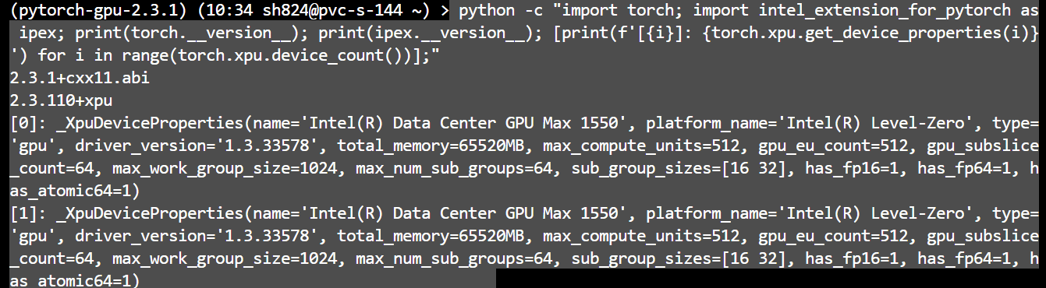
1. Dawn Modules Environments
The Pytorch environment may take 5 mins to load but it will return:

Slide 17
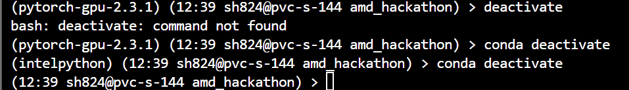
1. Deactivate Environments
The Pytorch environment deactivate:

Slide 18
1. Dawn Modules Environments
You can verify the current version of Python with:
You can also verify the current version of conda with:

Slide 19
Installing additional conda Python modules
If the central `base` installation does not have a package or module that you require, you can install this yourself by using conda environments.
A conda environment is a local copy of the central install that you can then modify with additional modules/packages or even use different versions of existing packages.
Full documentation on using conda environments can be found online at Managing conda environments.

Slide 20
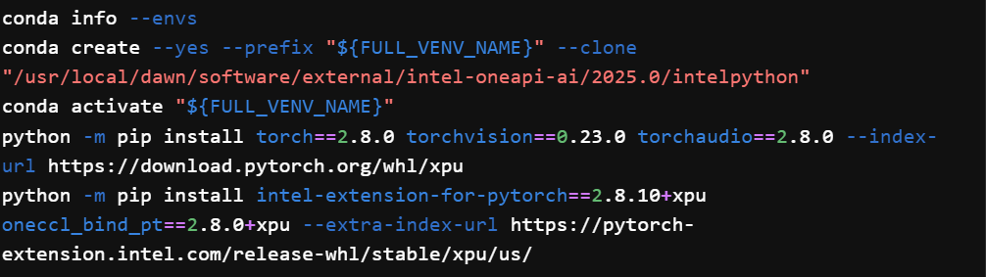
Installing additional conda Python modules
If you want you could install Pytorch 2.8 in a clone of the base environment:

Slide 21
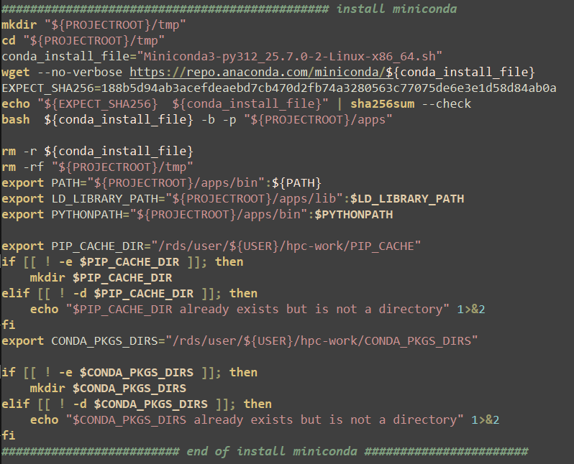
2. Install Script for Miniconda
Script for Miniconda.

Slide 22
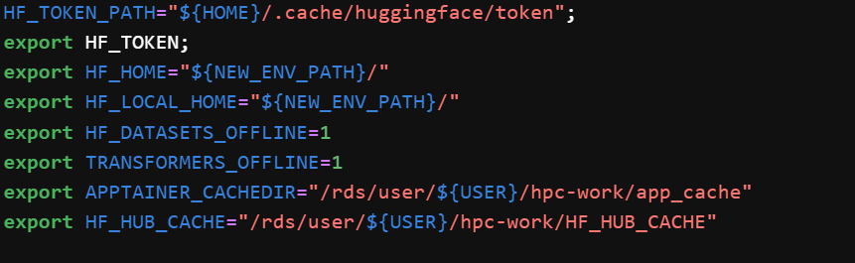
2. Miniconda Install Script Environments
The useful environment variable for where conda will still store its data (cache, Python installations, tools.
Other useful Environment variables are:

Slide 23
3. Install Script for UV
Script for UV Install.
Here we use wget to download UV and install:
Note: we use
To install UV into the directory in the variable UV_INSTALL_DIR .
Changing the installation path only affects where the UV binary is installed.
UV will still store its data (cache, Python installations, tools, etc.) in the default locations.
See the storage reference for details on these locations and how to customize them.
https://docs.astral.sh/uv/reference/installer/
UV_UNMANAGED_INSTALL=$UV_INSTALL_DIR

Slide 24
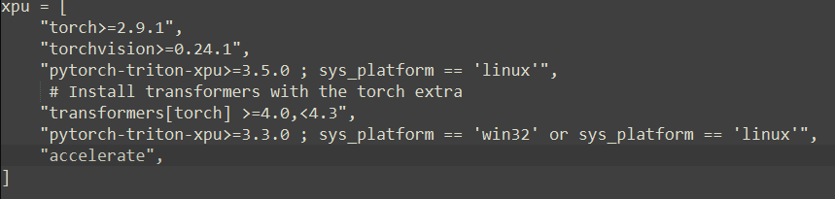
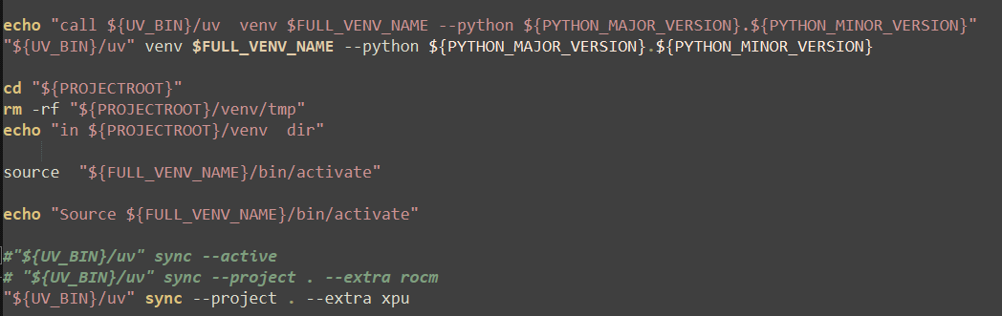
3. project.toml example for UV
The toml file for the project has an extra `XPU` section for installing Pytorch on Dawn.
see:
https://docs.astral.sh/uv/guides/integration/pytorch/

Slide 25
Thank You
When looking for answers try these pages:
dawn-intel-gpu-pvc-nodes
support@HPC.cam.ac.uk

