Slide 1

Apptainer on Dawn
RSE DAWN TEAM

Slide 2


Apptainer1
Singularity/Apptainer provides a container runtime and an ecosystem for managing images that is suitable for multi-tenant systems and HPC.
Important aspects :
- no need to have elevated privileges at runtime, although root privileges are needed to build the images.
- each application will have its own container
- containers are not fully isolated ( e.g. host network is available)
- users have the same uid and gid when running an application
- containers can be executed from local image files, or pulling images from a Docker registry
For basic usage, refer to:
https://apptainer.org/ (external)
https://www.sylabs.io/docs/(external)

Slide 3
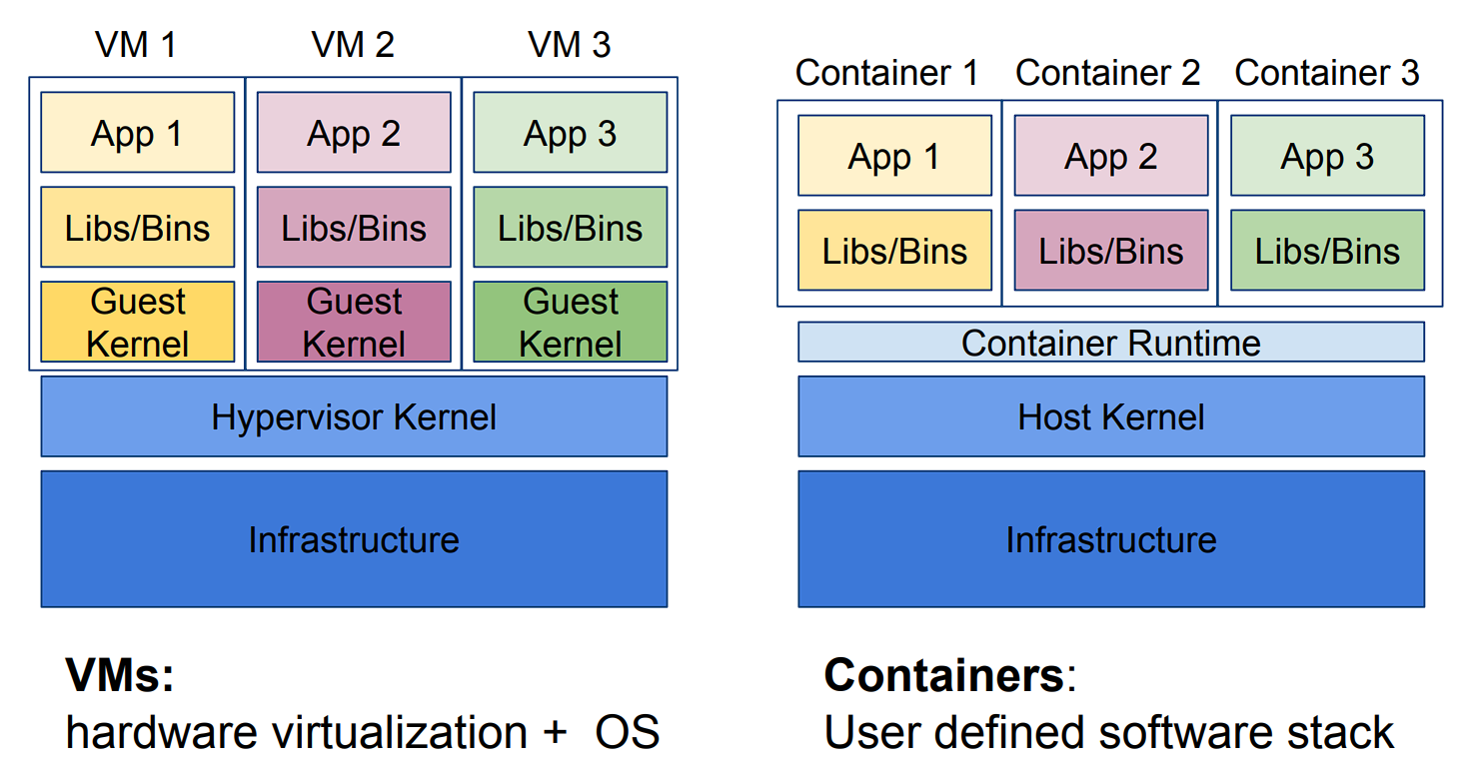
Apptainer1
Source: Docker.com (external)

Slide 4
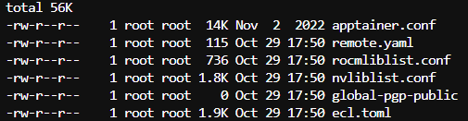
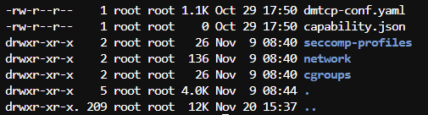
Apptainer: /etc/apptainer/apptainer.conf
$>which apptainer
/usr/bin/apptainer
$>ls -l /usr/bin | grep -i apptainer
$>ls -lathr /etc/apptainer

Slide 5
Apptainer Actions
The main Apptainer command
apptainer [options] [subcommand options] ...
has three essential subcommands:
build: Build your own container from scratch using a Singularity definition (or recipe) file; download and assemble any existing Singularity container; or convert your containers from one format to another (e.g., from Docker to Singularity)
shell: Spawn an interactive shell session in your container.
exec: Execute an arbitrary command within your container

Slide 6
apptainer --help always check the manual!!
$ apptainer help
Linux container platform optimized for High Performance Computing (HPC) and
Enterprise Performance Computing (EPC)
Usage:
apptainer [global options...]
Description:
Apptainer containers provide an application virtualization layer enabling
mobility of compute via both application and environment portability. With
Apptainer one is capable of building a root file system that runs on any
other Linux system where Apptainer is installed.
Options:
-d, --debug print debugging information (highest verbosity)
-h, --help help for apptainer
--nocolor print without color output (default False)
-q, --quiet suppress normal output
-s, --silent only print errors
-v, --verbose print additional information
Available Commands:
build Build an Apptainer image
cache Manage the local cache
capability Manage Linux capabilities for users and groups
exec Run a command within a container
help Help about any command
inspect Show metadata for an image
instance Manage containers running as services
key Manage OpenPGP keys
oci Manage OCI containers
plugin Manage apptainer plugins
pull Pull an image from a URI
push Upload image to the provided URI
remote Manage apptainer remote endpoints
run Run the user-defined default command within a container
run-help Show the user-defined help for an image
search Search a Container Library for images
shell Run a shell within a container
sif siftool is a program for Singularity Image Format (SIF) file manipulation
sign Attach a cryptographic signature to an image
test Run the user-defined tests within a container
verify Verify cryptographic signatures attached to an image
version Show the version for Apptainer
Examples:
$ apptainer help <command> [<subcommand>]
$ apptainer help build
$ apptainer help instance start

Slide 7
Apptainer Cache
Working with Apptainer images requires a significant amount of storage space. By default, Apptainer will use ~/.apptainer as a cache directory, which can cause you to go over your /home quota. Consider adding these environment variables to your ~/.bashrc file:
export APPTAINER_CACHEDIR=/local/$USER/APPTAINER_CACHE export APPTAINER_TMPDIR=/tmp

Slide 8
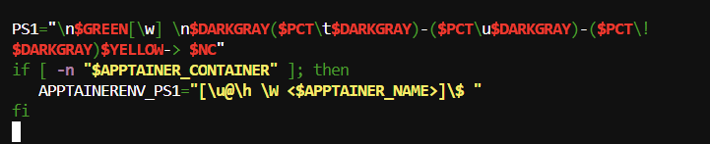
Running Apptainer: Customise .bashrc
When the apptainer is used, we can customise the prompt by testing and using the Apptainer Environment Variables

Slide 9
Apptainer Obtaining an Image via Pull
Some software is provided as a Dockerfile instead of an actual container. In this case, if you have Docker installed on your local machine (e.g., laptop) then you can create the Docker image yourself and then transfer it to one of the Research Computing clusters where the Apptainer image can be built.
On your local machine, after making the Docker image(), get the image id by running this command:
Next, save that image as a tar file (say it was id 9c27e219663c):
$ docker images
$ docker save 9c27e219663c -o myimage.tar

Slide 10
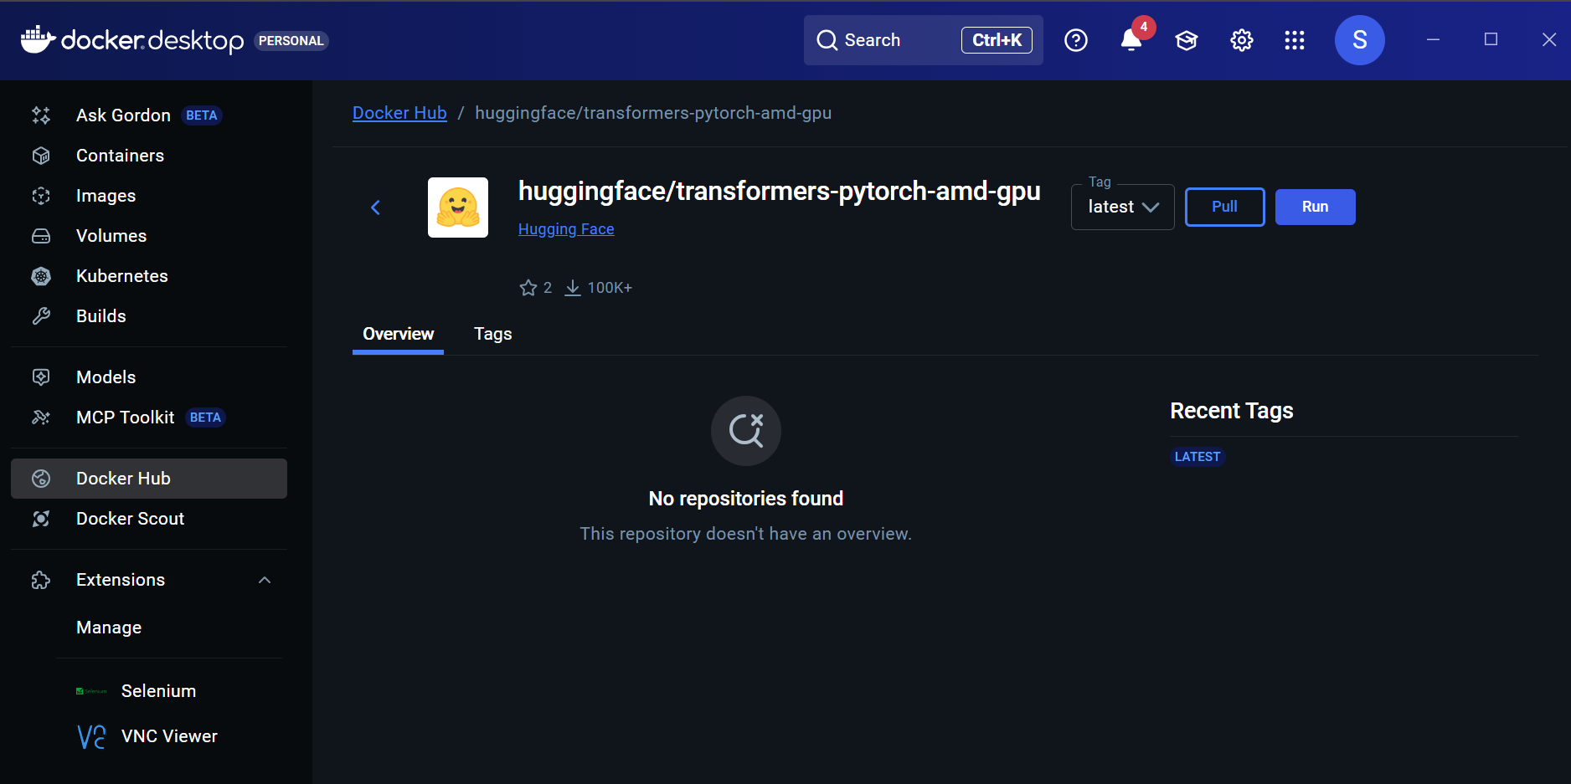
Apptainer Tutorial

Slide 11
Apptainer Obtaining an Image via docker file
Copy myimage.tar to one of the Research Computing clusters using scp and then create the Apptainer image. These commands might look as follows:
You may then follow the directions below for running myimage.sif which is a Apptainer container.
>scp myimage.tar <YourID>@cam.ac.uk:software
$ ssh <YourID>@cam.ac.uk
$ cd software
$ unset APPTAINER_BIND
$ apptainer build myimage.sif docker-archive://myimage.tar

Slide 12




Apptainer shell
Script for interactive shell in Apptainer
Use the "shell" command to run a shell within the container:
$ apptainer shell ./INTEL-WandB.sif
Apptainer> cat /etc/os-release
Apptainer> cd /
Apptainer> ls -l
Apptainer> exit

Slide 13
Apptainer Tutorial
The main Apptainer tutorial:
COW say! Moo/ Hello World
$ apptainer pull docker://ghcr.io/apptainer/lolcow
$apptainer shell lolcow_latest.sif
$apptainer lolcow_latest.sif:~> whoami
$apptainer exec lolcow_latest.sif cowsay moo

Slide 14
Apptainer Default script
To run the default command within the Apptainer image use, for example:
$ apptainer run ./INTEL-WandB.sif <arg-1>..<arg-N>>
Note that some containers do not have a default command. See the documentation for the apptainer run command.
To run a specific command that is defined within the container, use apptainer exec :
$ apptainer exec ./INTEL-WandB.sif <command> <arg-1> <arg-2> ... <arg-N>
$ apptainer exec ./ INTEL-WandB.sif python3 myscript.py 42

Slide 15
Looking at a Definition File
Bootstrap: docker
From: ubuntu:24.04
%arguments
%setup
touch /file1
touch ${APPTAINER_ROOTFS}/file2
%files /file1 /file1 /opt
%environment
LISTEN_PORT=54321
LC_ALL=C
%post
apt-get update && apt-get install -y netcat
NOW=`date`
"export NOW=\"${NOW}\"" >> $APPTAINER_ENVIRONMENT
%runscript
"Container was created $NOW"
"Arguments received: $*"
"$@"
%startscript nc -lp $LISTEN_PORT
%test
grep -q NAME=\"Ubuntu\" /etc/os-release
if [ $? -eq 0 ]; then
"Container base is Ubuntu as expected."
else
"Container base is not Ubuntu." exit 1
fi
%labels
Author myuser@example.com Version v0.0.1
%help
This is a demo container used to illustrate a def file
that uses all supported sections.
Warn

Slide 16
Running Apptainer:/.singularity.d - The Hidden Files
When in the image:
Apptainer$cd .singularity.d/
Apptainer$tree -f -L 1

Slide 17
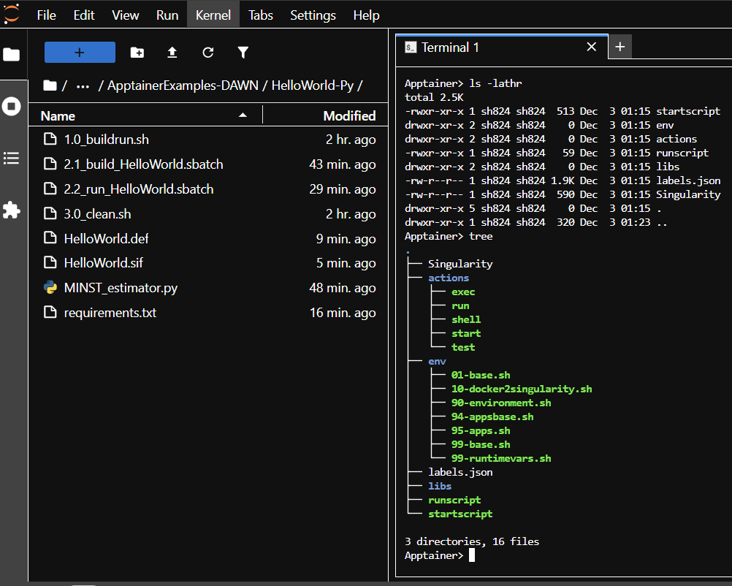
Running Apptainer:/.singularity.d - The Hidden Files

Slide 18
Running Apptainer: apptainer run or apptainer exec
When the apptainer run command launches the container, it first runs the %runscript defined for that container (if there is one), and then runs the specific command you specified.
The apptainer exec command will not run the %runscript, even if one is defined in the container.
We suggest that you always use apptainer run.

Slide 19
Building without elevated privileges with --fakeroot
apptainer Online manual(external)
The fakeroot feature (commonly referred as rootless mode) allows an unprivileged user to run a container as a "fake root" user by leveraging user namespace UID/GID mapping
This command fakes root privileges on file manipulation, telling programs that operations that would succeed as root have succeeded even though they really haven’t. This is useful for avoiding errors when building containers or when adding packages to a writable container, because many package installations attempt to do additional setup that only works as root.
The combination of a root-mapped user namespace with the fakeroot command allows most package installations to work, but the fakeroot command is bound in from the host so if the host libc library is a newer version than the corresponding library in the container the fakeroot command can fail with errors about missing GLIBC versions. Otherwise you can also try using the --ignore-fakeroot-command which may work if the commands in the %post section of the build definition file are simple enough.
Using fakeroot command inside definition file.

Slide 20
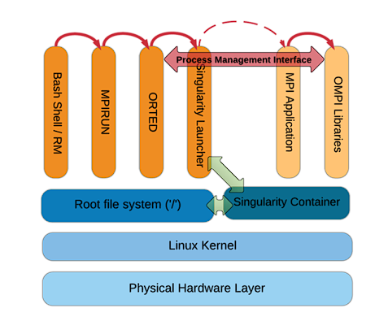
Apptainer MPI
Use same Message Passing Interface (MPI) distribution and version within container as would be used outside the container.
If using Infiniband (IB), install same OFED drivers and libraries inside the container as used on underlying HPC hardware.
https://apptainer.org/docs/user/main/mpi.html

Slide 21
Apptainer Tutorial
There are two primary approaches for executing MPI applications within an Apptainer container.
The first approach is called the `hybrid` model, which utilises a combination of libraries provided on the host and in the container to implement the MPI.
The second approach is called the `bind` model, which only uses the MPI implementation available on the host and does not include any MPI libraries in the container.
https://apptainer.org/docs/user/main/mpi.html

Slide 22
Apptainer MPI `Hybrid Approach`
At this point the processes within the container run as they would normally directly on the host.
The advantages of this approach are:
Integration with resource managers such as Slurm.
Simplicity since similar to natively running MPI applications.
The drawbacks are:
The MPI in the container must be compatible with the version of MPI available on the host.
The configuration of the MPI implementation in the container must be configured for optimal use of the hardware if performance is critical.
Since the MPI implementation in the container must be compliant with the version available on the system, a standard approach is to build your own MPI container, including the target MPI implementation.
https://apptainer.org/docs/user/main/mpi.html

Slide 23
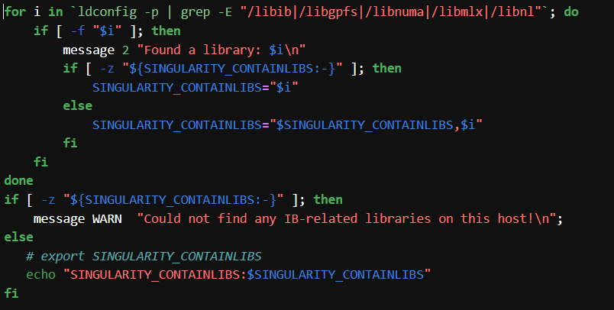
Apptainer Tutorial MPI
Create the Apptainer definition file.
Create the definition file that will later be used to create the Apptainer image. Copy the list of shared libraries from the previous step into the container. In the example, the shared libraries are copied to /usr/local/lib/ in the container, but they can be copied to any directory that is available in the container. The directory containing the shared libraries must be included in LD_LIBRARY_PATH.
2. Build the Apptainer image.
apptainer build --fakeroot "$(pwd -P)/MPI-hybrid.sif" "$(pwd -P)/MPI-hybrid.def“
3. Run the MPI application in the container on compute nodes using Slurm.
https://ncsa.github.io/containers-on-bw/04-hpccm/index.html

Slide 24
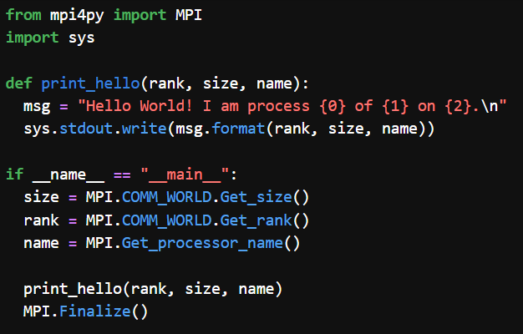
Apptainer MPI

Slide 25
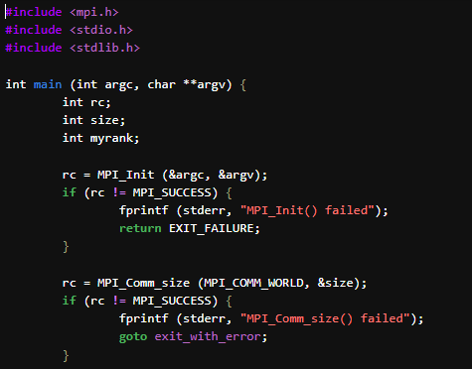
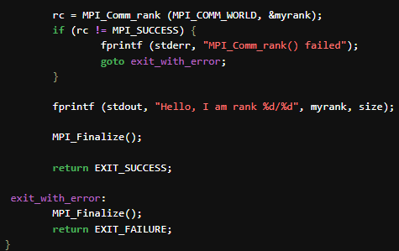
Apptainer MPI

Slide 26
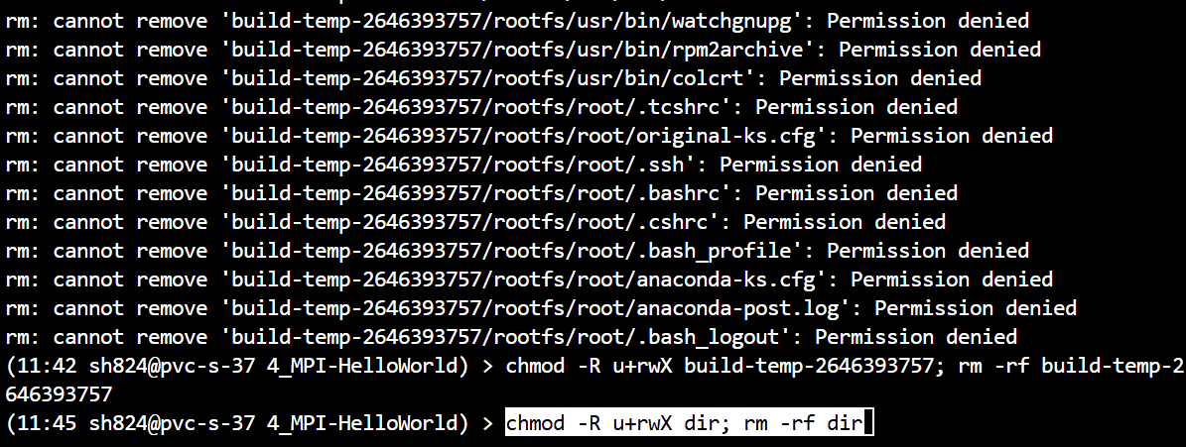
Apptainer Error Building

Slide 27
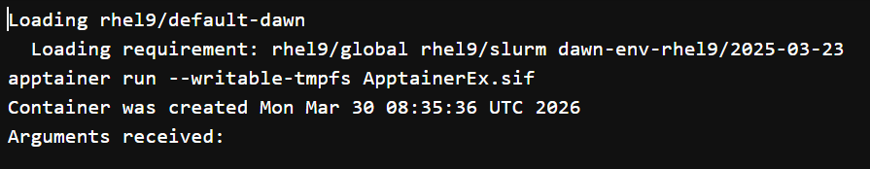
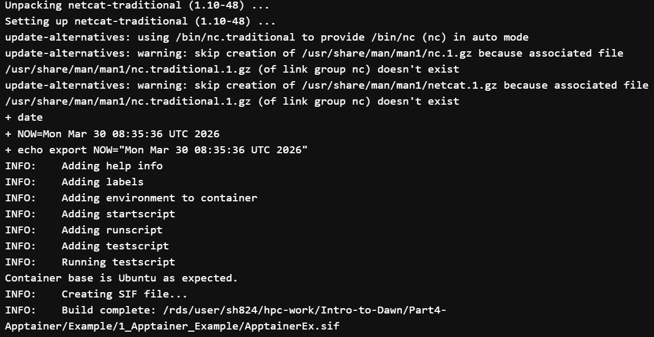
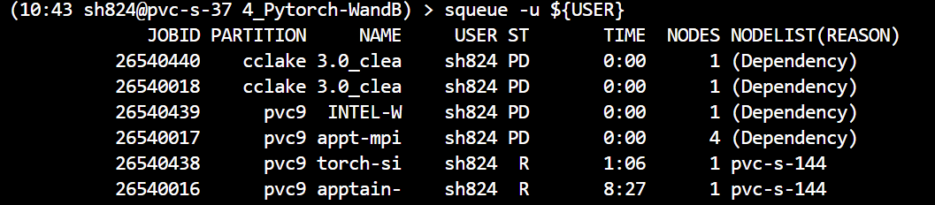
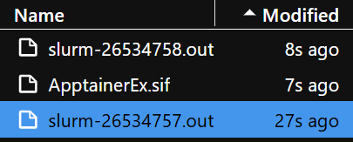
Example Building
1_Apptainer_Example

Slide 28
Example 1 Running
1_Apptainer_Example

Slide 29
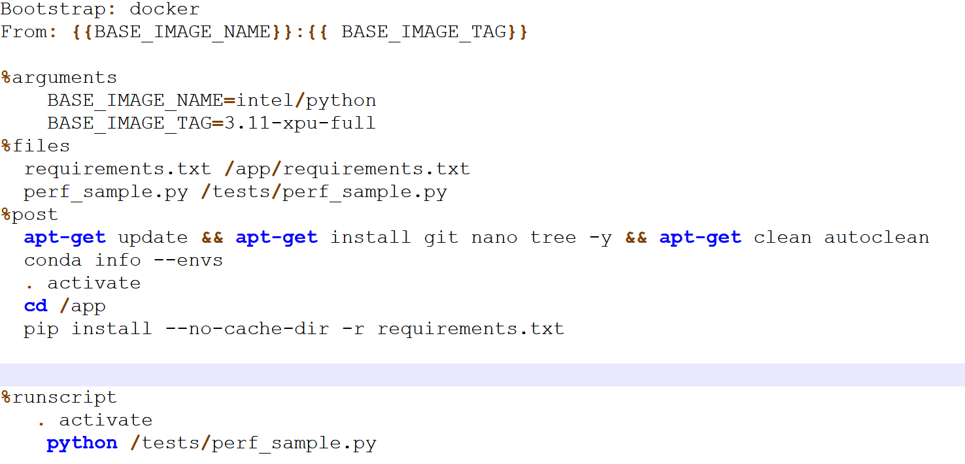
Example 2
2_Apptainer_Python

Slide 30
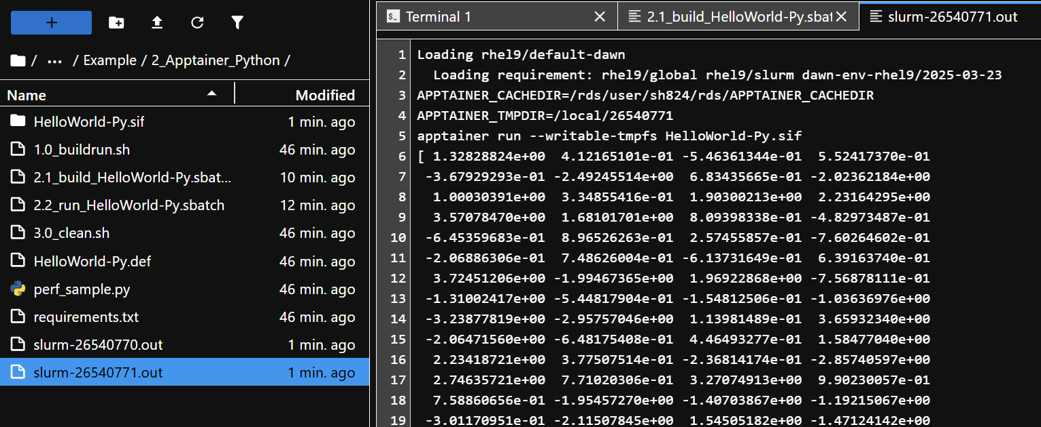
Example 2
2_Apptainer_Python

Slide 31
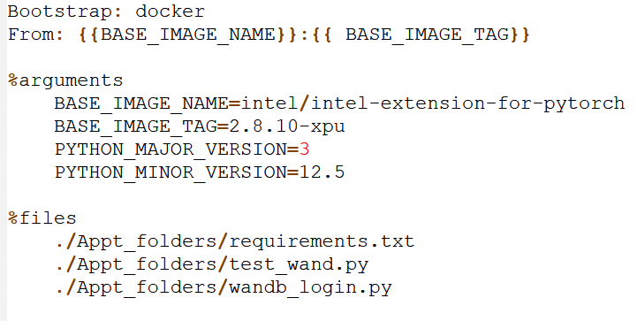
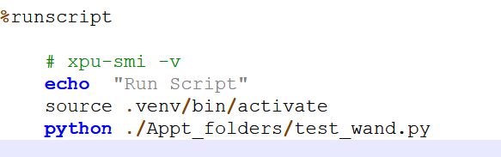
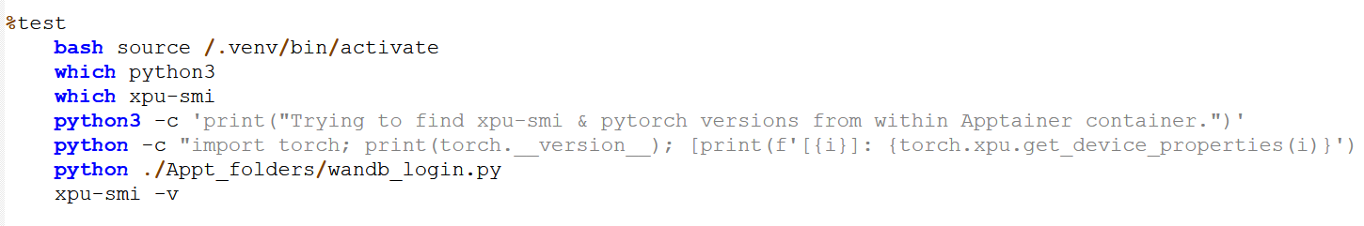
Example 3
3_Pytorch-Wand

Slide 32
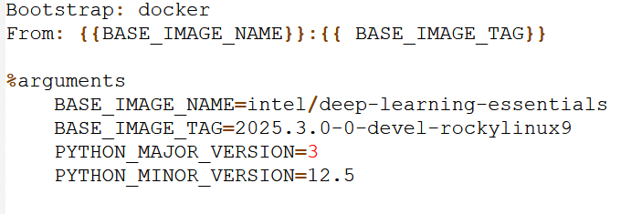
Example 4
4_MPI-HelloWorld

Slide 33
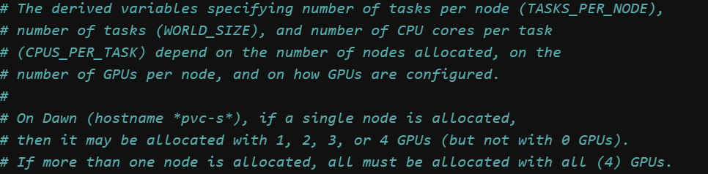
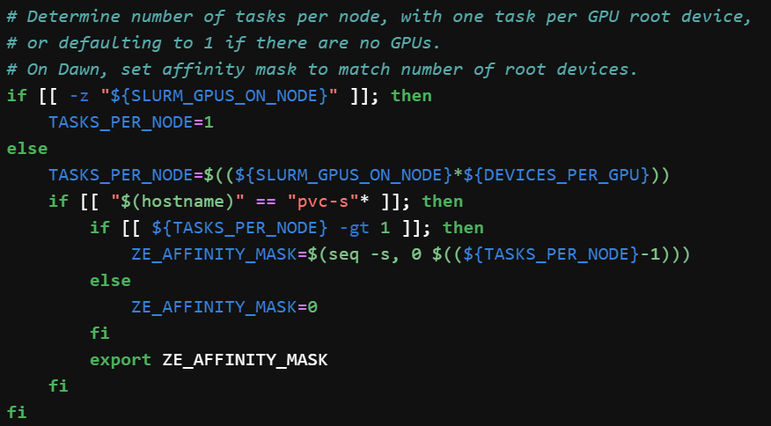
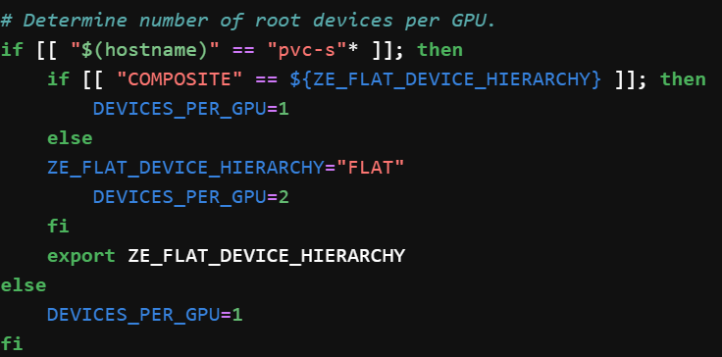

Example 5
5_dawn-containers

Slide 34
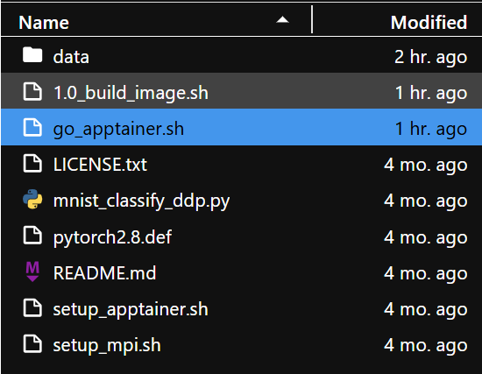
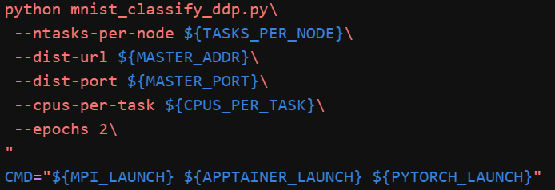
Example 5
5_dawn-containers

Slide 35
Thank You
When looking for answers try these pages:
dawn-intel-gpu-pvc-nodes
support@HPC.cam.ac.uk

