Slide 1
Introduction to Deep Learning on ShARC and DGX-1 Day 2
Twin Karmakharm
23rd February 2017

Slide 2
For Slides and Lab materials
http://gpucomputing.shef.ac.uk/education
“More” link under -> Introduction to Deep Learning on ShARC DGX-1

Slide 3
Course content
Day 1
Lab 00: Getting started
Machine Learning and Neural Network Refresher
Introduction to Deep Learning
Lab 01: A simple Neural Network model for MNIST classification
Lab 02: Convolution Neural Networks
Lab 03: Deploying Your Trained Network

Slide 4
Course content
Day 2
Lab 04: Using and Visualising Pre-trained Models
Lab 05: Deep Learning with multiple GPUs
Lab 06: Recurrent Neural Networks

Slide 5
4. Using and visualising pre-trained model

Slide 6
Using pre-trained models
ImageNet dataset is 55GB and can take a week to train!
150,000 images
1,000 categories
A pre-trained model only needs the weights (~240MB for Alexnet)
It’s possible to use pre-trained model to improve convergence time in your own dataset
Also possible to repurpose the network for a different function
But if additional classifier is needed you will need to re-train the model

Slide 7
Preparing your data
Store your dataset in databases such as:
LMDB – Memory mapped, can be larger than system memory, fast reads
LevelDB – More efficient storage, a little slower to read than LMDB
HDF5 – Simpler to use, must read entire DB to memory
[https://www.influxdata.com/benchmarking-leveldb-vs-rocksdb-vs-hyperleveldb-vs-lmdb-performance-for-influxdb]

Slide 8
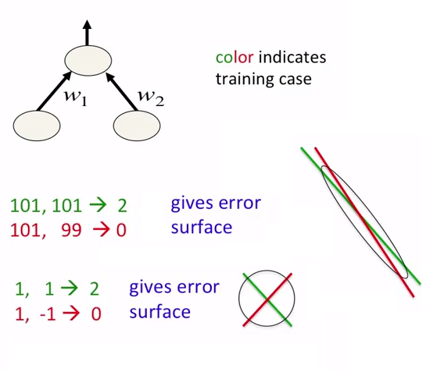
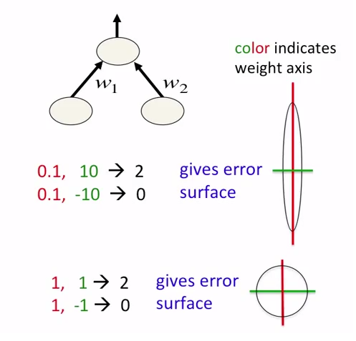
Preparing your data
Scaling your inputs
Inputs as floating point values
Normalization gives a better error surface and reduces training time
Convert your data to be around range of -1 and +1 with the mean being near 0

Slide 9
Preparing your data
Additional dataset can be created by applying noise, rotation, position shift, scaling, etc.
Making the most of existing dataset
Helps with feature invariancy
Reduces overfitting

Slide 10
Overfitting

Slide 11
Dropout

Slide 12
Normalised image
Non-normalised image

Slide 13
Preparing your data
Subtract mean from data (when using pre-built model)
Pre-built models should provide their input format and mean values

Slide 14
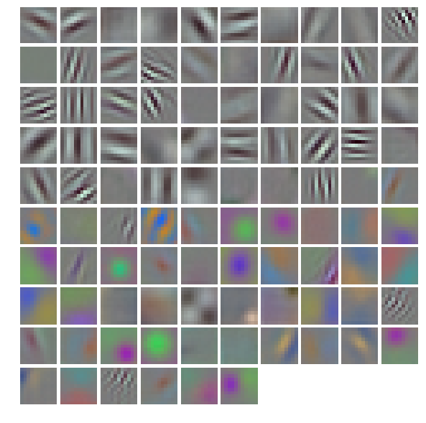
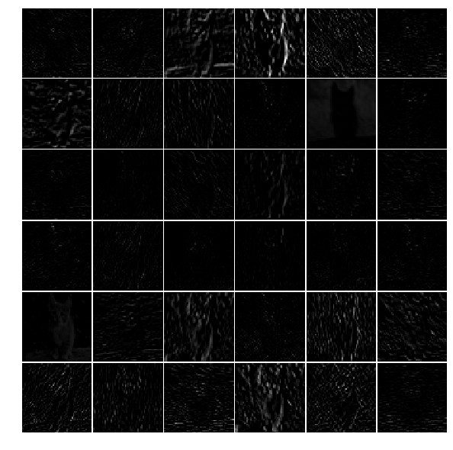
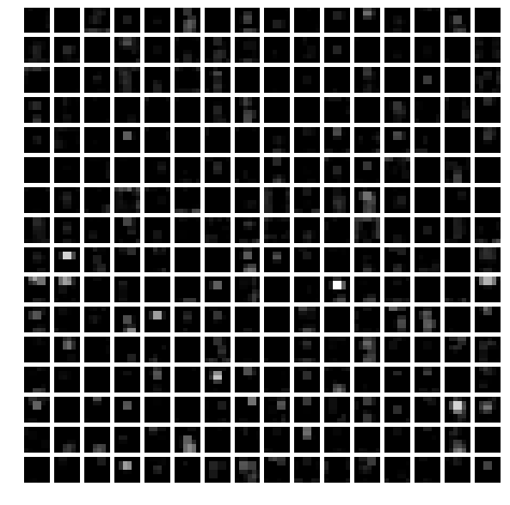
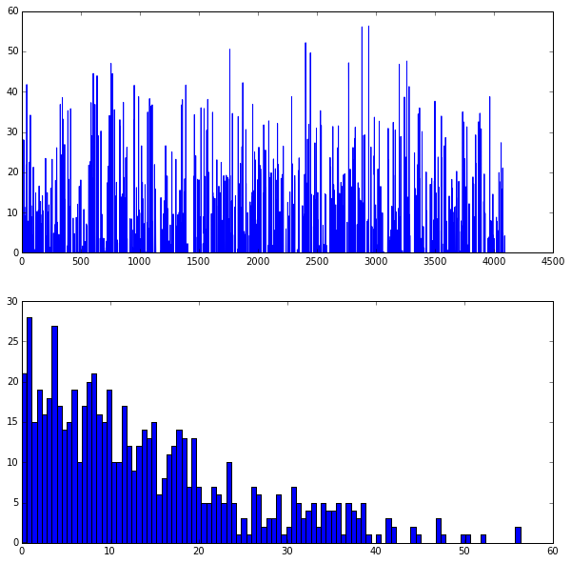
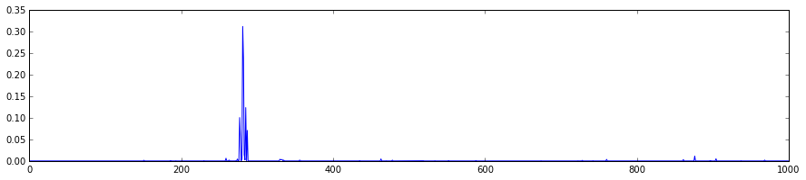
Visualisation of the Model
conv1 weights
conv1 output
pool5 output
fc6 histogram
output probability distribution

Slide 15
Visualisation of the Model
Deep visualisation toolbox - https://github.com/yosinski/deep-visualization-toolbox

Slide 16
Practical Lab 04

Slide 17
5. Training using multiple GPUs

Slide 18
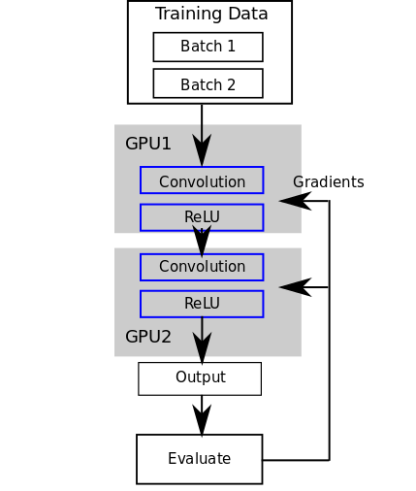
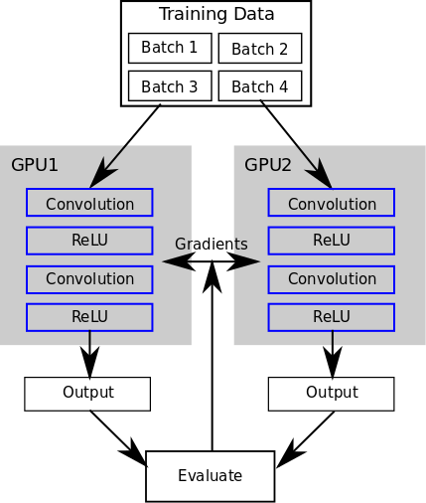
Training using multiple GPUs
Model parallelism – Synchronise inputs/outputs
Data parallelism – Synchronise weights
[https://blog.rescale.com/deep-learning-with-multiple-gpus-on-rescale-torch]

Slide 19
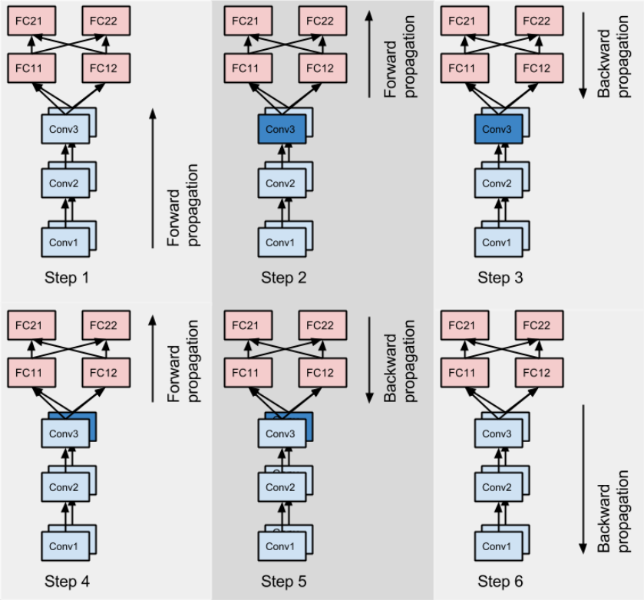
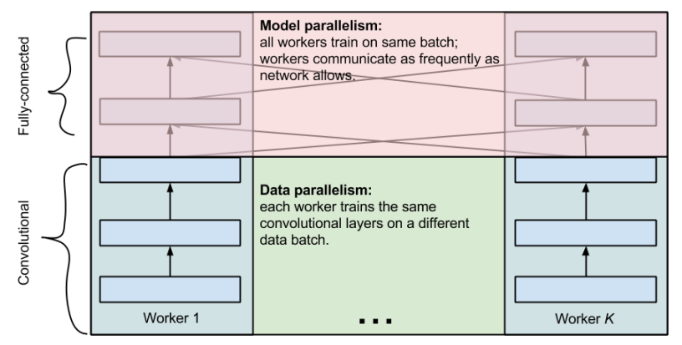
Training using multiple GPUs
It’s also possible to use a mixture [Krizhevsky 2014]

Slide 20
Training using multiple GPUs
Model parallel allows models larger than individuals GPUs to be run
Caffe does not support this
But you can do it on Theano, Torch and Tensorflow
Data parallel conceptually easier to implement, less communication during training
Beware of synchronisation cost!
Training time vs. Synchronisation time
On smaller models it may even take longer to synchronise than to train

Slide 21
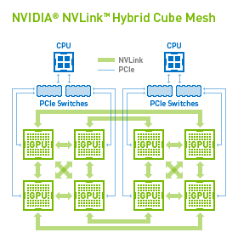
Training using multiple GPUs
Synchronisation performed GPU to GPU, does not pass through CPU
Check your GPU connection topology
Check with nvidia-smi topo –matrix
GPUs connected with NVLink will be faster than through PCI
E.g. Training on GPU 0 & 1 will be faster than GPU 2 & 4

Slide 22
Current Scheduler Not guaranteed NVLink
Tier 2 system you will get the whole DGX-1 Node
Benchmarking – calculation times roughly constant, scale linearly

Slide 23
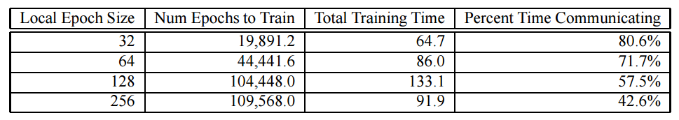
Training using multiple GPUs
Bigger Local Epoch/batch size means less communication time but can actually take longer to converge
[Dahl et al. 2008]

Slide 24
Training using multiple GPUs
Caffe has built-in data parallelism support on command line using the gpu flag
E.g. caffe train –solver solver.prototxt –gpu 0,1
Or caffe train –solver solver.prototxt –gpu all
Multi-gpu for training only and through the command line and C++ interface, not Python

Slide 25
Practical Lab 05

Slide 26
6. Recurrent Neural Networks
A simple text prediction model

Slide 27
Recurrent Neural Networks (RNN)
Where models of sequential data is important: automatic speech recognition, machine translation, natural language, …
Recurrent Neural Networks (RNN) can handle these types of problems as they have ‘memory’
Also called Elman network (Finding structure in time, Elman 1990)

Slide 28
Application of RNNs: Language modeling
Statistical language modeling is one of the oldest and most important NLP tasks
The language models are core of machine translation, speech recognition and many other applications
Historically, it was amazingly difficult to convincingly beat N-grams, especially on larger than tiny datasets

Slide 29
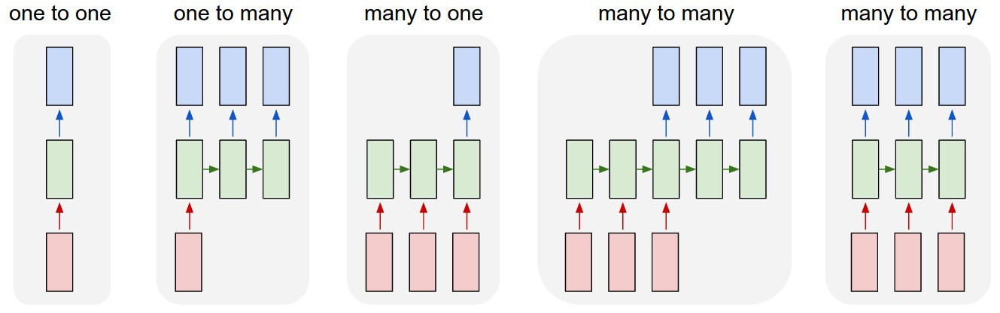
RNN & Data Sequences
One to many (sequence output) e.g. captioning an image with multiple words
Many to one (sequence input) e.g. sentiment analysis
[http://karpathy.github.io/2015/05/21/rnn-effectiveness]

Slide 30
RNN & Data Sequences
Many to many (sequence in and out) e.g. Machine translation such as translating an English sentence to a French one
Many to many (synced sequence in and out) e.g. Video classification for labelling frames in a video
[http://karpathy.github.io/2015/05/21/rnn-effectiveness]

Slide 31
RNN & Data Sequences
Can be used in absence of a sequence
RNN Learns to read house numbers
RNN Learns to paint house numbers
[Ba et al. 2015]
[Gregor et al. 2015]
[http://karpathy.github.io/2015/05/21/rnn-effectiveness]

Slide 32
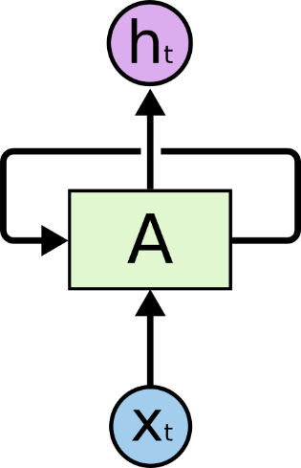
RNN - Architecture
Recurrent network has loops
In theory can lean to represent unlimited memory
[http://colah.github.io/posts/2015-08-Understanding-LSTMs]

Slide 33

RNN - Architecture
An unrolled RNN
We generally limit this to 5-10 steps
[http://colah.github.io/posts/2015-08-Understanding-LSTMs]

Slide 34
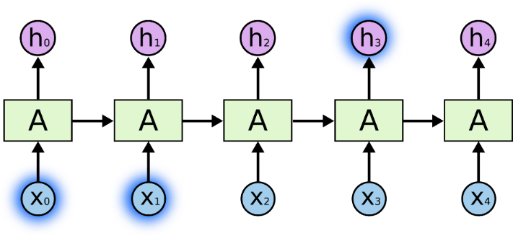
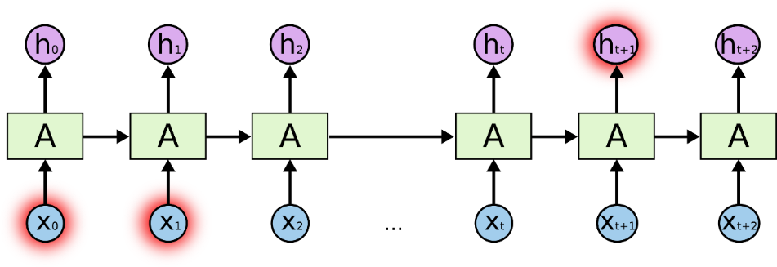
RNN - Architecture
The basic approach has problems with
Vanishing gradients - As we propagate the gradients back in time, usually their magnitude quickly decreases
Long term dependencies – Cannot connect information too far back in time
[http://colah.github.io/posts/2015-08-Understanding-LSTMs]

Slide 35
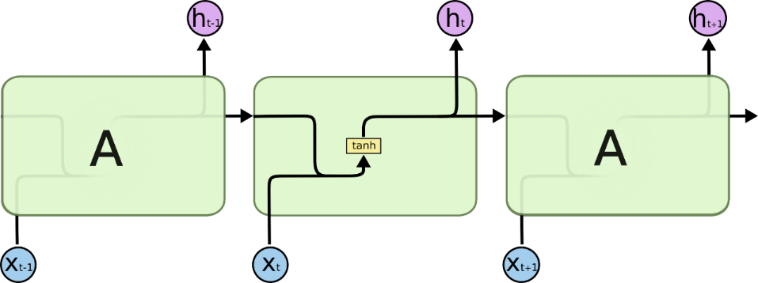

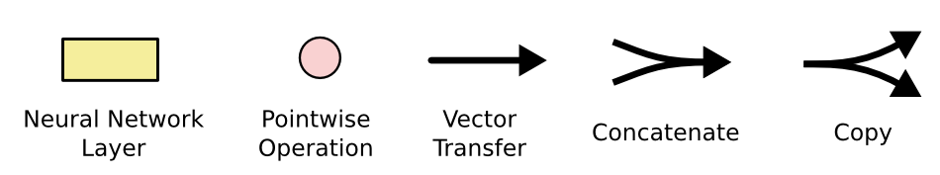
RNN - LSTM
Long Short Term Memory network (LSTM) can help the long-term dependency problem
Standard RNN, single layer
LSTM, has four interacting layers
[http://colah.github.io/posts/2015-08-Understanding-LSTMs]

Slide 36
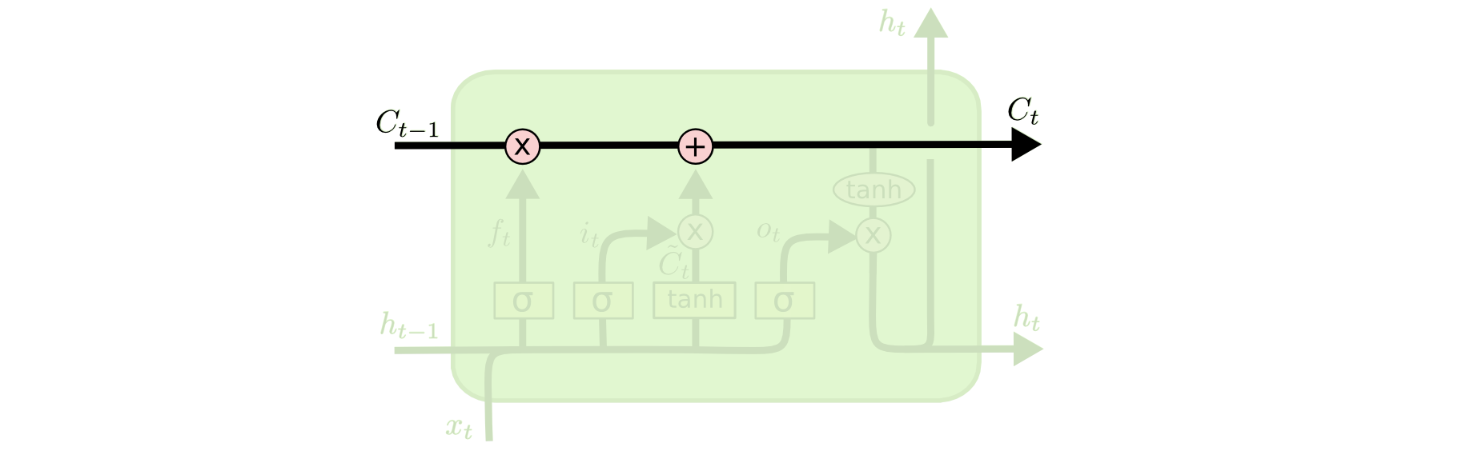
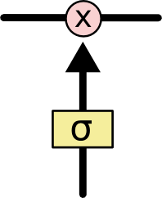
RNN - LSTM
Cell states perform simple linear operations
3 gates optionally let information though and controls the cell state
Has sigmoid activation functions
[http://colah.github.io/posts/2015-08-Understanding-LSTMs]

Slide 37
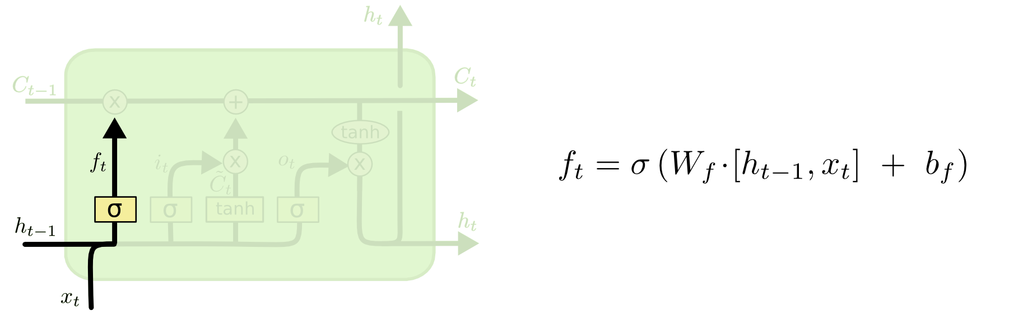
RNN - LSTM
Decide if we’re keeping this information
Is it the same context/subject?
[http://colah.github.io/posts/2015-08-Understanding-LSTMs]

Slide 38

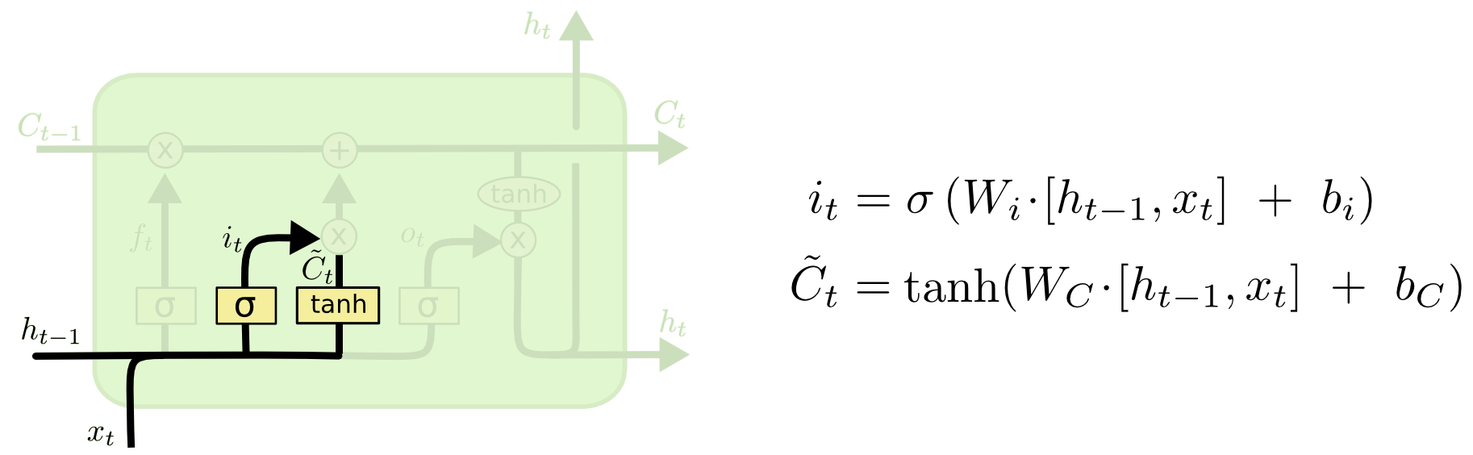
RNN - LSTM
Decide what new information to store
Input gate layer decides the value to update
tanh layer generates a vector of new candidate values
[http://colah.github.io/posts/2015-08-Understanding-LSTMs]

Slide 39


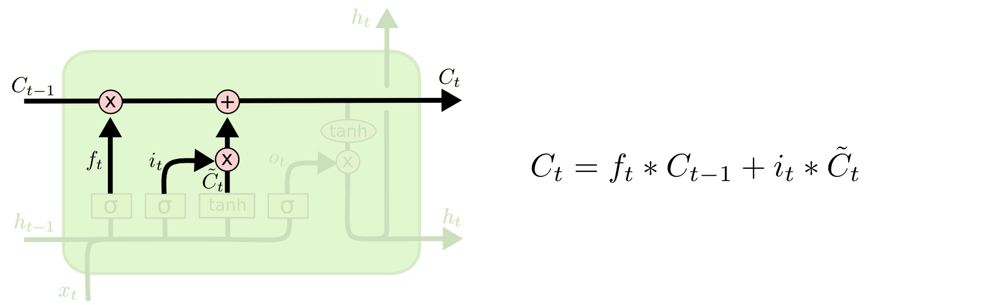
RNN - LSTM
Update old cell state in to new cell state
[http://colah.github.io/posts/2015-08-Understanding-LSTMs]

Slide 40
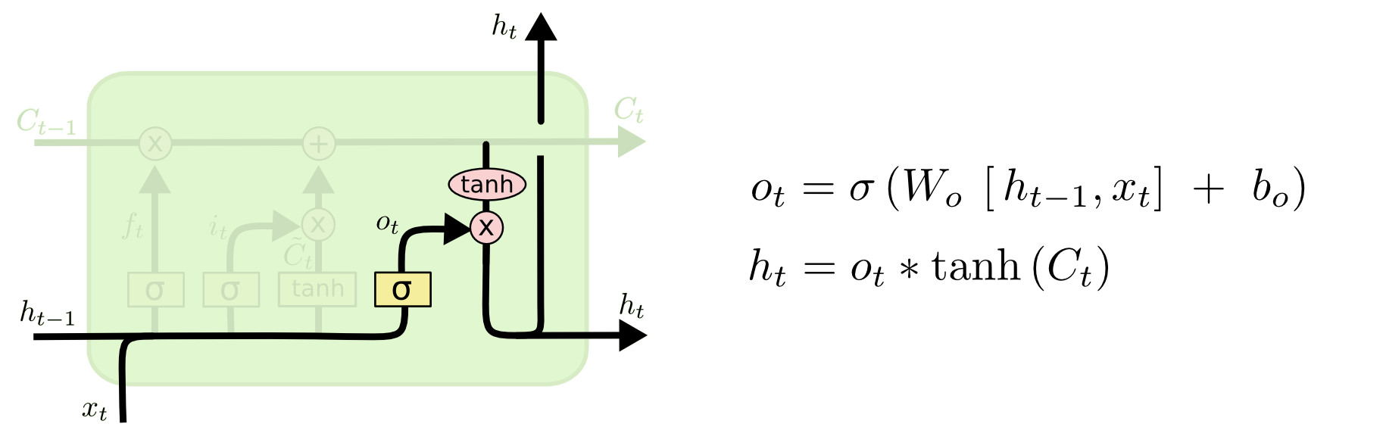
RNN - LSTM
Decide the output
[http://colah.github.io/posts/2015-08-Understanding-LSTMs]

Slide 41
Practical Lab 06

Slide 42
How to get access to DGX-1
Documentation, github site

Slide 43
Thank you for attending!

