Slide 1
Nextflow
Workflow manager

Slide 2
Introduction to Nextflow
Portable, including SGE and SLURM
Reproducible with containers: Docker, Conda and Singularity
Parallel
Saved progress
Fast scripting and many example pipelines

Slide 3
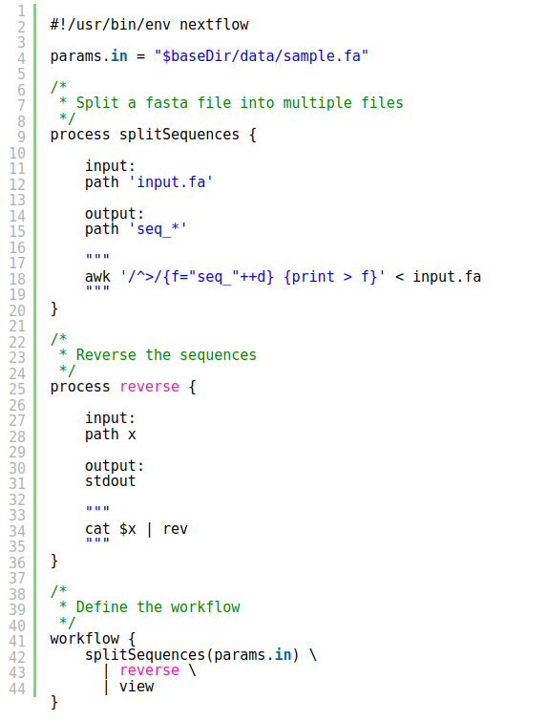
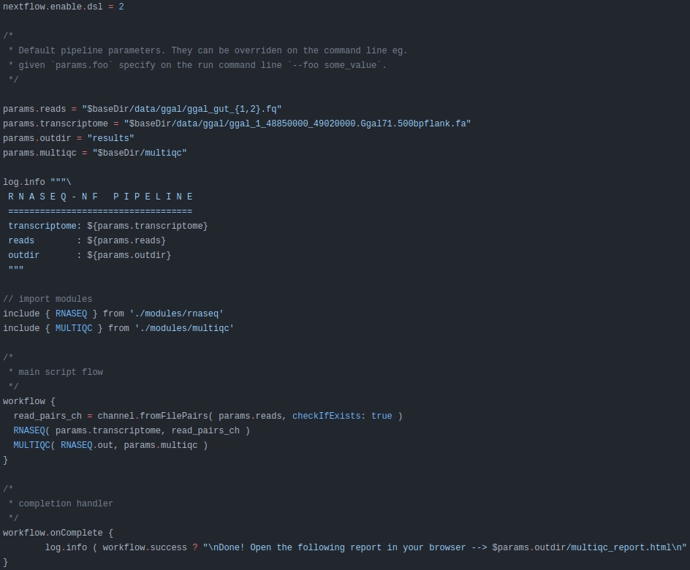
Starting with Nextflow - main.nf

Slide 4
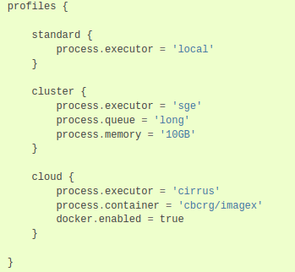
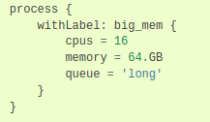
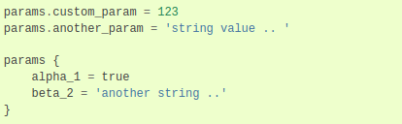
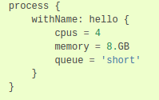

Starting with Nextflow - nextflow.config

Slide 5
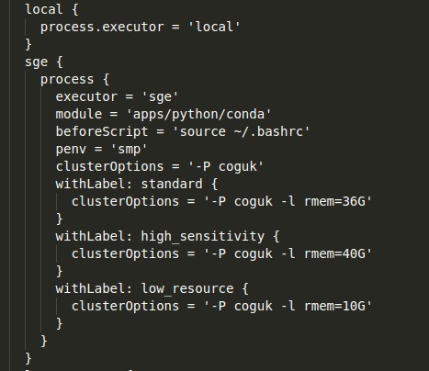
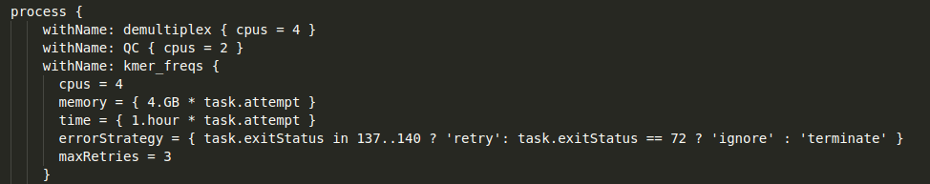
Portability - Multiple Executors
Local execution
SGE and SLURM - UoS workload managers used in SHARC and Bessemer
Simple profile setup
Easy to specify variable requirements (eg. memory, CPUs, execution time)

Slide 6
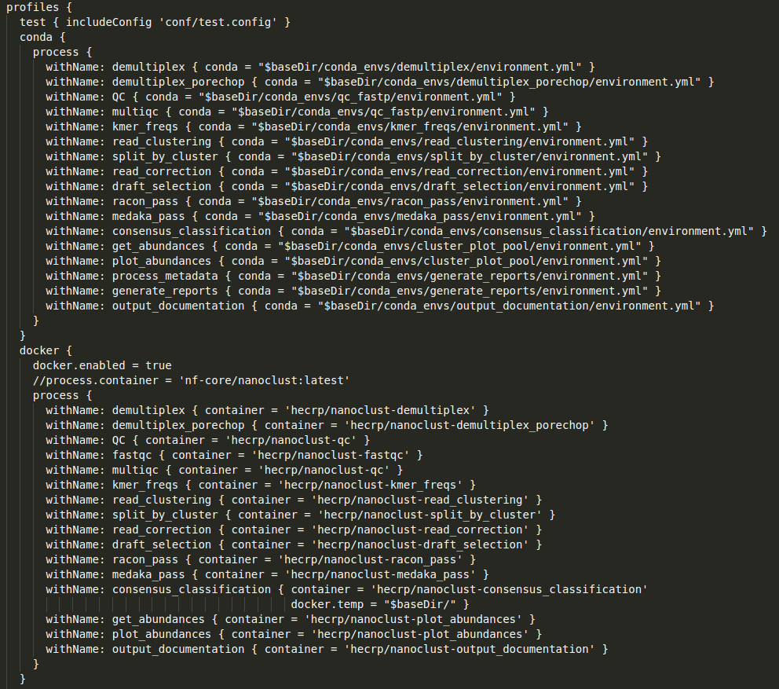
Reproducibility - Various Containers
Support for Conda, Docker or Singularity
Separate profiles for containers
Separate environments for processes

Slide 7
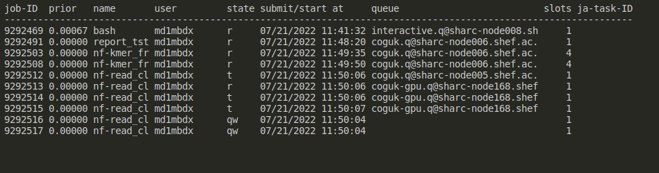
Parallelism
Runs samples independently
Asynchronous execution
Automatic resource allocation

Slide 8
Resuming the run
Progress is saved in a work folder
Integrity of files and script checked before execution
Ability to resume
Nextflow run main.nf -resume

Slide 9
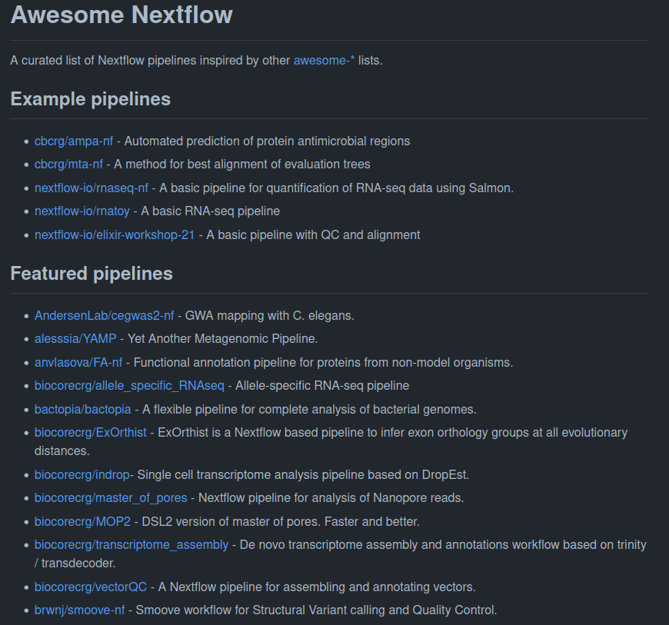
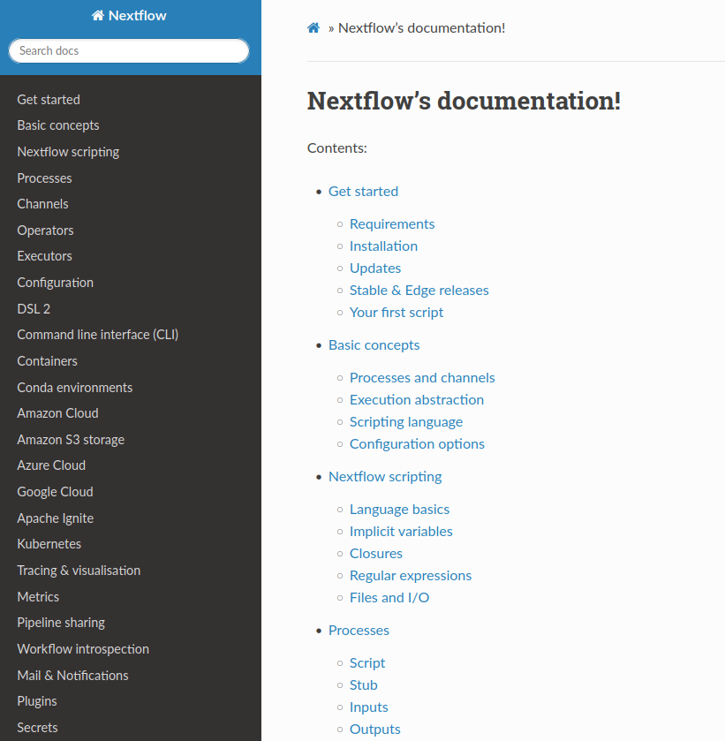
Available resources

Slide 10
Summary
Flexibility and countless features
Reproducibility, Portability, Parallelism
Availability of resources
Complex and non-intuitive
Relatively new
Groovy/Java knowledge recommended

