Slide 1

Going with the flow
Dr. ian Sudbery
Molecular Biology and Biotechnology
i.Sudbery@sheffield.ac.uk
@IanSudbery
www.github.com/sudlab

Slide 2
Using workflow managers to co-ordinate multistep analysis pipelines across multiple compute nodes in a reproducible manner.

Slide 3
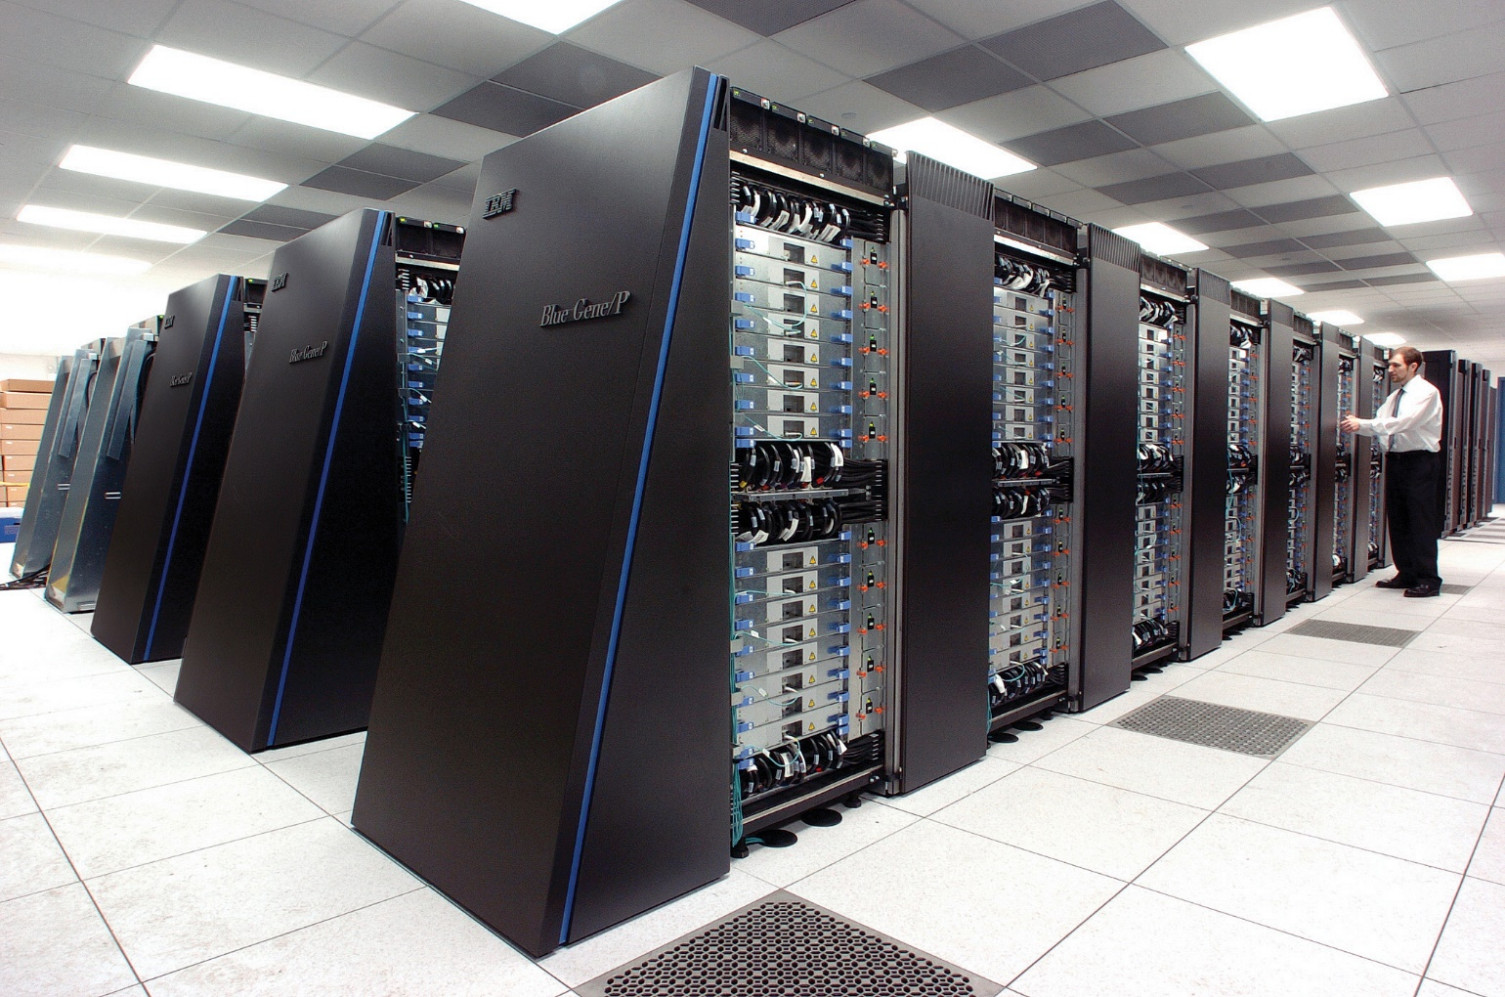
Traditional HPC jobs are single monolithic programs using multi-node parallelism
Notes:
HPC/supercomputer
Many nodes connected by highspeed internet, able to do many compuations at once.
Standard use-case is a single program that uses many CPUs across many nodes (via something like MPI) to complete a single calculation over a long period
User probably spends a long time crafting their job, running it on test sets, then uploads it, starts it and comes back in a week/month

Slide 4
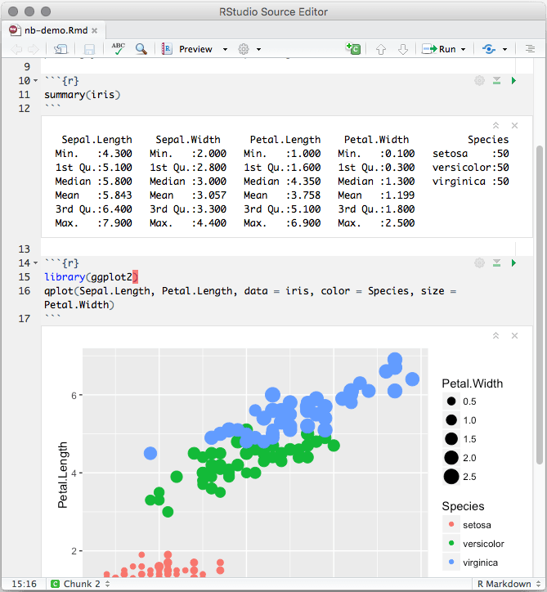
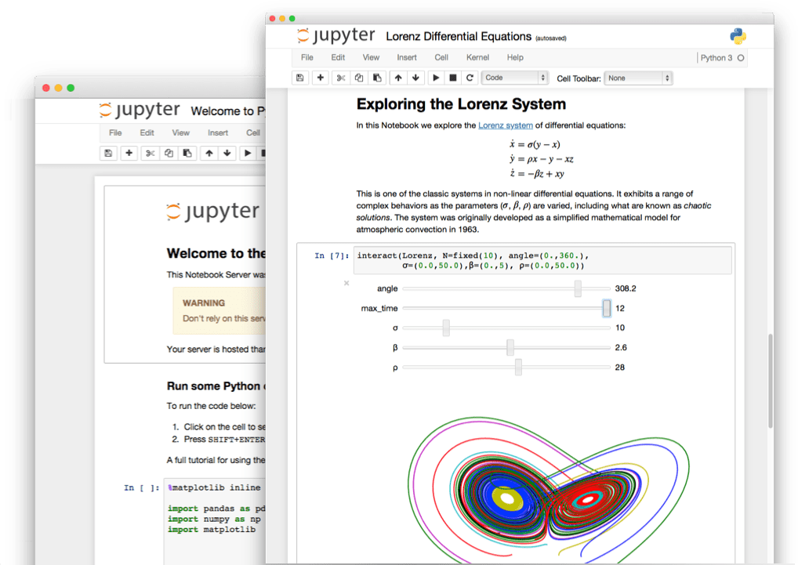
Today many researchers use notebooks on clusters to do interactive/interpretive analysis of datasets

Slide 5
Research computing spectrum
?
Single, large, long running, multimode jobs
Single core, quick running, interpretive analysis
e.g. a climate model
Regression analysis of a (quite) big dataset

Slide 6
clean_data.py
my_analysis.r
clean_data.py
my_analysis.r
clean_data.py
my_analysis.r
combined_result
clean_data.py
my_analysis.r
clean_data.py
my_analysis.r
clean_data.py
my_analysis.r

Slide 7
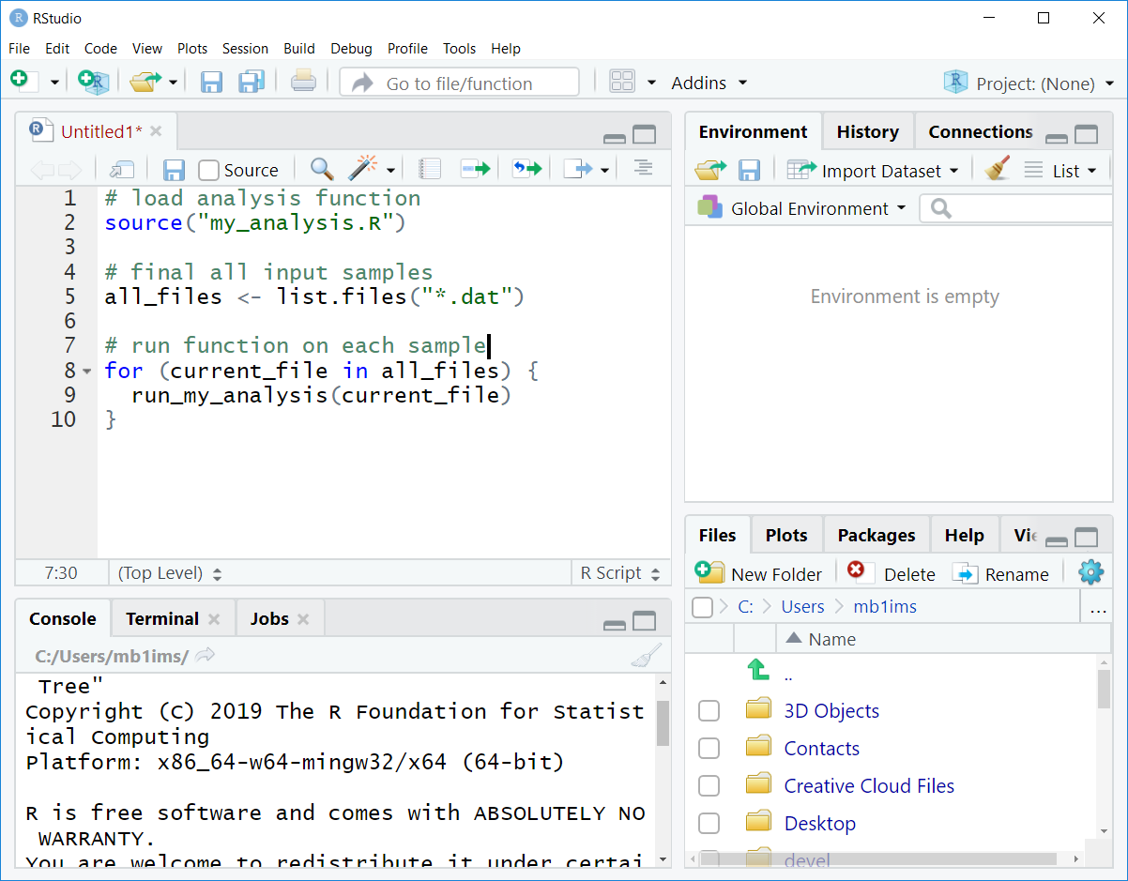
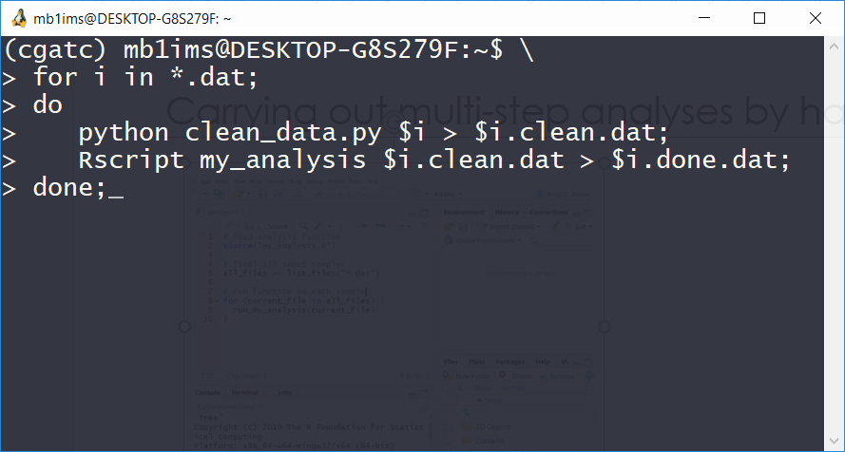
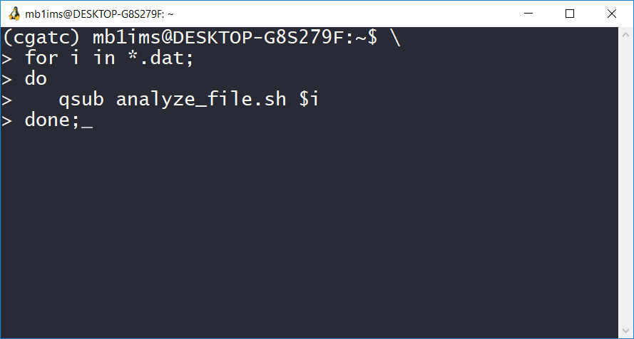
Carrying out multi-step analyses by hand

Slide 8
Reproducibility
results = code(data)
Typing at a terminal is BAD NEWS for reproducibility
Notebooks (for low intensity work)
Containers
Neither very easily work with multi-node parallelism

Slide 9
Easy/Automatic
Reproducible
Generalizable/Scalable
Notes:
You encourage the second 2 by making the solution easy and automatic

Slide 10
Workflow manager
Specify dependencies between tasks
Check if which dependencies need updating
Only run tasks that need updating
Do all this unsupervised.
Step1.gz
Step1.gz
Step1.gz
Step2.dat
Step2.dat
Step3.txt
Step3.txt

Slide 11
Modern workflow managers
Either DSLs, configuration based or library
Allow more complex forms of dependency
Automatically submit each job to the cluster
Monitor for successful completion and automatically submit next job
Parameterizable
Extensive logging

Slide 12
Modern Workflow managers
May also provide:
conda/singularity/docker integration
Use cloud compute and/or storage as well as local cluster
Allow (distributed) execution of arbitrary code as well as shell scripts
Helper functions for common analysis tasks

Slide 13







Some modern WFM
SNAKEMAKE
Ease of development
Flexibility, customisation
Scalability, portability, performance
Notes:
There are over 200 different workflow engines available.

Slide 14
Language | Python | DSL | DSL
Dependency Paradigm | Explicit | Implicit (pull) | Implicit (push)
Rich dependency graphs | Yes | Partial | Yes
Conda integration | Yes | Yes | Yes
Singularity/docker | Coming soon | Yes | Yes
Arbitrary code | Python | Python | Any interpreted
Cloud Execution | No | Kubernates | Amazon Batch
Cloud storage | Google/S3 | Many | Many
Functions for common analysis | Yes | No | No
SNAKEMAKE

Slide 15
Demonstration

Slide 16
It should take less time, effort and thought to it the right way than to do it the wrong way

Slide 17
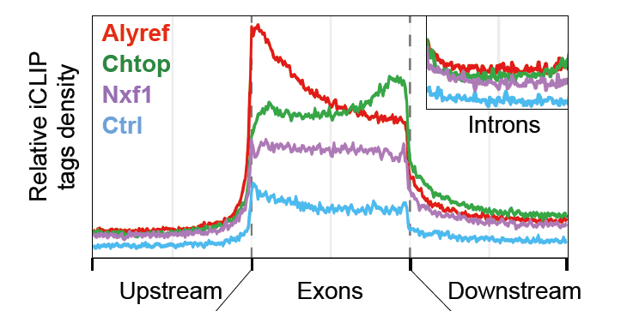
Gene profiles
ATAGAGAGCGCGAGATAGAGACAGTGAGACTATCATAGAGAGCGCGAGATAGAGACAGTGAGACTATCATAGAGAGCGCGAGATAGAGACAGTGAGACTATCATAGAGAGCGCGAGATAGAGACAGTGAGACTATCATAGAGAGCGCGAGATAGAGACAGTGAGACTATC
GAGACTATCATAGAG
TAGAGAGCGCGAGAT
TATCATATATCATAG
GAGACTATCATAGAG
TAGAGAGCGCGAGAT
TATCATATATCATAG
GAGACTATCATAGAG
TAGAGAGCGCGAGAT
TATCATATATCATAG
GAGACTATCATAGAG
TAGAGAGCGCGAGAT
TATCATATATCATAG
Millions of lines

Slide 19
Ruffus dependency types
Originate | None to one
Transform | One to One
Split | One to many
Merge | Many to one
Collate | Many to fewer
Subdivide | Many to more
Follows | Dependency without common files
Files | Arbitrary relationship
Permutations Product Combinations Combinations_with_replacement | Combinatorics

Slide 20
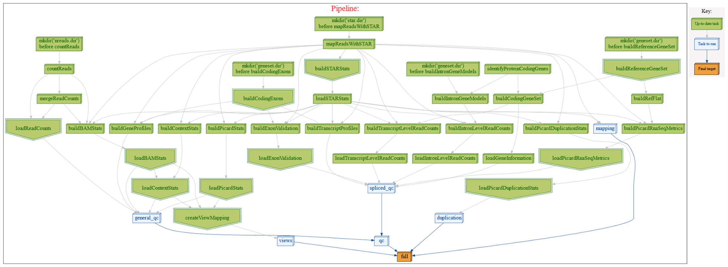
Pipelines can get quite complex…
pipeline_mapping

Slide 21
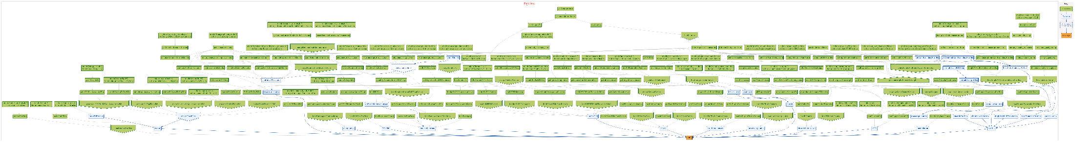
Really very complicated!

Slide 22
Summary
Automated farming and monitoring of pipelines of jobs to the cluster
Create fully logged and reproducible workflows
Generalizable and scalable
Should be easer than writing a SGE submission script and faster than running in an interactive session
Install with conda install –c bioconda –c conda-forge cgatcore

Slide 23
Acknowledgements
Sudbery Lab for Computational
Genomics @ TUOS
MRC Computational
Genomics Analysis and
Training/Tools
Dr. Cristina Alexandru-Crivac
Jaime Alvarez-Benayas
Justin Coyne
Magdelena Dabrowska
Sumeet Deshmurkh
Jacob Parker
Ivaylo Yonchev
Dr. Adam Cribs
Sebastian Luna-Valero
Dr. Charlotte George
Dr. Antonio Berlanga-Taylor
Dr. Stephen Sansom
Dr. Tom Smith
Dr. Nicholas Ilott
Dr. Jethro Johnson
Jakub Scaber
Dr. Katherine Brown
Dr. David Sims
Dr. Andreas Heger
Dr. Leo Goodstat (Ruffus)

Slide 24
https://cgaticore.readthedocs.io Cribbs AP, et al. F1000Research 2019, 8:377
https://snakemake.readthedocs.io
Köster, J and Rahmann, S. Bioinformatics 2012, 28:2520
https://nextflow.io
P. Di Tommaso, et al. Nature Biotechnology 2017 35, 316

