Slide 1

Dynamic-developers

Slide 2

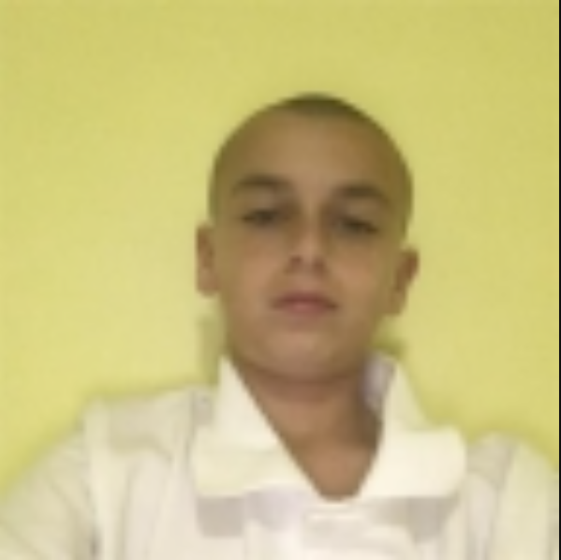
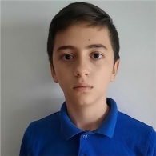

About Us
Стефан Чапкънов Раян Христов Йордан Жечев Александър Фотев
Q&A SCRUM Trainer Backend Developer Backend Developer

Slide 3


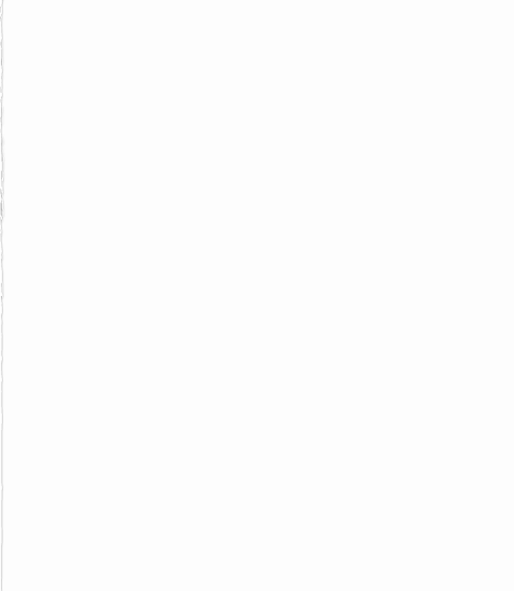





Used apps throughout the project
Communication –Discord
App work – Visual Studio
Documentation – Word
Presentation – PowerPoint
Submission - GitHub

Slide 4
link to our repository
Repository

Slide 5


Thank you for your attention !!!

