Slide 1
Semantic Segmentation
Paola Ardón
Rodrigo Daudt
April 18th, 2016

Slide 2
1. Outline
What is Semantic Segmentation
Examples
Semantic Segmentation vs Object Detection
O2P Algorithm
Other notable algorithms

Slide 3
Semantic Segmentation
Definition
Input-output
Purpose
Examples and how – where to use it

Slide 4
Examples
Semantic Image Segmentation by Torr Vision Group: http://www.robots.ox.ac.uk/~tvg/
Real-time Semantic Video Segmentation: https://www.youtube.com/watch?v=CrnLINlbfFA

Slide 5
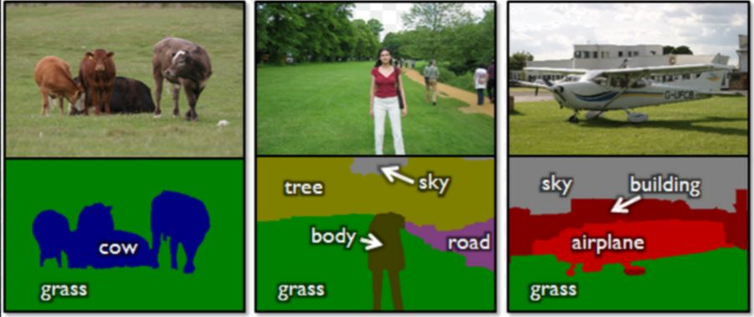
Semantic Segmentation vs Object Detection
Two different ways to solve the recognition task.
Object Detection: localization of objects of certain clases
  Approach – sliding windows
  Output - MBRs
Which task has more applications?
Notes:
Object detection addresses the problem of localization of objects of the certain classes. Minimum bounding rectangles (MBRs) of the objects are the ideal output. The simplest approach here is to use a sliding window of varying size and classify sub-images defined by the window. Usually, neighbouring windows have similar features, so each object is likely to be alarmed by several windows. Since multiple/wrong detections are not desirable, non-maximum suppression (NMS) is used.
In theory, the two problems are almost equivalent. Object detection reduces easily to semantic segmentation. If we have a segmentation output, we just need to retain object classes (or discard the "stuff" classes) and take MBRs of regions. The contrary is more difficult. Actually, all the stuff turns into the backgroundclass. All the found objects within the rectangles should be segmented, but it is a solvable issue since foreground extraction techniques like GrabCut could be applied. So, there are technical difficulties which could be overcome and the two problems could be considered equivalent, however, in practice the approaches are different.
Which task has more applications?-we are interested in finding objects more
which task is more suitable for solving the global problem of exhaustive scene analysis- Take home message

Slide 6
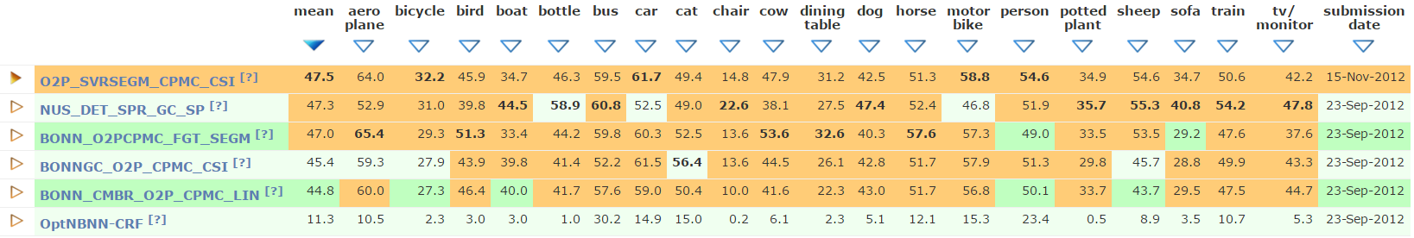
O2P
Why O2P:
  Well structured paper and algorithm
  Focused specifically on Semantic Segmentation
  Fast training and testing
  Best results for PASCAL VOC 2011 when published, very good results on PASCAL VOC 2012 to this day

Slide 7
O2P
Feature Pooling
  “The role of pooling is to produce a global description of an image region - a single descriptor that summarizes the local features inside the region and is amenable as input to a standard classifier.”
Second Order?
  First order pooling – extracting first order statistics (mean, max, etc.) from features in region
  Second order pooling – using second order statistics instead, such as covariance matrix

Slide 8
O2P – Basics
Divide the image into square patches (overlapping or not?)
Extract descriptors, authors mentioned augmented version of SIFT
Segment the image
A feature is considered to belong to a region if the center of its origin square belongs to that region
Apply second order pooling for the features inside each region

Slide 9
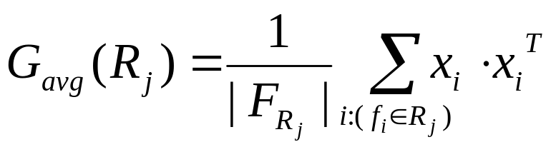
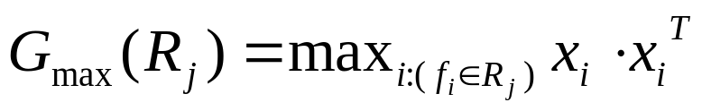
O2P - Second Order Pooling
Second order statistical operations using outer product
  Second-order average-pooling
  Second-order max-pooling

Slide 10
O2P – Non-linear operations
Log-Euclidean Tangent Space Mapping
  Second-order average-pooling generates a symmetric positive definite (SPD) matrix
  SPDs form a Riemmanian manifold, a non-Euclidean space
  Using the Schurr-Parlett algorithm we can map the result to an Euclidean tangent space
  Doing so allows us to use linear classifiers

Slide 11
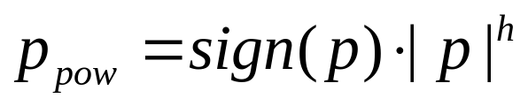
O2P - Non-linear operations
Power Normalization
  Linear classifier have been shown to match well with non-sparse features
  Power normalization can be used to reduce sparsity by increasing small feature values and saturating large feature values
  Power normalization:
  Final descriptor is obtained by concatenating the elements of the upper triangle of G, since it’s symmetric

Slide 12
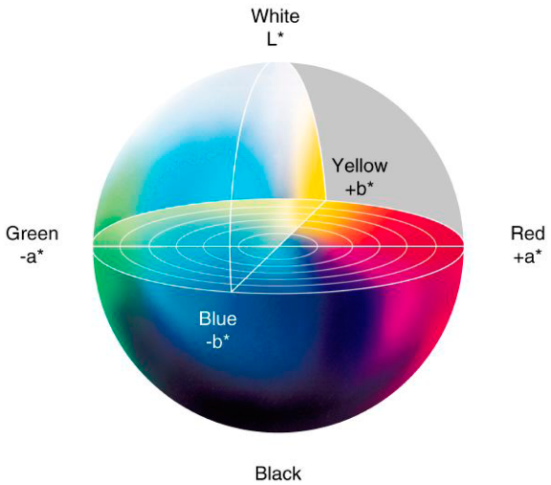
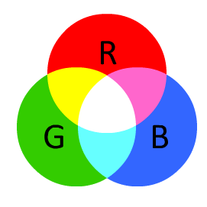
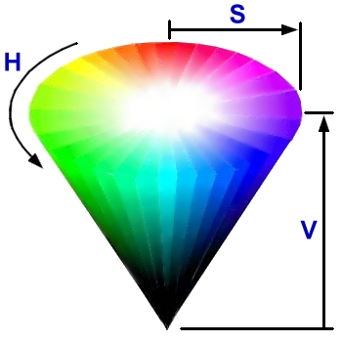
O2P-Local Feature Enrichment
Good Performance-SIFT
Enrich local descriptors:
  By using relative coordinates within regions and additional raw information
  By adding RGB, HSV and LAB
Notes:
Performance: (without any coding). This may be due to the fact that, with this type of pooling, information between all interacting pairs of descriptor dimensions is preserved.
By using relative coordinates: Let the width of the bounding box of region Rj be denoted by wj , its height by hj and the coordinates of its upper left corner
be [bjx; bjy]. We then encode the position of di within Rj by the 4 dimensional vector.
The total descriptor length is of 9 extra dimensions.

Slide 13
O2P-Local Feature Enrichment
Multiple local descriptors
  Three local descriptors are used:
    SIFT
    MSIFT
    LBP
  The SIFT descriptors have a total of 143 dimensions
Notes:
We pool the enriched SIFT local descriptors over the foreground of each region (eSIFT-F) and separately over
the background (eSIFT-G). The normalized coordinates used with eSIFT-G are computed with respect to the full-image coordinate frame, making them inde-pendent of the regions, which is more efficient.
SIFT descriptor dimensions size is 143, while the adopted local LBP descriptors [26] have 58 dimensions before and 73 dimensions after the enrichment procedure just described.

Slide 14

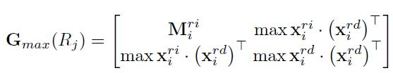
O2P-Efficient Pooling over Free-Form Regions
Two ways to speed up the pooling:
  Caching over Region Intersections
    Computation of :
    Two level hierarchical strategy
  Favorable Region Complements
    Speed-up impact
    Desired matrix
Notes:
The elements of local descriptors that depend on the spatial extent of regions must be computed independently for
each region Rj , so it will prove useful to dene the decomposition x = [xri; xrd] where xri represents those elements of x that depend only on image information, and xrd represents those that also depend on Rj .
Catching over regions intersections: The general idea is to cache intermediate results obtained in areas of the image that are shared by multiple regions. We implement this idea in two steps. First we reconstruct the regions in R by sets of ne-grained superpixels. Then each region Rj will require as many sum/max operations as the number of superpixels it is composed of, which can be orders of magnitude smaller than the number of local features contained inside it.
Favorable Region Complements. Average pooling allows for one more speed-up by using Σi xrii , the sum over the whole image, and by taking advantage of favorable region complements. Given each region Rj , we determine whether there are more superpixels inside or outside Rj . We sum inside Rj if there are fewer superpixels inside, or sum outside Rj and subtract from the precomputed sum over the whole image, if there are fewer superpixels outside Rj . This additional speed-up has a noticeable impact for pooling over very large portions of the image, typical in feature eSIFT-G

Slide 15
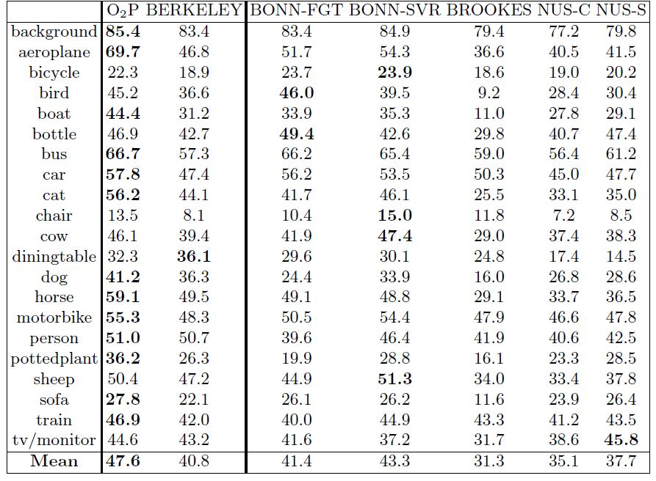
O2P-Results
TABLE 1-Semantic Segmentation Results on VOC 2011 test set
Notes:
The proposed methodology, O2P in the table, compares favorably to the 2011 challenge. Being signicantly faster to train and test, due to the use of linear models instead of non-linear kernel-based models. It is the most accurate method on 13 classes, as well as on average.

Slide 16
Girshick
Definition
Go over the main step of the algorithm
It is good for something something

Slide 17
Torr
Definition
Go over the main step of the algorithm
It is good for something something

Slide 18
Concoolsions-PUT A COOL NAME

Slide 19
References
Carreira, Joao, et al. "Semantic segmentation with second-order pooling."Computer Vision–ECCV 2012. Springer Berlin Heidelberg, 2012. 430-443.
Zheng, Shuai, et al. "Conditional random fields as recurrent neural networks."Proceedings of the IEEE International Conference on Computer Vision. 2015.
Girshick, Ross, et al. "Rich feature hierarchies for accurate object detection and semantic segmentation." Proceedings of the IEEE conference on computer vision and pattern recognition. 2014.

