Slide 1
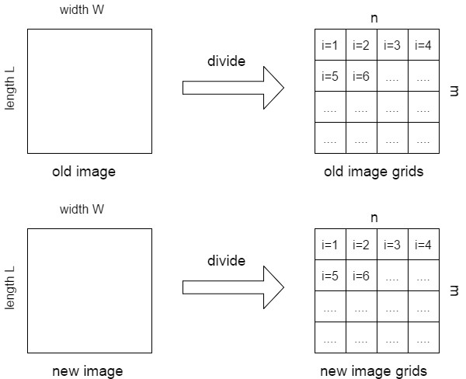
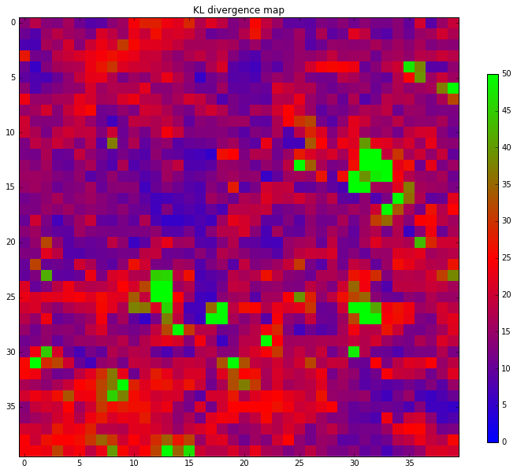

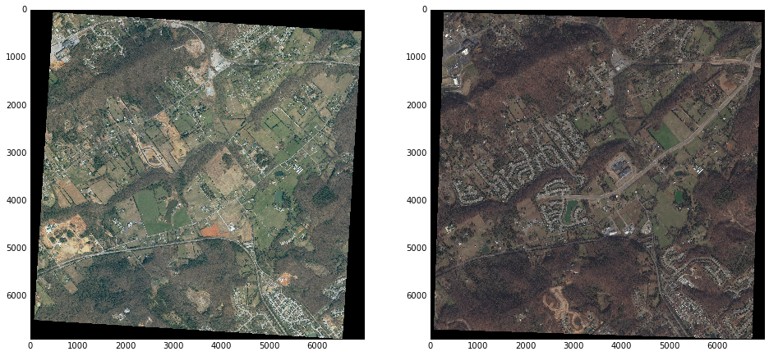
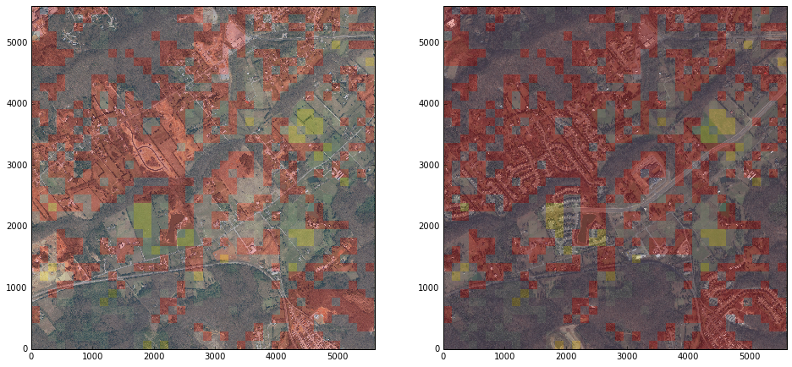

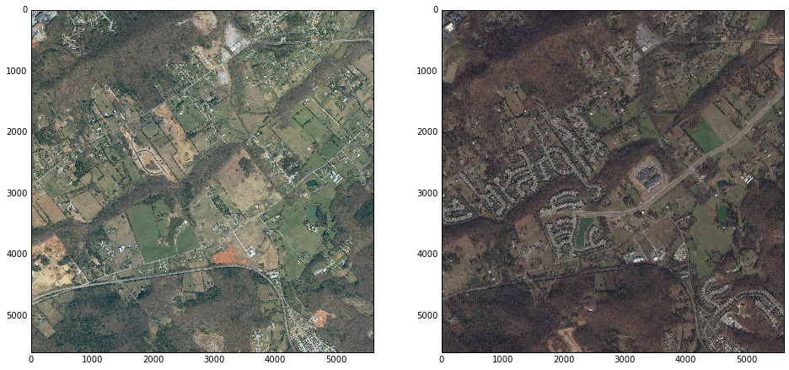
Change Detection For High-Resolution Satellite
Images By Using Gaussian Mixture Model
Department of Computer Science
Shijie Li, Tianpei Xia, Jingjuan Deng, Zhiren Lu, Zifan Nan, Rui Liu
North Carolina State University
1. Introduction
5. Parameter choices
In modern times, human civilization’s settlement landscapes and patterns are changing rapidly because of the growth of human population, acceleration of urbanization and the application of varied technologies. Keep detecting and assessing these changes and mastering the accurate information are quite important for civilized human development. High resolution images provided by satellites are good resource to use to identify and quantify landscapes changes. We explore a detection method to identify landscape changes using high resolution satellite images. This grid based method is helpful in Bi-temporal change detection. By given two satellite images from the same area, it can identify changes accurately.
3. Methodology
To divide the image into grids, we need to choose the right size of grids. The size of grids determines the quality and computational cost of the algorithm. It should not be too large since that may result in poor change detection: larger grids may contain more than a single object, therefore the Gaussian distribution fitted to the grid may not have a single peak. On the other hand, the time costs of computation will drastically reduce with increases in grid size. If the grid size is too small it would increase the computational cost, and may also cause model parameter estimation and matrix inversion problems. In our experiment, after testing a set of different sample size, we use 50 pixel as the grid size since it has good overall result.
We model the image data into grids. Given two satellite images (one old and one new) which describe exactly the same land area, we divide these two images into two square grid clusters. The grids have the same size and each image has the same number of grids.
After dividing images into the grids properly, we convert all of these grids into their relative Gaussian distributions.
2. Data description
We compute the Kullback–Leibler(KL) divergence between each pair of Gaussian distributions, then we can create a matrix map of KL divergence distance:
6. Conclusions
The original data are two high resolution satellite images about the same area with some artificial and natural objects from different time. Inside the images, there are some changes between older and newer ones.
Before implementing our method to the data, we need to do a pre-processing procedure. After executing some rotation and crop steps, these two images will be ready to use.
In our project, we presented a GMM based change detection method for satellite images. Our method can detect a quite part of artificial changes between different high resolution images data, although to some extent, it still has some inaccuracy issues about detecting changing details.
It’s always a very challenging task to keep improving the performance for some new technologies. However, we believe this method will have good prospects for further research.
Using this KL divergence matrix, we model the DKL map into Gaussian Mixture Model, then we can apply this clustering model to categorize the changes on KL divergence map, plot the change map to detect changes.
4. Results
To compare the changes between two images, we overlaid this GMM change cluster map onto the original satellite maps. the red and green rectangle grids suggest the areas has relatively greater changes, all other parts are the areas that basically remain the same.
7. References
[1] Vatsavai, R. Graesser, J. 2012. “Probabilistic Change Detection Framework for Analyzing Settlement Dynamics Using Very High-resolution Satellite Imagery. ICCS: 907-916.
[2] Hershey, John R., and Peder A. Olsen. "Approximating the Kullback Leibler divergence between Gaussian mixture models." 2007 IEEE International Conference on Acoustics, Speech and Signal Processing-ICASSP'07. Vol. 4. IEEE, 2007.
Github Link:
https://github.ncsu.edu/sli41/CSC522_Project

