Slide 1
Bootcamp on FastAPI
- Muthu Kumaran R

Slide 2

Introduction

Slide 3
StepUp Python
Decorator
Typing
Pydantic
Generator
Lambda function

Slide 4
API
Application Programmable interface

Slide 5
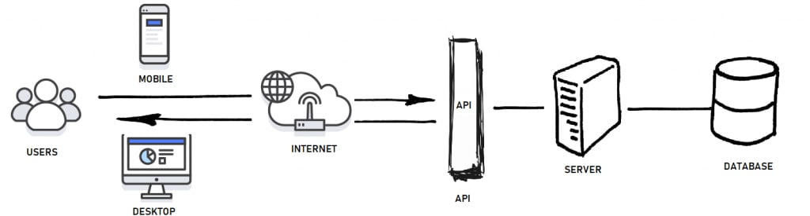
HTTP API
API for web applications/servers

Slide 6
RESTFul API
Architectural Style for HTTP API – combination of HTTP methods & endpoint structure. Below is a sample on how we structure the API
For creating an item,
POST /api/item
For checking an item,
GET /api/item/{id}

Slide 7
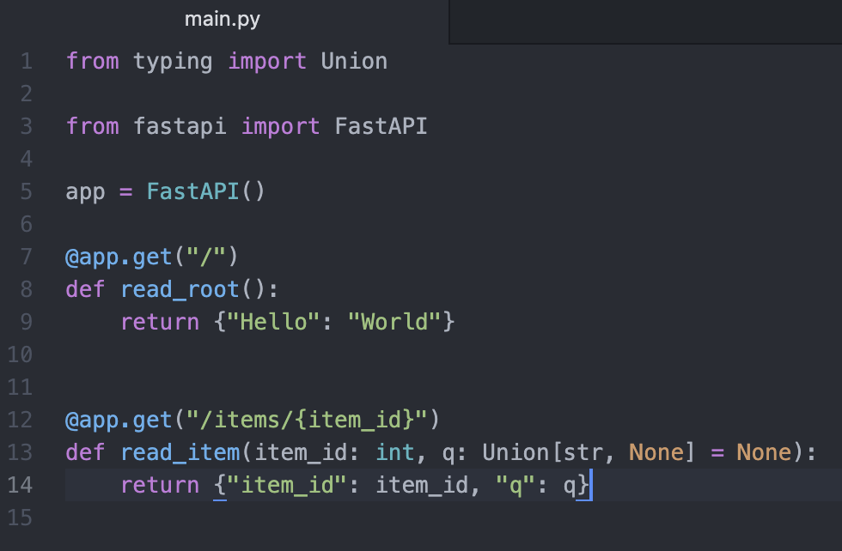
FastAPI
$ pip install pipenv
- Installs env based Package manager
$ pipenv --python 3.10.4
- Creates a virtual environment for our work with python version 3.10.4
$ pipenv install fastapi uvicorn sqlalchemy pydantic
- Installs the necessities into the virtual env
Write the given program to `main.py` file
$ pipenv run uvicorn main:app

Slide 8
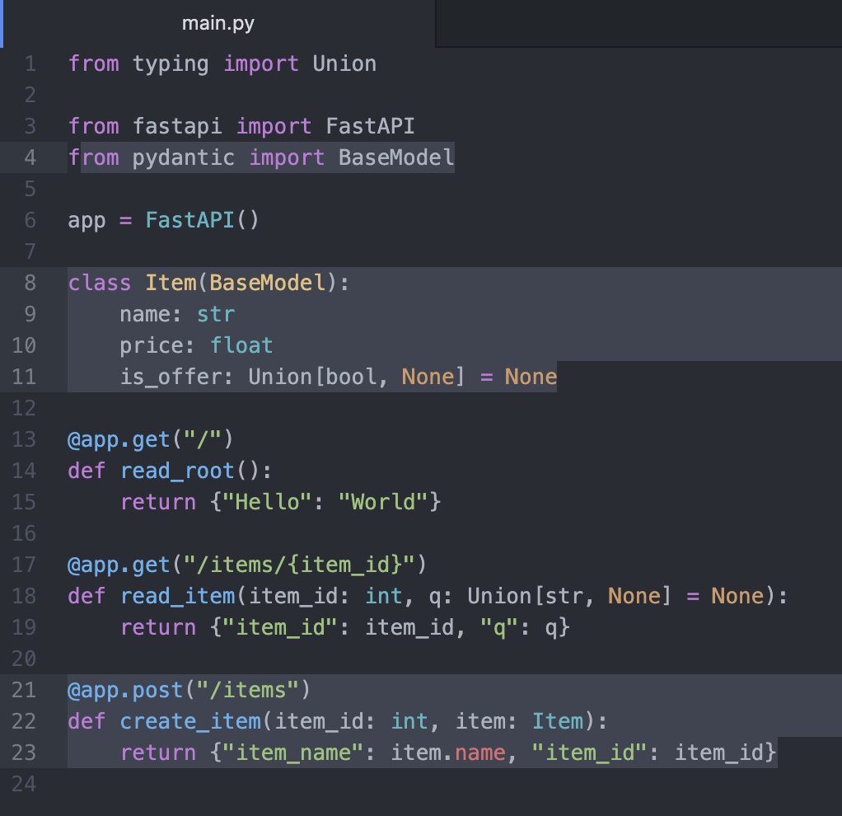
Extending FastAPI with Pydantic

Slide 9

BrainStroming

Slide 10
URL Shortener

Slide 11
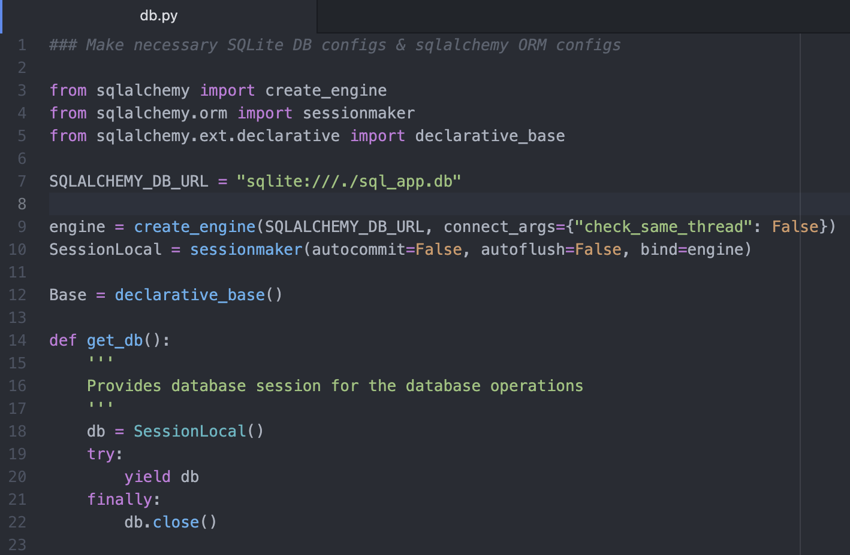
DB Setup

Slide 12
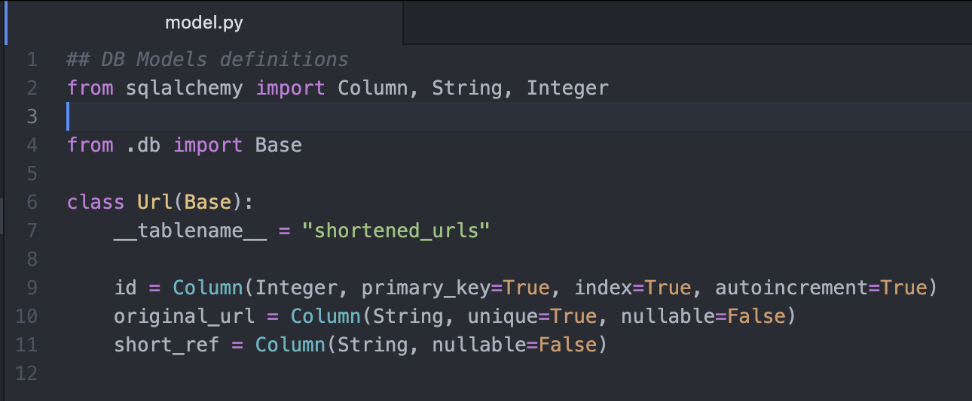
Model & Schema Setup

Slide 13
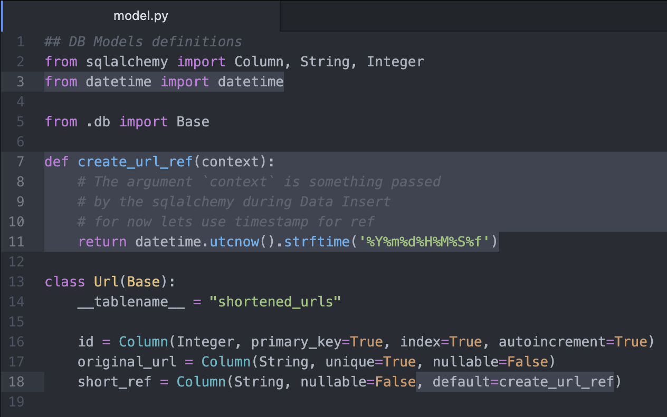
Model Adjustment

Slide 14
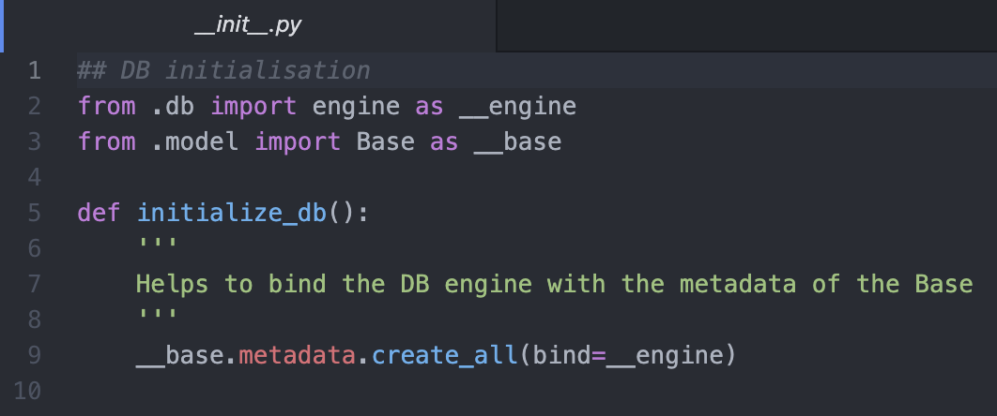
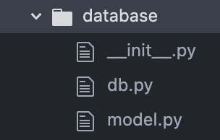
Grouping DB & Models

Slide 15
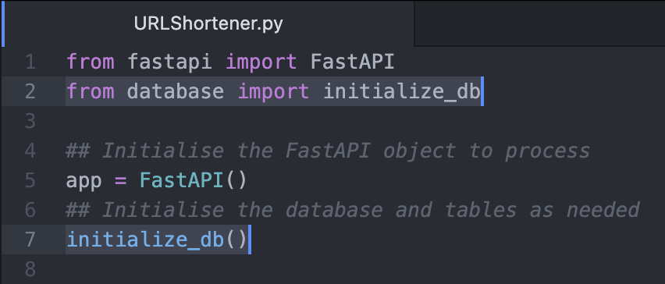
Initialize DB from main

Slide 16
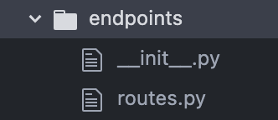
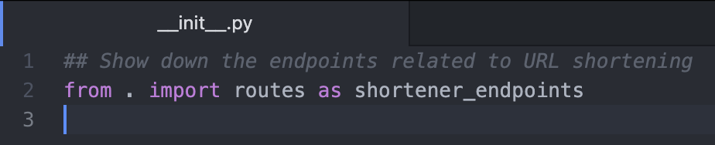
Modularize Endpoints

Slide 17
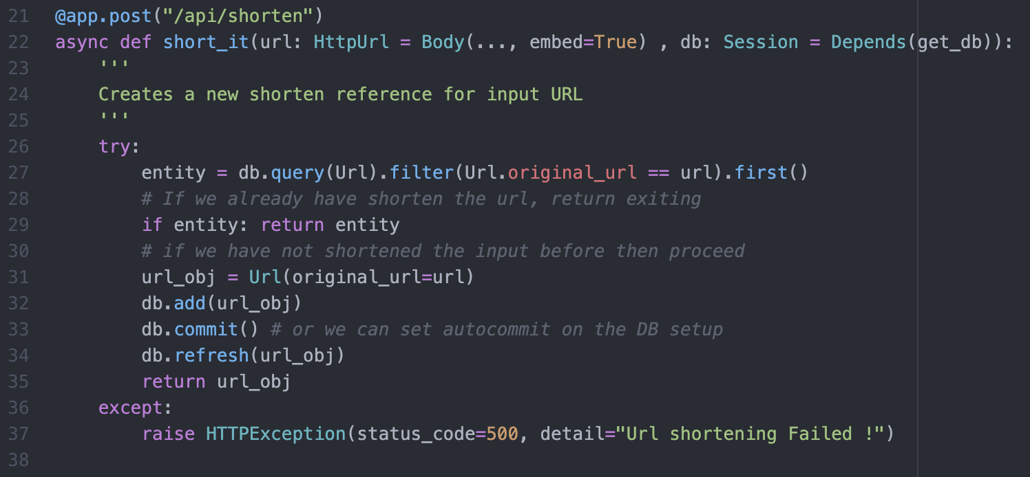
Routes Setup – Short reference creation
Notes:
Query single item from Table in Database
→ db.query(<table model object>).filter(<condition needed for filter>).first()
Query all items from Table in Database
→ db.query(<table model object>).filter(<condition needed for filter>).all()
Insert into Table in Database
→ db.add(<Table model object>)
Delete from Table in Database
→ db.delete(<Table model object>)
Commit Changes happened on Database
→ db.commit()
Refresh <table model object>
→ db.refresh(<table model object>)

Slide 18
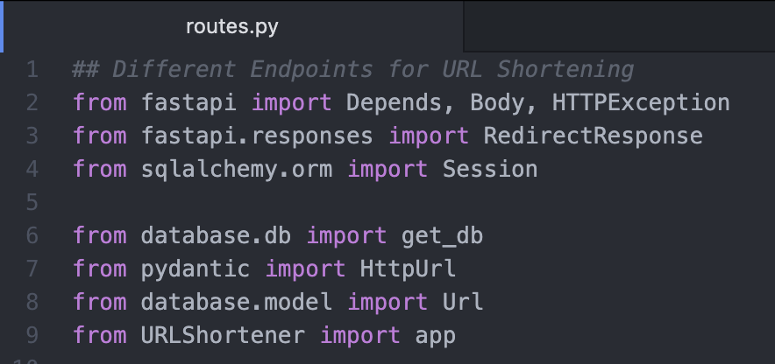
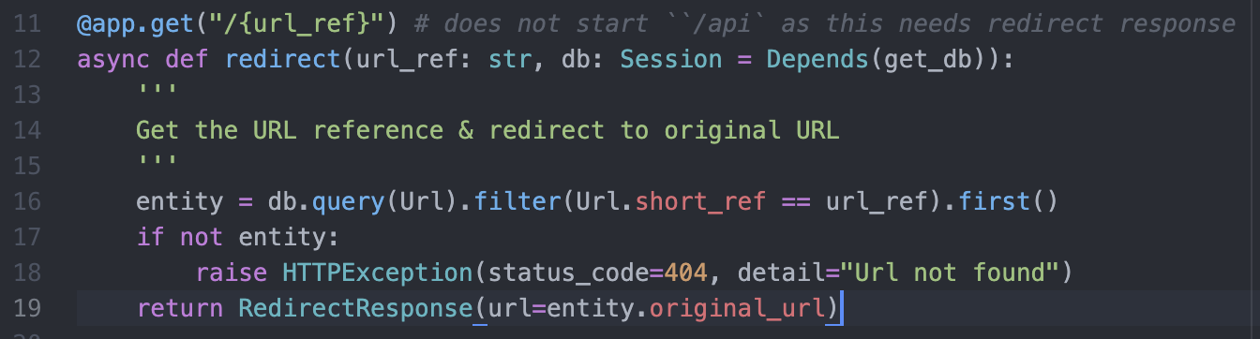
Routes Setup – navigate via short url

Slide 19
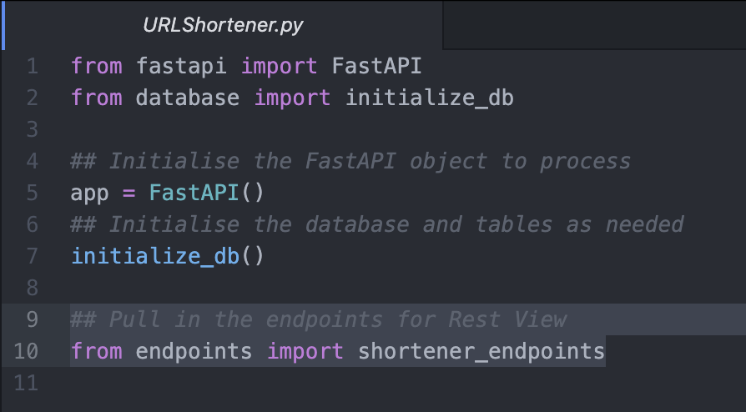
Initialize Endpoints from main

Slide 20
Improvements
Add uniqueness to short ref URL
Add more routes
To delete any shorten URL entry
To get all existing URL entries

Slide 21
Thank You !
LinkedIn: https://www.linkedin.com/in/muthu-kumaran-r
Github: https://github.com/RSMuthu
Email: rsmuthu@duck.com / muthukumaranr95@gmail.com

