Slide 1
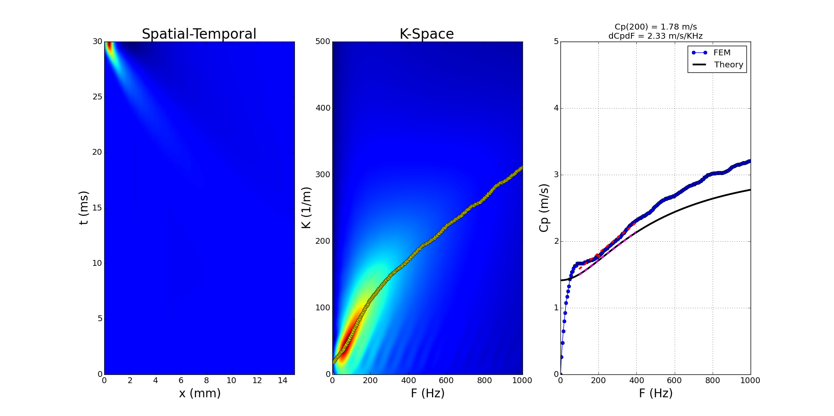
G010kPa_GI2kPa_BETA6667_res_sim

Slide 2
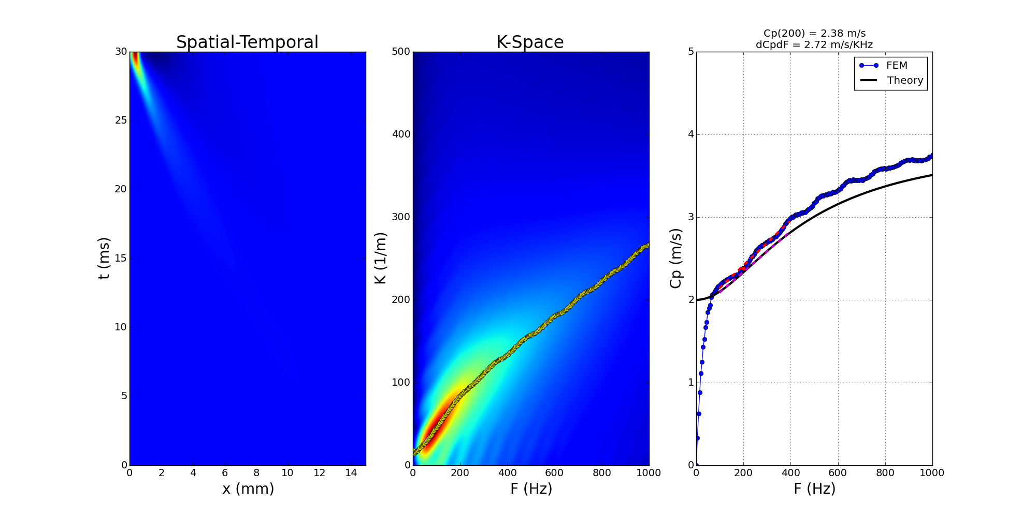
G015kPa_GI4kPa_BETA5500_res_sim

Slide 3
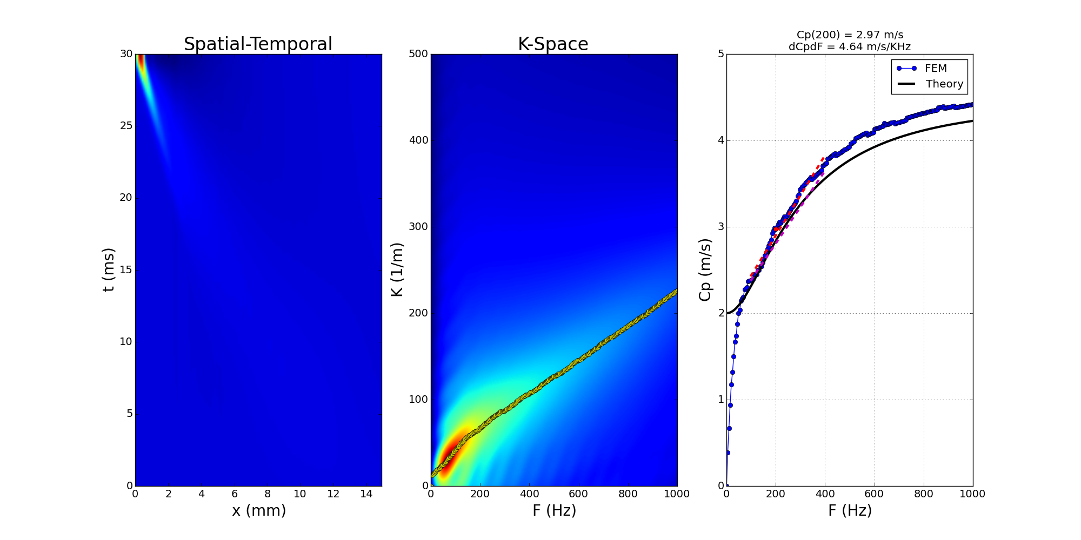
G020kPa_GI4kPa_BETA4000_res_sim

Slide 4
Summary
Data Set | C(200) |  | dC/dF (*)
 | FEM | Theory | FEM | Theory
G010kPa_GI2kPa_BETA6667_res_sim | 1.78 | 1.71 | 2.33 | 2.16
G015kPa_GI4kPa_BETA5500_res_sim | 2.38 | 2.33 | 2.72 | 2.47
G020kPa_GI4kPa_BETA4000_res_sim | 2.97 | 2.84 | 4.64 | 4.21
* dC/dF are calculated based on a linear regression between 100-400 Hz

