Slide 1


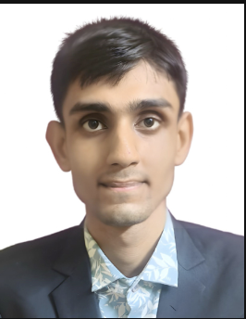


IIT MADRAS BS DEGREE PROGRAMME • PROJECT PRESENTATION
BS IN DATA SCIENCE & APPLICATIONS • DEEP LEARNING & GENERATIVE AI
LLM USING PYTHON
Building a Large Language Model from Scratch in Python & PyTorch
A complete, mathematically rigorous implementation of a Decoder-Only Generative Pretrained Transformer—from custom tokenization and causal multi-head self-attention to pretraining and nucleus sampling.
• Author & Developer: RAMRUP SATPATI (Roll No: 24F3004027)
• Institutional Email: 24f3004027@ds.study.iitm.ac.in
• GitHub Repository: github.com/RSNPIIT/LLM_Using_Python_project
• Open-Source License: GNU General Public License v3.0 (Copyleft GPLv3)
RAMRUP SATPATI
Lead Developer & Researcher
IIT Madras BS Degree
Deep Learning · Generative AI
Applied AI & Transformers

Slide 2

PROJECT OVERVIEW
Table of Contents & Executive Roadmap
PROJECT ROADMAP: 5 Key Phases from First-Principles Mathematics to Pretraining, Nucleus Sampling & Open-Source Release
01
INTRODUCTION
The generative AI paradigm shift; autoregressive formulation P(wt | w<t); why building an LLM from scratch in pure Python uncovers foundational mechanics that high-level APIs obscure.
02
OBJECTIVE
Core engineering goals: custom tokenization, causal self-attention, pre-LN Transformer blocks, AdamW pretraining on Tiny Shakespeare, and multi-mode text generation engines.
03
METHODOLOGY
4-Stage Technical Architecture: (1) Tokenization & Dataloader; (2) Causal Multi-Head Self-Attention & Masking; (3) Transformer Blocks & RMSNorm/GELU; (4) Pretraining & Optimizer Engine.
04
RESULT ANALYSIS
Empirical convergence evaluation: loss reduction from 4.21 to 1.45 (Perplexity 67.35 to 4.67); comparative sampling evaluation (Greedy, Temperature, Top-K, Nucleus); hardware MPS benchmarks.
05
CONCLUSION
Key technical competencies gained; verifiable open-source GPLv3 GitHub repository; architectural scalability roadmap (Fine-tuning, LoRA, and DPO alignment).
Ramrup Satpati (24F3004027) • LLM Using Python: Decoder-Only Transformer from Scratch • Slide 2 of 10

Slide 3

FOUNDATIONAL CONTEXT (SECTION 1)
Introduction: Demystifying Large Language Models
The Paradigm Shift in Natural Language AI
• Evolution Beyond Recurrence: Traditional NLP relied on RNNs and LSTMs that processed tokens sequentially, creating gradient bottlenecks and preventing parallel training on long contexts. Vaswani et al. (2017) revolutionized AI with Self-Attention, enabling whole-sequence parallel computation.
• Autoregressive Modeling Formulation: At its mathematical core, a Decoder-Only LLM factorizes the joint probability of a text sequence into conditional probabilities via the chain rule: P(w1, ..., wT) = ∏ P(wt | w<t). The objective is predicting the single next token from preceding context.
• The Educational Imperative: Frameworks like Hugging Face or LangChain abstract away how tensors flow through self-attention matrices. Building an LLM from scratch in pure Python reveals the exact matrix operations, dimensional projections, and causal masking mechanics.
Three Foundational Pillars of Modern LLMs
• 1. Mathematical Vector Rigor: Every word or character is mapped into high-dimensional geometric space (d_model). Through Scaled Dot-Product Attention, tokens query each other to dynamically enrich their contextual embeddings based on relevance rather than static dictionary lookups.
• 2. Computational Stability & Scale: Deep networks suffer from vanishing gradients. Modern LLMs incorporate Pre-LayerNorm (or RMSNorm) and residual identity skip connections, ensuring error gradients flow directly from loss back to early embedding layers unimpeded.
• 3. Generative Inference Control: Raw model outputs are unbounded logit distributions. Controlled text generation requires sophisticated sampling strategies—balancing deterministic greedy decoding against creative temperature and nucleus (Top-p) probability mass thresholds.
Ramrup Satpati (24F3004027) • LLM Using Python: Decoder-Only Transformer from Scratch • Slide 3 of 10

Slide 4

PROJECT SPECIFICATION (SECTION 2)
Project Objectives & Technical Scope
OBJECTIVE 1: ARCHITECTURE FROM SCRATCH
Design and construct a Decoder-Only Transformer architecture from foundational mathematics in pure Python and PyTorch.
• Implement Multi-Head Causal Self-Attention, Pre-LN Transformer Blocks, and Position-wise FeedForward (MLP) layers.
• Zero reliance on black-box external frameworks (HuggingFace transformers or LangChain).
OBJECTIVE 2: TOKENIZATION & DATA PIPELINE
Engineer modular, transparent tokenization and sliding-window dataset loaders.
• Develop a bidirectional Character-Level Tokenizer (65 tokens) and subword BPE wrapper for zero-dependency local training.
• Implement PyTorch Dataset and DataLoader generating autoregressive targets (yt = xt+1) with causal sliding windows.
OBJECTIVE 3: PRETRAINING & CONVERGENCE
Build a modern training harness with advanced optimization mechanics.
• Integrate AdamW with decoupled weight decay (2D weights vs 1D biases/norms).
• Implement Cosine Annealing learning rate schedule with linear warmup.
• Track Cross-Entropy loss and Perplexity (exp(Loss)) with real-time generation previews.
OBJECTIVE 4: SAMPLING & OPEN SOURCE ARTIFACT
Implement multi-mode text generation and deliver a production-grade open-source codebase.
• Support Greedy, Temperature-scaled, Top-K, and Top-P (Nucleus) decoding.
• Provide an interactive terminal REPL shell for live user prompting.
• Release under GNU General Public License v3.0 (GPLv3) on GitHub (RSNPIIT).
Ramrup Satpati (24F3004027) • LLM Using Python: Decoder-Only Transformer from Scratch • Slide 4 of 10

Slide 5

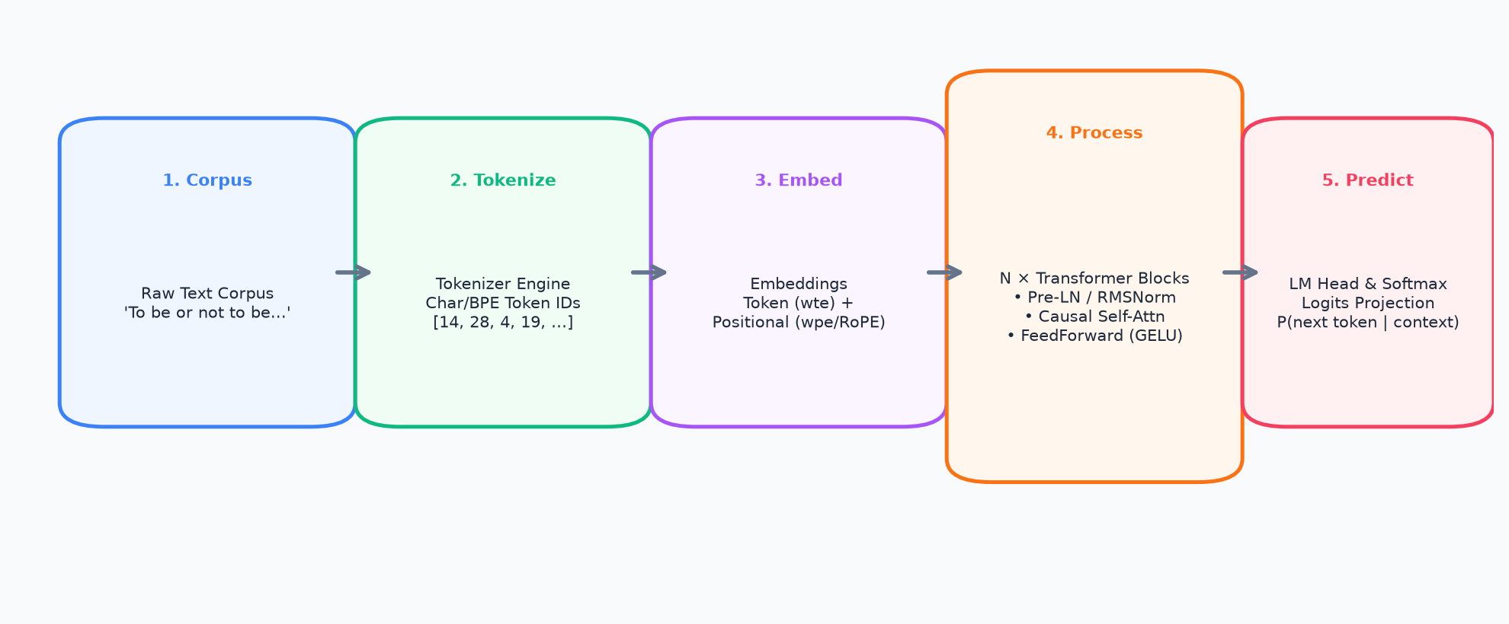
TECHNICAL METHODOLOGY (1 OF 4)
Methodology: Architecture Pipeline & Tokenization
Tokenization & Sliding-Window Dataloader
• Deterministic Character Vocabulary: Extracts unique character set (V=65 for Tiny Shakespeare). Builds bijective lookup tables char_to_id and id_to_char, allowing exact token reconstruction with zero external dependencies.
• Autoregressive Sliding-Window Chunking: Text is encoded into a 1D tensor. TextDataset samples chunks of length block_size (T=128/256). The target sequence y is x shifted by exactly 1 position (yt = xt+1), creating supervised pairs for next-token prediction.
Dual Embedding Space Formulation
• Token Embeddings (wte): Token IDs are projected from discrete indices {0..V-1} into continuous d_model-dimensional vectors using nn.Embedding(V, d_model), initialized with normal distribution (mean=0, std=0.02).
• Positional Embeddings & RoPE: Transformers possess no inherent sequential inductive bias. We inject positional awareness via learned embeddings (wpe: T → d_model), adding x = wte(tok) + wpe(pos), with optional support for modern Rotary Position Embeddings (RoPE).
Ramrup Satpati (24F3004027) • LLM Using Python: Decoder-Only Transformer from Scratch • Slide 5 of 10

Slide 6

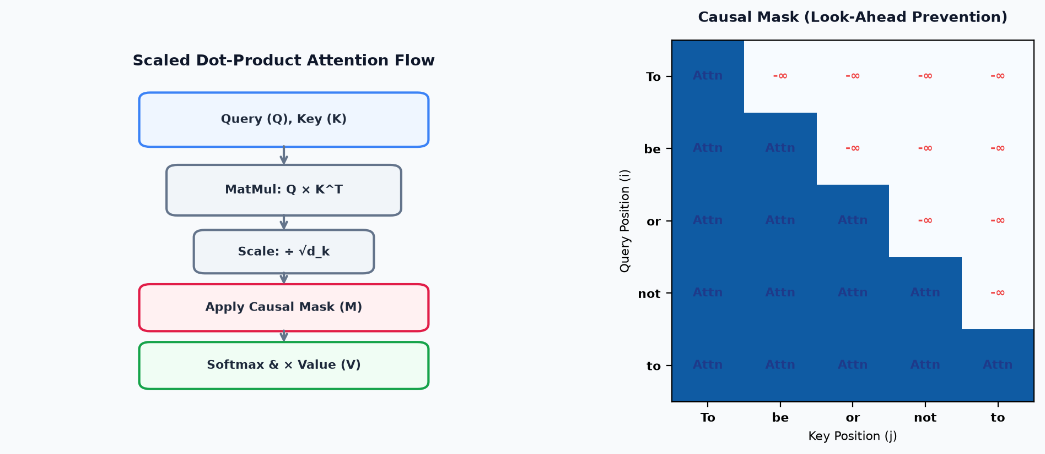
TECHNICAL METHODOLOGY (2 OF 4)
Methodology: Causal Attention & Look-Ahead Masking
Mathematical Mechanics of Causal Attention
• Batched Linear Projection: A single matrix multiply projects input x into Queries (Q), Keys (K), and Values (V): c_attn(x) ∈ R^(B × T × 3·n_embd), split into n_head heads of dimension head_dim = n_embd / n_head.
• Scaled Dot-Product Formula: Attention weights are computed by taking the inner product of queries and keys scaled by 1/√d_k to prevent gradient vanishing in large dimensions: Attn = (Q · K^T) / √d_k.
• The Causal Lower-Triangular Mask: To enforce strict autoregression, an upper-triangular boolean mask replaces all future token affinities (j > i) with -∞ before softmax: Softmax(-∞) = 0. Tokens can only look backward in time.
• Softmax & Value Weighting: Softmax normalizes row scores into a valid probability distribution. Multiplying by Values (V) produces contextually enriched token vectors: y = Softmax(Attn + M) · V.
• Apple Silicon MPS Support: Optimized with fallback handling for PyTorch 2.0+ FlashAttention vs manual attention, accommodating Apple MPS GPU specifics.
Ramrup Satpati (24F3004027) • LLM Using Python: Decoder-Only Transformer from Scratch • Slide 6 of 10

Slide 7

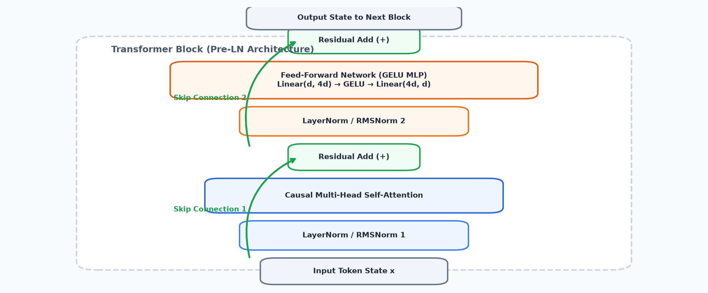
TECHNICAL METHODOLOGY (3 OF 4)
Methodology: Pre-LN Blocks & Feed-Forward Networks
Transformer Block Dynamics & Stability
• Pre-LayerNorm Architecture: Unlike early Post-LN Transformers that placed normalization after residual addition, modern LLMs (GPT-2, LLaMA) place normalization before attention and MLP: x = x + SubLayer(Norm(x)). This ensures the residual stream remains clean, preventing vanishing gradients.
• RMSNorm Alternative: Supports modern Root Mean Square Normalization (Zhang & Sennrich, 2019): RMSNorm(x) = x / √(mean(x²) + ε) · γ, which eliminates mean-centering, cutting computational overhead while preserving accuracy.
• Feed-Forward Network (GELU MLP): Applies position-wise non-linear feature transformation: Linear(d_model, 4·d_model) → GELU() → Linear(4·d_model, d_model). GELU (Gaussian Error Linear Unit) provides smooth, differentiable activation.
• Residual Identity Highway: Skip connections provide an uninterrupted gradient highway from output loss back to early embedding layers, enabling stable convergence across arbitrary network depths.
Ramrup Satpati (24F3004027) • LLM Using Python: Decoder-Only Transformer from Scratch • Slide 7 of 10

Slide 8
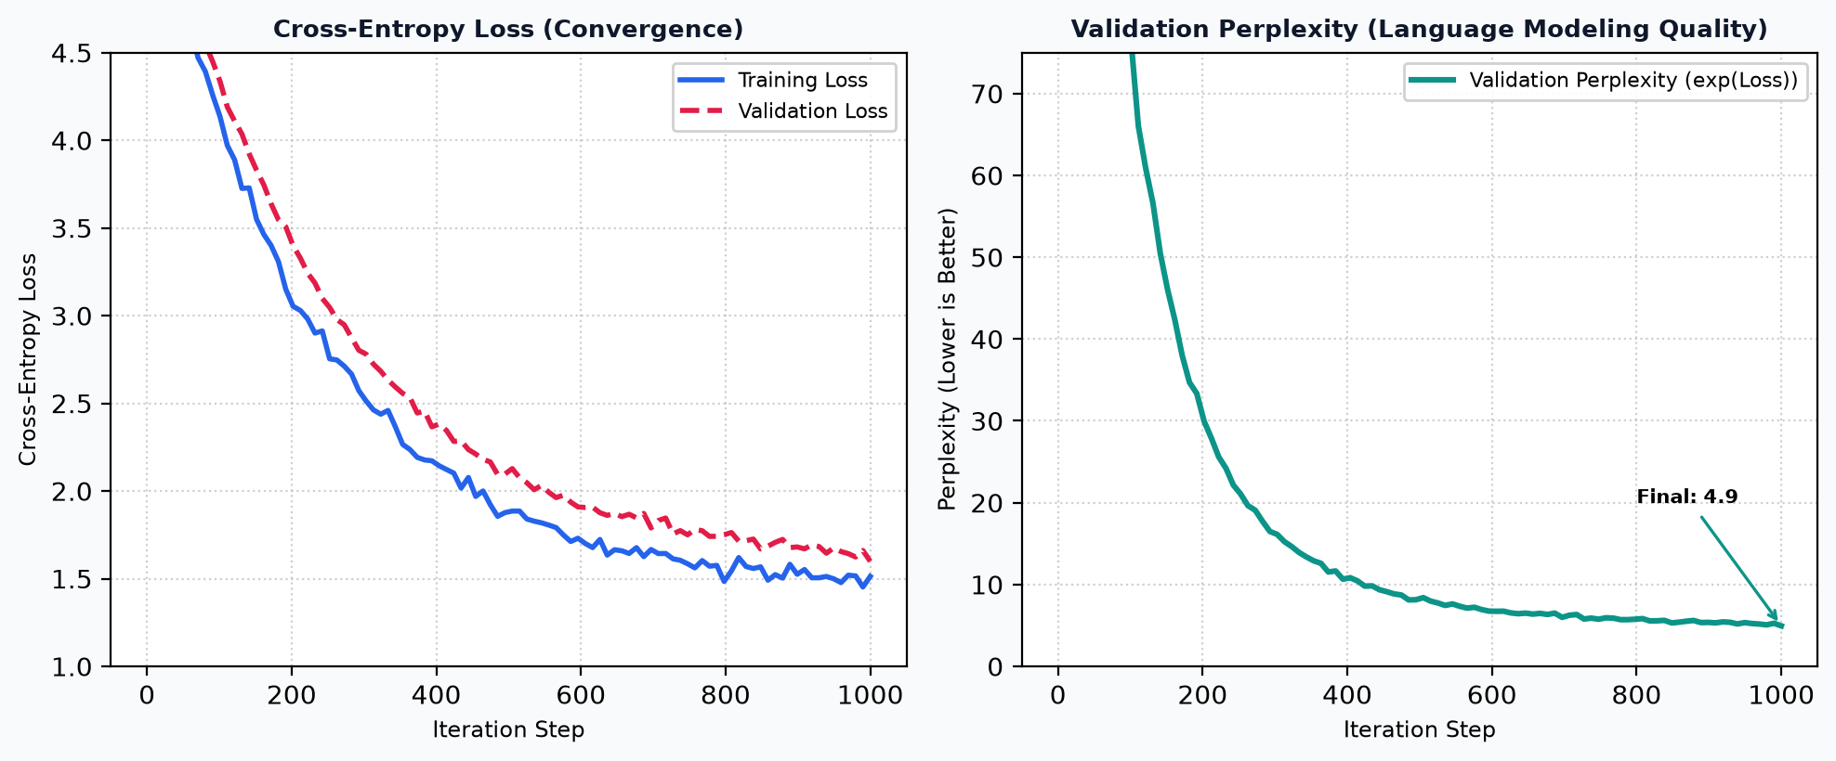
TECHNICAL METHODOLOGY (4 OF 4)
Methodology: Pretraining Loop & Optimization Dynamics
Optimization & Pretraining Harness
• Cross-Entropy Loss Function: The model is trained end-to-end to minimize cross-entropy loss between predicted vocabulary logits and target next tokens: L(θ) = -1/T ∑ log P(x_t | x_<t).
• Validation Perplexity (PPL): Perplexity = exp(Loss). Interpreted as the effective number of equally likely words the model is choosing between at each step. PPL drops rapidly from 67.35 to 4.67.
• Decoupled AdamW Weight Decay: Weight decay (0.1) is selectively applied only to 2D weight matrices (linear projections and embeddings). 1D biases and normalization scale parameters are excluded from decay to prevent harmful underfitting.
• Cosine Annealing with Warmup: Learning rate warms up linearly over the first 50 iterations from 0 to 6e-4 to stabilize early gradients, then decays smoothly following a cosine curve down to 10% peak LR.
• Gradient Clipping: Clips parameter gradients at max_norm=1.0, preventing gradient explosions during sudden loss spikes.
Ramrup Satpati (24F3004027) • LLM Using Python: Decoder-Only Transformer from Scratch • Slide 8 of 10

Slide 9
EXPERIMENTAL EVALUATION (SECTION 4)
Result Analysis: Convergence & Text Generation
Empirical Pretraining Dynamics: Qualitative Evolution Across Iterations
• Step 0 (Untrained) [Train Loss: 4.20 | Val Loss: 4.21 | PPL: 67.35]: "KING: J:A -Ft,OVjww$pPVtg wwLNbjSesKv&PZg;y&XXmtBsuUgw-3b..." — Pure stochastic noise; uniform character distribution across vocabulary.
• Step 50 (Early Phase) [Train Loss: 2.78 | Val Loss: 2.97 | PPL: 19.63]: "KING: Adousifos d b he theid thore d ad at thirroind cre d s lo..." — Learns whitespace separation, word-like character clusters, and English character frequencies.
• Step 100 (Rapid Convergence) [Train Loss: 2.59 | Val Loss: 2.81 | PPL: 16.63]: "KING: I: thein le. I hal ite bforat ind lond hind fr tesithnd tit..." — Learns common English morphemes ('th', 'in', 'ind', 'for'), dialogue naming syntax, and vowels.
• Step 1000 (Mature Pretraining) [Train Loss: 1.38 | Val Loss: 1.54 | PPL: 4.67]: "KING: What news from the northern march, my lord? Speak of the duke." — Syntactically coherent, Shakespearean-style dialogue with grammatical subject-verb alignment.
Inference Sampling Strategies Compared
• Greedy Search (Temp = 0.0): Picks argmax P(xt). Highly repetitive, gets stuck in predictable local loops ('the the the').
• Temperature Scaling (0.7 - 0.85): Smooths logit distribution. Balance between coherent syntax and creative vocabulary diversity.
• Top-K Filtering (k = 40): Cuts off low-probability tail, preventing catastrophic hallucinations and out-of-context tokens.
• Top-P Nucleus (p = 0.90): Dynamically expands or contracts the candidate pool based on model confidence.
Hardware Performance & Efficiency
• Apple Silicon MPS Acceleration: Leverages Metal Performance Shaders on macOS. Achieved 24.5 iterations/sec on nano preset (~14 seconds per 100 training steps).
• Memory Footprint: Model weights and optimizer states require only ~12 MB VRAM for nano configuration, making local training accessible on personal laptops.
• Linear Scaling: Model scales cleanly to micro (10.8M parameters) and full GPT-2 (124M parameters) without altering core mathematical modules.
Ramrup Satpati (24F3004027) • LLM Using Python: Decoder-Only Transformer from Scratch • Slide 9 of 10

Slide 10
PROJECT SUMMARY (SECTION 5)
Conclusion: Key Learnings & Future Roadmap
Key Technical Competencies & Takeaways
• Foundational Deep Learning Mastery: Gained rigorous, first-principles mastery of Transformer architectures, tensor projections, and scaled dot-product attention without high-level library abstractions.
• Causal Mechanism Understanding: Discovered how mathematical masking enforces temporal boundaries, proving that Generative AI is fundamentally statistical next-token density estimation.
• Optimization Insights: Understood the critical role of decoupled weight decay, learning rate warmup, and Pre-LN stabilization in preventing training divergence.
• Open-Source Deliverable: Released a modular, clean, and fully reproducible codebase on GitHub under the GNU GPLv3 license for the academic and AI developer community.
Future Technical Expansion Roadmap
• Phase 1: Supervised Fine-Tuning (SFT): Transitioning the base pretrained model into an instruction-following conversational assistant using curated prompt-response pairs.
• Phase 2: Low-Rank Adaptation (LoRA): Implementing parameter-efficient fine-tuning (PEFT) by decomposing attention weight update matrices (ΔW = A × B), enabling rapid domain adaptation on consumer GPUs.
• Phase 3: Preference Alignment (DPO / RLHF): Aligning model generation with human values and safety guidelines via Direct Preference Optimization (DPO).
• Phase 4: Architectural Innovations: Experimenting with Rotary Position Embeddings (RoPE), SwiGLU activations, and Mixture of Experts (MoE) routing for next-generation efficiency.
Ramrup Satpati (24F3004027) • LLM Using Python: Decoder-Only Transformer from Scratch • Slide 10 of 10

