Slide 1
SEMINAR PRESENTATION
ON
Agpest : An Efficient Rule-Based Expert System to Prevent Pest Diseases of Rice & Wheat Crops
Authors:
Kaliuday Balleda
D Satyanvesh
NVSSP Sampath
KTN Varma
P K Baruah
Presented By: RISHABH RASTOGI - 1DS12CS076
Under the Guidance of
Mrs. RASHMI S R
Asst. Professor,
Dept of Computer Science & Engineering

Slide 2
OVERVIEW
The presentation would deal with the following
Abstract
Introduction
Related Work
Proposed System
Experimental Setup and Results
Conclusion and Future Work
References

Slide 3
ABSTRACT
Diagnose diseases caused by pests in rice and wheat plants.
A new approach for knowledge representation in expert systems for agricultural domain.
Key terms used
-Expert System
-Console Base
-Explanation Block

Slide 4
INTRODUCTION
An Expert System is a computer program designed to mimic the decision-making ability of a decision-maker.
It integrates human expertise into computer processes.
Major components which form the Expert System Kernel are :
Knowledge Base
Inference Engine
Explanation Engine
User Interface

Slide 5
INTRODUCTION
Purpose of an Agriculture Expert System
Lack of knowledge about technical & scientific methods to prevent pest diseases, results in degradation of quality and quantity of major crops such as rice and wheat.
Advanced fertilizers and pest management information is provided by agricultural specialists and advisors, whose assistance is not always available when the farmer needs it.
This is illustrated by a video in the next slide.

Slide 6


Slide 7
RELATED WORK
DENDRAL – First expert system, written in LISP to benefit organic chemists.
AMRAPALIKA – Expert system for diagnosis of pests, diseases and disorders in Indian Mango, developed using ESTA.
Dr. WHEAT – Web-based expert system for diagnosis of diseases and pests in wheat, developed using e2gLite shell.

Slide 8
RELATED WORK
Crop-9-DSS - Expert system developed with macromedia flash MX professional 2004 6.0, for identification of pests diseases, with control measure, water management system, fertilizer recommendation and farm implements for leading crops of Kerala.
Web based Expert System for Diagnosis of Micro Nutrients Deficiencies in Crops, application of expert system in the area of nutrient deficiencies in crops, built using ServCLIPS tool.

Slide 9
DESIGN ANALYSIS
Uses forward chaining mechanism.
Let s1,s2.....,sn be the symptoms related to the disease d1.
The rule base is formulated as follows
If (s1) Then (s2) Else (No Match)
Same procedure is followed till sn symptoms are satisfied.

Slide 10
DESIGN ANALYSIS
Rules formulation for Rice pest-diseases.
Color division module provides plant pest visuals.
Divide pest diseases according to leaf color.
Rules formulation for Wheat pest-diseases.
Rules are fired sequentially and symptoms differ.
Knowledge representation in CLIPS 6.0
Supports rule-based, Object Oriented and procedural programming.

Slide 11
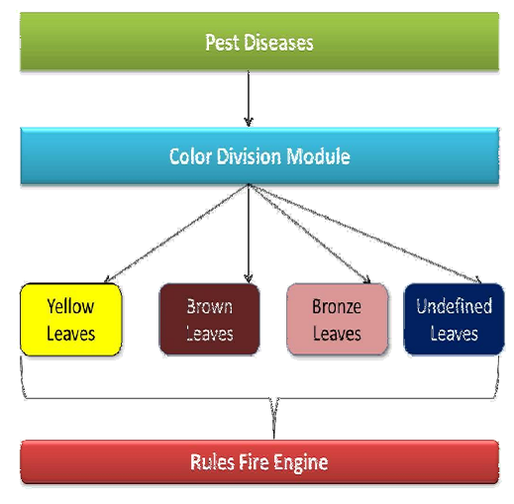
Fig. 1. Rice Pest Diseases knowledgebase classification
This diagram explains the proposed method to formulate rule base for pest disease diagnosis

Slide 12
Code module - AgPest Rice pest management.
CLIPS 6.0 CODE
C Language Integrated Production System
(defrule determine-yellow-leaves
(leaves-color yellow)
=)
(assert (fired rule1))
(printout t ”WHAT IS THE COLOR OF LESIONS”crlf)
(printout t ”OPTIONS:1.YELLOW 2.OTHER”crlf)
(bind ?leison-color (read))
(if(eq ?lesion-color 1)
then (assert (lesion-color yellow))
else(if(eq ?lesion-color 2)
then (assert (check-foot-rot))))
Construct | Purpose
defrule | To declare rules.
assert | To declare facts.
salience | A library construct to set priority of execution for rules.
bind | Values assigned to variables.

Slide 13
Pest Management Classified Diseases
RICE
WHEAT
Yellow leaves | Brown leaves | Bronze leaves | Unidentified leaves
Bacterial leaf blight | Blast Pyricularia Oryzae | Grassy stunt | Bunt kernel smut
Foot Rot | Brown spot | - | False smut
Rice Yellow dwarf | Narrow brown spot | - | -
Serial Number | Pest Disease
1. | Black Point
2. | Foot Rot
3. | Kamal Bunt
4. | Leaf Blight
5. | Leaf Rust
6. | Stem Rust

Slide 14
IMPLEMENTATION
Decision procedure for Rice Pest-Management
Decision procedure for Wheat Pest-Management
Explanation Block
Implementation of Explanation Block in CLIPS 6.0
Processes involved in the development of AgPest are
Knowledge Acquisition
Knowledge Representation
Implementation in CLIPS 6.0

Slide 15
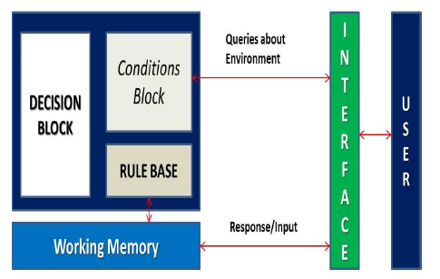
Fig. 2. Sequential flow of Execution Wheat Model
Wheat module executes the rule whose RHS field is empty. This is the starting point for execution in this module.
2. Facts are assigned during run time and are stored in working memory.
Using these facts, rules get fired.
4. Decision is displayed through the standard output.

Slide 16
EXPLANATION BLOCK
Provides user with the information about decision making and reasoning behind a particular decision.
Contains set of Cause[] Effect[] Decision[] type statements.
The rules which get fired in explanation block contains the detailed explanation about expert system decision.
These rules contains a condition statement which evaluates the users response and prints the validation of user response

Slide 17
EXPERIMENTAL SETUP
Serial code run on Intel(R) Pentium(R) Dual core 2.20 GHz processor with 4GB RAM on Ubuntu 10.04 LTS & Win 7.
Domain knowledge information is gathered from AgroWeb.
Testing and Verification of rule clusters
Two types
Local Verification Criteria
Such as missing and inconsistent rules
Perform exhaustive testing due to smaller size
Global Verification Criteria
Such as reachable and dead-end IFs
Not computationally expensive to test

Slide 18
Local Verification Criteria
Domain Constraints
All values must be consistent with the domain.
Tests input and data type for correctness.
Completeness
fire(no).dat temporary file used for communication among rules.
xpl(no).dat stores the user input for a query.
var(no) variable to assert Fact-(rule ?var(no)).
Rule’s LHS field is empty, RHS field consists of file constructs.
Main attributes to fire a rule are Initial Facts and Salience Priority.
s(rN) denotes Salience of rule N.

Slide 19
Global Verification Criteria
Tested through
Attribute Dictionary contains the definitions and sources for each condition and conclusion.
Rules Dictionary which contains conditions and conclusions used in rules, information about state and location of the AgPest.
Instantiation Criteria
Creation of outputs for all possible conditions
Domain Constraints
File constructs store temporary values, generated due to rules fired.

Slide 20
RESULTS
The decision making capability of the AgPest is correct for all possible valid inputs.
The response time for an interactive session is good.
Statistics in terms of Runtime, Rules Fired, Rules per second, Mean no of facts and Mean no of Instances for each pest disease is tabulated.

Slide 21
COMPUTATIONAL STATISTICS DURING RUNTIME
Disease | Runtime | Rules Fired | Rules per second | Mean no of facts
Bacterial leaf blight | 0.0159 | 4 | 250.0 | 12
Foot Rot | 0.0160 | 4 | 249.9 | 11
Yellow dwarf | 0.0470 | 5 | 106.38 | 15
Blast Pyricularia Oryzae | 0.014 | 4 | 266.6 | 12
Brown spot | 0.047 | 8 | 170.21 | 24
Narrow brown spot | 0.046 | 7 | 148.93 | 21
Grassy stunt | 0.0310 | 3 | 96.774 | 9
Bunt kernel smut | 0.031 | 5 | 161.29 | 15
False smut | 0.030 | 7 | 225.80 | 21
Disease | Runtime | Rules Fired | Rules per second | Mean no of facts
Black Point | 0.016 | 4 | 249.0 | 11
Foot Rot | 0.0310 | 7 | 225.86 | 20
Kamal Bunt | 0.0469 | 7 | 148.93 | 20
Leaf Blight | 0.0469 | 8 | 170.21 | 25
Leaf Rust | 0.0619 | 11 | 177.41 | 32
Stem Rust | 0.0469 | 9 | 191.48 | 26
RICE PEST MANAGEMENT MODULE
WHEAT PEST MANAGEMENT MODULE

Slide 22
CONCLUSION AND FUTURE WORK
Decision given by AgPest is consistent, accurate and complete.
Gives accurate results and has a quick response time.
A basic prototype to build expert system for pest management.
Distributed AgPest can be built, pest management information is maintained by isolated servers located at different locations.
AgPest can be parallelized for better response time.

Slide 23
REFERENCES
[1] Rajkishore Prasad A.K. Sinha Kumar Rajeev, Ranjan. Amarapalika: An expert system for diagnosis of pests, diseases, disorders in indian mango. Knowledge Based Systems, 19(1):9–21, 2006.
[2] Ahmad Farid Inam illahi fahad Shahbaz Khan Saad razzaq Kashif Irfan, Fahad Maqbool and Tauqeer Ul Amin. Dr.wheat: A web-based expert system for diagnosis of diseases and pest in Pakistani wheat. In Proceedings of the World Congress on Engineering, 2008.
[3] Ganesan V. Decision support system ”crop-9-dss” for identified crops. Proceedings of the World Academy of Science Engineering and Technology, ISSN 1307-6884 PWASET, March,2006

Slide 24
REFERENCES
[4] Ahmed Rafea. Expert System applications : Agriculture. Central Laboratory for Agricultural Expert Systems. Integrating diagnostic expert system with image processing via loosely coupled technique.
[5] S.S.Patil B.V.Dhandra U.B.Angadi, A.G.Shankar and Neena Joshi. Web-based expert system for diagnosis of micro nutrients deficiencies in crops. Proceedings of the World Academy of Science, Engineering and Computer Science, Vol1 WCECS, Oct 09.
[6] A film on how technological innovation could play the role of a catalyst for agricultural productions. The rice expert system funded to CAU, Meghalaya by NABARD diagnoses rice diseases and helps farmers increase productivity. Published on Jul 24, 2015.

Slide 25

ANY QUESTIONS
Thank You ☺

