Slide 1
Introduction to POWER BI
PRESENTED BY – REMYA R S

Slide 2
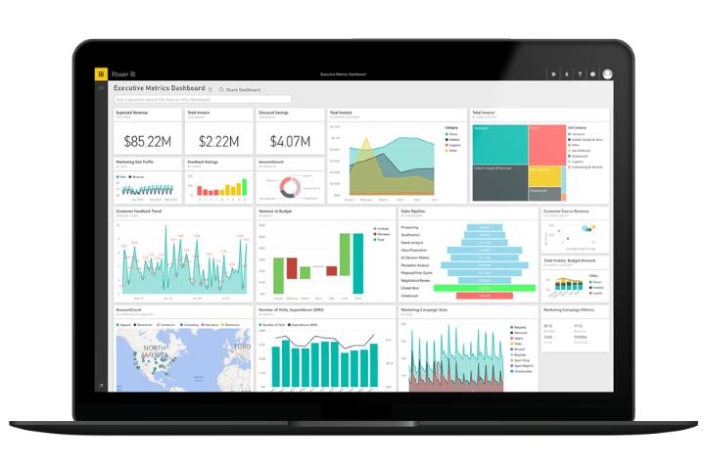
POWER BI
Power BI – Business intelligence used to clean and convert data into visualization format like dashboards and reports
Power BI Desktop - Application where we do visualization
Power BI tools
Power Query – Cleans data
Power Pivot – Data modelling, create relation between multiple data sources
Power View – To create 250 + charts
Power BI Service – To share files and dashboards

Slide 3
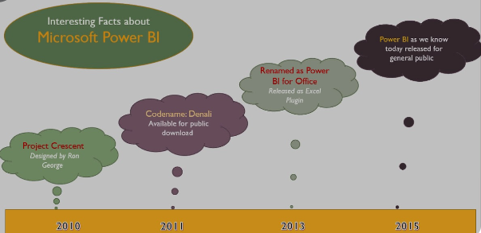
facts
It was originally designed by Ron George in the summer of 2010 and named Project Crescent.

Slide 4
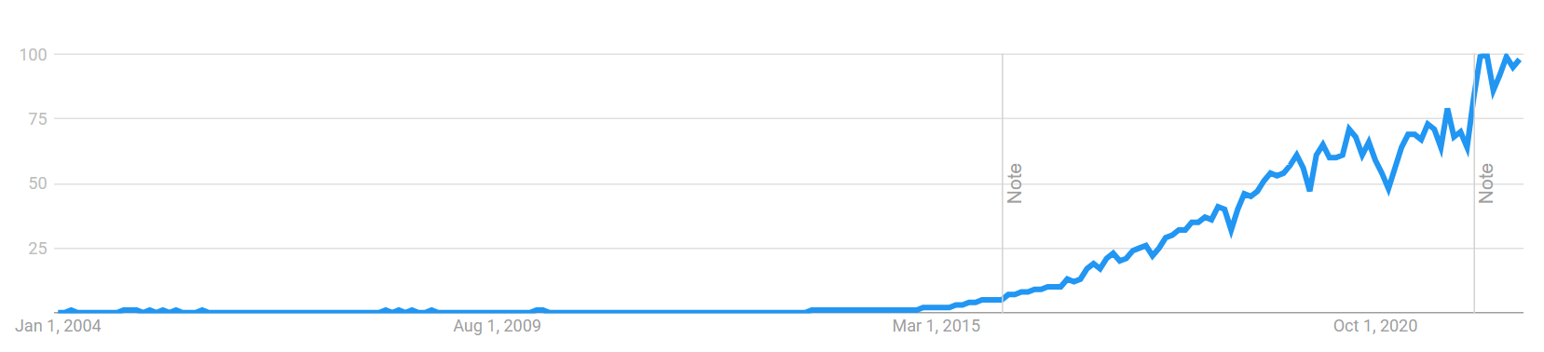
Importance of power bi
https://www.google.com/search?q=power+bi+and+other+tools+by+gartner&rlz=1C1ONGR_enIN1019IN1019&sxsrf=ALiCzsbo8oaNkyMhAO9ttpKqNUj7hIMRWQ:1662261340835&source=lnms&tbm=isch&sa=X&ved=2ahUKEwil7fmFlvr5AhUjBLcAHY69B9sQ_AUoAnoECAEQBA&biw=1280&bih=609&dpr=1.5#imgrc=v5s_jWoAQgipHM
1200 different functions available
280 visuals
Least expensive compared to other BI tools
Can accept data from 100 different data sources
Recognized by Gartner Company (which compares all BI products)
https://exceleratorbi.com.au/extract-numerical-data-points-from-an-image/

Slide 5
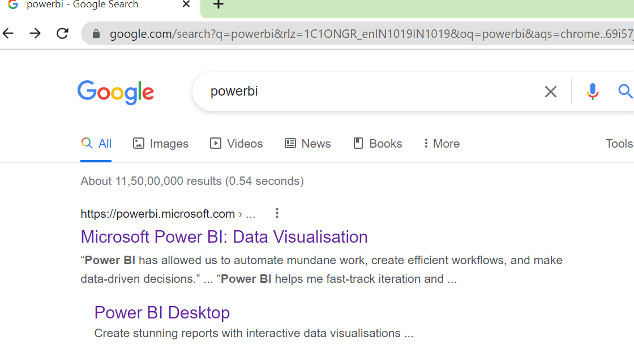
Install power bi

Slide 6

Install power bi

Slide 7
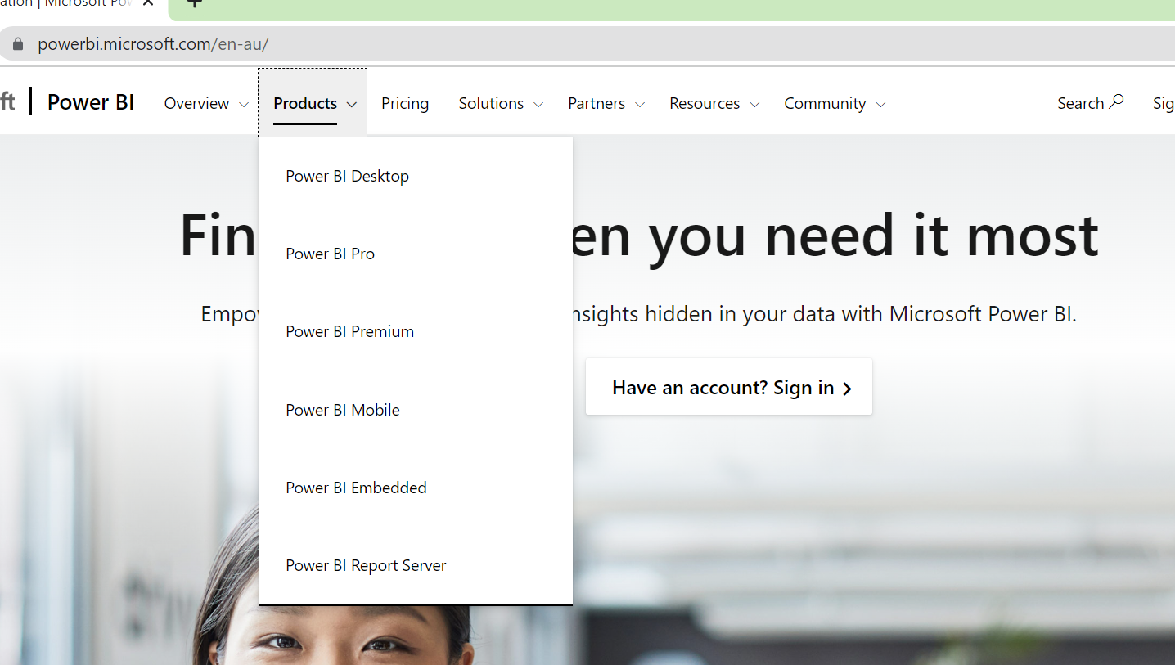
Install power bi

Slide 8
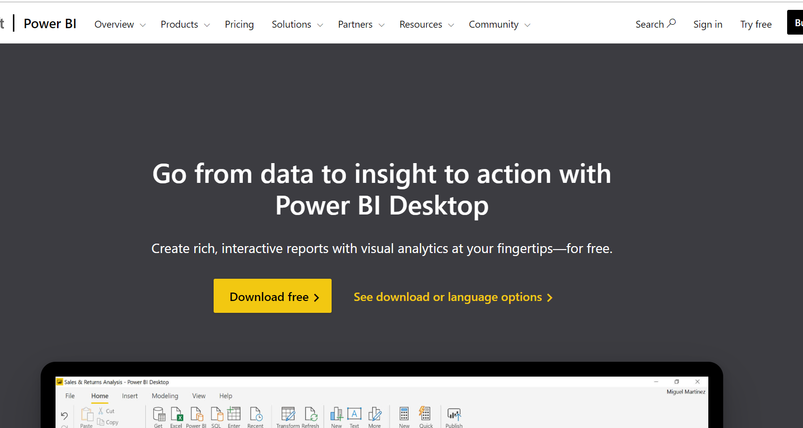
Install power bi

Slide 9
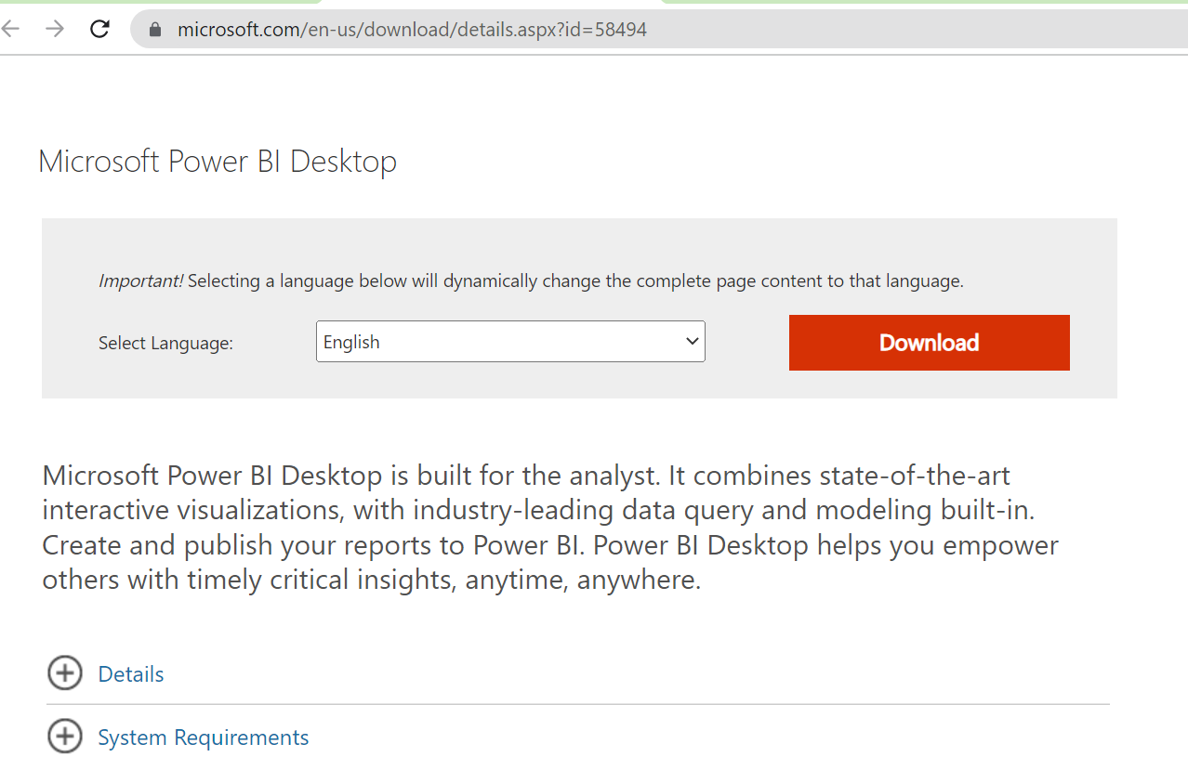
Install power bi
Choose the language you want
Then click on Download

Slide 10
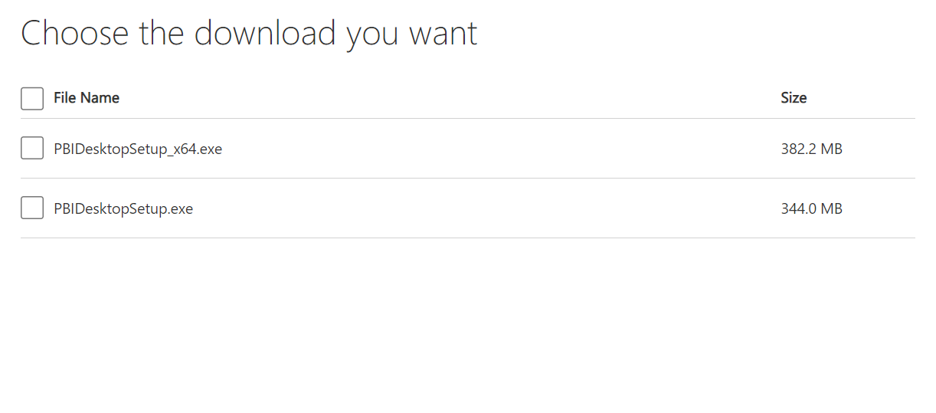
Install power bi
Choose this check box if your system is of 64 bit
Choose this check box if your system is of 32 bit

Slide 11
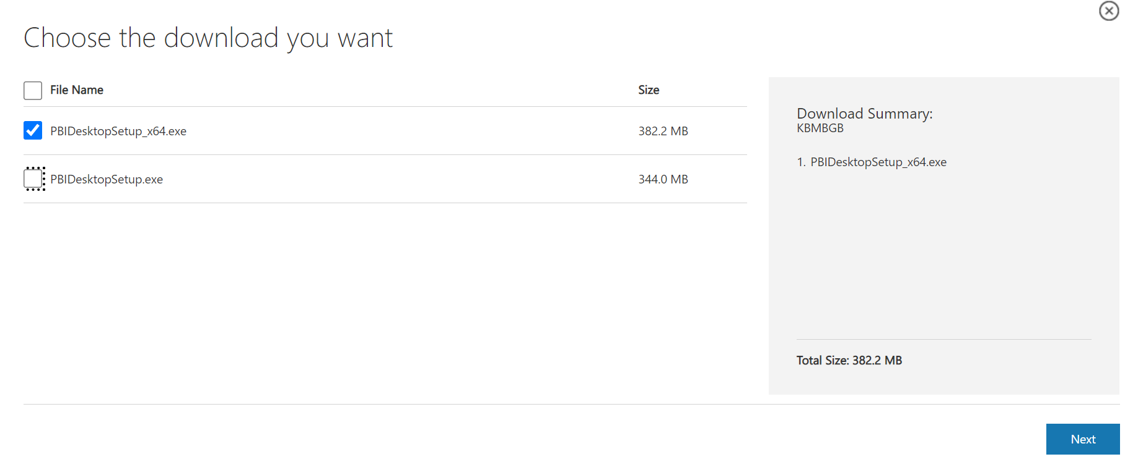
Install power bi

Slide 12
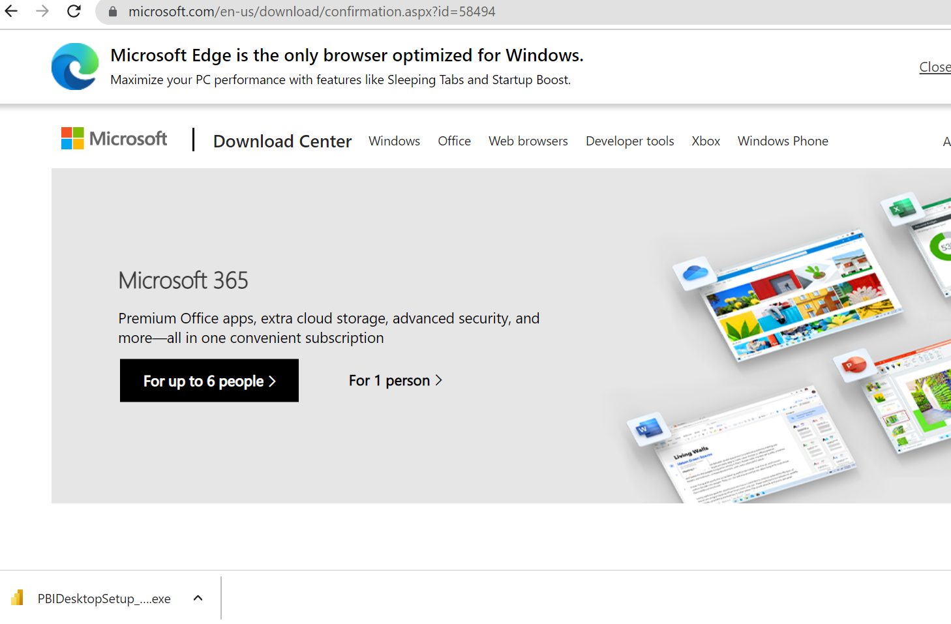
Install power bi
Double click on setup file

Slide 13
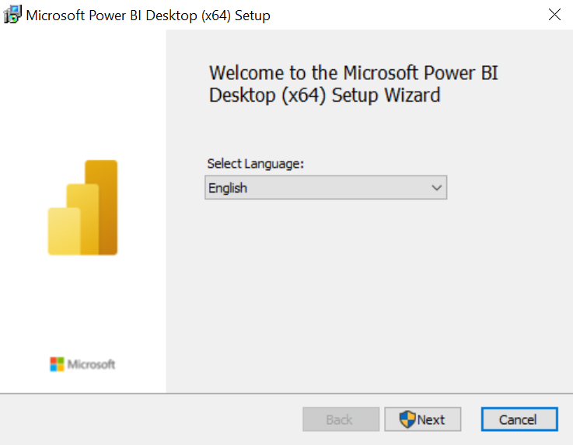
Install power bi

Slide 14
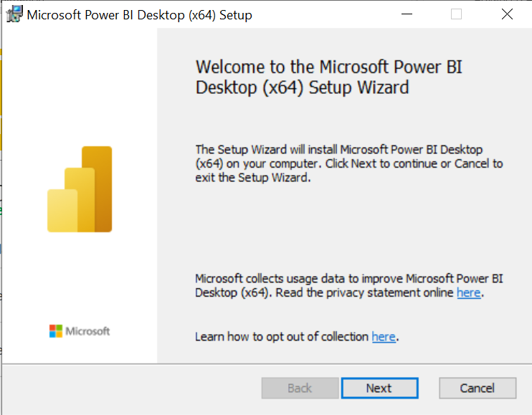
Install power bi

Slide 15
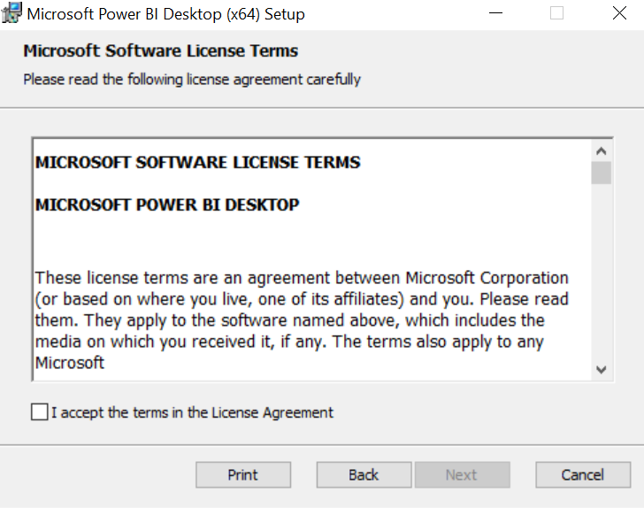
Install power bi

Slide 16
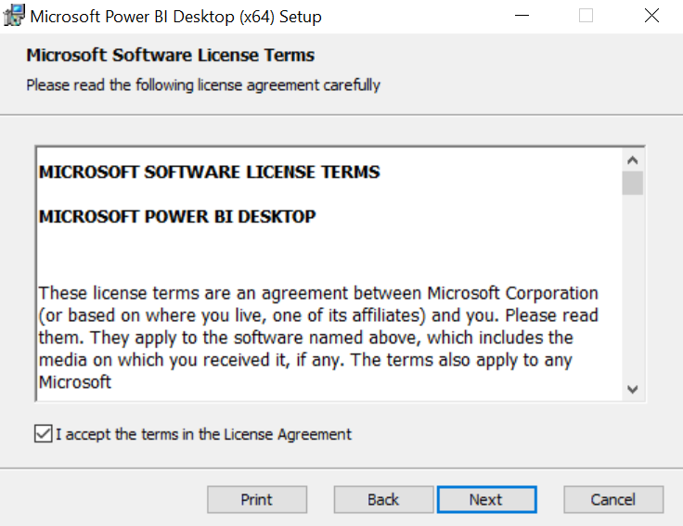
Install power bi

Slide 17
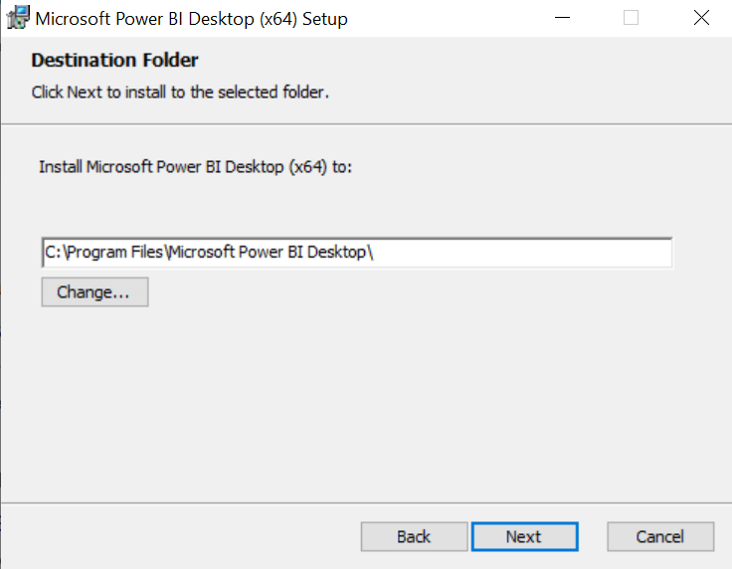
Install power bi

Slide 18
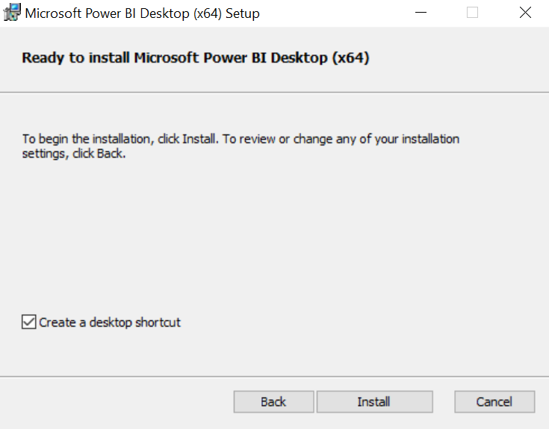
Install power bi

Slide 19
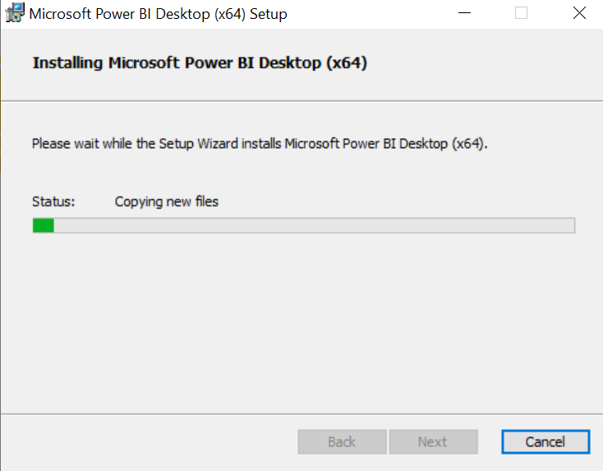
Install power bi

Slide 20
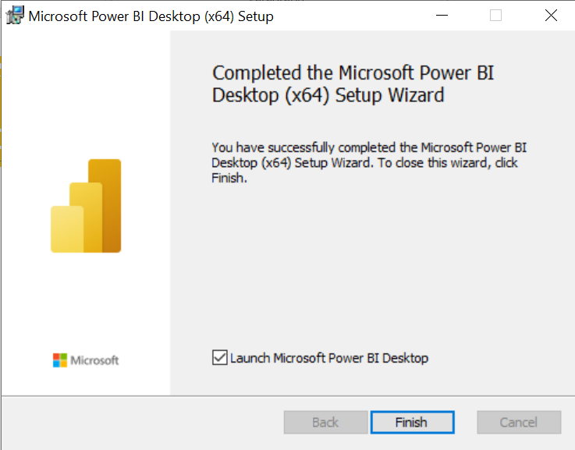
Install power bi

Slide 21

Install power bi

Slide 22
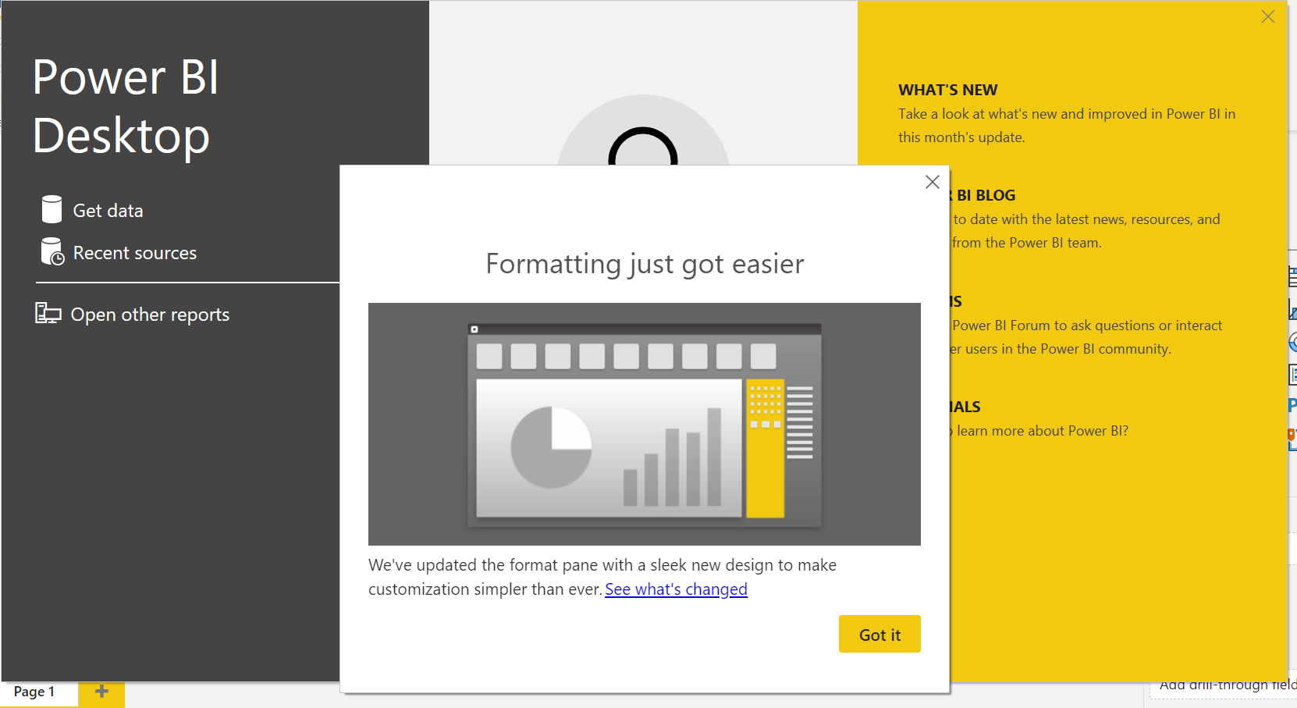
Install power bi

Slide 23
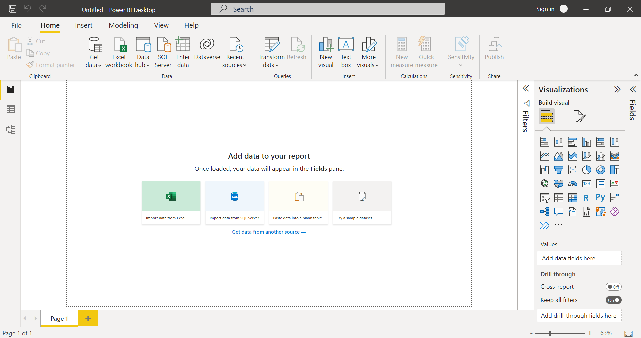
CHECK power bi
If you do not have this option then you are in older version of Power BI

Slide 24
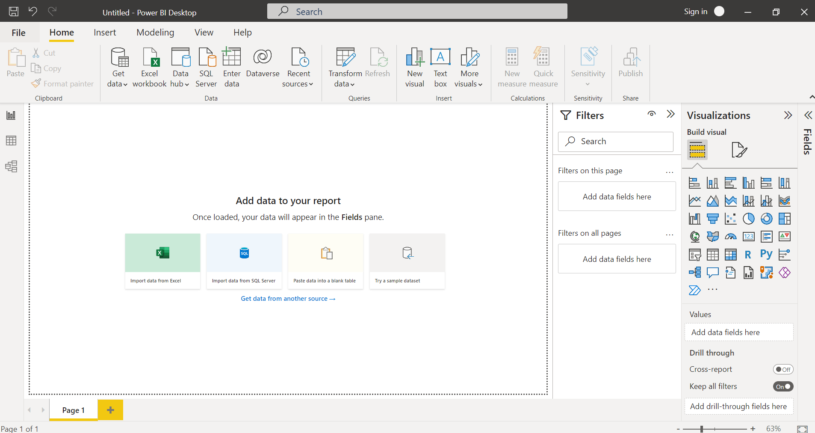
check power bi
If you do not have this window pane then you are in older version of Power BI

Slide 25
Upgrade power bi

Slide 26
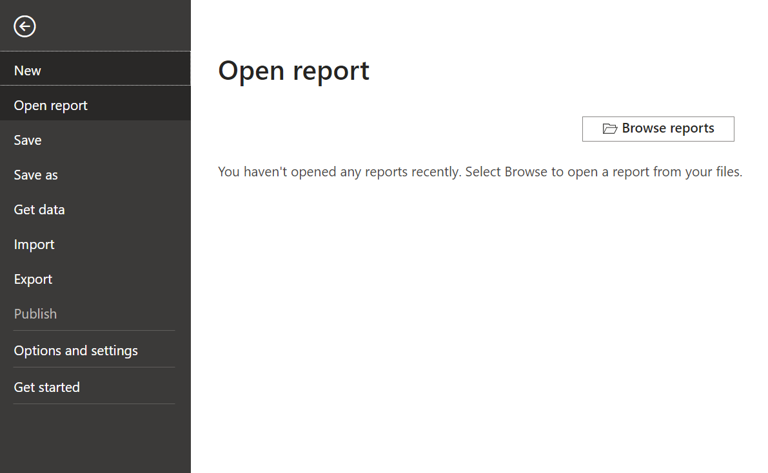
Upgrade power bi

Slide 27
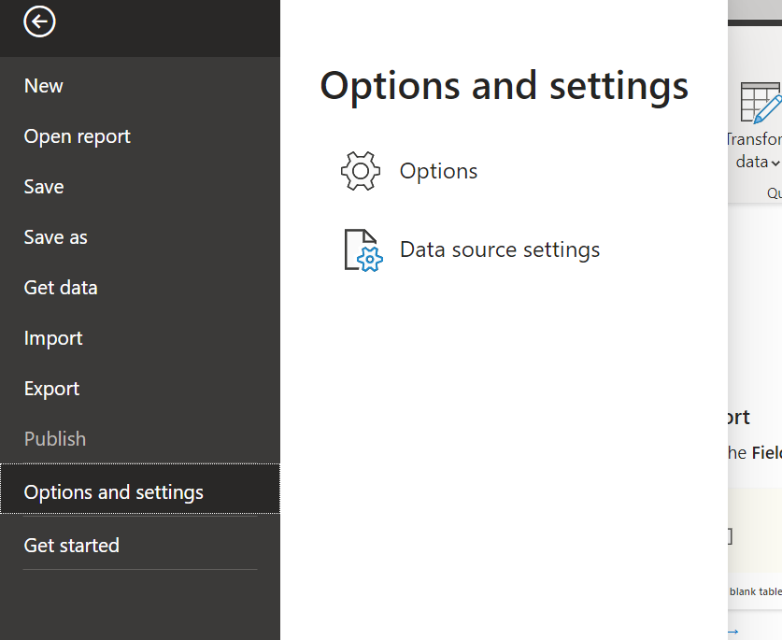
Upgrade power bi

Slide 28
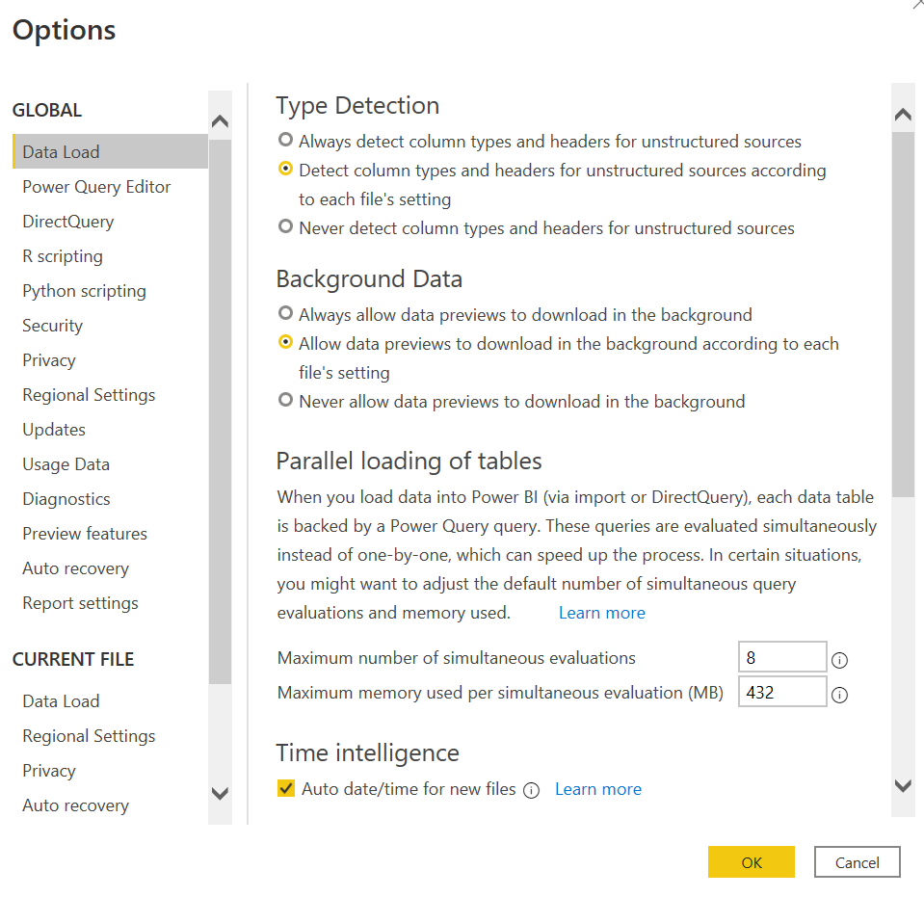
Upgrade power bi

Slide 29
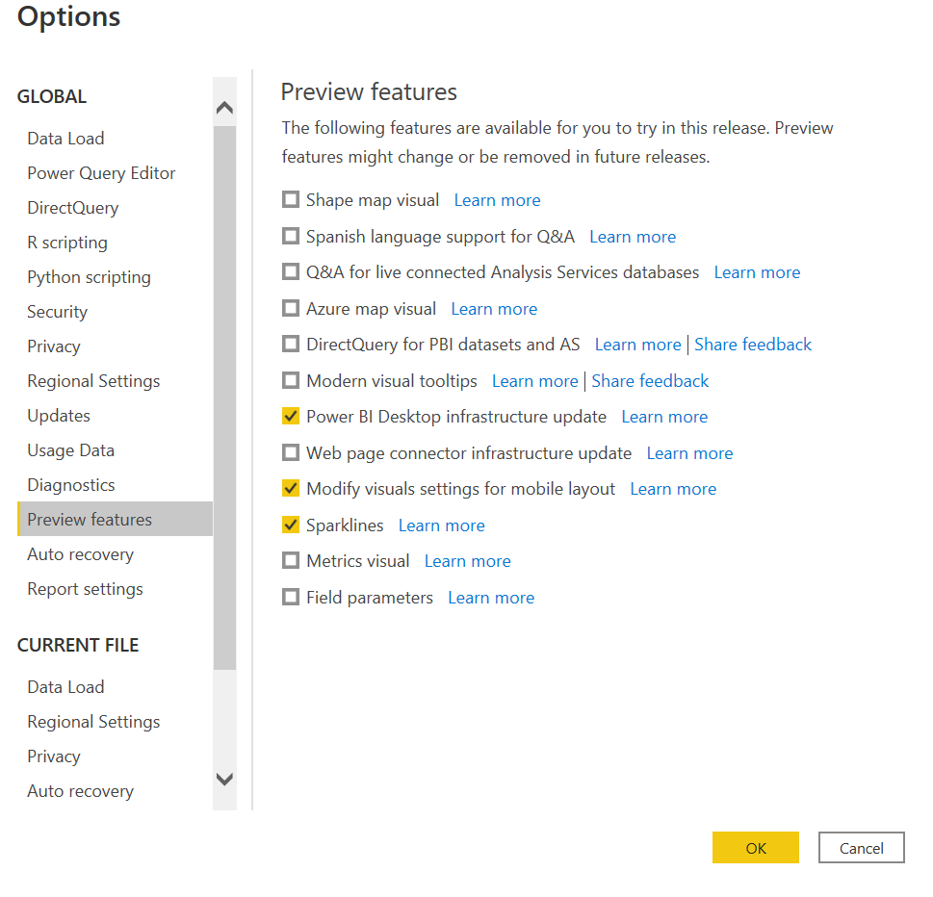
Upgrade power bi
Now click check boxes whichever you want

Slide 30
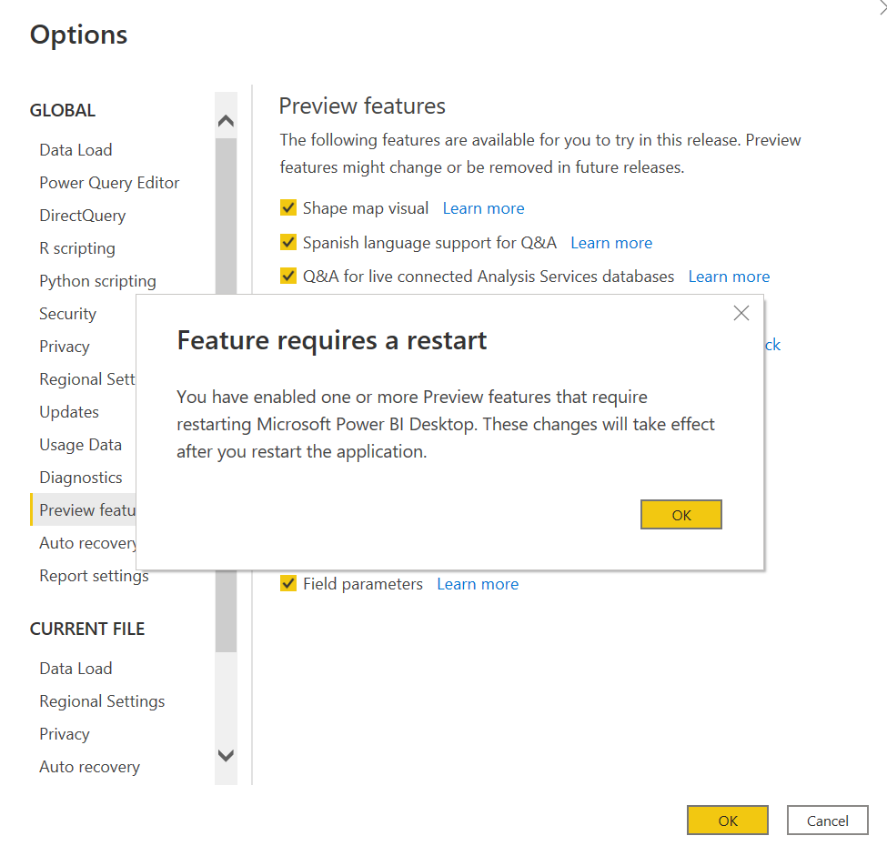
Upgrade power bi

Slide 31
Upgrade power bi

