Slide 1
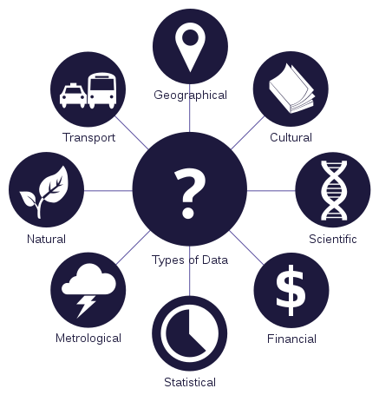

Practical tips for improving data management.
Shiobhan Smith, Research Support Unit
Justin Farquhar, Subject Librarian

Slide 2

What does Research Data Management mean (or look like) to you?

Slide 3
What does Research Data Management mean (or look like) to Researchers, Librarians, Data Curators/Stewards, Publishers, Funders, Government Agencies…?
Metadata
Quality Assurance
Restricted Access
Secure Storage
Chain of Custody
Risk Management
File Inventory
Persistent Identifier
Software Registry
Versioning
Succession Planning
Embargo
Full-Text Indexing
Contact Information
Discovery Services
Documentation
Data Citation
Use Analytics
Migration
File Validation
Rights Management
Code Review
Contextualise a Data Set
File Format Transformations
File Audit
Peer-Review
Terms of Use
Technology Monitoring and Refresh
Metadata Brokerage
Selection
Deposit Agreement
Indexing
Repository Certification
Cease Data Curation
Data Cleaning
Data Restructuring
Data Visualisation
Arrangement and Description
Authentication
Conversion (Analog)
Curation Log
Emulation
Deidentification
Interoperability
Transcoding

Slide 4
What does Research Data Management mean (or look like) to Researchers, Librarians, Data Curators/Stewards, Publishers, Funders, Government Agencies…?
Metadata
Quality Assurance
Restricted Access
Secure Storage
Chain of Custody
Risk Management
File Inventory
Persistent Identifier
Software Registry
Versioning
Succession Planning
Embargo
Full-Text Indexing
Contact Information
Discovery Services
Documentation
Data Citation
Use Analytics
Migration
File Validation
Rights Management
Code Review
Contextualise a Data Set
File Format Transformations
File Audit
Peer-Review
Terms of Use
Technology Monitoring and Refresh
Metadata Brokerage
Selection
Deposit Agreement
Indexing
Repository Certification
Cease Data Curation
Data Cleaning
Data Restructuring
Data Visualisation
Arrangement and Description
Authentication
Conversion (Analog)
Curation Log
Emulation
Deidentification
Interoperability
Transcoding

Slide 5
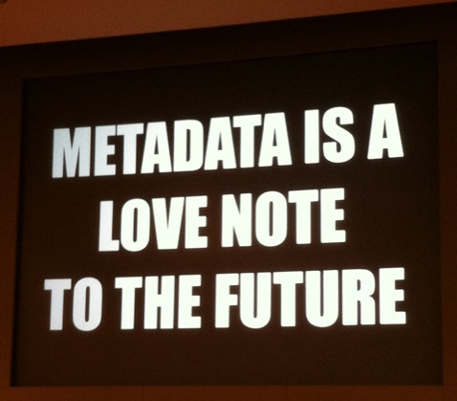
Activity 1: Describing data for preservation and reuse
From Flickr https://www.flickr.com/photos/centralasian/8071729256 Attribution 2.0 Generic (CC BY 2.0)

Slide 6
Basic Metadata
These are some ISO suggested minimal metadata elements to use when you are documenting your data:
Title
Creator (Principal Investigators)
Date Created (also versions)
Format (and software required)
Subject
Unique Identifier
Description of the specific data resource
Coverage of the data (spatial or temporal)
Publishing Organization
Type of Resource
Rights
Funding or Grant
Data Management: Level 3

Slide 7
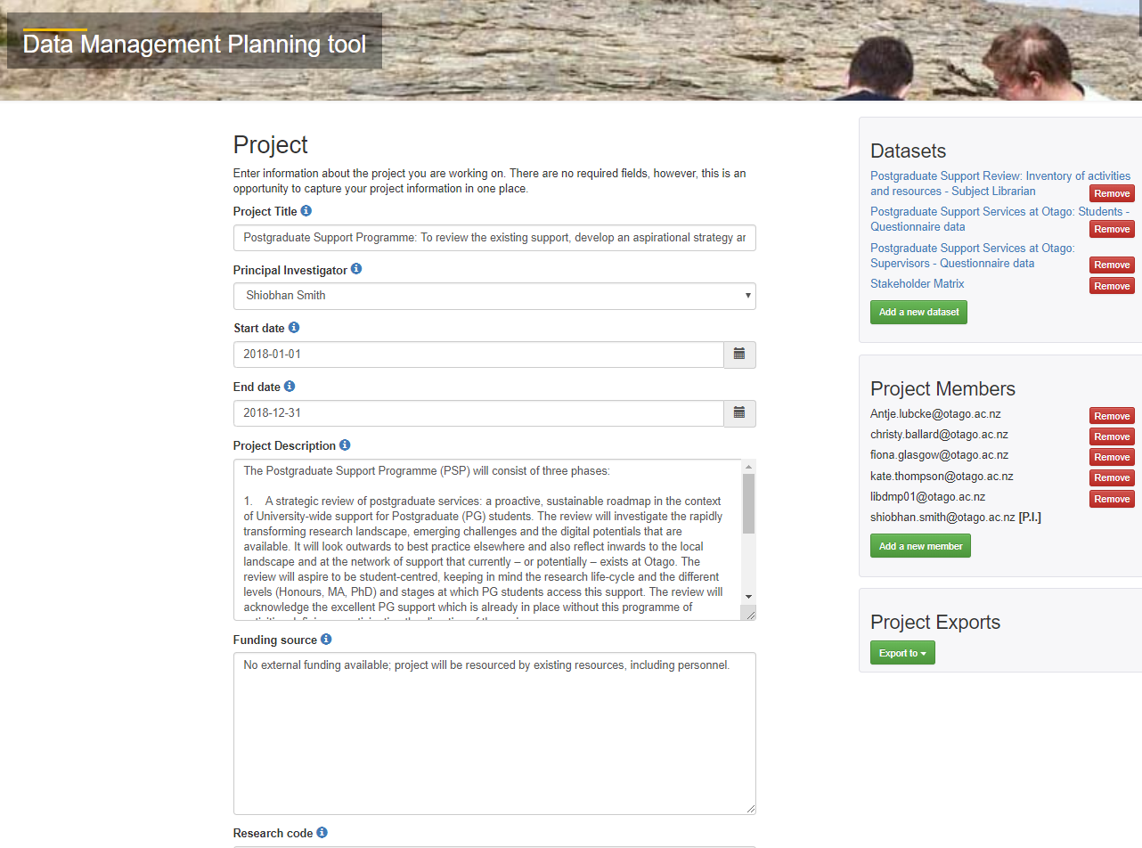
Notes:
https://dmp.otago.ac.nz/

Slide 8
Data Management Key Takeaway
Data Management Plan
Agreed plan on the collection, description, short and long term storage, and potential sharing of data
Ensure ethics and consent align with future goals
Do you have funder obligations?
What does your publisher of choice require?
Do you have commercialisation plans?
Obligations to the University (e.g. IP) or another organisation (e.g. using data from a third party)?
What data to keep long term?
Proprietary or open file formats?
If sharing the data, what are the terms of use?
Be clear about who owns your data and what is expected!

Slide 9
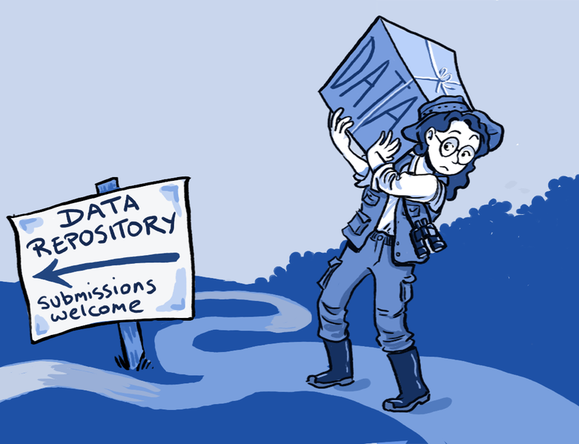
Activity 2: Uploading data to a repository
From Wikimedia Commons: Creative Commons Attribution 4.0 International license.

Slide 10
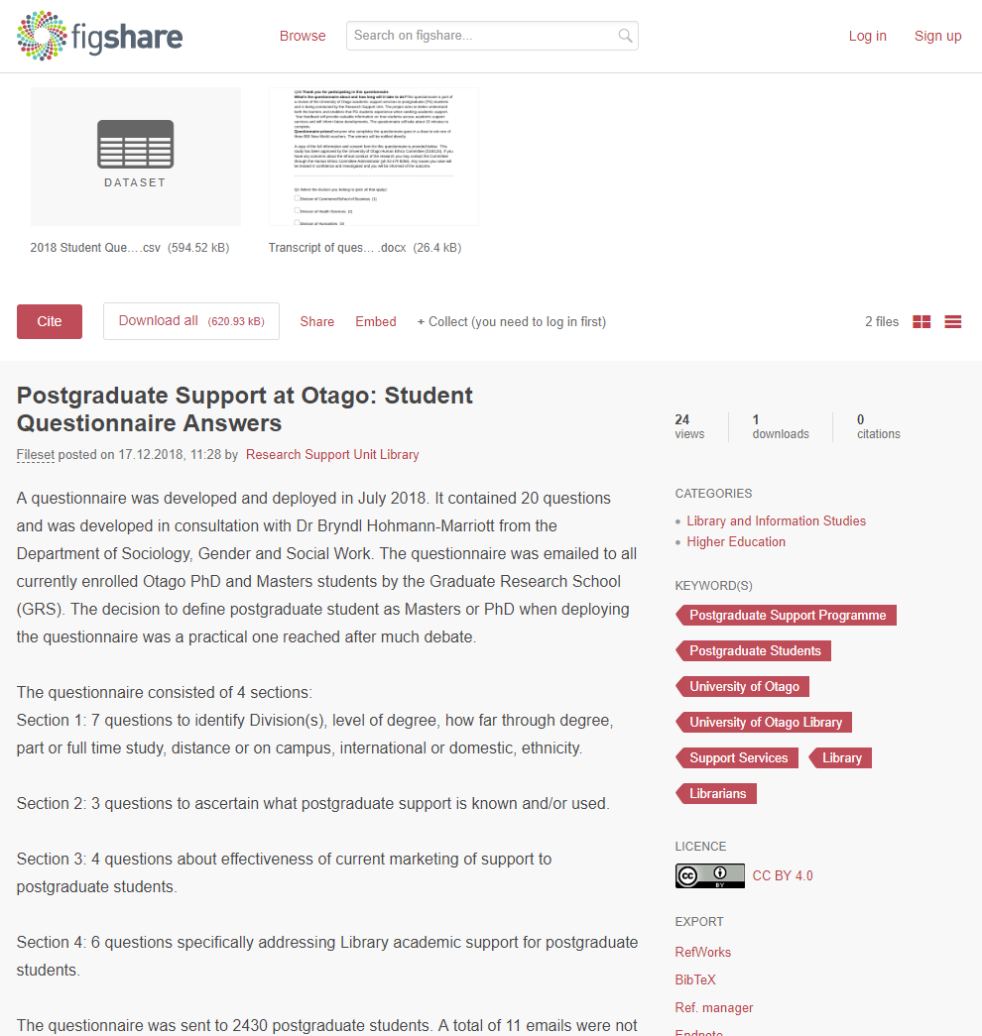
Notes:
https://doi.org/10.6084/m9.figshare.7464938.v1

Slide 11
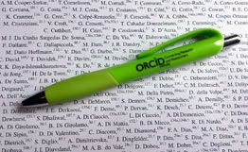
Activity 2: Adding data to ORCID

Slide 12
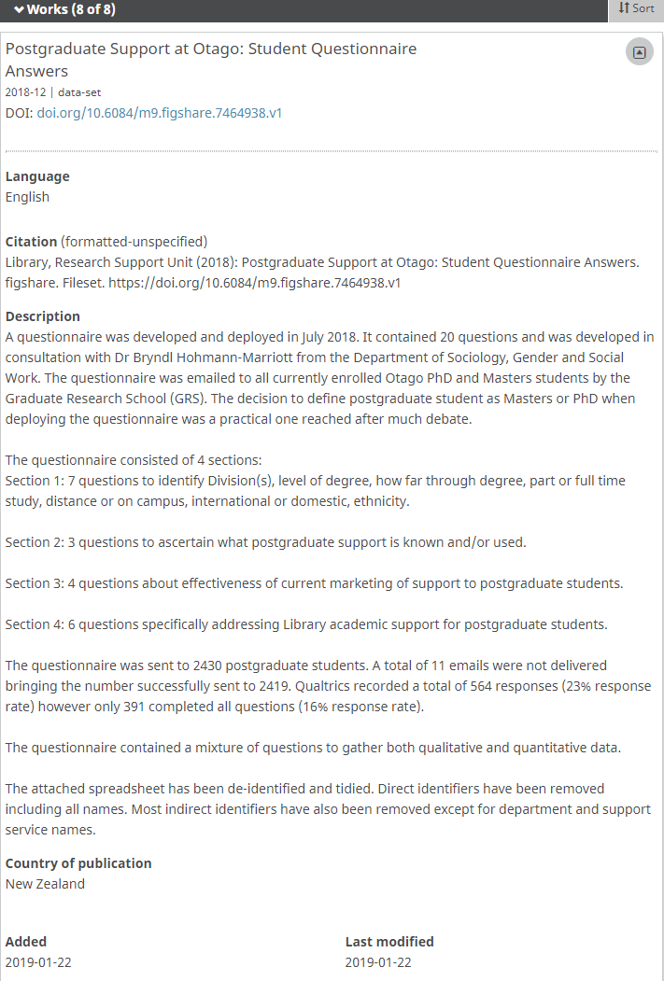
Notes:
https://orcid.org/0000-0003-1738-9836

Slide 13
Data Management Key Takeaway
Data Repositories
Domain/discipline Specific vs General vs Institutional
Researchers can find information about your data
Maybe even download and use it…
Persistent Identifier for your data
Citation Impact
Increase citations to your publication
Cite the data directly
Creative commons licence
Data as a first class research output added to your ORCID
Notes:
Acknowledge that two common ways data is shared is through supplementary materials and/or through departmental, project or personal webpage. – There are some cons however – may be costly, unlikely to offer a data repository’s functionality or long term solution. Least likely to make your data collection visible to new users and contacts, or to sustain long term access to your data collection.
https://figshare.com/articles/Perceptions_of_competence_strength_and_age_influence_voters_to_select_leaders_with_lower_pitched_voices/1478783
https://www.wiki.ed.ac.uk/display/datashare/Sources+of+dataset+peer+review
https://creativecommons.org/share-your-work/licensing-types-examples/

Slide 14

Notes:
https://youtu.be/66oNv_DJuPc

Slide 15
Before you go…
Make sure you delete the example data from your Figshare account
Make sure you delete the entry in your ORCID profile
Enrol for the Library’s postgraduate workshop on research data management
In department workshops by arrangement and in partnership with faculty
Want more?

