Slide 1
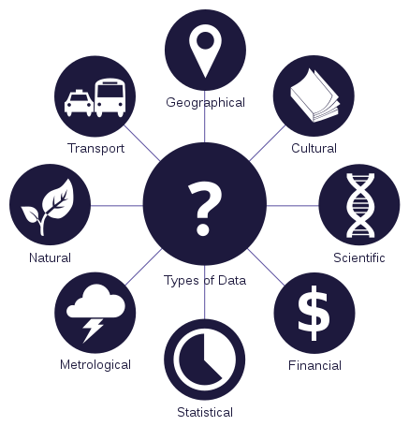

Practical tips for improving data management.

Slide 2
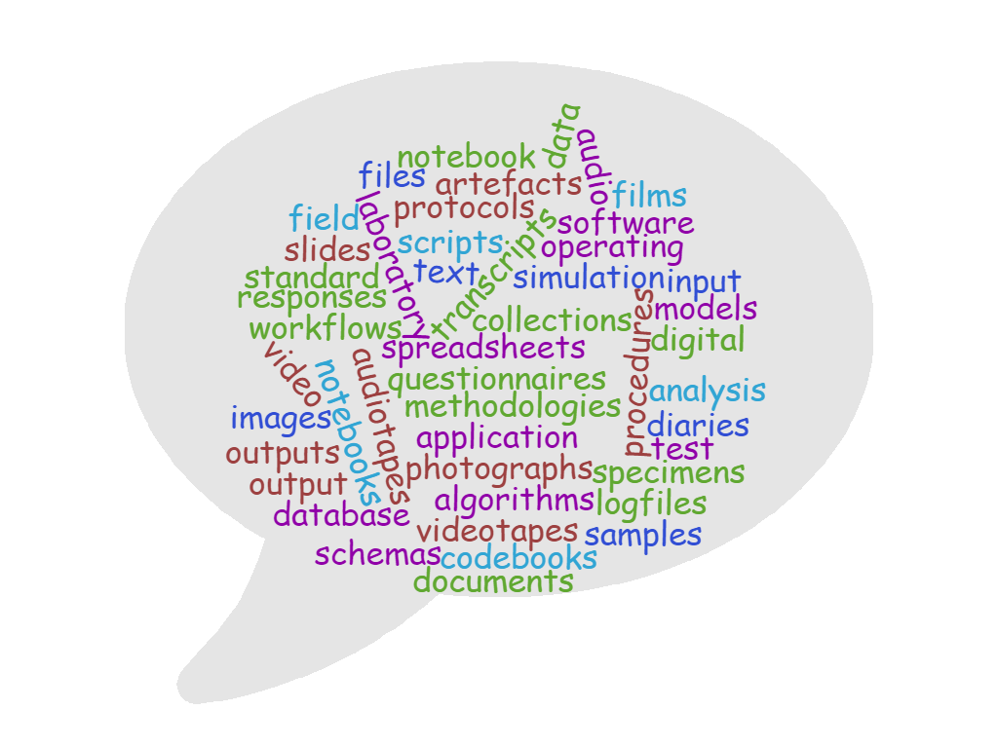
What is your research data?
Notes:
In your discipline what is your research data
Talk to your neighbour then share

Slide 3
Research Dataset:
Actual dataset produced as part of a research activity
May be small or large
May or may not be available from a URL
May not be digital
Could come in a variety of different formats including weird file formats, or a hundred XML files
May require speciality knowledge and/or tools to understand or be accessible to most people

Slide 4

What does Research Data Management mean (or look like) to you?

Slide 5
What does Research Data Management mean (or look like) to Researchers, Librarians, Data Curators/Stewards, Publishers, Funders, Government Agencies…?
Metadata
Quality Assurance
Restricted Access
Secure Storage
Chain of Custody
Risk Management
File Inventory
Persistent Identifier
Software Registry
Versioning
Succession Planning
Embargo
Full-Text Indexing
Contact Information
Discovery Services
Documentation
Data Citation
Use Analytics
Migration
File Validation
Rights Management
Code Review
Contextualise a Data Set
File Format Transformations
File Audit
Peer-Review
Terms of Use
Technology Monitoring and Refresh
Metadata Brokerage
Selection
Deposit Agreement
Indexing
Repository Certification
Cease Data Curation
Data Cleaning
Data Restructuring
Data Visualisation
Arrangement and Description
Authentication
Conversion (Analog)
Curation Log
Emulation
Deidentification
Interoperability
Transcoding

Slide 6
What does Research Data Management mean (or look like) to Researchers, Librarians, Data Curators/Stewards, Publishers, Funders, Government Agencies…?
Metadata
Quality Assurance
Restricted Access
Secure Storage
Chain of Custody
Risk Management
File Inventory
Persistent Identifier
Software Registry
Versioning
Succession Planning
Embargo
Full-Text Indexing
Contact Information
Discovery Services
Documentation
Data Citation
Use Analytics
Migration
File Validation
Rights Management
Code Review
Contextualise a Data Set
File Format Transformations
File Audit
Peer-Review
Terms of Use
Technology Monitoring and Refresh
Metadata Brokerage
Selection
Deposit Agreement
Indexing
Repository Certification
Cease Data Curation
Data Cleaning
Data Restructuring
Data Visualisation
Arrangement and Description
Authentication
Conversion (Analog)
Curation Log
Emulation
Deidentification
Interoperability
Transcoding

Slide 7
What about research domain specific information?
What we will cover:
Let’s make Research Data Management a little less scary
Best-practice principles of management, storage and sharing of research data
Practical tips for improving your data management practices that you can implement immediately
How to be prepared for university, employer, funder and/or publisher data requirements
Opportunities to reflect and share how this might apply to your research data specifically with Faculty and Librarians.

Slide 8
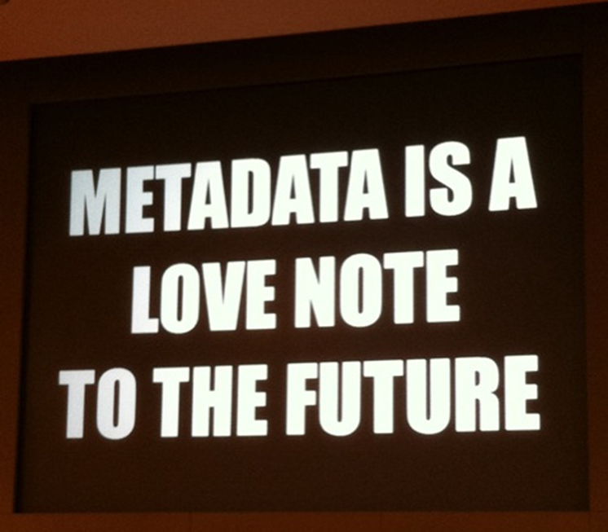
Tidy Data
File and folder naming
Space, saving and back-up
Metadata
Basic metadata
Data Management Planning
Data Management Plan
Collaboration, moving and sharing
Version control and preservation
Subject specific metadata
Bibliographic metadata
From Flickr https://www.flickr.com/photos/centralasian/8071729256 Attribution 2.0 Generic (CC BY 2.0)

Slide 9

Subject-specific metadata
Decided by the researcher and research communities
Provides context for the dataset
Processes used
Type and configuration of equipment
Timelines
Sample size
Assumptions made
In some cases this information may be outputted by equipment during data collection [like exchangeable image file format (exif) from a digital camera]
May merge with other layers of metadata
Subject-specific repositories tend to be more proscriptive about what subject-specific metadata to collect and the format it should be presented
Decided by researcher/research communities

Slide 10

Bibliographic Metadata
Non-scientific context of the dataset
Who created it
What parts of what organisations were involved
Where it is stored
Who owns it
Access rights
Licenses applied
Physical location of equipment/facility
Funder
Research group
Tool to support = Data Management Plan
Libraries support through data management planning tools and advice

Slide 11
Basic Metadata
These are some ISO suggested minimal metadata elements to use when you are documenting your data:
Title
Creator (Principal Investigators)
Date Created (also versions)
Format (and software required)
Subject
Unique Identifier
Description of the specific data resource
Coverage of the data (spatial or temporal)
Publishing Organization
Type of Resource
Rights
Funding or Grant
Data Management: Level 3

Slide 12
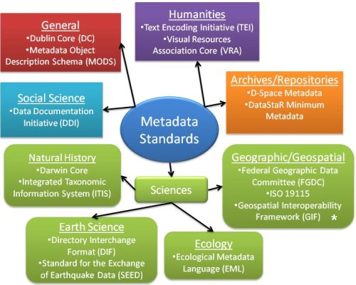

Slide 13
Data Management Key Takeaway
Data Management Plan
Agreed plan on the collection, description, short and long term storage, and potential sharing of data
Ensure ethics and consent align with future goals
Do you have funder obligations?
What does your publisher of choice require?
What are your obligations to the University (e.g. IP) or another organisation (e.g. using data from a third party)?
Planning de-identification of sensitive data
What data to keep long term?
Proprietary or open file formats?
If sharing the data, what are the terms of use?
Be clear about who owns your data and what is expected!

Slide 14
Uploading data to a repository
Data Repositories
Domain/discipline Specific vs General vs Institutional
Researchers can find information about your data
Maybe even download and use it…
Persistent Identifier for your data
Citation Impact
Increase citations to your publication
Cite the data directly
Creative commons licence
Why a repository over supplementary materials or department/project/personal website?
Data as a first class research output added to your ORCID
Notes:
Acknowledge that two common ways data is shared is through supplementary materials and/or through departmental, project or personal webpage. – There are some cons however – may be costly, unlikely to offer a data repository’s functionality or long term solution. Least likely to make your data collection visible to new users and contacts, or to sustain long term access to your data collection.
https://figshare.com/articles/Parents_with_mental_health_problems_and_their_children_in_a_German_population_based_sample_Results_of_the_BELLA_study/5169391
https://creativecommons.org/share-your-work/licensing-types-examples/

Slide 15
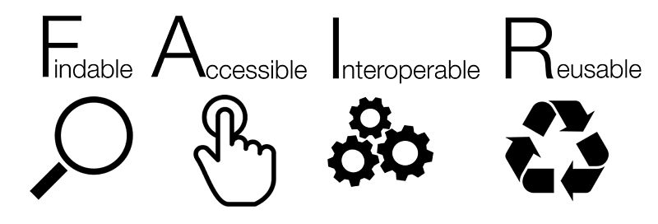
Go F.A.I.R.
FAIR and CARE

Slide 16
Findable
This includes assigning a persistent identifier (like a DOI or Handle), having rich metadata to describe the data and making sure it is findable through disciplinary discovery portals (local and international).
Accessible
This may include making the data open using a standardised protocol. However the data does not necessarily have to be open. There are sometimes good reasons why data cannot be made open, for example privacy concerns, national security or commercial interests. If it is not open there should be clarity and transparency around the conditions governing access and reuse.
Interoperable
To be interoperable the data will need to use community agreed formats, language and vocabularies. The metadata will also need to use a community agreed standards and vocabularies, and contain links to related information using identifiers.
Reusable
Reusable data should maintain its initial richness. For example, it should not be diminished for the purpose of explaining the findings in one particular publication. It needs a clear machine readable licence and provenance information on how the data was formed. It should also have discipline-specific data and metadata standards to give it rich contextual information that will allow for reuse.
From: https://www.ands.org.au/working-with-data/fairdata

Slide 17
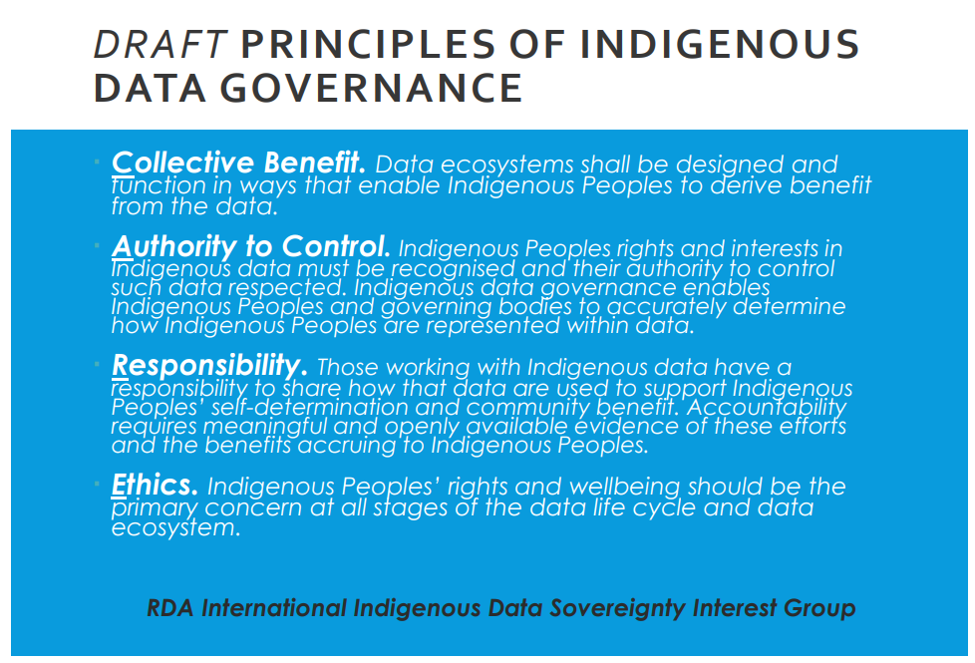
From: https://www.otago.ac.nz/wellington/otago706724.pdf

Slide 18

Notes:
https://youtu.be/66oNv_DJuPc

Slide 19
Thinking of your data – how easily can you answer these questions:
If someone wants to access data from your research project who should they contact?
How proprietary is/are the formats your data is/are in? Could you access them in 10 years’ time?
Do you have a copy of the raw data you don’t touch? Is it securely stored?
Are you planning on destroying your data after X number of years? If not have you ensured your ethics and consent reflect this [where applicable].
Is it possible you might use the data for a future project? Have you accounted for this in ethics and consent [where applicable].
Are you planning on making your data available to others? Do you have a funder or publisher mandate? Have you accounted for this in ethics and consent [where applicable].
How will you share the data? - Should preservation copies and shared copies be in the same format?
If you leave Otago for another University – do you know if you can still access the data, take it with you etc.?

