Slide 1

Data Analysis Of Calls
Hunt Digital Media
Raj Sahu
rajsahu192002@gmail.com

Slide 2
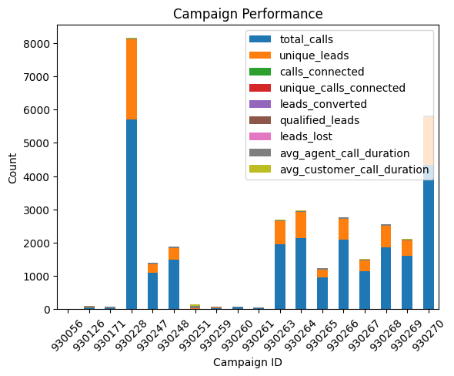
Campaign Performance Report:

Slide 3
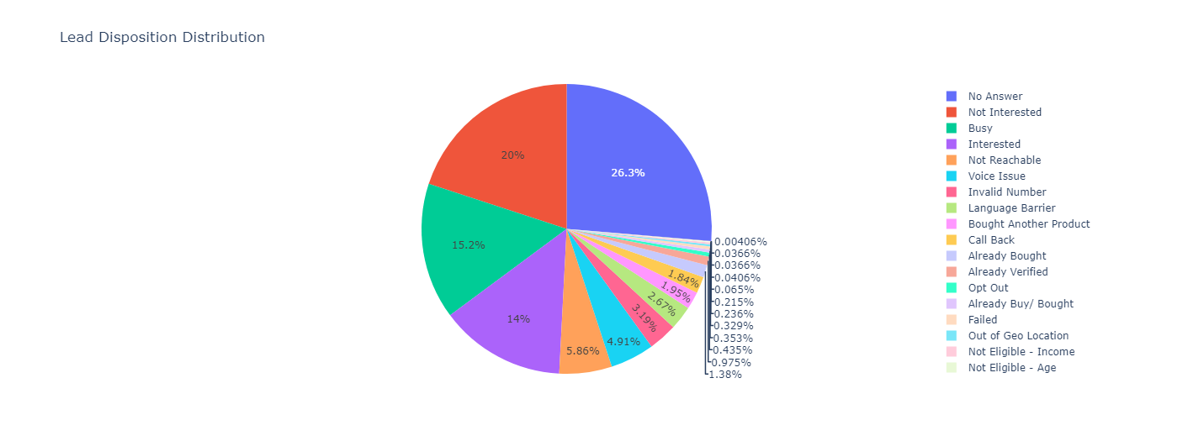
2. Lead Disposition Report:

Slide 4
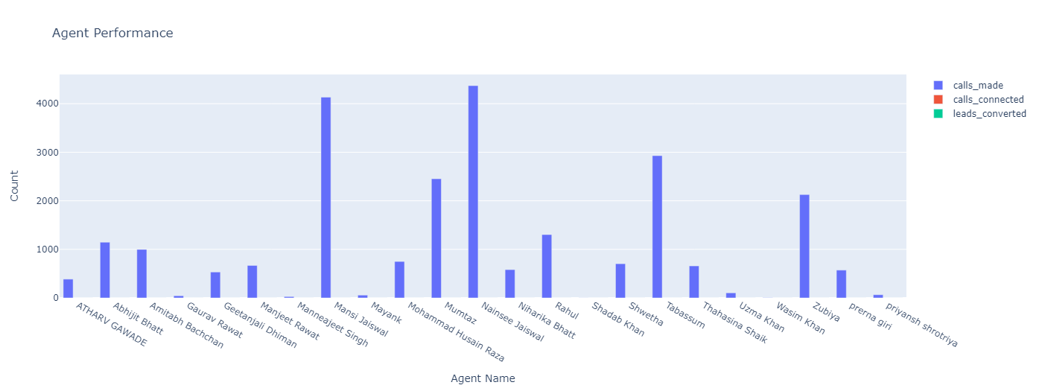
3. Agent Performance Report:

Slide 5
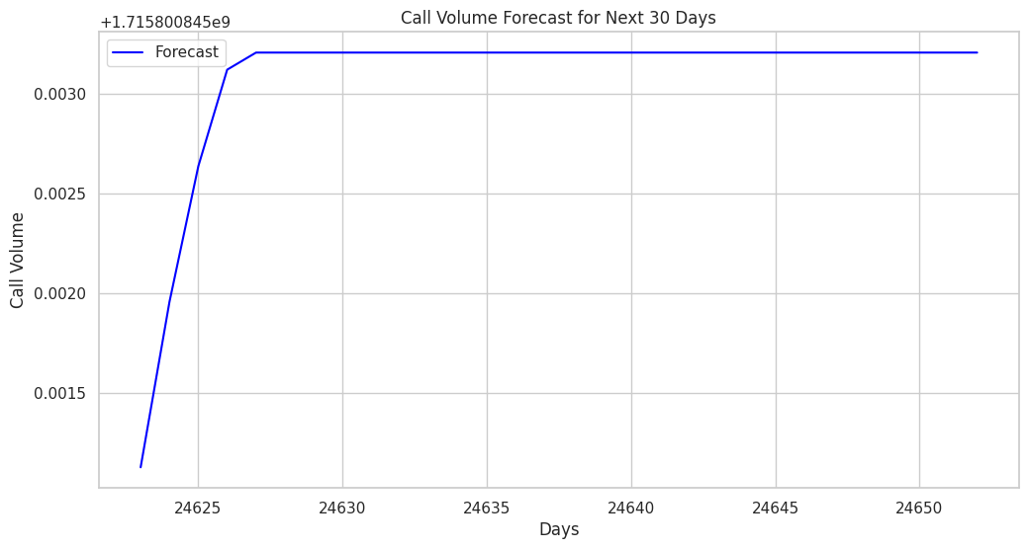
Call Volume Forecast:

Slide 6
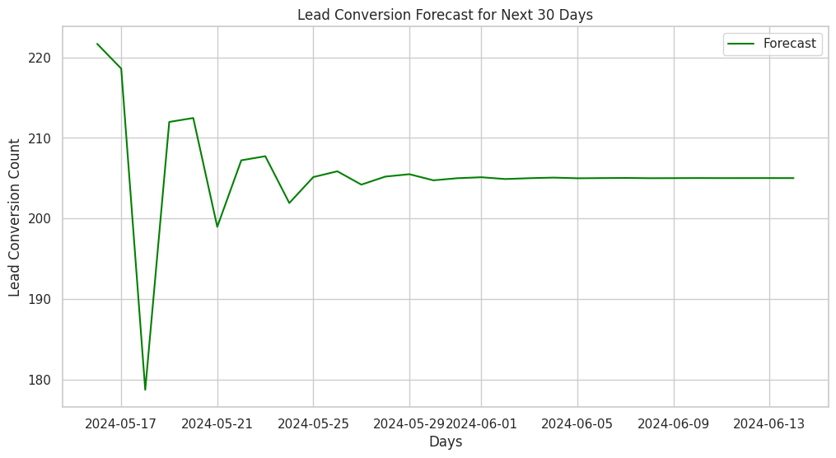
Lead Conversion Forecast:

Slide 7
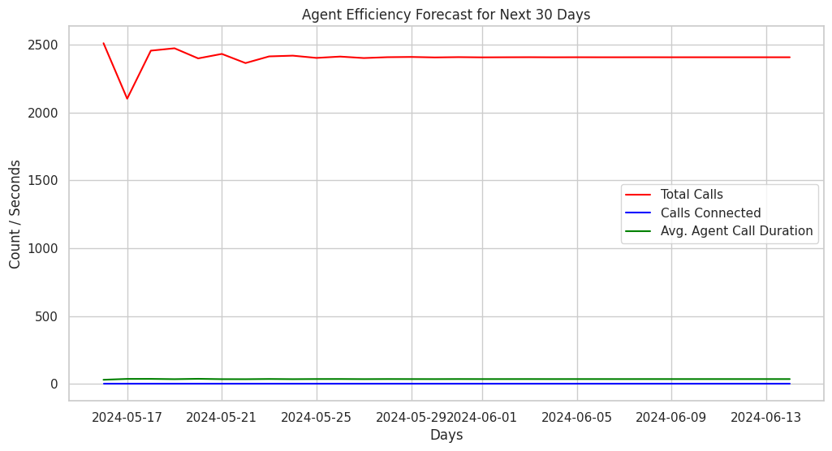
Agent Efficiency Forecast:

Slide 8
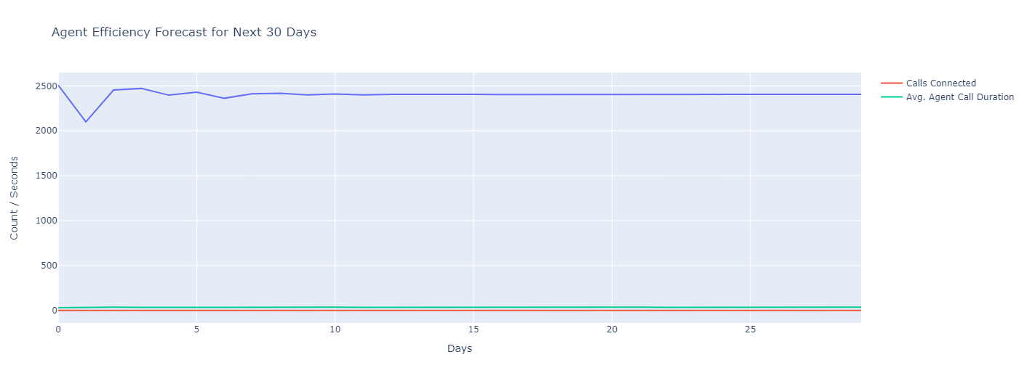

Slide 9
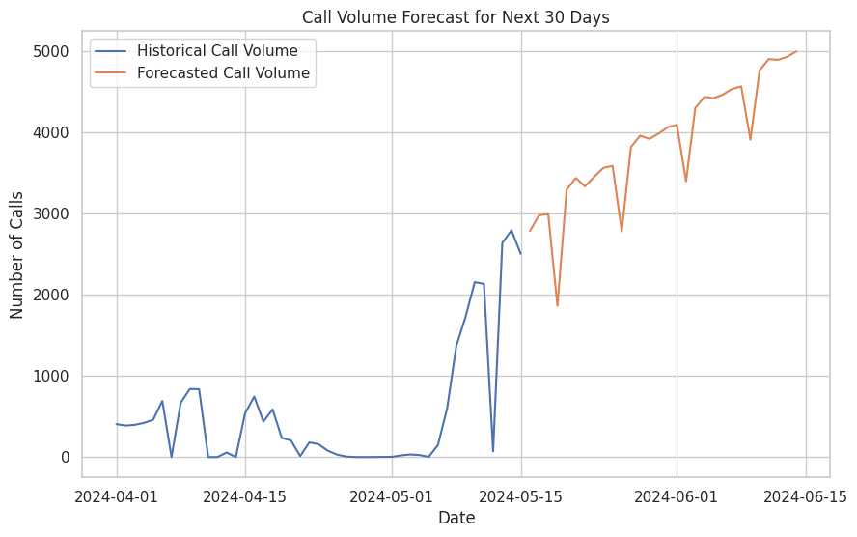
Resource Allocation Forecast:
Forecasted Call Volume for Next 30 Days: 116448.85401647449
Average Calls Handled per Hour per Agent: 0.5989738591289986
Estimated Required Agents: 8100.579866833232

Slide 10
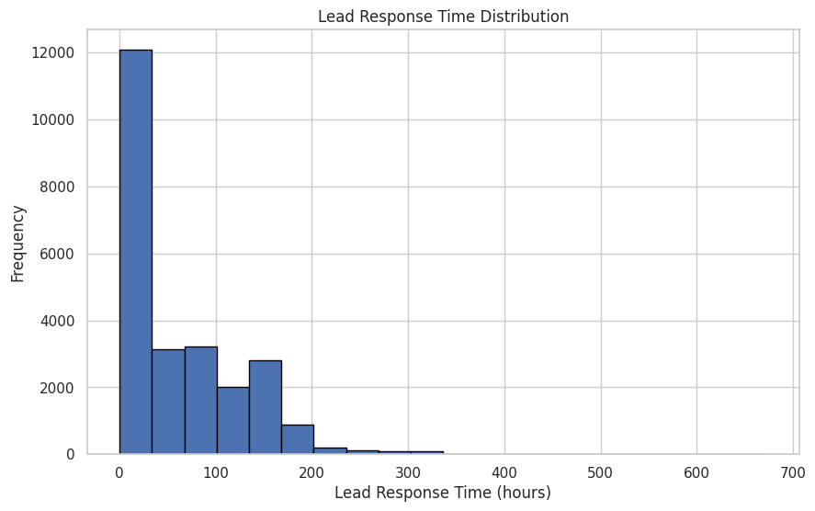
Additional Work:Lead Response Time Analysis:

Slide 11
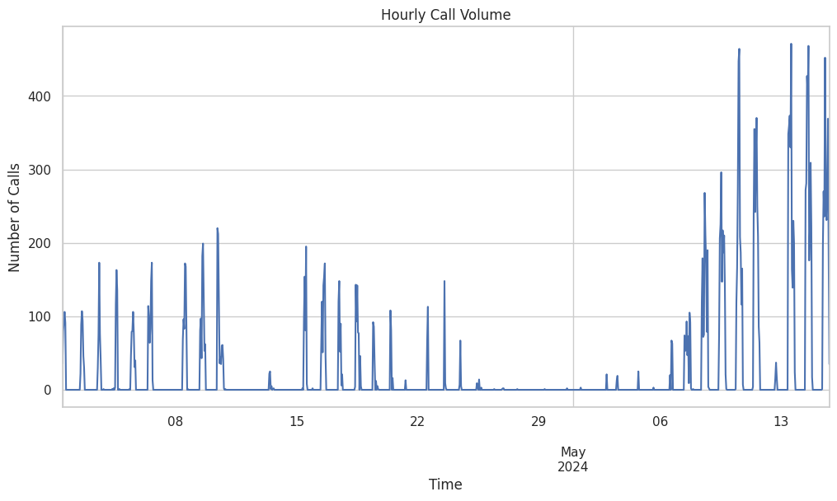
Additional Work:Time Series Analysis of Call Volume:

Slide 12
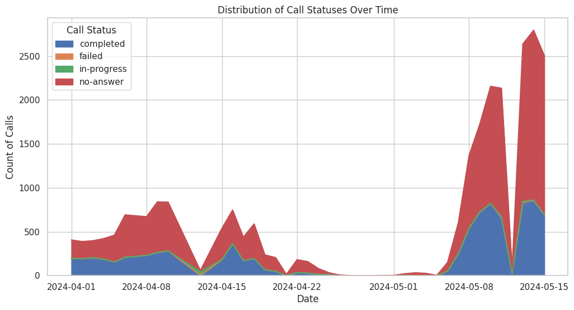
Additional Work:

