Slide 1
SWE-4501: Design Pattern
Observer Design Pattern
Md. Nazmul Haque
Lecturer, IUT
Department of Computer Science and Engineering
Islamic University of Technology
July 8, 2021
Notes:
Assalamualaikum, good day my respected teachers, audiences. Today I am going to present my thesis paper titled “Class Specific feature Selection for High Dimensional low sample size Data”. I am Nazmul haque and my supervisor is Dr. Mohammad Shoyaib.
Before going in detail about my Literature review, I would like to give an outline of my whole presentation.

Slide 2
Contents
Contents
Motivation
Solution

Slide 3

Motivation
Clock design
23:04:45
11:04:45 PM
Digital clock
Analog clock

Slide 4
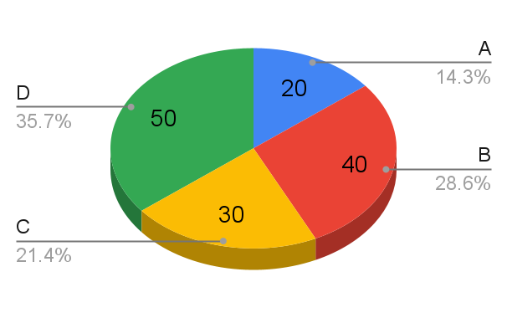
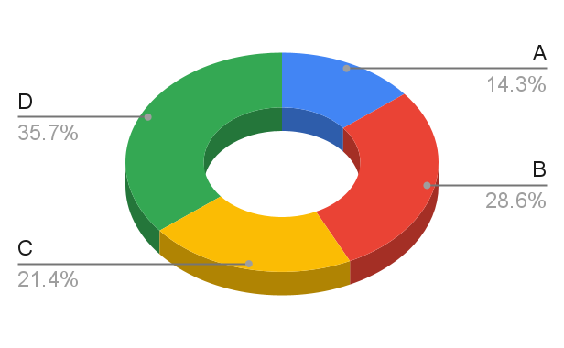
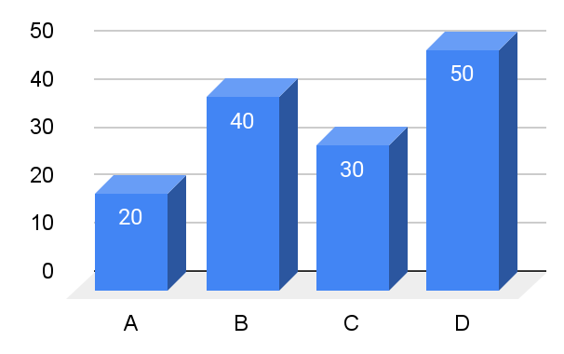
Motivation
Data view
A | B | C | D
20 | 40 | 30 | 50

Slide 5
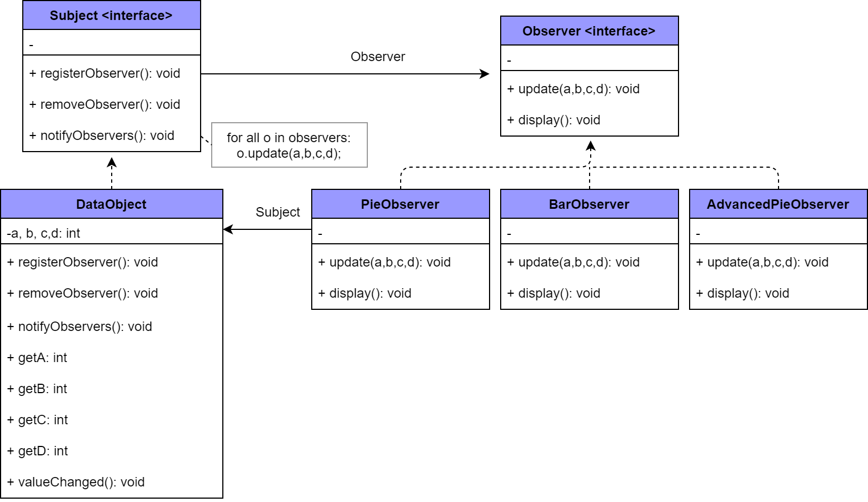
Solution
Data view
Solution

Slide 6
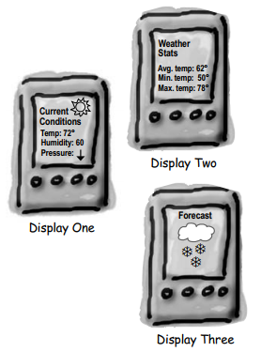
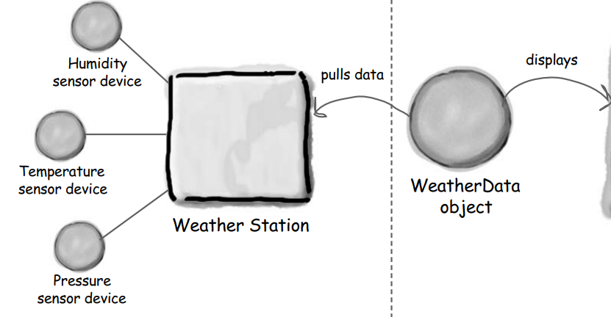
Motivation
Problem scenario
The weather station will be based on our patent pending WeatherData object, which tracks current weather conditions (temperature, humidity, and barometric pressure). Weʼd like for you to create an application that initially provides three display elements: current conditions, weather statistics and a simple forecast, all updated in real time.

Slide 7
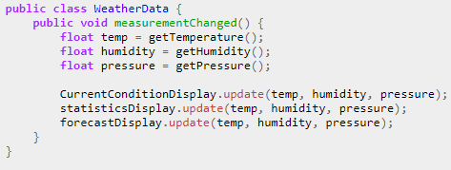
Solution
WeatherData object
i. Dependent on concrete implementations,
ii. Difficult to add or remove display

Slide 8
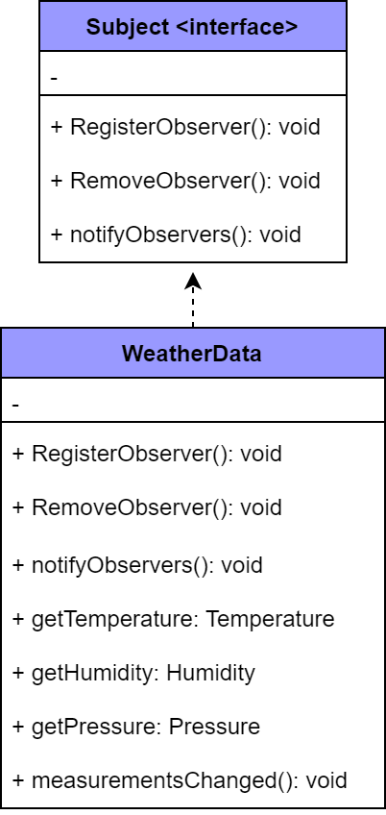
Solution
WeatherData object

Slide 9
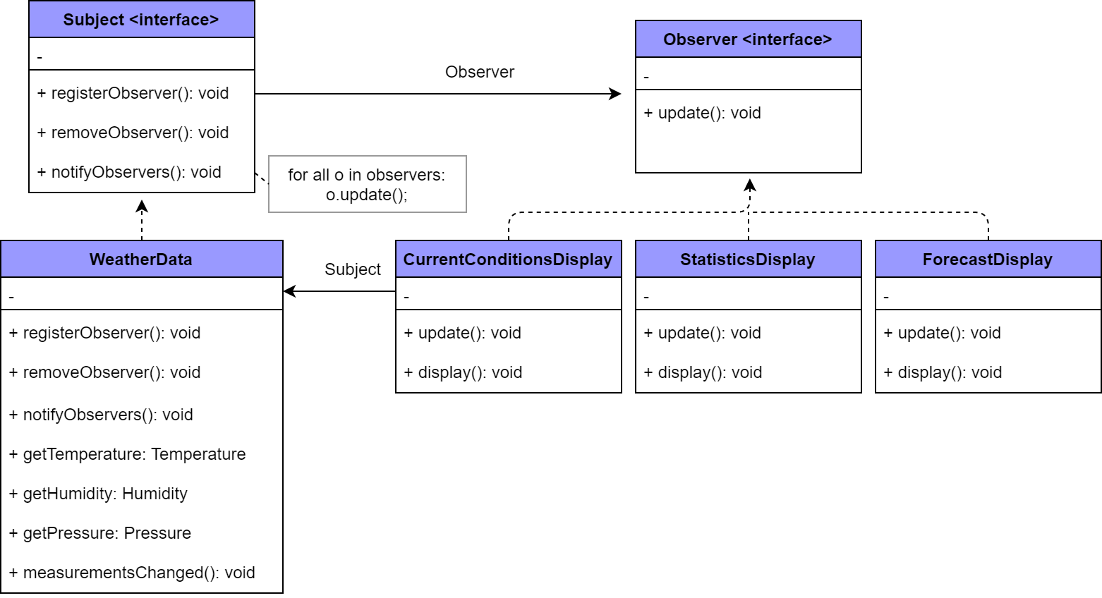
Solution
Solution

Slide 10
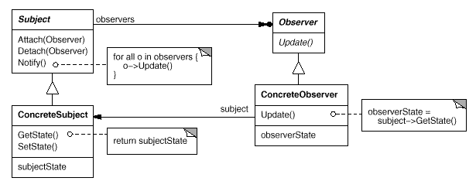
Solution
Observer Pattern

Slide 11
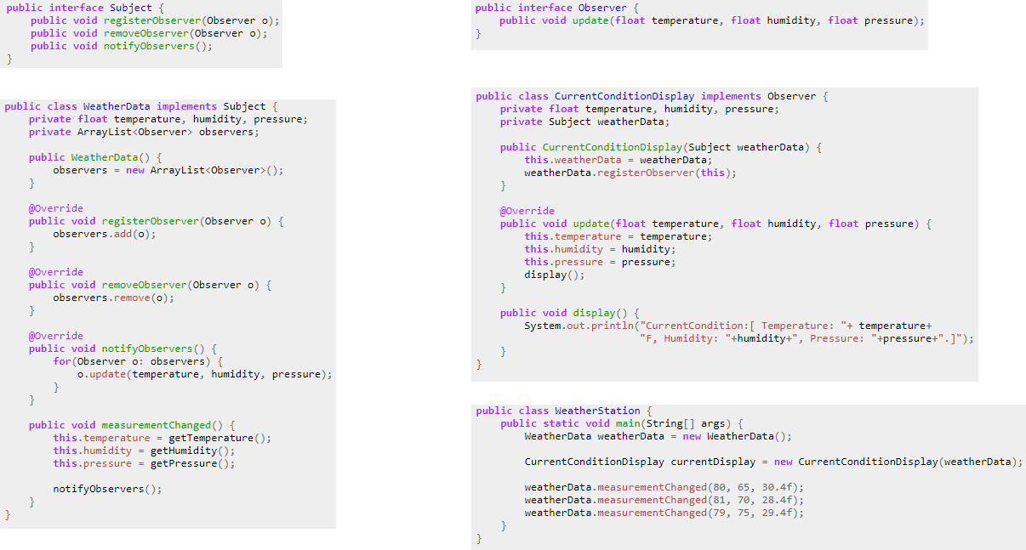
Solution
Implementation

Slide 12
ANY QUESTION ?
THANK YOU !

Slide 13
Acknowledgements
Acknowledgements
[1] Gamma, Erich. Design patterns: elements of reusable object-oriented software. Addison-Wesley Professional, 1 edition, 1994.
[2] Freeman, Eric, et al. Head first design patterns. " O'Reilly Media, Inc.", 2008.
[3] TutorialsPoint
[4] GeeksforGeeks

