Slide 1
SWE-4501: Design Pattern
Strategy Pattern
Md. Nazmul Haque
Lecturer, IUT
Department of Computer Science and Engineering
Islamic University of Technology
July 5, 2021
Notes:
Assalamualaikum, good day my respected teachers, audiences. Today I am going to present my thesis paper titled “Class Specific feature Selection for High Dimensional low sample size Data”. I am Nazmul haque and my supervisor is Dr. Mohammad Shoyaib.
Before going in detail about my Literature review, I would like to give an outline of my whole presentation.

Slide 2
Contents
Contents
Motivation
Solution

Slide 3
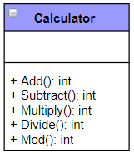
Motivation
Calculator design
Operations: Addition, Subtraction, Multiplication, Division and Modulo (optional).

Slide 4
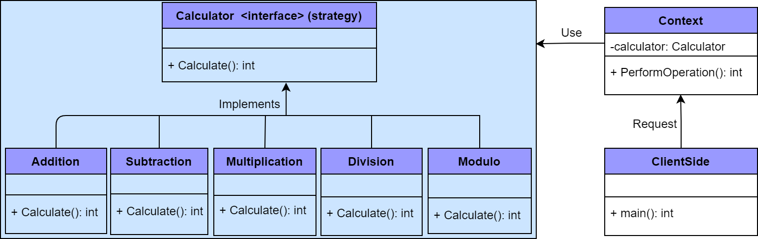
Solution
Calculator design
Solution

Slide 5
Motivation
Problem scenario
Suppose we are building a game “Street Fighter”. For simplicity assume that a character may have four moves that is kick, punch, roll and jump. Every character has punch and roll moves, but kick (Lightning/Tornado) and jump (Long/Short) are optional.

Slide 6
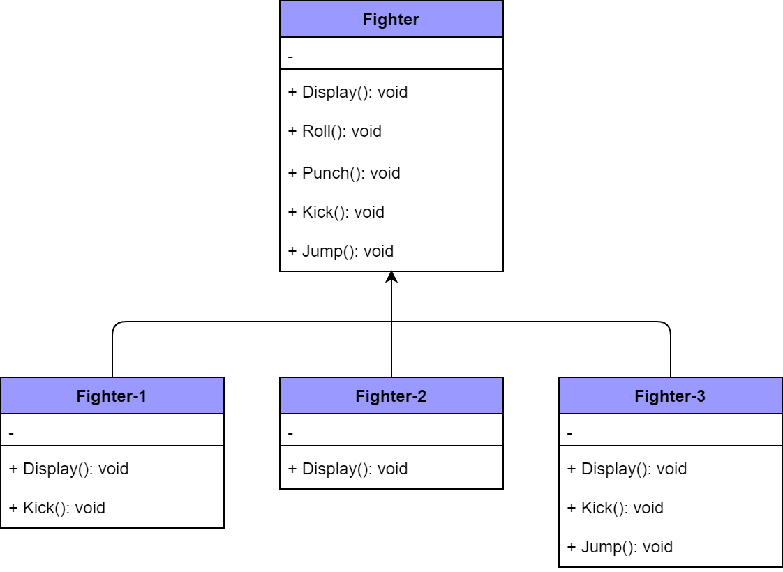
Solution
Probable solution
Notes:
What if a character doesn’t perform jump move? It still inherits the jump behavior from superclass. Although you can override jump to do nothing in that case but you may have to do so for many existing classes and take care of that for future classes too. This would also make maintenance difficult. So we can’t use inheritance here.

Slide 7
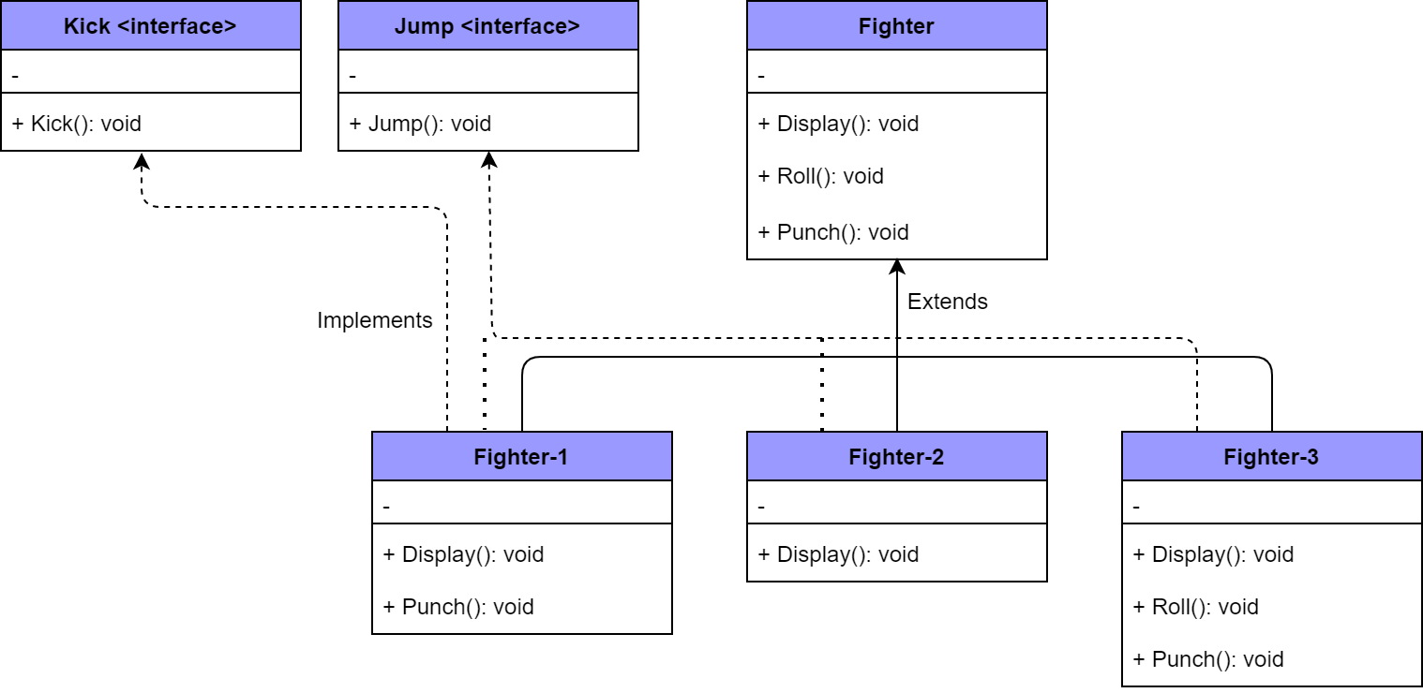
Solution
Probable solution
Notes:
The main problem with the above design is code reuse. Since there is no default implementation of jump and roll behavior we may have code duplicity. You may have to rewrite the same jump behavior over and over in many subclasses.

Slide 8
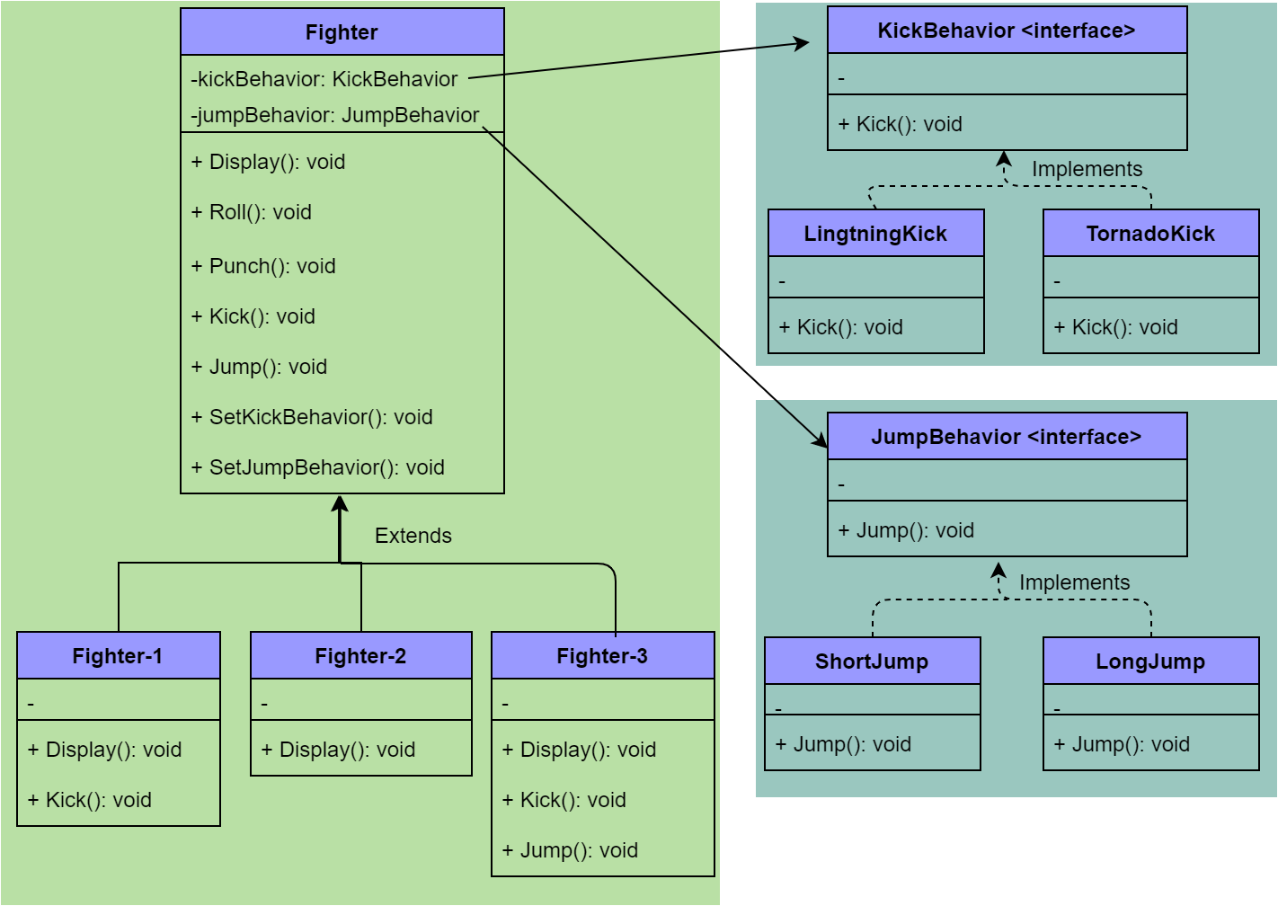
Solution
Probable solution

Slide 9
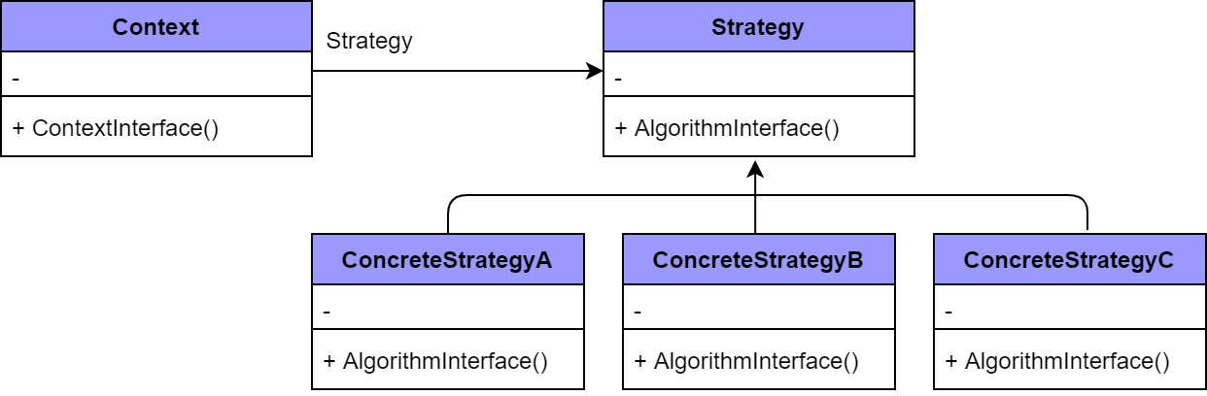
Solution
Strategy Design Pattern

Slide 10
ANY QUESTION ?
THANK YOU !

Slide 11
Acknowledgements
Acknowledgements
[1] Gamma, Erich. Design patterns: elements of reusable object-oriented software. Addison-Wesley Professional, 1 edition, 1994.
[2] Freeman, Eric, et al. Head first design patterns. " O'Reilly Media, Inc.", 2008.
[3] TutorialsPoint
[4] GeeksforGeeks

