Slide 1
Chatbots
After the hype now the fail?
Notes:
Robert

Slide 2


Robert Schlaeger
Developer
schlaeger@medialesson.de
@RobAnybody_
Notes:
Robert

Slide 3
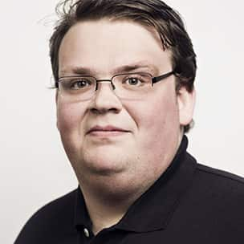
Sebastian Jensen
Developer
jensen@medialesson.de
@tsjdevapps
Notes:
Sebastian

Slide 4
What is a chatbot?
A chatbot is a computer program or an artificial intelligence which conducts a conversation via auditory or textual methods.
Such programs are often designed to convincingly simulate how a human would behave as a conversational partner.
Source: Wikipedia
Notes:
Sebastian

Slide 5
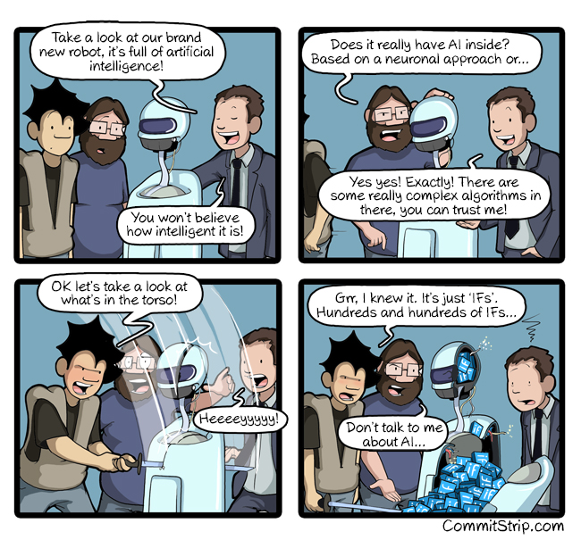
Chatbots with AI?!
http://www.commitstrip.com/en/2017/06/07/ai-inside/
Notes:
Sebastian

Slide 6
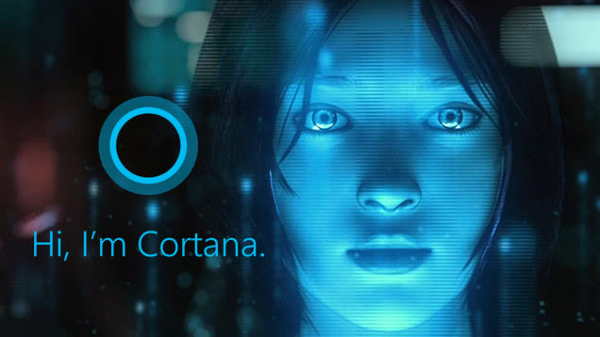
What is the Microsoft Botframework?
Notes:
Robert

Slide 7

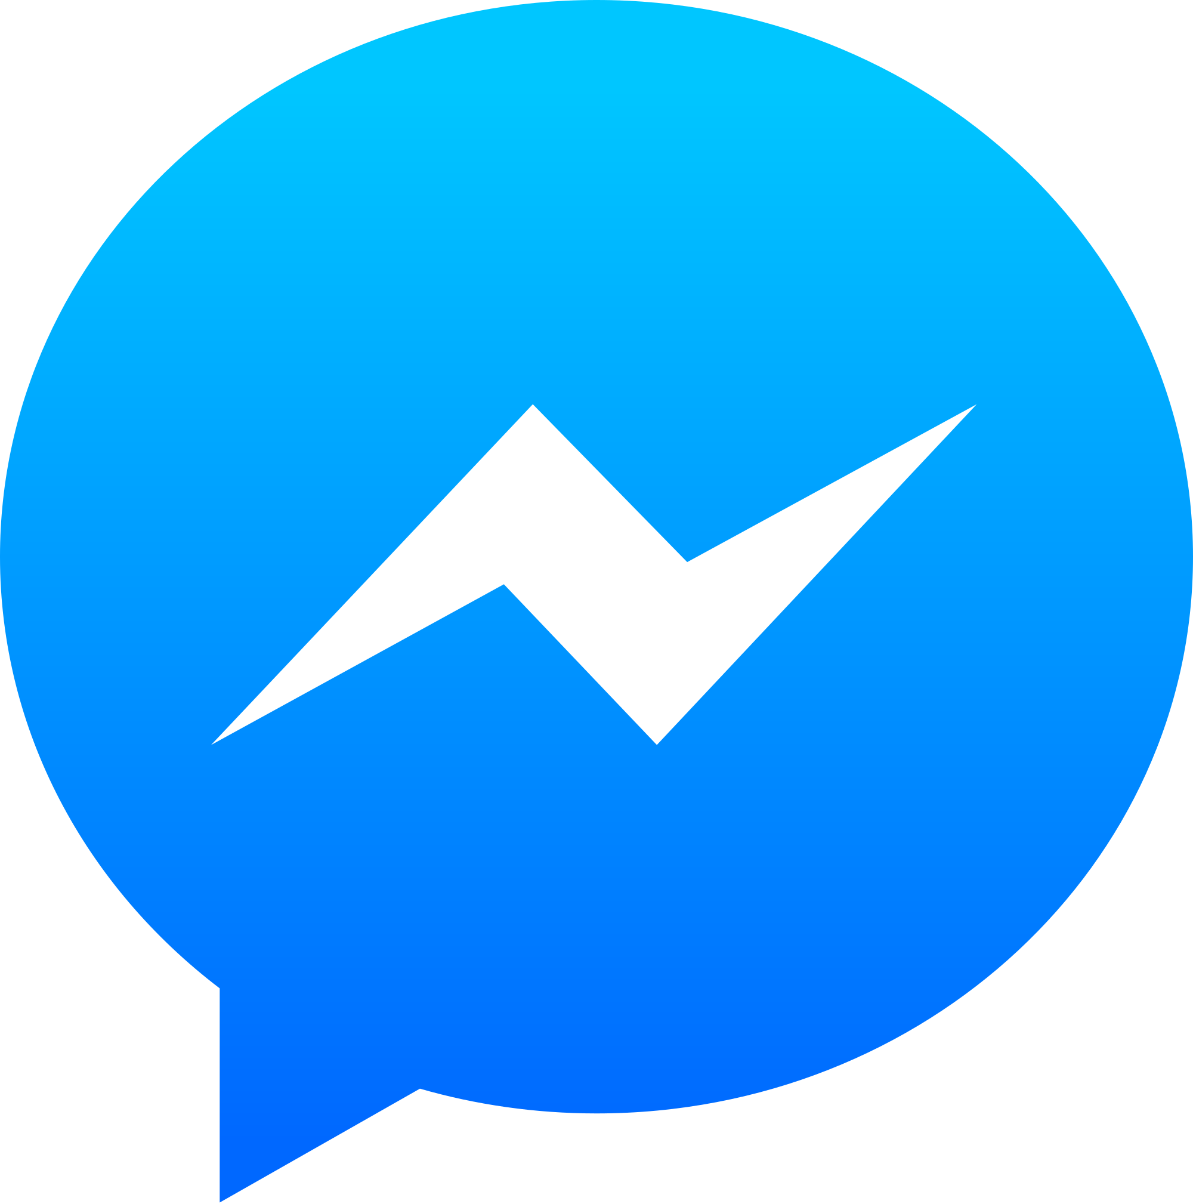

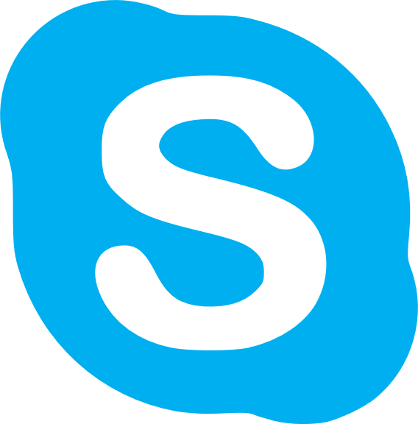
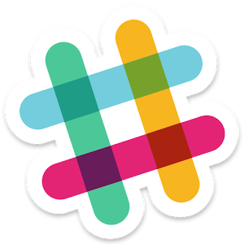
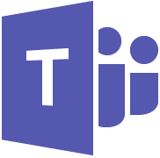
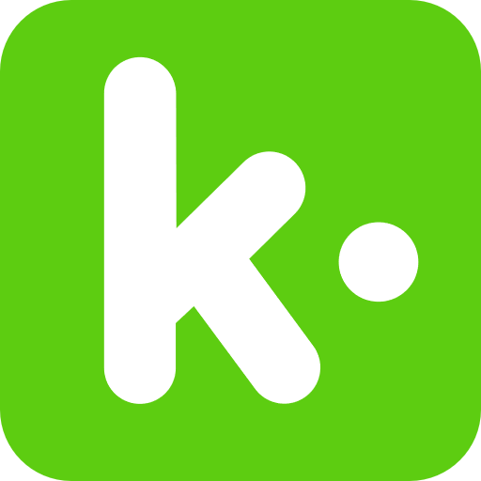


Some supported Channels…
Notes:
Robert

Slide 8
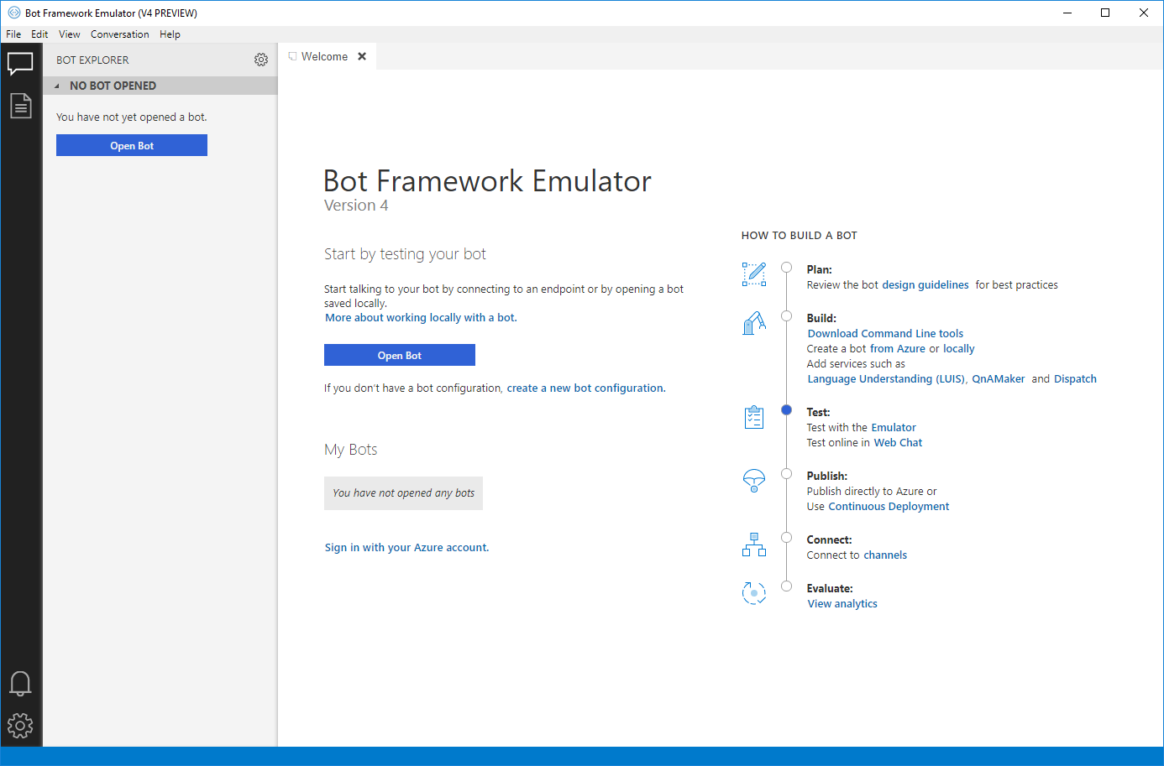
Local Testing
Notes:
Sebastian

Slide 9
Demo
Notes:
Sebastian + Robert

Slide 10
Pros of BotFramework
Pretty simple to start the development, for example QnA Maker
Many supported channels which can easily be used
Can also be deployed to different cloud providers like AWS
Notes:
Sebastian

Slide 11
Cons of BotFramework
Some popular channels are missing, for example Alexa
Pricing
Notes:
Sebastian

Slide 12
Resources
Microsoft BotFramework
https://dev.botframework.com/
QnA Maker
https://www.qnamaker.ai/
Luis
https://eu.luis.ai/
Notes:
Sebastian + Robert

Slide 13
Any questions?
Notes:
Sebastian + Robert

Slide 14
Thank you for
your interest!
www.medialesson.de
Notes:
Sebastian + Robert

