Slide 1
Chatbots
After the hype now the fail?
Notes:
Robert

Slide 2


Robert Schlaeger
Developer
schlaeger@medialesson.de
@RobAnybody_
Notes:
Robert

Slide 3
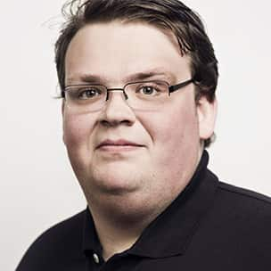
Sebastian Jensen
Developer
jensen@medialesson.de
@tsjdevapps
Notes:
Sebastian

Slide 4
What is a chatbot?
A chatbot is a computer program or an artificial intelligence which conducts a conversation via auditory or textual methods.
Such programs are often designed to convincingly simulate how a human would behave as a conversational partner.
Source: Wikipedia
Notes:
Sebastian

Slide 5
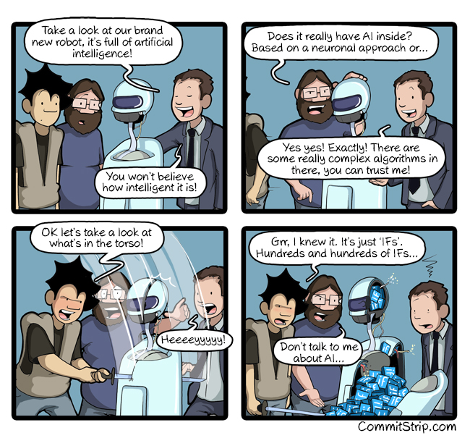
Chatbots with AI?!
http://www.commitstrip.com/en/2017/06/07/ai-inside/
Notes:
Sebastian

Slide 6
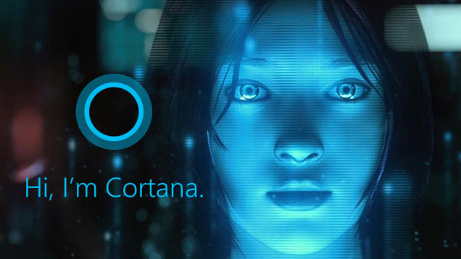
What is the Microsoft Botframework?
Microsoft
Notes:
Robert

Slide 7

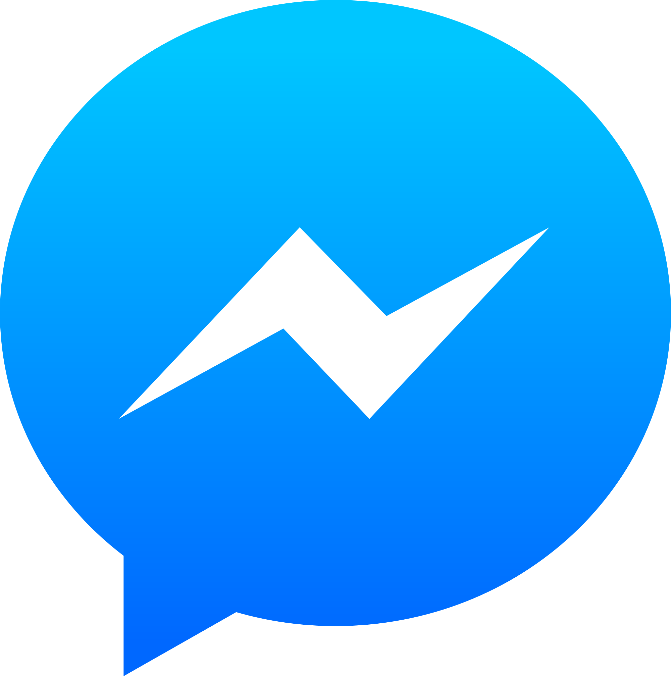

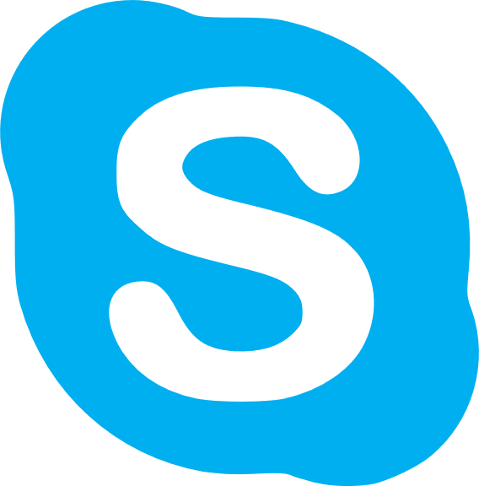
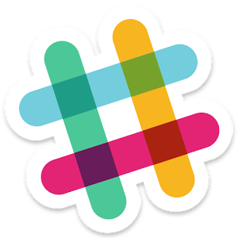
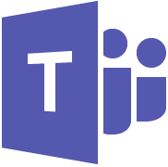
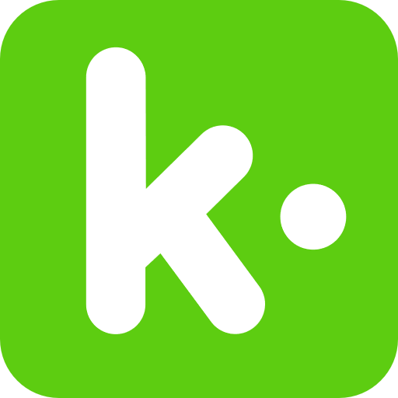


Some supported Channels…
Notes:
Robert

Slide 8
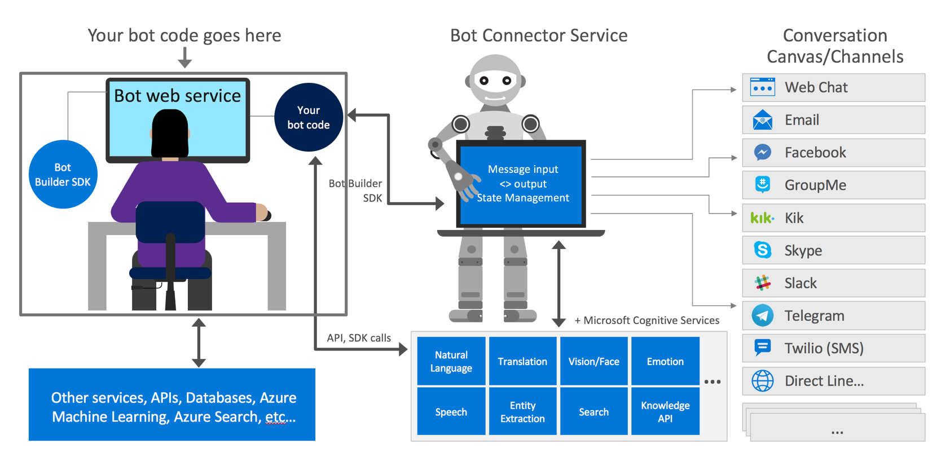
What is the Microsoft Botframework?
https://i.stack.imgur.com/DWxHb.png
Notes:
Sebastian

Slide 9
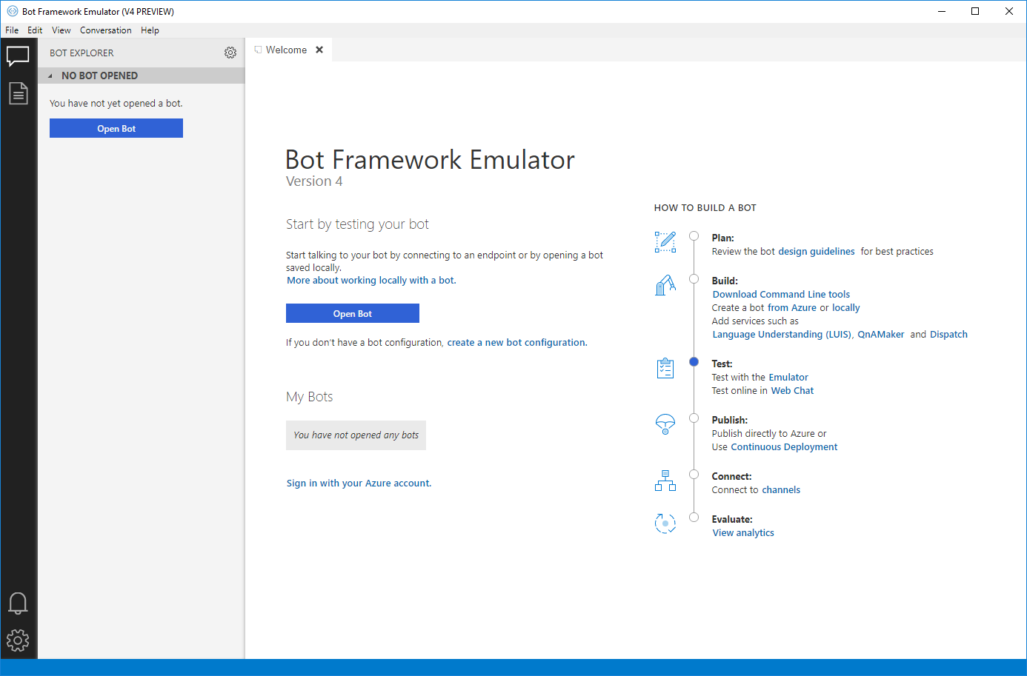
Local Testing
Notes:
Sebastian

Slide 10
Demo
Notes:
Sebastian + Robert

Slide 11
Pros of BotFramework
Pretty simple to start the development, for example QnA Maker
Many supported channels which can easily be used
Can also be deployed to different cloud providers like AWS
Notes:
Sebastian + Robert

Slide 12
Cons of BotFramework
Some popular channels are missing, for example Alexa
Pricing
Notes:
Sebastian + Robert

Slide 13
After the hype now the fail?
Short Answer
No
Long Answer
Currently not, because the tool chain is getting better and better. All the global players like Google, Microsoft and Amazon are committed to their speech assistant and they will improve each day. Also we are moving from typing with the chat bot to talking with the chat bot, like Amazon Alexa.
Notes:
Robert

Slide 14
Resources
Microsoft BotFramework
https://dev.botframework.com/
QnA Maker
https://www.qnamaker.ai/
Luis
https://eu.luis.ai/
Notes:
Sebastian + Robert

Slide 15
Any questions?
Notes:
Sebastian + Robert

Slide 16
Thank you for
your interest!
www.medialesson.de
Notes:
Sebastian + Robert

