Slide 1
Ref vs SCNA

Slide 2
Steps for checking:
Espace - equivalent except for parameters
Post processing - identical arguments, identical executables
Examine difference in E values per catchment and then per substance
Examine differences in Cdis for 4 compounds, 2 with increase, 2 with decrease, 2 pharmaceuticals, 1 REACH, 1 pesticide

Slide 3
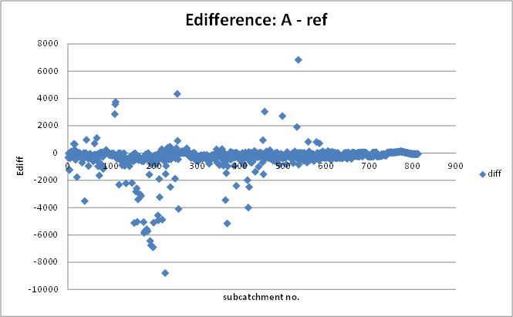
E factor per catchment,
Not all positive differences between SCNA and reference. We would expect SCN A to have a higher E for all substances, except maybe pharmaceuticals

Slide 4
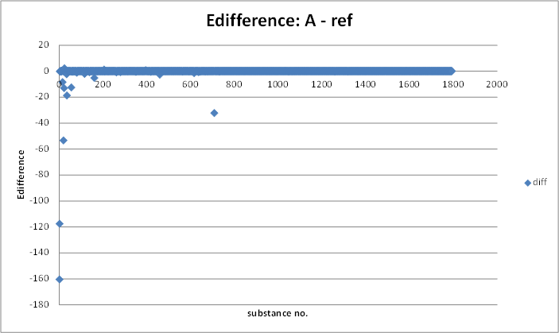
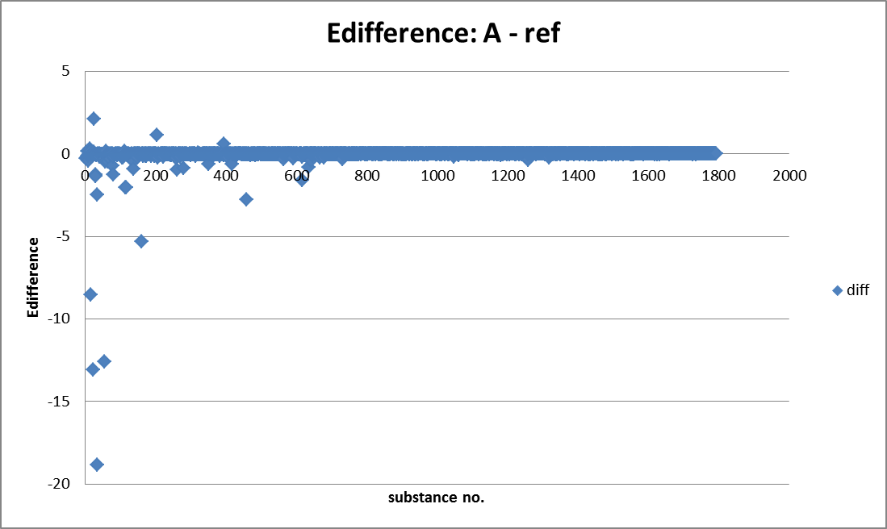
E factor per substance
Not all positive differences between SCN A and reference

Slide 5
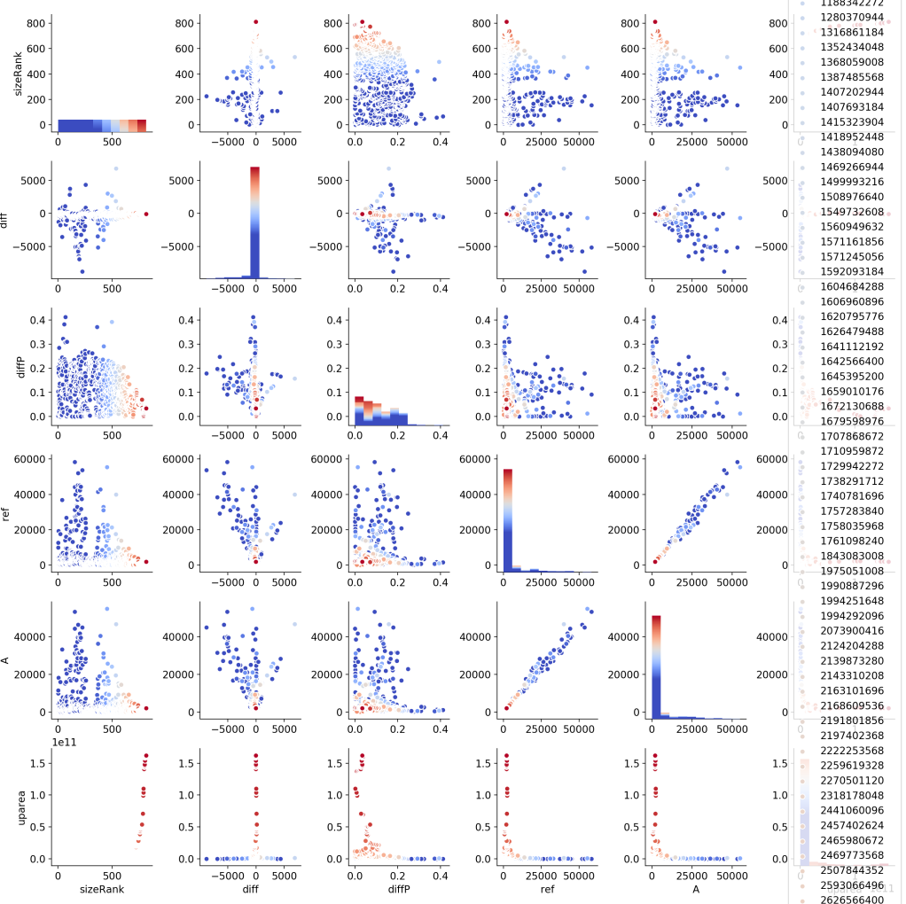
Catchment based E(ref), E(A), Ediff(ref,A), hue is upstream area
We see that the difference is generally larger for smaller sub catchments, both the absolute difference (diff) and relative difference (diffP, relative to magnitude of E)

Slide 6
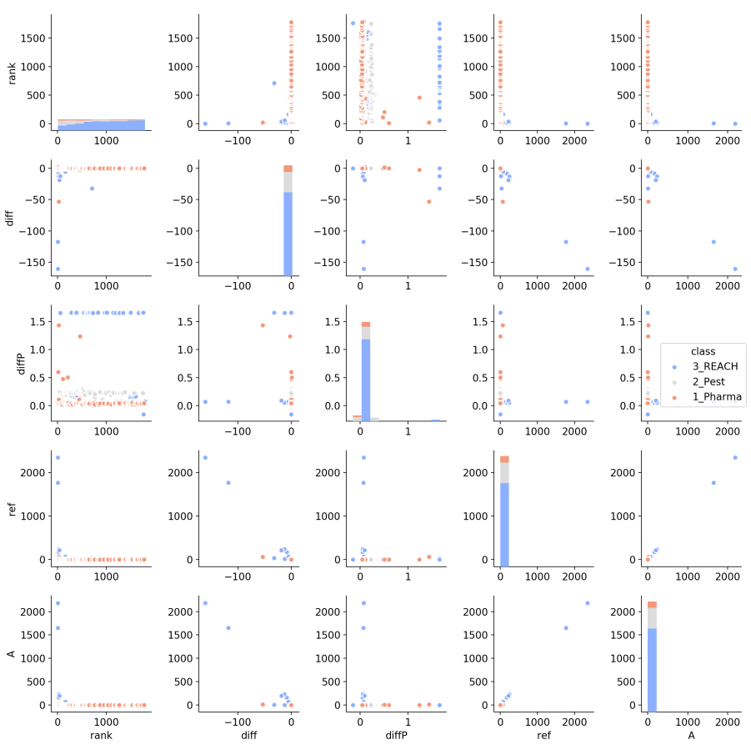
Substance based E(ref), E(A), Ediff(ref,A), hue is substance
We see that the reach chemicals tend to be the ones that deviate most strongly, there are a few chemicals that dominate (or have much higher) E values. Numerous reach chemicals have deviations between the two simulations that are larger than the magnitude of E itself
This is odd, some systematic difference between diffP based on class

Slide 7
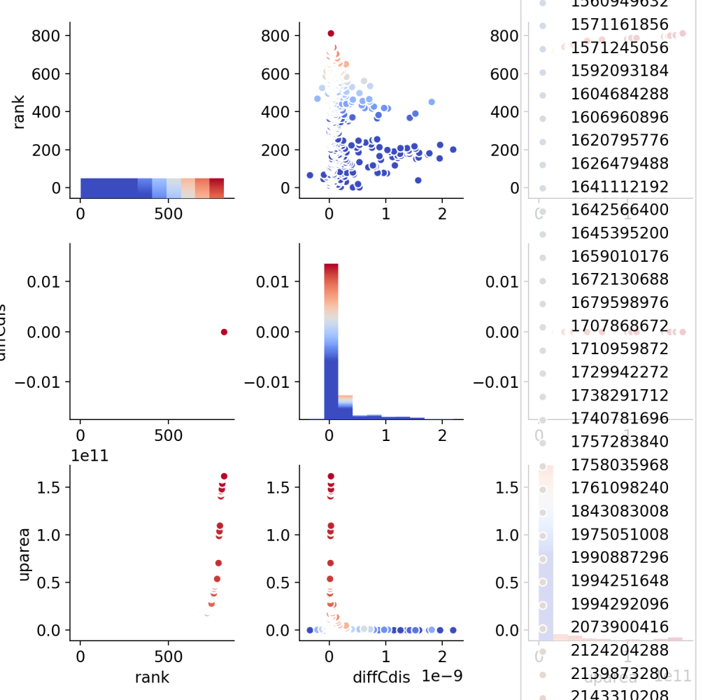
100986-85-4 (pharma, Ediff = 9e-6), Cdis difference
For a pharmaceutical 100986-85-4, positive difference (E = 9e-6), differences in Cdis are clustered in smaller subcatchments, 98.5% show increase for A vs ref

Slide 8
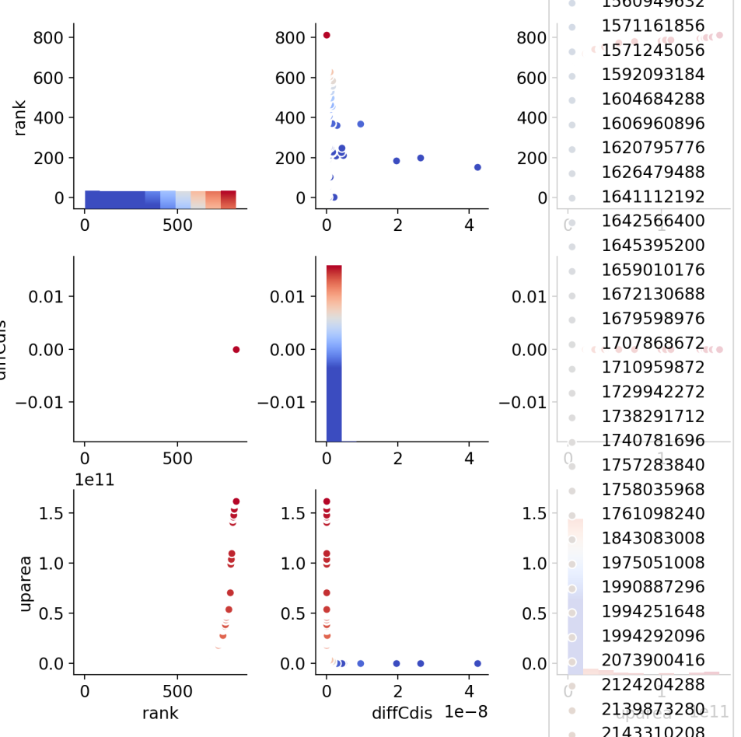
52918-63-5 (Pest, Ediff = 0.3), Cdis difference
For a Pesticide 52918-63-5, positive difference (E = 0.3), differences in Cdis clustered in smaller subcatchments, 100.0% show increase for A vs ref

Slide 9
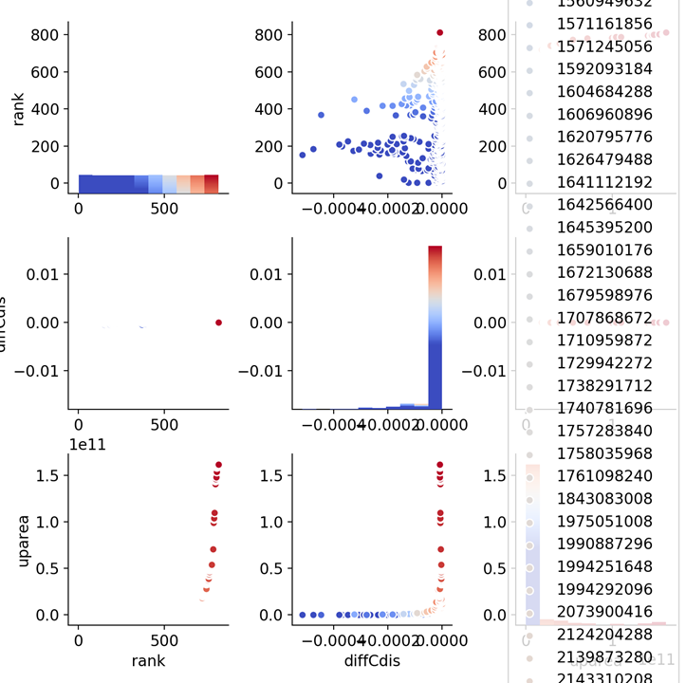
103-90-2 (pharma, Ediff = -2.75), Cdis difference
For pharmaceutical 103-90-2, negative difference (E = -2.75), differences clustered in smaller subcatchments, 0% show increase for A vs ref
A factor = 0.24

Slide 10
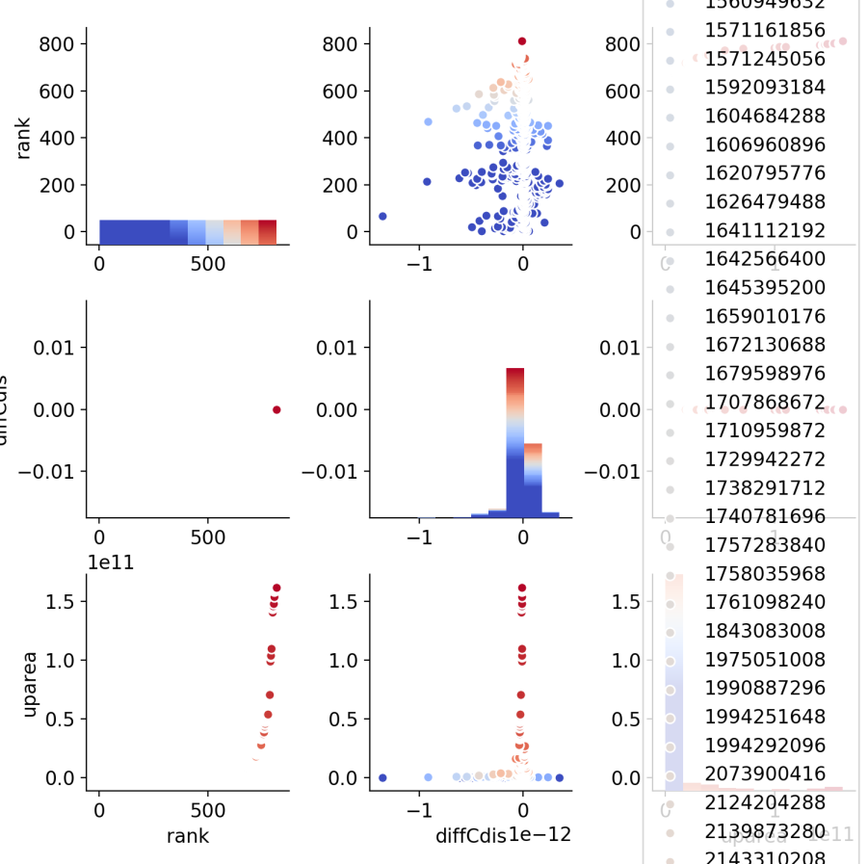
118-82-1 (Reach, Ediff = -117), Cdis difference
For reach 118-82-1, negative difference (E = -117, second lowest), differences in Cdis are clustered in smaller subcatchments, but effect is less drastic than for others, 53% show increase in A vs ref

Slide 11
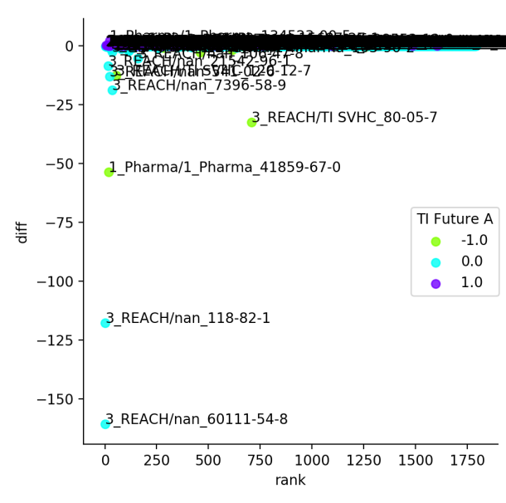
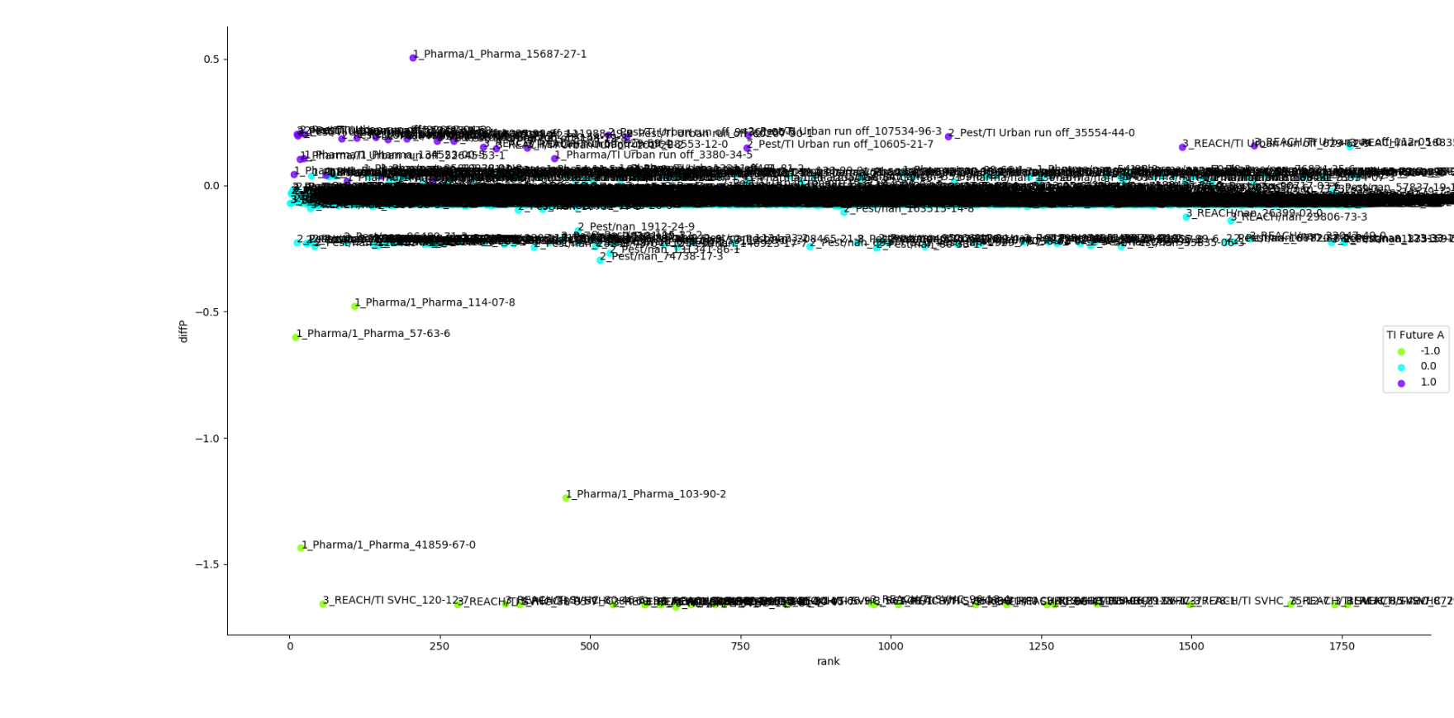
Incorporate the SCNA scaling
Many of the differences are expected. We expect blue above the 0 line and green/yellow below it.
What is unexpected that we see is there is a band of predominately reach chemicals which have deviated from 0 in the negative direction. This is not exclusive to reach
Large culprits are (all reach):
60111-54-8
118-82-1
7396-58-9

Slide 12
Aug 30 –
From the looks of it, after redoing the work in python, I had copied the wrong CSV file to chk_sub tab, as the numbers actually match those seen in p:\1209104-solutions\WP14\SIM\_Scen\QP_RhineChf_old\_PP-IF\chfootprintA.csv instead of
p:\1209104-solutions\WP14\SIM\_Scen\QP_RhineChf\PP-IF\chfootprintA.csv
This was confirmed by running the script in Python

Slide 13
Run selected substances
Running espace in _Prod/EP_Europe_Scn for the reference runs, keeping binary and his files, these are ‘reference’ runs that are redone
Running espace in _Scen/EP_Europe_Scn for the scenario A runs, keeping binary and his files,

Slide 14
22047-49-0
Message file appears to be consistent between ref and A
CdisEnd file shows numerous positive and negative differences between final concentration in each subcatchment, as big as a -31% difference
The same can be said for the CdisAvg file

