Slide 1
DFMWAQ with Python
Rudy Schueder and Lauriane Vilmin

Slide 2
Agenda
D-Flow with processes (DFMWAQ) use case
Why might you want to use scripting?
Arranging the input data
Making the model
Making a restart file
Examining the balances
Making coastal water quality boundaries (if there is time)
Remember: Still beta!
These python tools are not a Deltares product

Slide 3
Use case
Total time for simulation
In the past
Hydro model
WQ model
Parallelizability
Common now
Hydro model
WQ model

Slide 4
D-FLOW with processes – parallelizing water quality simulations
Pro: no more big water balance files
Pro: no other coupling problems (e.g. changes in cell numbers in D-WAQ compared to D-FLOW)
Pro: no parallelized transport solver in D-WAQ needed
Con: rerunning hydrodynamics is expensive (in CPU time)
It is common that you might want to compare the speed of an online model with that of an offline model
For this you need to be able to create the same model twice using quite different architectures
It is best to do this in a structured way

Slide 5
Typical workflow to consider
The user has a D-FLOW hydrodynamic model that they want to use as the foundation of a water quality model
Run the FLOW model, obtain coupling output files, and import into DeltaShell
Set up the water quality simulation and run D-WAQ
What if you want to see if D-FLOW with processes is a good choice for your application??
Option 1:
Augment the D-FLOW model in Deltashell to include processes (shown in previous workshop)
Option 2:
‘Grow’ a new model using the old D-FLOW model and a sub file
This is what we will look at today

Slide 6
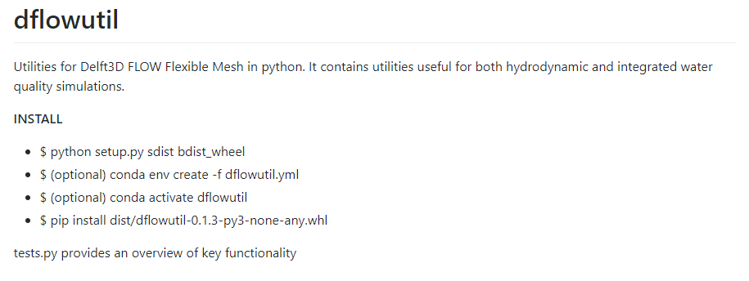
‘Grow’ a D-FLOW with processes model
Model Prerequisites:
A D-FLOW model
A sub file
Deltashell-format boundary condition files (optional)
These will be provided for this workshop
Python Prerequisites
Download the following repository: https://github.com/RSchueder/dflowutil
Follow readme instructions

Slide 7
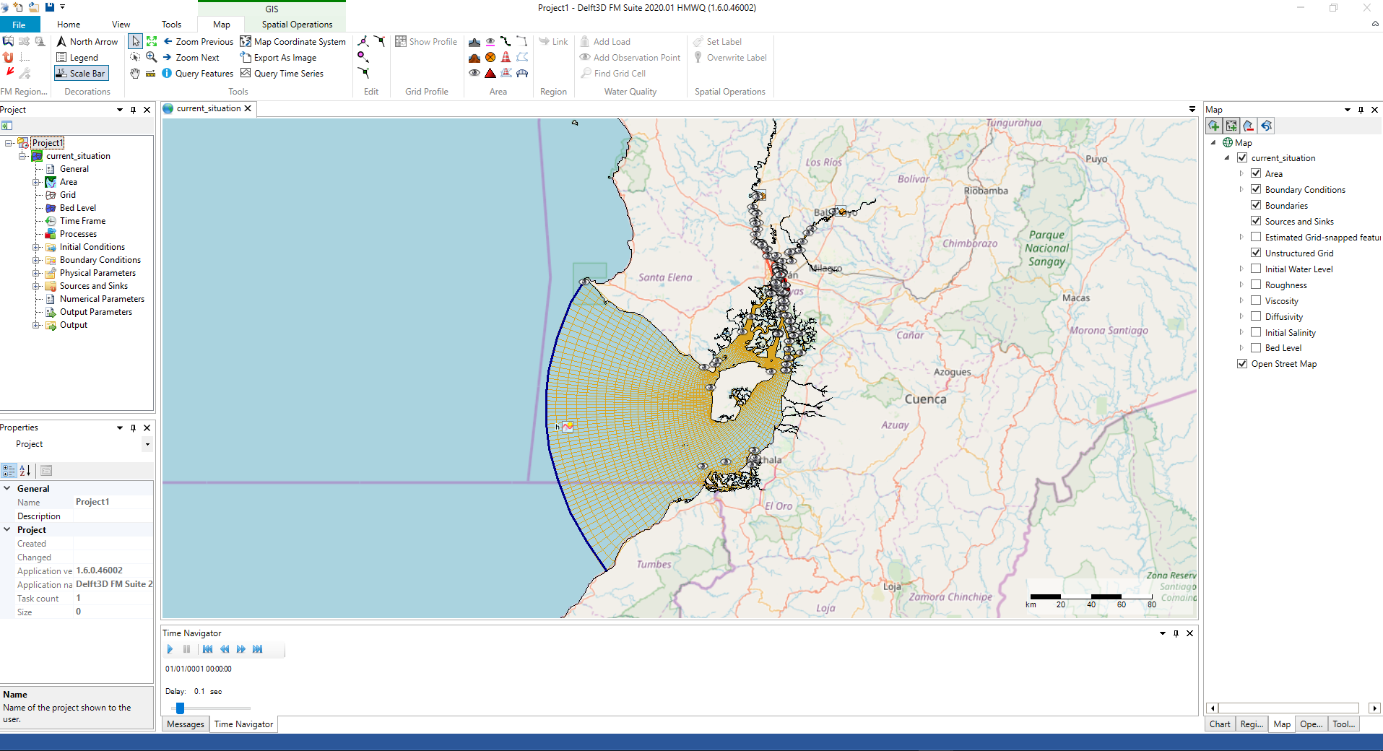
The FLOW model we will be working with
Path = \dflowutil\tests\DSD\00_src\current_situation.mdu
Rivers
WWTP
Open this model in deltashell
Sea

Slide 8
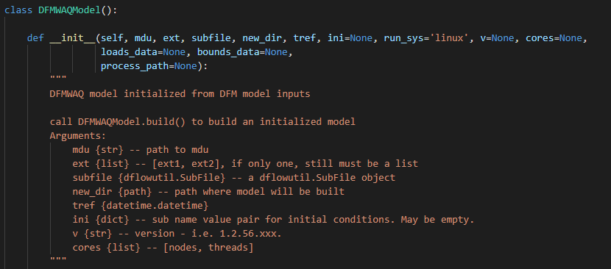
dflowutil.DFMWAQModel
dflowutil is a python package
DFMWAQModel is a module of the package
It is a class that holds information and functions needed to build a new D-FLOW with processes model from a D-FLOW model

Slide 9
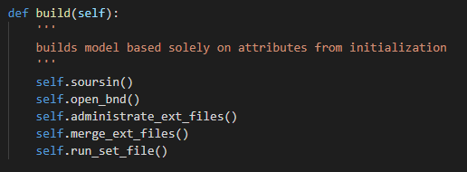
What does dflowutil.DFMWAQModel do?
It builds an entire model from a sub file. This way there is no room for mistake in the ordering of substances in the loads file!
It scans the mdu for all model assets, excluding boundary conditions (specify these explicitly)
It creates boundary conditions for all transportable substances. The data is either dummy (== 0) or is taken from deltashell-formatted *.csv files (if available)
It creates initial conditions for all substances, either uniform, or as 2D field

Slide 10
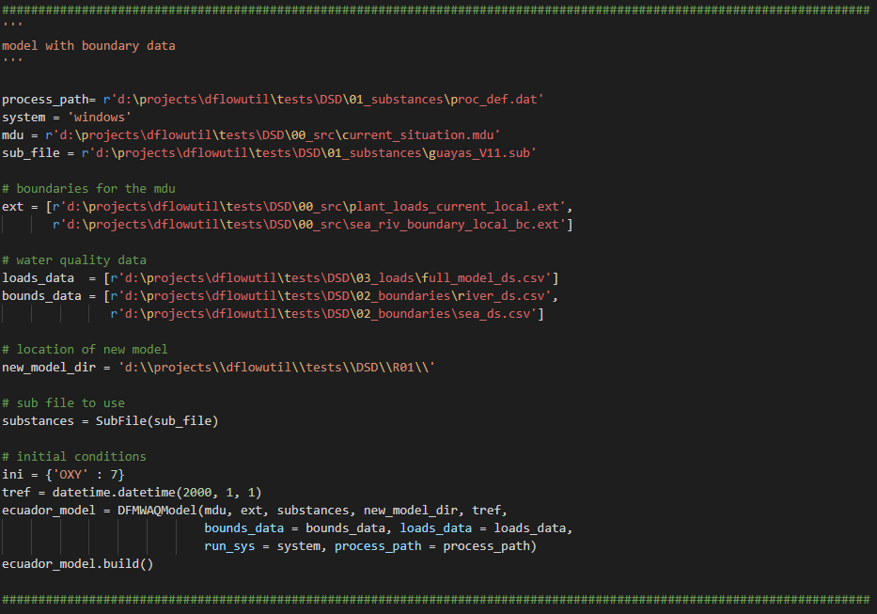
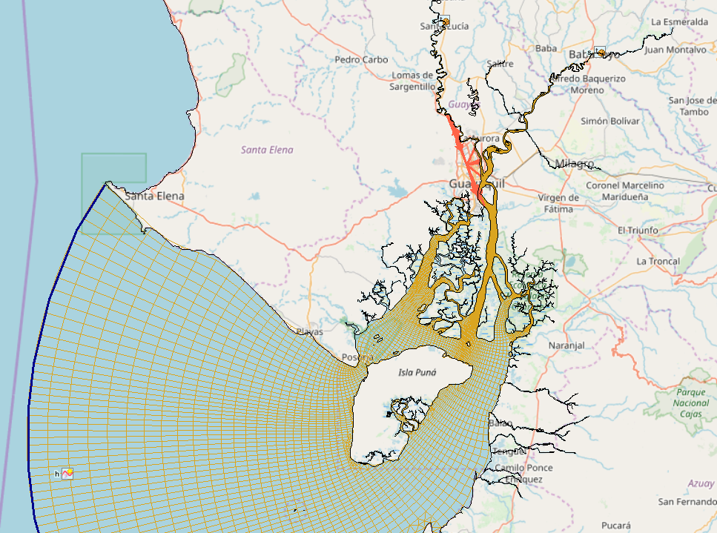
How can I use it: making the model
\dflowutil\make_model.py
Task for you: Please edit the paths

Slide 11
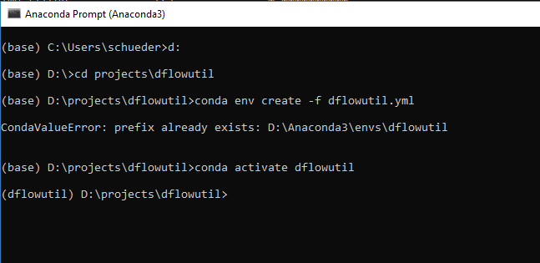
Set up conda environment and running
\dflowutil\make_model.py
python make_model.py

Slide 12
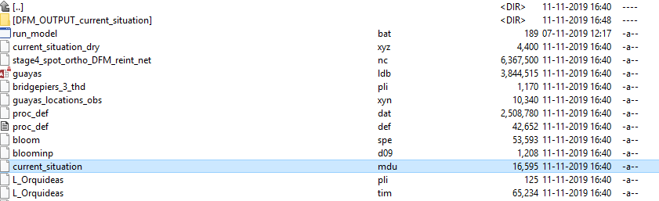
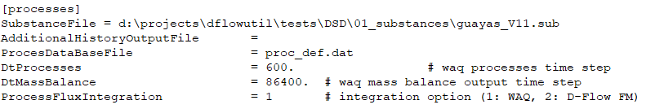
Examine the new model
d:\projects\dflowutil\tests\DSD\R01\

Slide 13
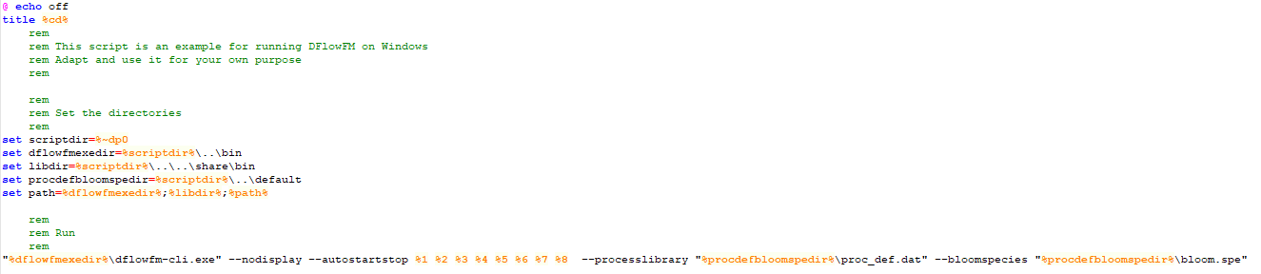
Running the model
We need to edit a batch file to allow for running in this exercise
C:\Program Files (x86)\Deltares\Delft3D FM Suite 2020.01 HMWQ (1.6.0.46002)\plugins\DeltaShell.Dimr\kernels\x64\dflowfm\scripts\run_dflowfm_processes.bat
Ensure there are quotes here

Slide 14
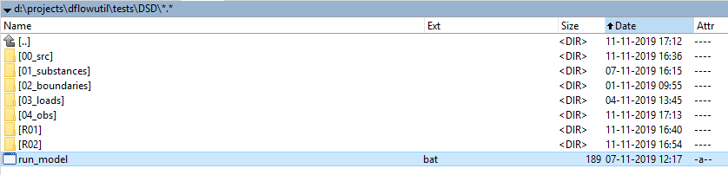
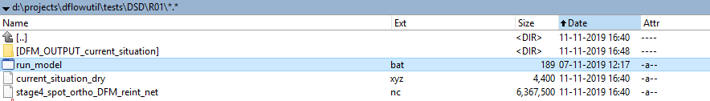
Run and take a break
Copy the bat file to the run directory

Slide 15
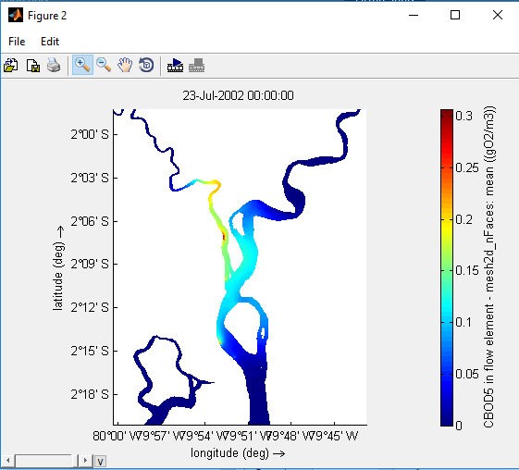
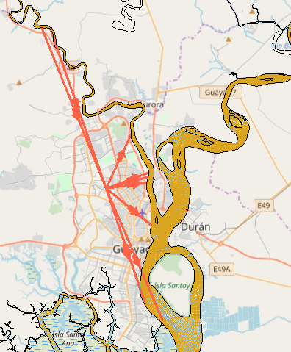
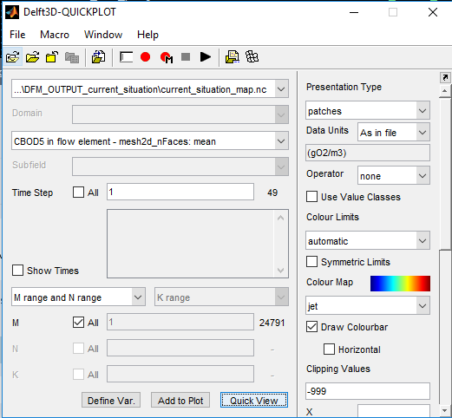
Take a look at the results

Slide 16
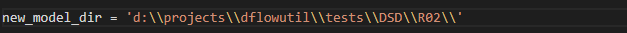
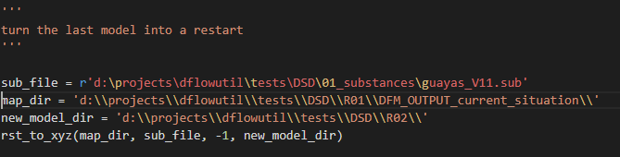
Making a restart
\dflowutil\make_restart.py
\dflowutil\make_model.py (you ran this earlier)
\dflowutil\make_restart.py
python make_restart.py

Slide 17
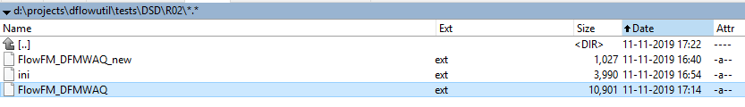
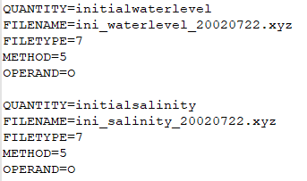
Adding the restart to the model
Open R02/FlowFM_DFMWAQ.ext
Delete old initial conditions from bottom of file
Open R02/ini.ext
Copy contents from ini.ext -> FlowFM_DFMWAQ.ext
In FlowFM_DFMWAQ.ext , rename:
initialtracers1 -> initialwaterlevel
initialtracersa1 -> initialsalinity
Delete from top of FlowFM_DFMWAQ.ext :

Slide 18
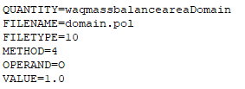
Adding a balance area to the model
Good idea to include balances so you can examine the relative contribution of different loads
The domain.pol file was created for you when the model was created.
It is a polygon that contains the entire domain
Add to -> \dflowutil\tests\DSD\R02\FlowFM_DFMWAQ.ext

Slide 19
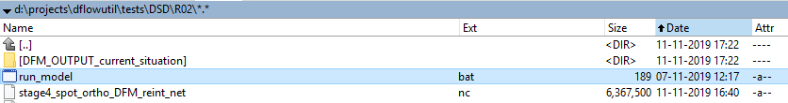
Run and take a break
Copy the bat file to the run directory

Slide 20
Take a look at the results

Slide 21
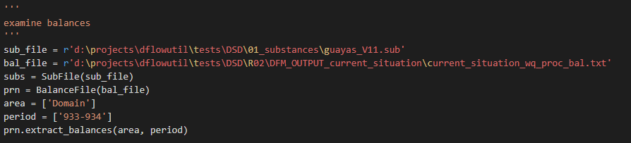
Create balances
\dflowutil\make_balances.py

Slide 22
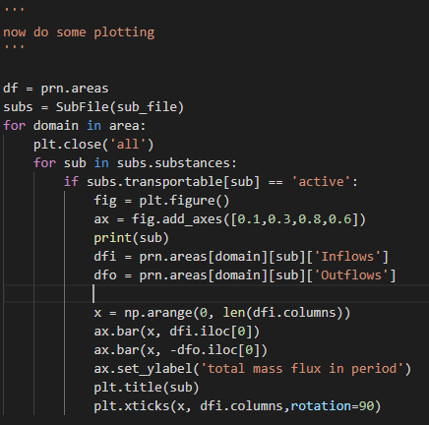
Create balances
\dflowutil\make_balances.py

Slide 23
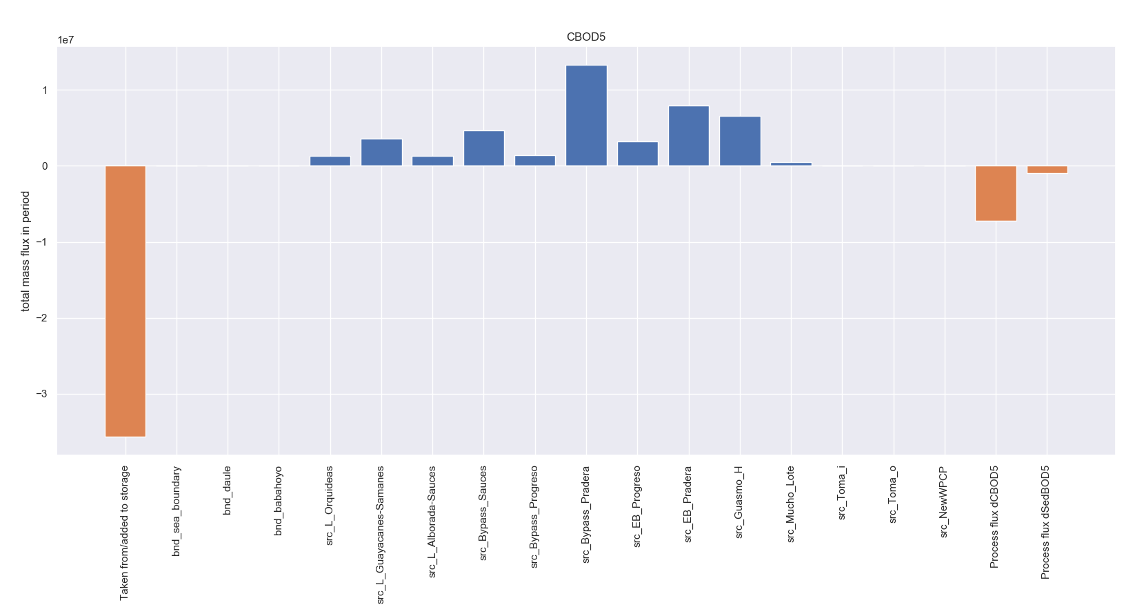
Examine balances

Slide 24
Conclusion
We started with a D-Flow FM hydrodynamic model and decided to add water quality processes to it
We obtained a substance file, and some Deltashell-formatted csv files
We built a new D-Flow FM model from the old one, with new boundaries and a new [processes] section in the mdu
We ran the model and examined the output
We created restart samples from one model and ran a new model using this initial condition
We examined the computed mass balances for different substances
Notes:
Does not support 3D boundaries yet. See https://github.com/RSchueder/COASTSERV_Model/tree/FlaskApp for examples of how to do this using CMEMS data
Did not cover things like spatial parameters (critical shear stress) or temporal functions (i.e. solar radiation). These are possible to use!
Not extensively tested, not an official Deltares product, collaboration is welcome!

Slide 25
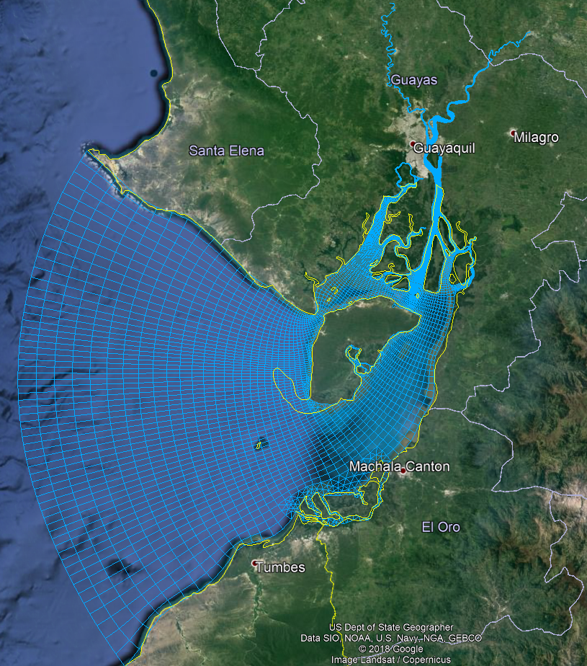
Any questions?

Slide 27
Making the DFMWAQ model
\dflowutil\make_model.py

