Slide 2
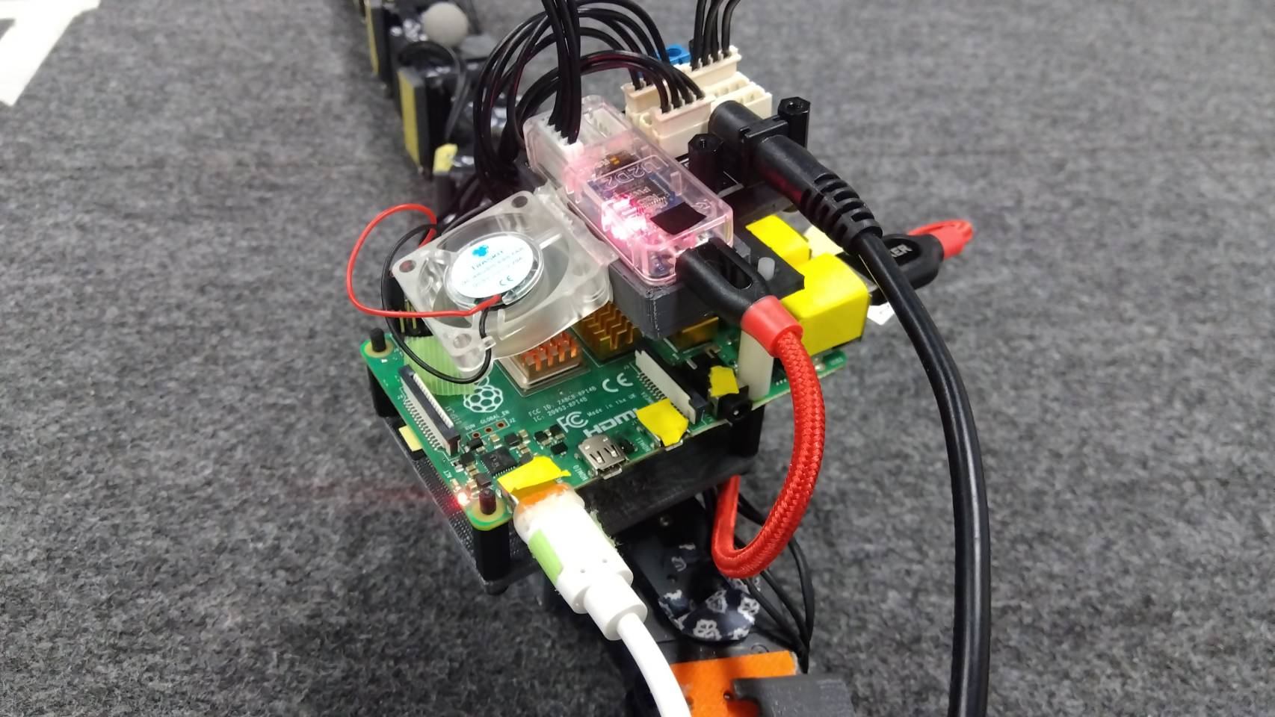
Servo Motor
Raspberry Pi

