Slide 1
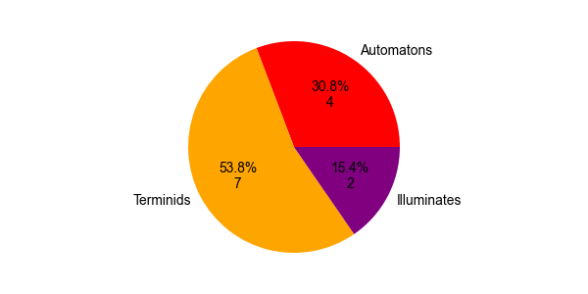
Number of deployments by front
Automatons
Illuminates
Terminids
The majority of deployments in the bug front reflect the 505th responsiveness to the bug major orders issued in the period

Slide 2
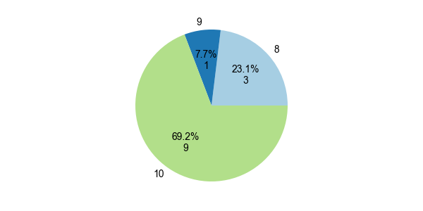
T8
T9
T10
The 505th don’t back down and face the most difficulty missions available in the name of our beloved Super Earth

Slide 3
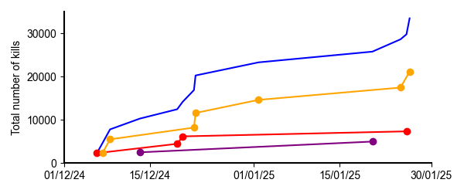
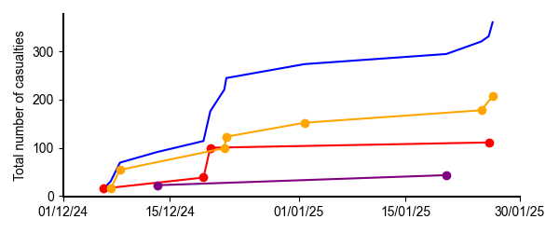
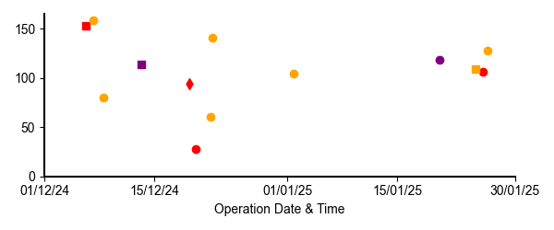
Total
Terminids
As expected, due to the number of deployments, most of our confirmed kills and casualties happened in the bug front
Automatons
Illuminates
Total
Terminids
Automatons
Illuminates
There is no clear correlation of K/D ratio with difficulty, however the number of non-T10 operations is low
Circle – T10
Square – T9
Diamond – T8
K/D Ratio

Slide 4
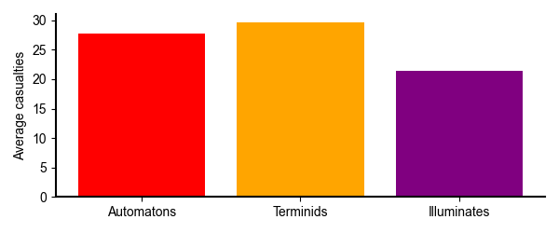
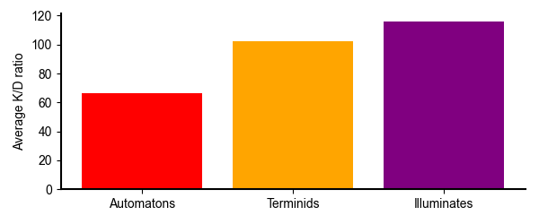
As expected, due to the number of deployments, most of our confirmed kills and casualties happened in the bug front
Stats:
Average Kills per Deployment (All three operations): 2574.6 --- 643.7 per helldiver
Average Casualties per Deployment (All three operations): 27.8 --- 6.9 per helldiver
Average Kills/Casualty ratio: 92.7
Automaton front
Average Kills per Deployment (All three operations): 1835.2 --- 458.8 per helldiver
Average Casualties per Deployment (All three operations): 27.8 --- 6.9 per helldiver
Average Kills/Casualty ratio: 66.1
Terminid front
Average Kills per Deployment (All three operations): 3021.7 --- 755.4 per helldiver
Average Casualties per Deployment (All three operations): 29.6 --- 7.4 per helldiver
Average Kills/Casualty ratio: 102.2
Illuminate front
Average Kills per Deployment (All three operations): 2488.5 --- 622.1 per helldiver
Average Casualties per Deployment (All three operations): 21.5 --- 5.4 per helldiver
Average Kills/Casualty ratio: 115.7

