Slide 1
CityVille
Adam Moulton
Alain Edwards
Lance Williams

Slide 2
CityVille
An application that displays to users events/activities currently around them through the use of Google Maps.
These activities can range between educational activities such as an upcoming Museum event or entertainment events for example a festival.
Anybody who uses the application can even upload their own events for other users to view

Slide 3
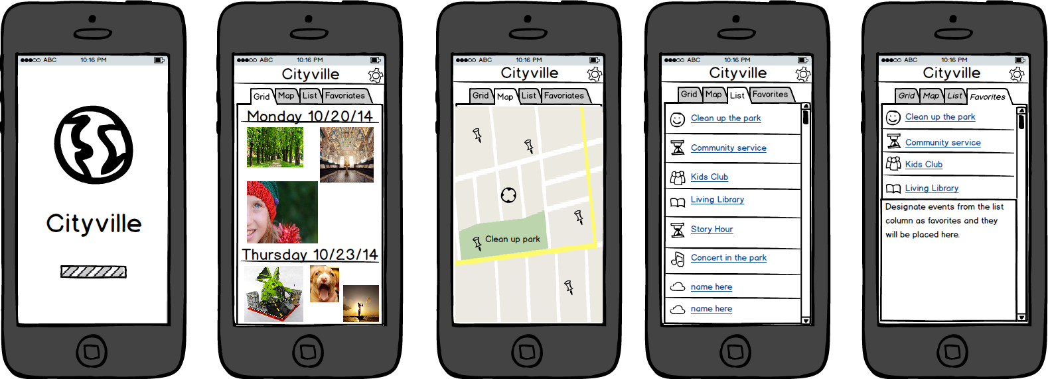
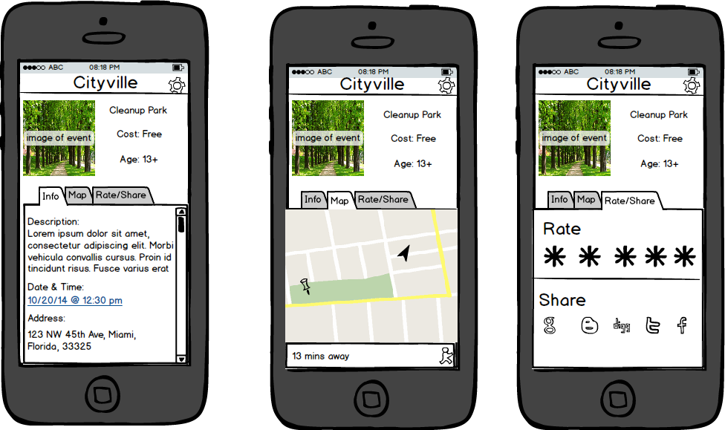
Early Mockups

Slide 4
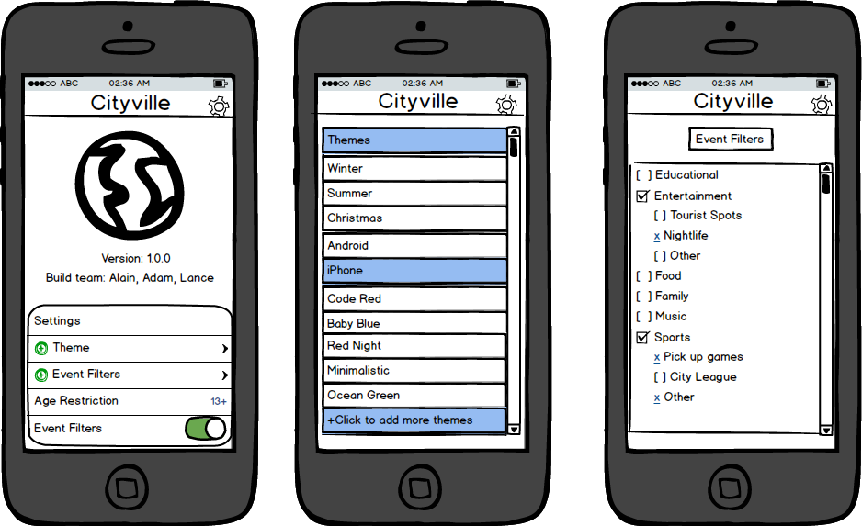
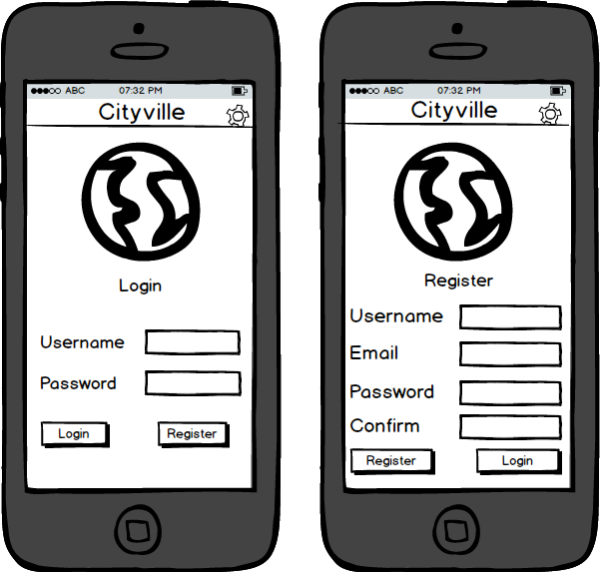
Early Mockups

Slide 5

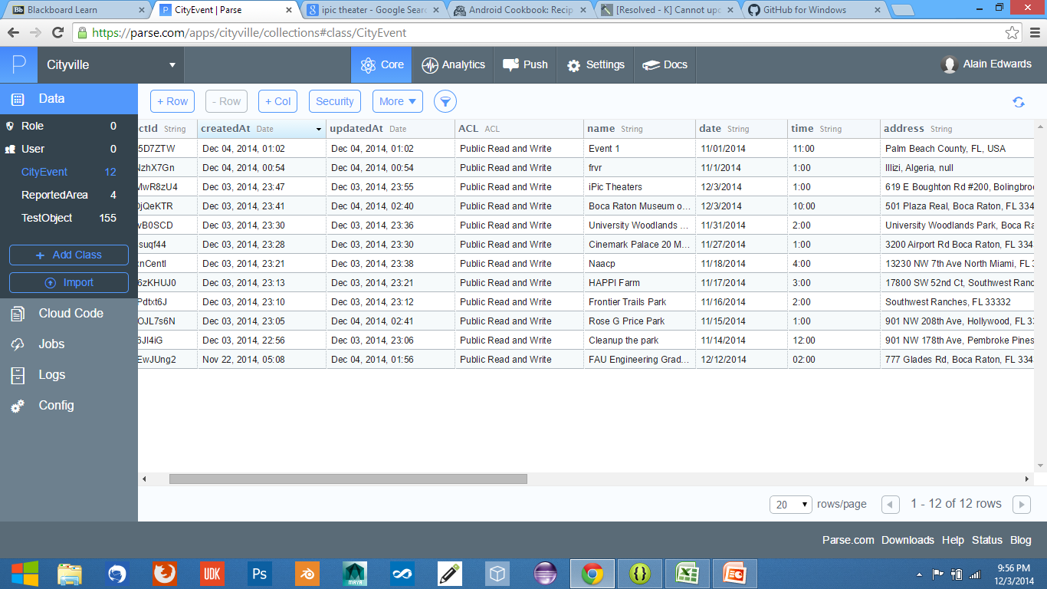
Parse Integration
.Events are stored in the Parse database
.Events uploaded by users will also
use the same Parse database

Slide 6
Google Map and Data Analytics Integration
The application uses Google Maps to pinpoint event locations
Application also uses Google Data Analytics to track how the application is being used.

Slide 7




Graphics
Logo generates first letter of event
Logo
Background Wallpaper

Slide 8
Sound Integration
Sounds have been implemented when clicking on certain buttons

Slide 9
Final Application
Application Views
Slide Outs
Grid
List
Post Event
Report Event
Map event

Slide 10
Initiliaztion
Performs pre system checks:
checking for a network card
internet, connectivity to servers
user location is activated

Slide 11
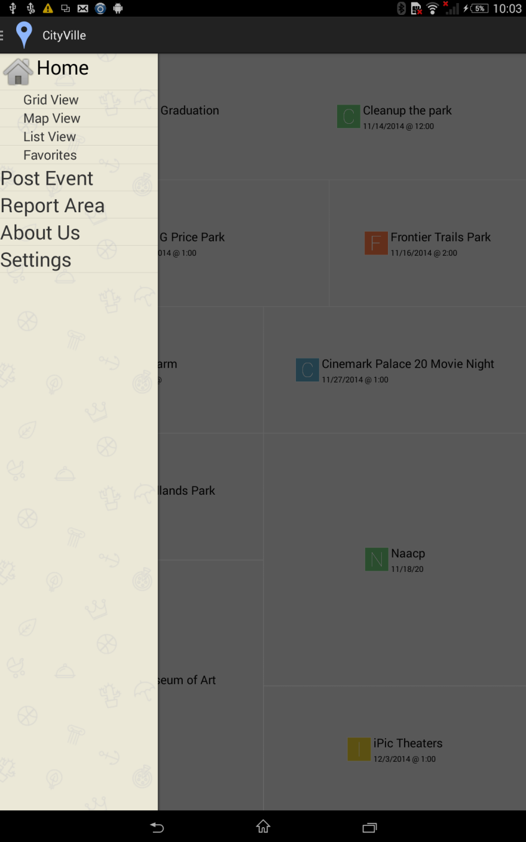
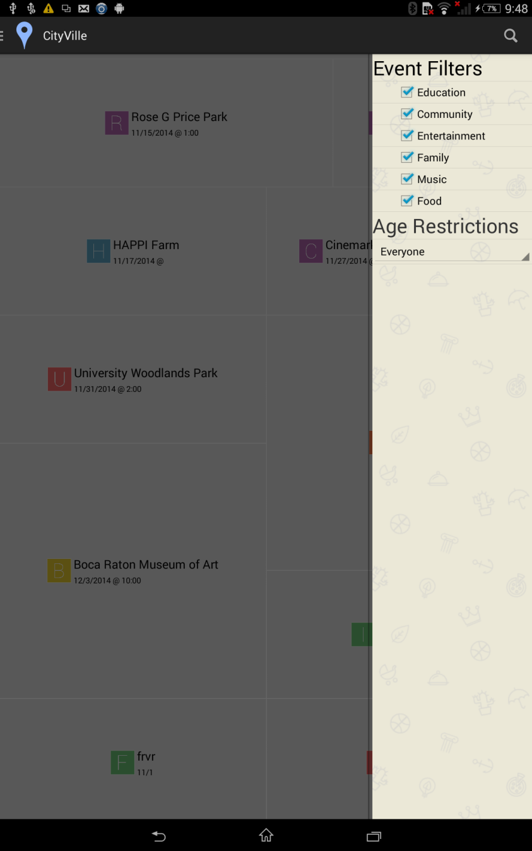
Slide Out Menus

Slide 12

Slide Out Menu
Features
.The use of the slide out menu replaced
tabs shown in previous mockups
.Slide out menu gives more room to
display on the screen
.From here users can go to the different
views of the application
.Menus slide out with a swipe to the right
for view selection and to the left for filter
selection

Slide 13

Slide Out Menu
Features
.Users can filter out certain activities
to display by unchecking specific
boxes
.A dropdown menu is used for filtering
age restrictions

Slide 14
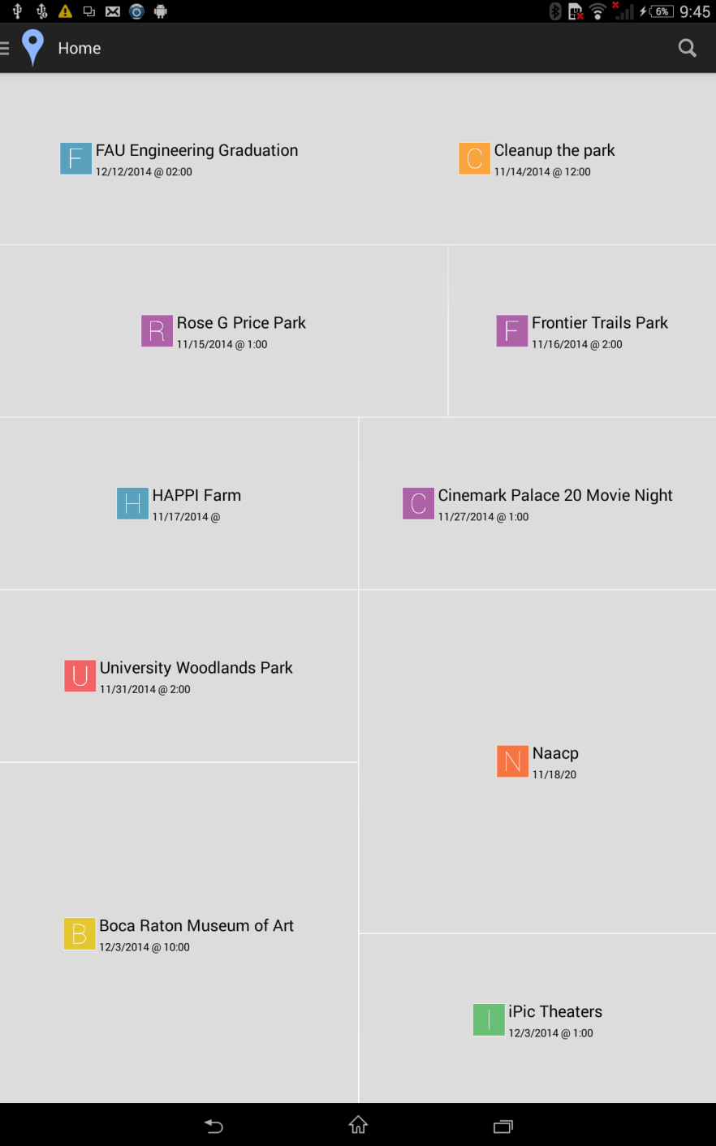
Grid View
Features
.Programmed to dynamically display
events by splitting up the screen into
sections of 10
.Events are generated from the Parse
database
.Will take users to the event view once
an event on the grid has been selected

Slide 15
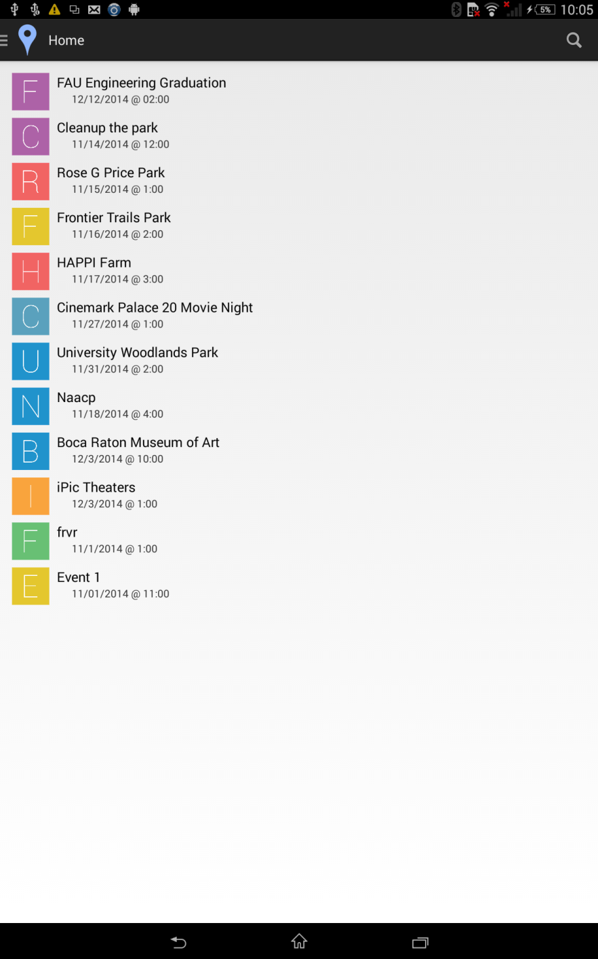
List View
Features
.Events are displayed in list form for quick accessibility
.Will take users to the event view
the same way it does in the grid view

Slide 16
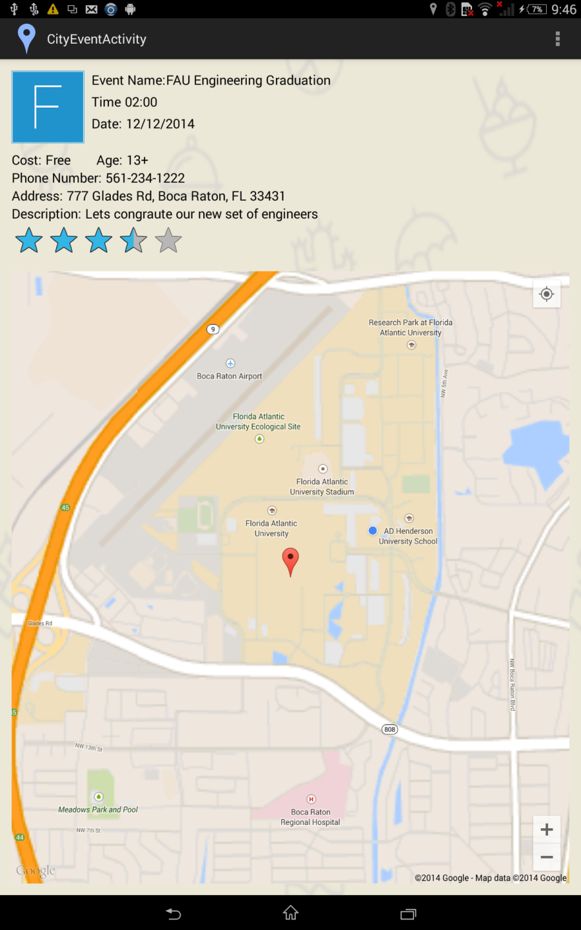
Event View
Features
.Implemented rating system
.Provides information
-Time
-Date
-Cost
-Age
-Phone Number
-Address
-Event Description
.New events will have a default zero
rating
.Location of event is displayed on the map

Slide 17
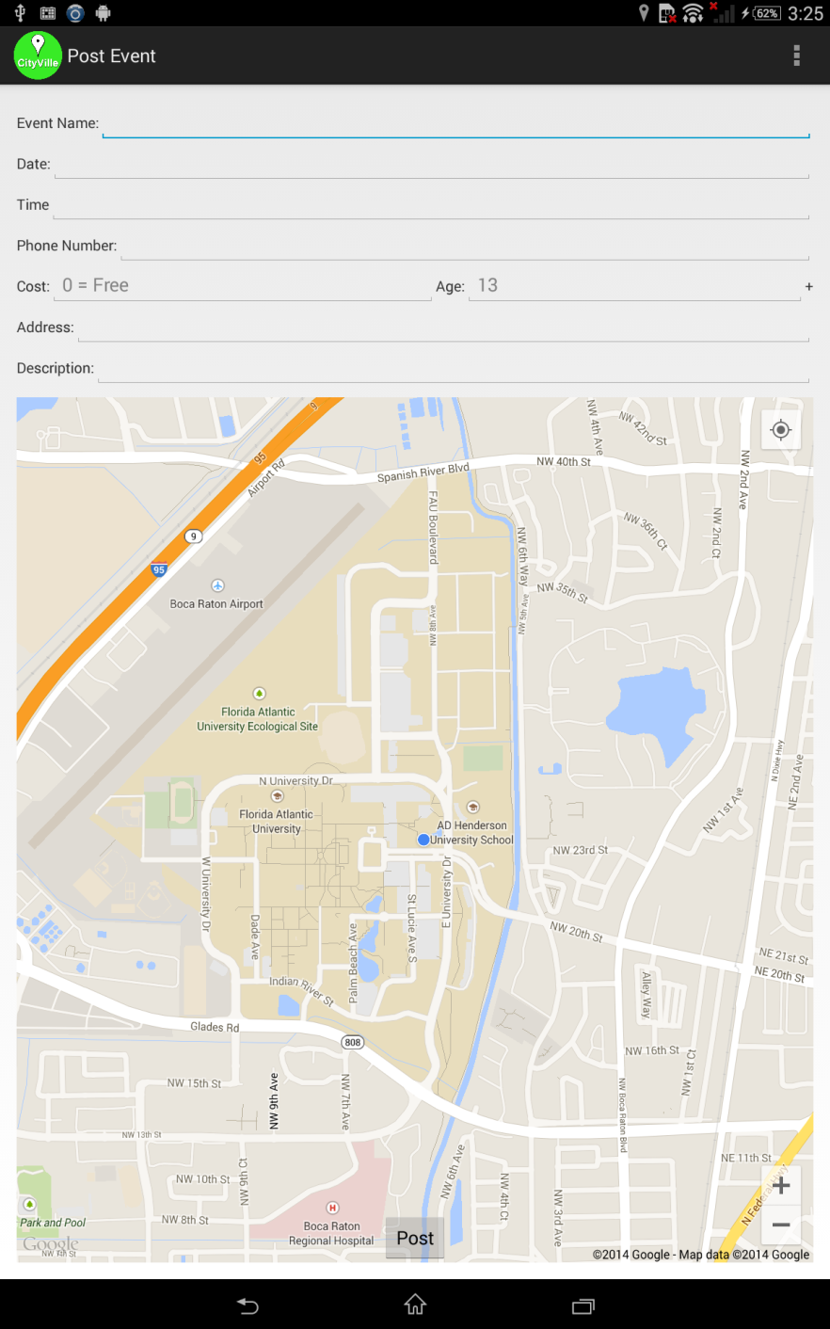
Post Event
Features
.Users can upload their own events
.New events are uploaded to Parse
database
.Long clicking on the location of event
on map will automatically fill out the
address
.Dialog boxes will show if user does
not completely fill out form

Slide 18
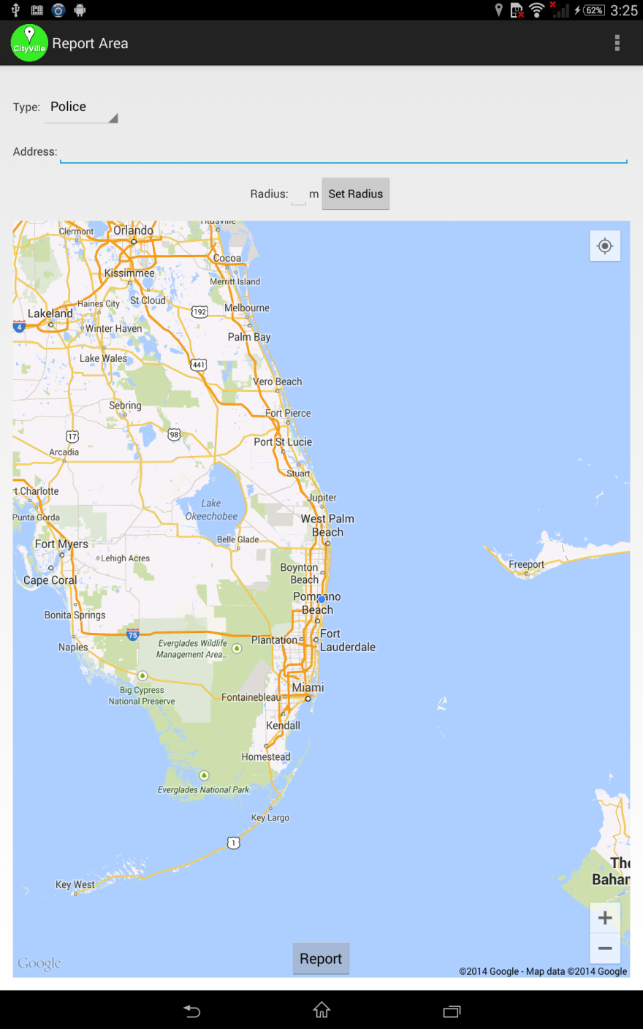
Report Area
Features
.Users can also report certain locations
.Will also utilize the Parse database
.These reported areas are color coded
separately from events
.Long clicking on the map will
automatically fill address section

Slide 19
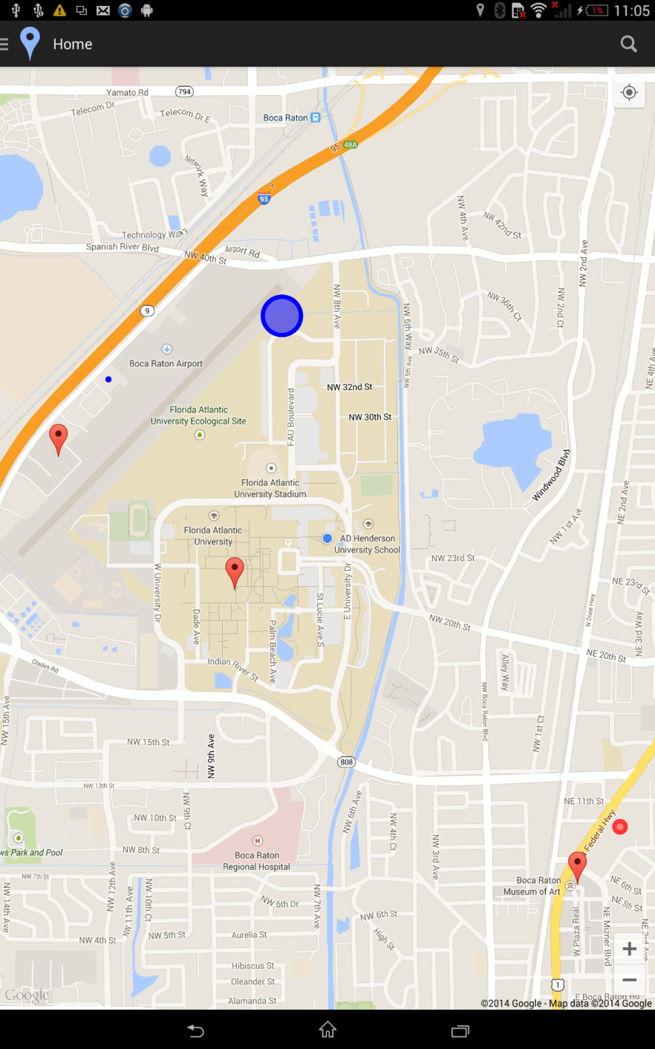
Map View
Features
.Shows all events that surround the
user’s location
.Clicking on the event will also take the
user to the Event View

Slide 20
Marketing Video

Slide 21
Demo

Slide 22
Q&A

