Slide 1
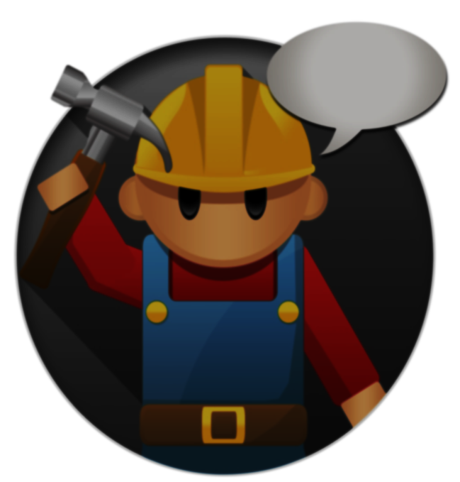
Community Upgrade App
Group Members:
Jermaine Boywer.
Kyle Shamblin
and
Steven Kelsey

Slide 2
What is the App?
The name of the app is Community Upgrade. The propose of this app is to make suggested upgrades/changes to any specific place/building within one’s community.

Slide 3
How does it work?
Balsamiq Mock ups to Explain the Operations of the app
Balsamiq

Slide 4
Security/Restriction?
To Limit the chances of internet trolls or spams: we set the input radius of 45 miles. Therefore you can not add a place on the map outside of that 45 mile radius.

Slide 5
What can the middle school children change within the app
The Middle School Children can change the user interface from within PROCESSING. This includes the Titles, Colors, Sizes of Text and etc….

Slide 6
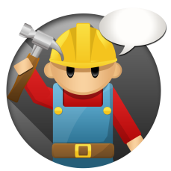
Conclusion/Issues
We should have spent more time on the architecture phase, specifically with PROCESSING.
Special Thanks to Gulfstream Middle School, Also special thanks David Ramirez for creating our App’s Icon.

Slide 7
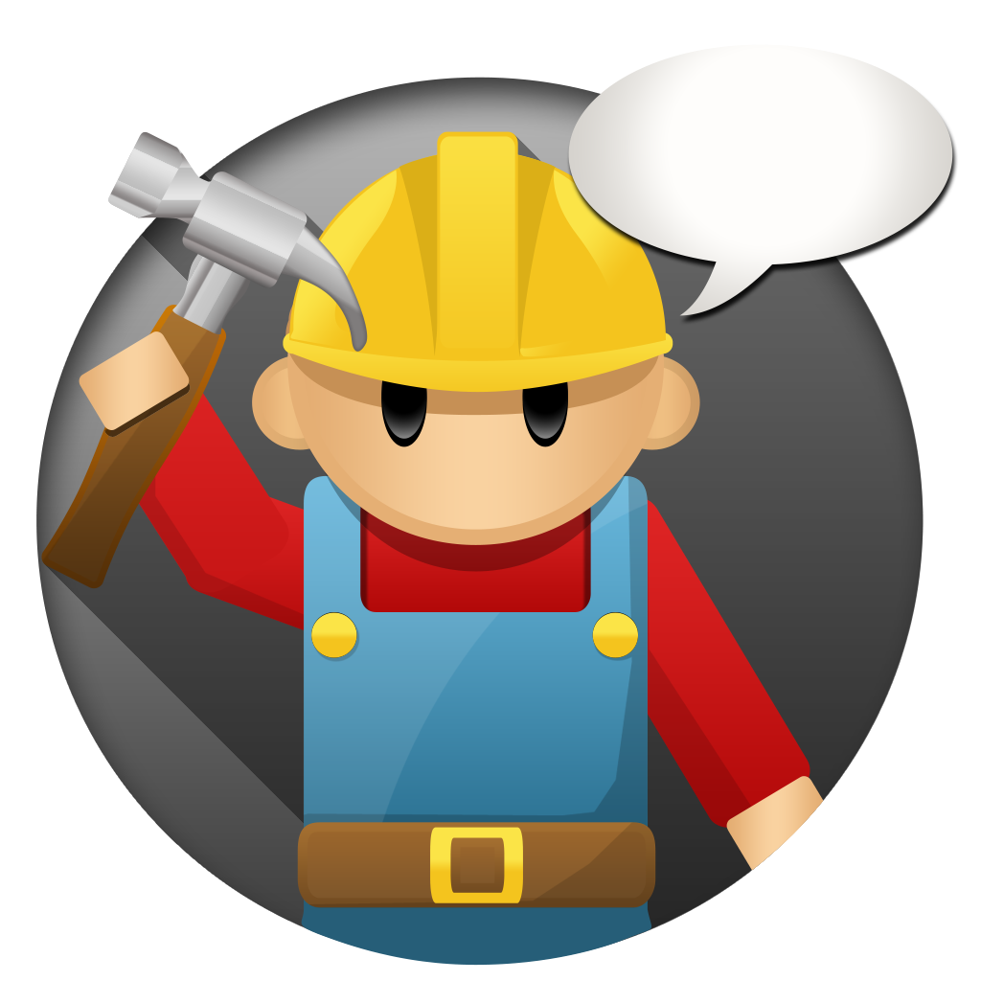
THANK YOU
Let’s Fix Things
Community Upgrade

