Slide 1
Showcase
John Odlum
Maryam Eneim
Glenn Freytag

Slide 2

Concept

Slide 3
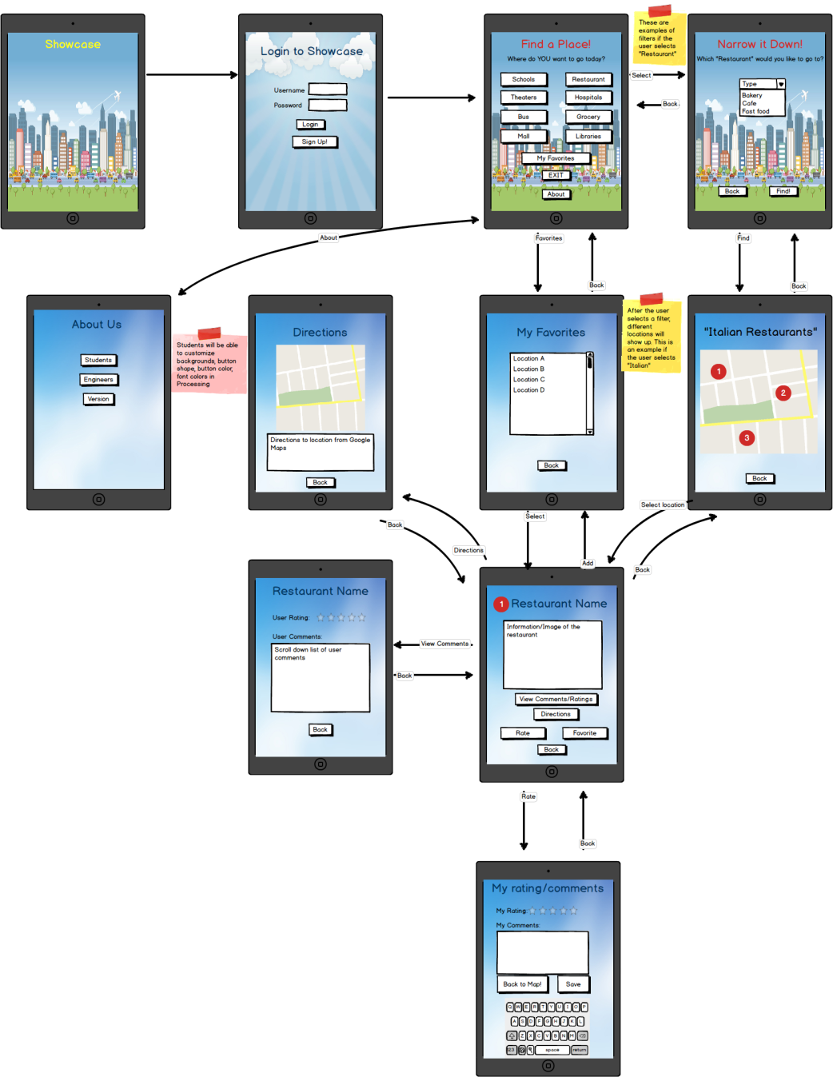
Mockups

Slide 4
Meeting with the Students
Meeting 1: We got suggestions for the categories to use, logos for the maps, and ratings
Meeting 2: We got suggestions on new categories and allowing customizability of backgrounds and colors

Slide 5
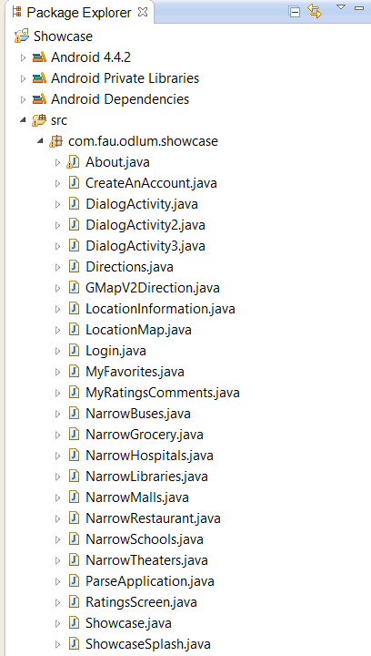
Java
List of all activities in the app
Multiple activities vs One activity for Narrow screens

Slide 6
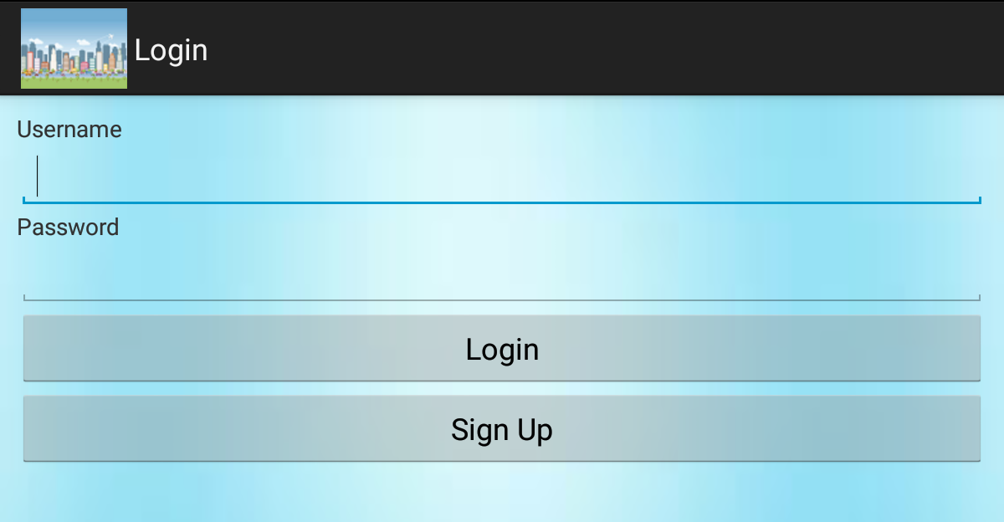
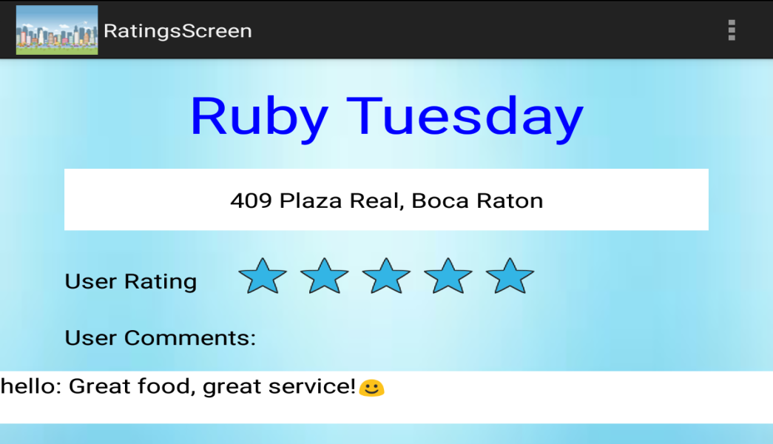
Parse
Usernames and passwords
Pairs are saved in the database
Ratings and comments
Data is saved by the latitude/longitude location

Slide 7
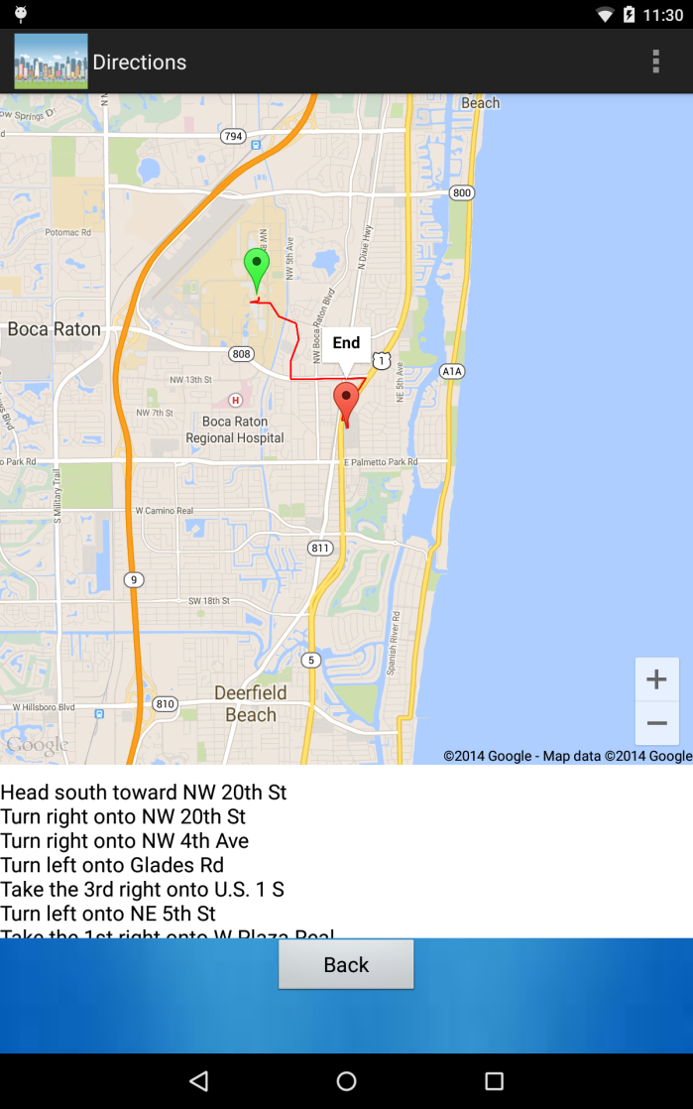
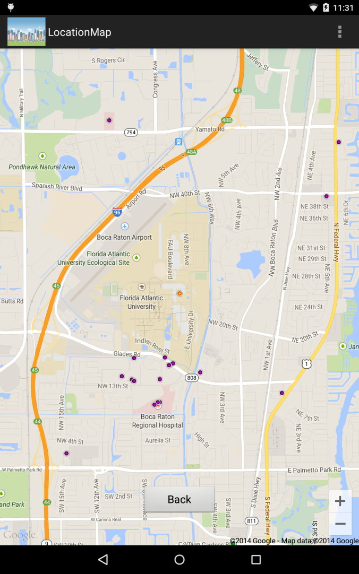
Google Maps
Google Places was used to show the markers for the locations and also for the directions. Google Maps provides the map and your location

Slide 8
Graphics and UI
Free images from the Internet
Toast messages
Short click vs Long click
Drop down menus
Scrolling

Slide 9
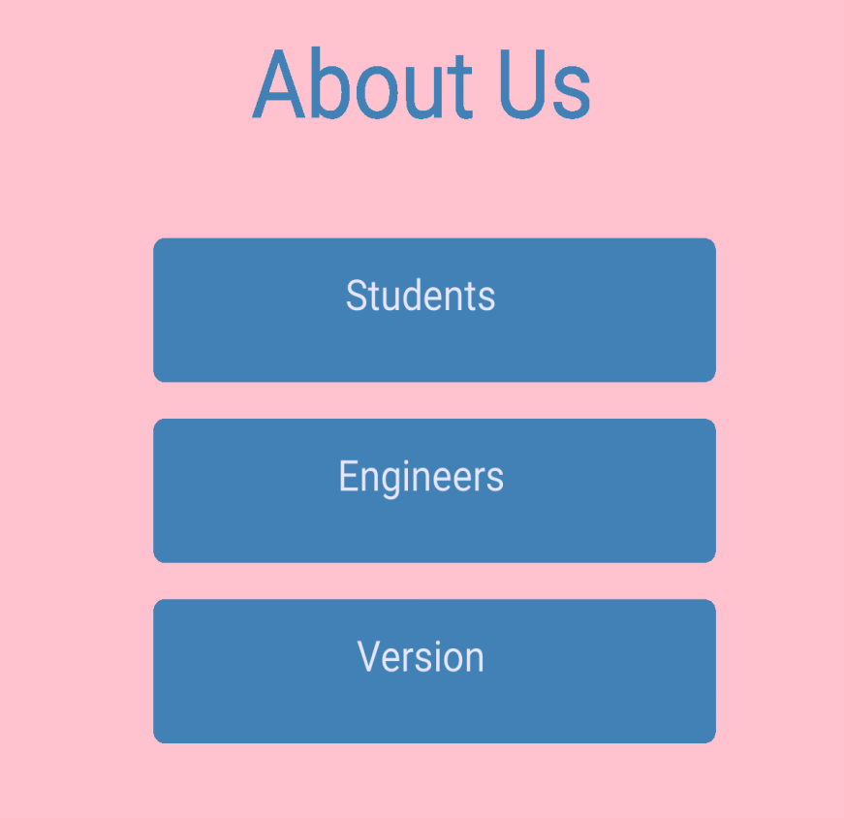
Processing
Students can edit the “About Us” page
Background color
Font color
Button color
Button text

Slide 10
TIME FOR THE DEMO!

