Slide 1
Paypal
Malissa Augustin and Robert Nadrich

Slide 2
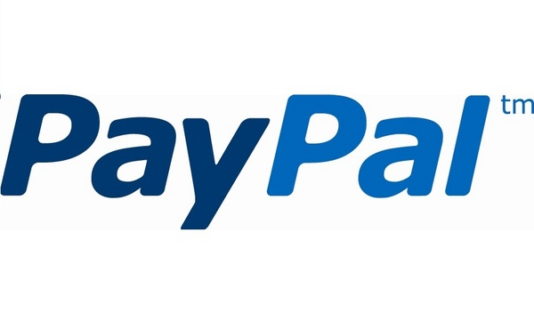
PayPal is an online payment service that allows individuals and businesses to transfer funds electronically
What is PayPal?
Notes:
Without paypal, merchants need to do a lot of things to be fit for ecommerce: http://www.takeflyte.com/resources/newsletters/06/09-paypal-good-bad-ugly.php
Paypal is not a bank because it doesn’t engage in fractional reserve banking

Slide 3
Peter Thiel and Max Levchin founded PayPal in December 1998 . They envisioned for the company to work on a borderless currency, free from governmental controls.
By the end of 2011, PayPal was available in over 100 markets for transactions in 25 international currencies.
PayPal’s Vision
Notes:
More than 100 million active PayPal users across 190 markets look for PayPal when it comes time to pay – and PayPal is adding, on average, more than 1 million new accounts per month

Slide 4
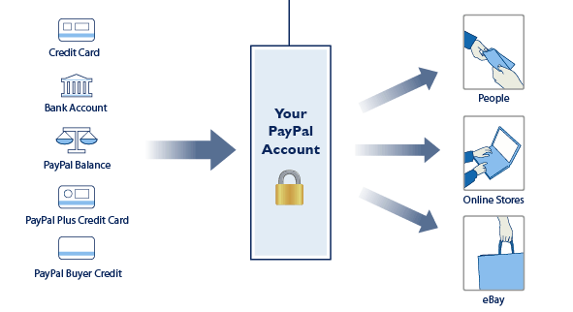
How PayPal Works

Slide 5
Classic API
REST API
Mobile SDK
Website buttons
PayPal Integration

Slide 6
Uses non-RESTful interfaces to provide a complete set of payment solutions
Legacy code that the REST API will eventually replace
Still actively being maintained
Classic API

Slide 7
Adaptive Accounts
Adaptive Payments
Express Checkout
Fraud Protection Services/Fraud Management Filters
Invoicing Service
Mass Payments
Merchant Setup and Administration Guide
Payflow Gateway / PayPal Payments Pro
PayPal Mobile
PayPal Payments Advanced (US & Canada only)
PayPal Payments Standard
Permissions Service
Recurring Billing/Recurring Payments
Reporting
Website Payments Pro
Website Payments Pro Hosted Solution (outside the US)
PayPal Services
Notes:
We should choose particular amount to show here instead of all

Slide 8
API Credentials
Service Endpoints
Call payload
Call Format
HTTP Headers
PayPal API Call Format

Slide 9
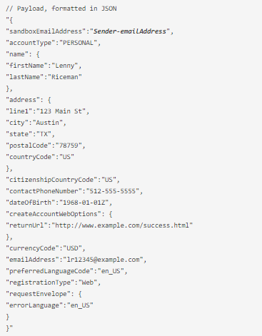
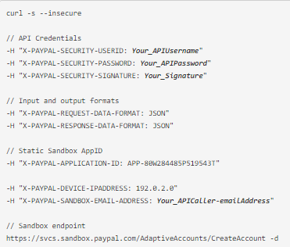
Example API request to the Adaptive Account’s ”CreateAccount” operation in the Classic API
Notes:
curl is a tool to transfer data from or to a server, using one of the supported protocols (DICT, FILE, FTP, FTPS, GOPHER, HTTP, HTTPS, IMAP, IMAPS, LDAP, LDAPS, POP3, POP3S, RTMP, RTSP, SCP, SFTP, SMB, SMBS, SMTP, SMTPS, TELNET and TFTP). The command is designed to work without user interaction.

Slide 10

  streamlines the checkout process for a buyer.
  Most popular solution
Classic API Example :
Express Checkout
Notes:
Express Checkout allows merchants and developers to minimize the number of steps customers must complete when they checkout. Customers using Express Checkout pay on PayPal's secure site and return to the merchant's site to complete the transaction. It is designed for merchants who don't have an Internet Merchant Account for processing credit and debit card payments.

Slide 11
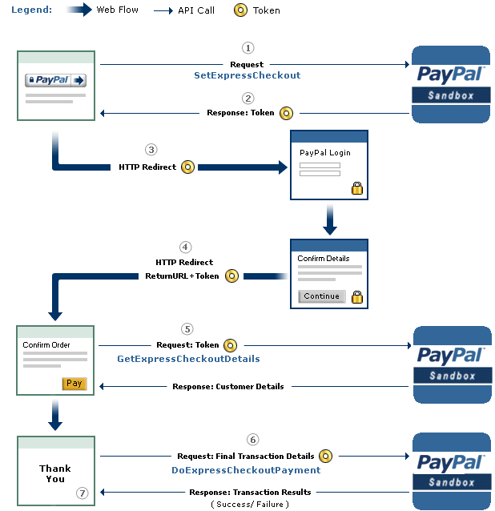
Classic API – Express Checkout
Notes:
https://developer.paypal.com/docs/classic/express-checkout/ht_ec-singleItemPayment-curl-etc/
When customers choose Express Checkout, the merchant website makes an API call to pass PayPal the transaction details. Customers are redirected to PayPal to log in. They then select a shipping address and payment method, and approve the transaction. PayPal then returns customers to the merchant's website to review and finalize the order.
The merchant website makes an API call to retrieve transaction details, including the shipping address, email address, and other information needed to fulfill the order. Customers finish the checkout process on the merchant's website and review and approve payment. When customers complete the order, the website makes an API call (unseen by the customer) to PayPal to request payment. The payment transaction is initiated and PayPal sends customers an email receipt for the payment.

Slide 12
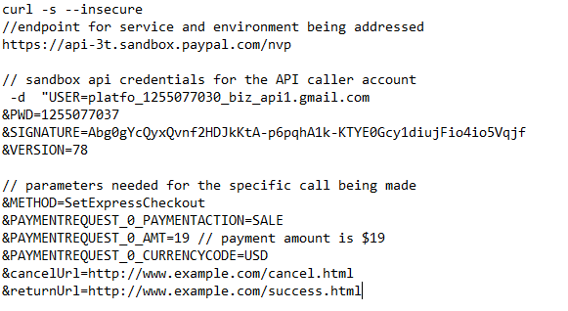
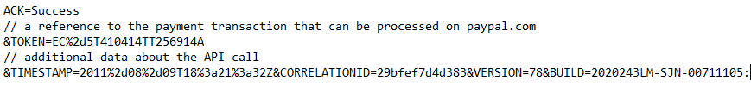
Code Example for Request Call to SetExpressCheckout and Success Response
Notes:
Demo site: https://demo.paypal.com/home
https://developer.paypal.com/docs/classic/express-checkout/ht_ec-singleItemPayment-curl-etc/
When customers choose Express Checkout, the merchant website makes an API call to pass PayPal the transaction details. Customers are redirected to PayPal to log in. They then select a shipping address and payment method, and approve the transaction. PayPal then returns customers to the merchant's website to review and finalize the order.
The merchant website makes an API call to retrieve transaction details, including the shipping address, email address, and other information needed to fulfill the order. Customers finish the checkout process on the merchant's website and review and approve payment. When customers complete the order, the website makes an API call (unseen by the customer) to PayPal to request payment. The payment transaction is initiated and PayPal sends customers an email receipt for the payment.

Slide 13
Representational state transfer
It is an architectural style utilizing commonly found technologies and protocols.
Performs action on the Resources using the representation.
Uses XML, HTTP, URI, and MIME
REST API
Notes:
All data is passed from the server to the browser for the browser to perform actions needed to process the data

Slide 14
When data is received by a web service (PayPal) the data is returned to in XML format
There is no slandered structure for the data stored in the XML
Using XML with REST

Slide 15
The two main methods in HTTP while using rest are GET and POST
GET will get the information needed
POST will create, update, manipulate, and even delete the data passed.
Using HTTP with REST
Notes:
What actions that is performed on the data are based on the parameters passed in the URL

Slide 16
uniform resource identifier (URI) is a string of characters used to identify a name of a resource.
It is a pointer to resources
Ex)
  URL: www.example.com/autos/ford
  URI: autos/ford
Using URI with REST

Slide 17
Why are URI important?
As time passes data is updated.
While using a fixed URI, you must think on how to handle updated versions of this data
One way is to pass the version number by either URL or in the XML file
URI Cont.

Slide 18
Creating a Payment
REST Example

Slide 19
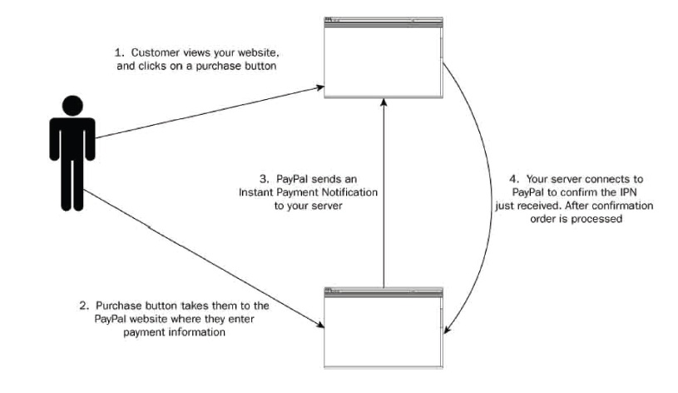

Slide 20
The biggest safety issue Paypal faces is fraud
People would hack into accounts and transfer small amounts of money out of each one. By 2001 PayPal had gross revenues of $14 million per year, but was losing $10 million per month to fraud.
Safety Issues

Slide 21
Automatically encrypts your confidential information with an encryption key length of 128-bits
Paypal servers are not directly connected to the internet and only can be accessed by authorized computers
Paypal developed their own fraud monitoring system.
How to protect against fraud

Slide 22
Fraud monitoring system is called lgor
Used artificial intelligence to detect potentially fraudulent transactions
If separate accounts were transferring to one account and that recipient was suddenly attempting to withdraw it would alert PayPal employees check up on the situation.
Fraud monitoring system

Slide 23
lgor could learn over time and became quite good at approving legitimate transactions and preventing bad ones
PayPal had to weigh the risk of letting bad transactions go through against the cost of turning down good ones.
Rather than treating the problem of fraud as a legal problem, the company treated it as a risk management one.
Fraud monitoring system

Slide 24
Buyer Protection
Seller Protection
Paypal offers protection

Slide 25
If a buyer purchase an item online and they never receives it, does not match the description, or that something is wrong (ie the account was hacked).
Paypal will run an investigation
The protection will allow the buyer a full reimbursement.
Buyer Protection

Slide 26
An unauthorized payment (for example, from a hacked account) or a buyer claims they never received their item, Paypal will reimburse for the full amount of the payment
Seller Protection

Slide 27
Paypal will allow you to keep track of a merchants inventory and order details
Seller Protection
(cont.)
Record Keeping Tutorial

Slide 28
PayPal’s business depends on buyer’s trust
  If the customers want them, merchants have no choice but to offer the option of using PayPal
Because of this, PayPal has no problems treating the sellers poorly with some of their business practices
Ethical Issues
Notes:
http://en.wikipedia.org/wiki/PayPal#Criticism

Slide 29
Paypal has a policy where it takes 30% of every transaction from a seller it deems “risky” and holds this amount for 90 days.
This puts small businesses in a tight situation as a good amount of the funds they were expecting to have in their account is unavailable
  This creates a cash-flow problem that can shut businesses down or force them to take on expensive and otherwise-unnecessary loans
Ethical Issues -
30% transaction holds
Notes:
http://en.wikipedia.org/wiki/PayPal#Criticism

Slide 30
PayPal argues that they do these “rolling reserves” to protect the buyer incase if the purchase was fraudulent and the buyer wants their money back.
  This is done to protect themselves from these chargebacks
PayPal does not pay interest on the funds they withhold
  This may encourage PayPal to be less careful when cracking down on “risky” accounts
Ethical Issues -
30% transaction holds
Notes:
There is also criticism about the perceived arbitrariness of the 90-day waiting period, when customers have only 45 days to file a claim against a seller

Slide 31
Paypal puts the "Limited Access" designation on accounts that are subject to fraud or unauthorized use and holds all the funds up to 180 days
This lead to freezing accounts of sellers who had not done anything wrong.
Ethical Issues-
Account Freezing

Slide 32
Notable instance: In September 2010, Markus Persson, the developer of Minecraft, had his account frozen and was not given a clear explanation of why.
He felt that PayPal was threatening to keep the money if they found anything wrong
At that time, he had around €600,000 ( about $677,904)
Ethical Issues -
Account Freezing
Notes:
http://en.wikipedia.org/wiki/PayPal#Criticism

Slide 33
Affected innocent merchants complained to PayPal and asked them why them
  PayPal didn’t give a reason
Many felt that PayPal arbitrarily selects accounts to hold funds from
There is good reason to believe that PayPal is using the reserved funds as capital
  Using other people’s money to invest with
  No laws against this action
Ethical Issues -
Merchant Response
Notes:
though PayPal is unwilling to disclose the nature of its risk analysis. In an email spokesperson Jennifer Hakes said the company considers a number of factors when deciding to place a hold or reserve, such as the seller’s credit rating, the number and frequency of customer disputes, the type of business a seller runs, and average delivery timeframes.

Slide 34
There are class action lawsuits against PayPal addressing these issues:
  Zepeda vs. PayPal
  Fernando v. PayPal
There are websites that displays the horror stories that some merchants had with PayPal:
  paypalsucks.com
  aboutpaypal.org
Ethical Issues -
Merchant Response

Slide 35

Redcats is a direct marketer of women’s and men’s plus size apparel, home/lifestyle products, and sporting goods/outdoor gear
They are a dynamic, multichannel, web-driven home-shopping retailer
Case Study: PayPal & Redcats
Notes:
https://www.paypalobjects.com/webstatic/mktg/docs/Redcats_case_study.pdf

Slide 36
They were looking for ways to attract new customers and increase sales
They focused on PayPal because of its broad customer acceptance and market adoption
They implemented their Express Checkout service
Case Study: PayPal & Redcats
Notes:
While knowing consumers broadly use PayPal, Redcats wanted to know how its own customer base might respond specifically to PayPal. Its analysis proved promising. “When we conducted customer surveys, we got a healthy percentage of customers, over 11 percent, who said they would use PayPal regularly if we provided the option,” he says.

Slide 37
The Results:
  approximately 50 % of those choosing to use PayPal are new customers
  PayPal transactions comprise nearly 10 % of all of their online transactions
Case Study: PayPal & Redcats
Notes:
While knowing consumers broadly use PayPal, Redcats wanted to know how its own customer base might respond specifically to PayPal. Its analysis proved promising. “When we conducted customer surveys, we got a healthy percentage of customers, over 11 percent, who said they would use PayPal regularly if we provided the option,” he says.

Slide 38
Paypal is an online payment system, it is available in multiple currencies
It provides security for both buyers and sellers alike.
The two ways to implement this is through the Classic API or REST API
Conclusion

Slide 39
"How Secure Is the PayPal Site? - PayPal." How Secure Is the PayPal Site? - PayPal. N.p., n.d. Web. 10 Feb. 2015. <https://www.paypal.com/cgi-bin/webscr?cmd=xpt%2FHelp%2Fgeneral%2FTopQuestion6-outside>.
"PayPal Security Center - PayPal Safety - PayPal." PayPal Security Center - PayPal Safety - PayPal. N.p., n.d. Web. 10 Feb. 2015. <https://www.paypal.com/webapps/mpp/paypal-safety-and-security>.
"PayPal's Private Governance." : The Freeman : Foundation for Economic Education. N.p., n.d. Web. 11 Feb. 2015. <http://fee.org/freeman/detail/paypals-private-governance#ixzz2Ma4h62Lo>.
Richards, Robert. "Representational State Transfer." Pro PHP XML and Web Services. Berkeley (CA): Robert Richards, 2006. 633-72. Print.
Work Cited

Slide 40
Polgar, Jana, and Greg Adamson. Web Portal Design, Implementation, Integration, and Optimization. Hershey, PA: Information Science Reference, 2013. IGI Global. Web. 30 Jan. 2015.
Waxman, Simon. "How Pay-Pal Squeezes Merchants with Unfair and Likely Illegal Business Practices." Alternet. 18 Dec. 2011. Web. 11 Feb. 2015. <http://www.alternet.org/story/153474/how_pay-pal_squeezes_merchants_with_unfair_and_likely_illegal_business_practices>.
"Case Studies – PayPal." Case Studies – PayPal. 1 May 2012. Web. 13 Feb. 2015. <https://www.paypal.com/webapps/mpp/ent-case-studies>.
Grabianowski, Ed, and Stephanie Crawford. "How PayPal Works" 13 December 2005. HowStuffWorks.com. <http://money.howstuffworks.com/paypal.htm> 12 February 2015.
Work Cited

Slide 41
"How Would You like to Integrate with PayPal?" PayPal Documentation Home. Web. 13 Feb. 2015. <https://developer.paypal.com/docs/>.
Work Cited

