Slide 1

IDENTIFICATION OF MEDICINAL PLANTS USING MACHINE LEARNING APPROACH
PHASE 2 REVIEW
GUIDED BY:
Dr. A. GEETHA, M.E., Ph.D.,
ASSOCIATE PROFESSOR
TEAM MEMBERS: SIKKANTHAR MYDEEN. R(2004325)
SURYA.K(2004327)
SURYA.V(2004328)

Slide 2
PHASE 1 OUTCOMES
NAME OF THE CONFERENCE:
IEEE INTERNATIONAL CONFERENCE ON NETWORKING AND COMMUNICATIONS 2024
PAPER TITLE:
INTELLIGENT REACTIVE ENERGY MANAGEMENT FOR INDUSTRIAL AND POWER GRID EFFICIENCY
PAPER STATUS:
COMPLETED (3/4/2024)

Slide 3
OBJECTIVE
Develop an innovative system for automated identification of medicinal plants using image processing and machine learning techniques.
Create a user-friendly platform enabling users to upload plant images for species identification and detailed medicinal information retrieval.
Bridge traditional medicinal knowledge with modern technology to facilitate accessible Botany information.

Slide 4
INTRODUCTION
Medicinal plants have been integral to human healthcare for centuries, offering therapeutic benefits across diverse cultures.
Technological advancements present opportunities to leverage image processing and machine learning for medicinal plant identification.
This proposed system introduces to identifying medicinal plants, providing valuable Botany insights via a user-friendly digital platform.

Slide 5
LITERATURE SURVEY
AUTHOR | TITLE OF PAPER | NAME OF JOURNAL | WORD DONE
Shah, K. R., & Thakkar, P. M. | Medicinal plant identification and classification using machine learning techniques | In 2021 international conference on computing, communication and intelligent systems (ICCCIS) (pp. 1-6). IEEE. | Studies highlight the medicinal properties of various plants, underscoring the need to merge traditional knowledge with modern tools.
Raut, S. K., & Kumari, S. | A survey on machine learning techniques for medicinal plants identification. | In 2020 IEEE 11th annual information technology, electronics and mobile communication conference (IEMCON) (pp. 0962-0967). IEEE. | To involves summarizing and categorizing existing articles, and publications related to the use of machine learning for medicinal plant identification.

Slide 6
PROPOSED METHODOLOGY
Data collection: Gathering a diverse dataset of medicinal plant images. Types of data required (images, features), Sources of data (datasets, online repositories)
Data preprocessing: Image cleaning, normalization, and feature extraction.
Model selection: Choosing suitable machine learning algorithms (e.g., CNNs) for classification with accuracy, interpretability.

Slide 7
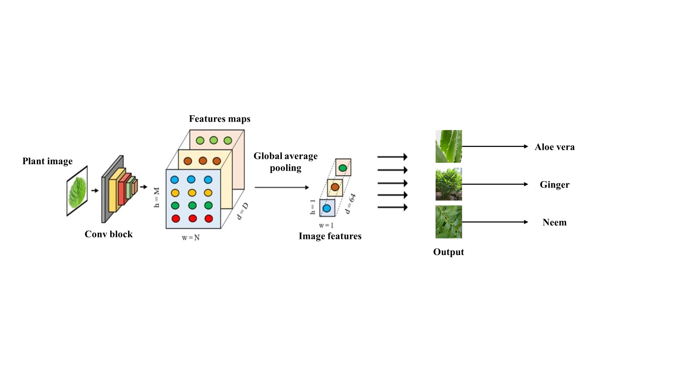
PROPOSED METHODOLOGY

Slide 8
PROPOSED METHODOLOGY
Feature Extraction: Image-based features (color, texture, shape), Other relevant features (geolocation, habitat).
Global average pooling: It is technique commonly used in convolutional neural networks for reducing the spatial dimensions of feature maps while preserving important information.
Output : Implement the trained model into real-world applications for medicinal plant identification.

Slide 9
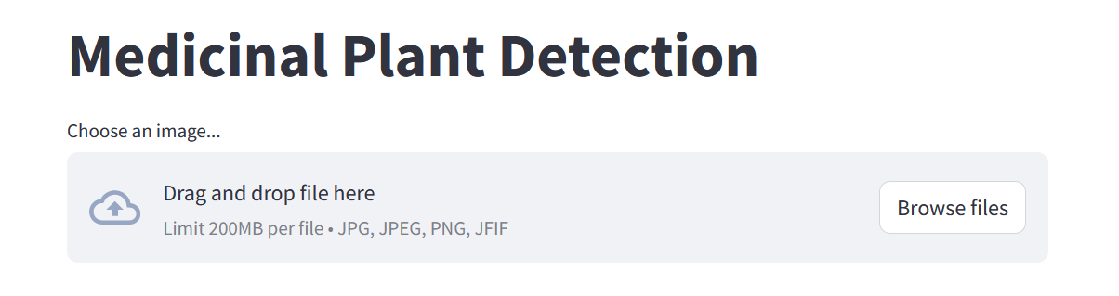
RESULTS AND DISCUSSION
Web link: http://localhost:8501/#medicinal-plant-detection
Local URL: http://localhost:8501
Network URL: http://192.168.204.116:8501

Slide 10
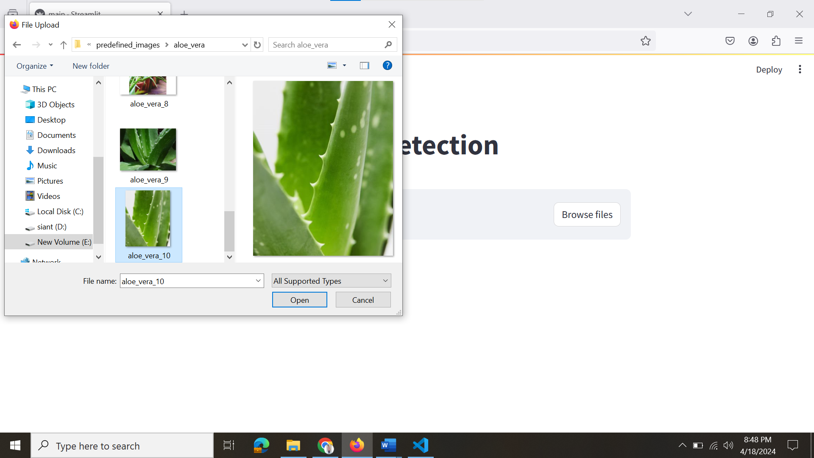
RESULTS AND DISCUSSION

Slide 11
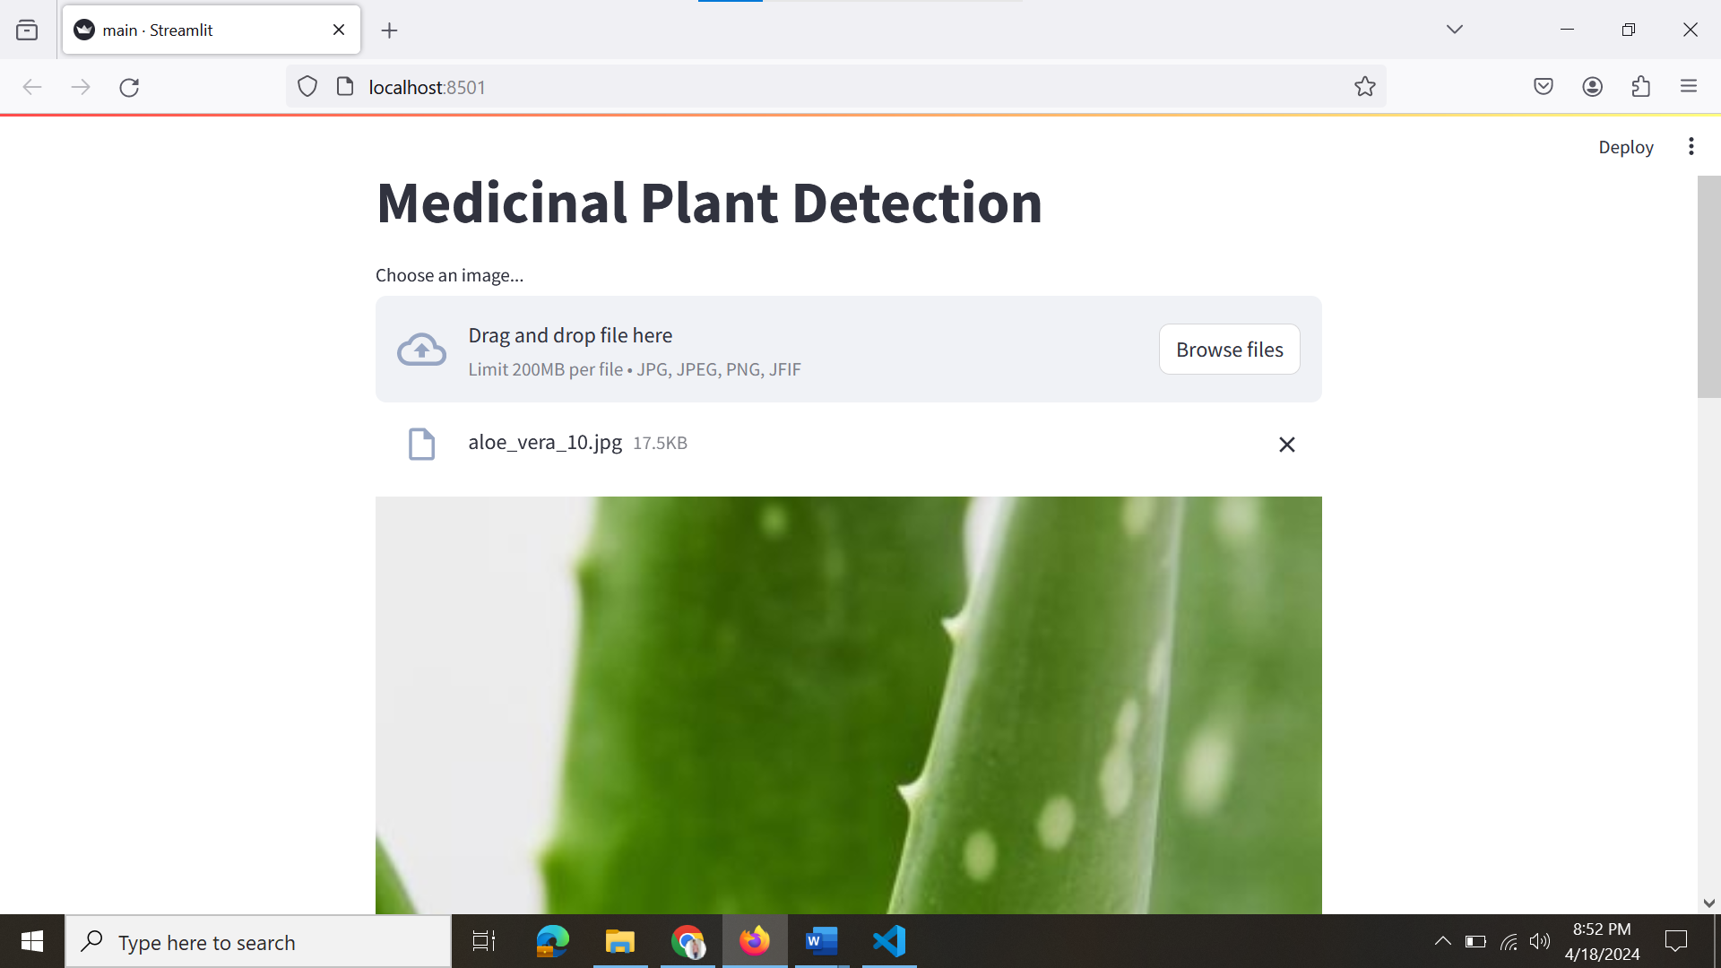
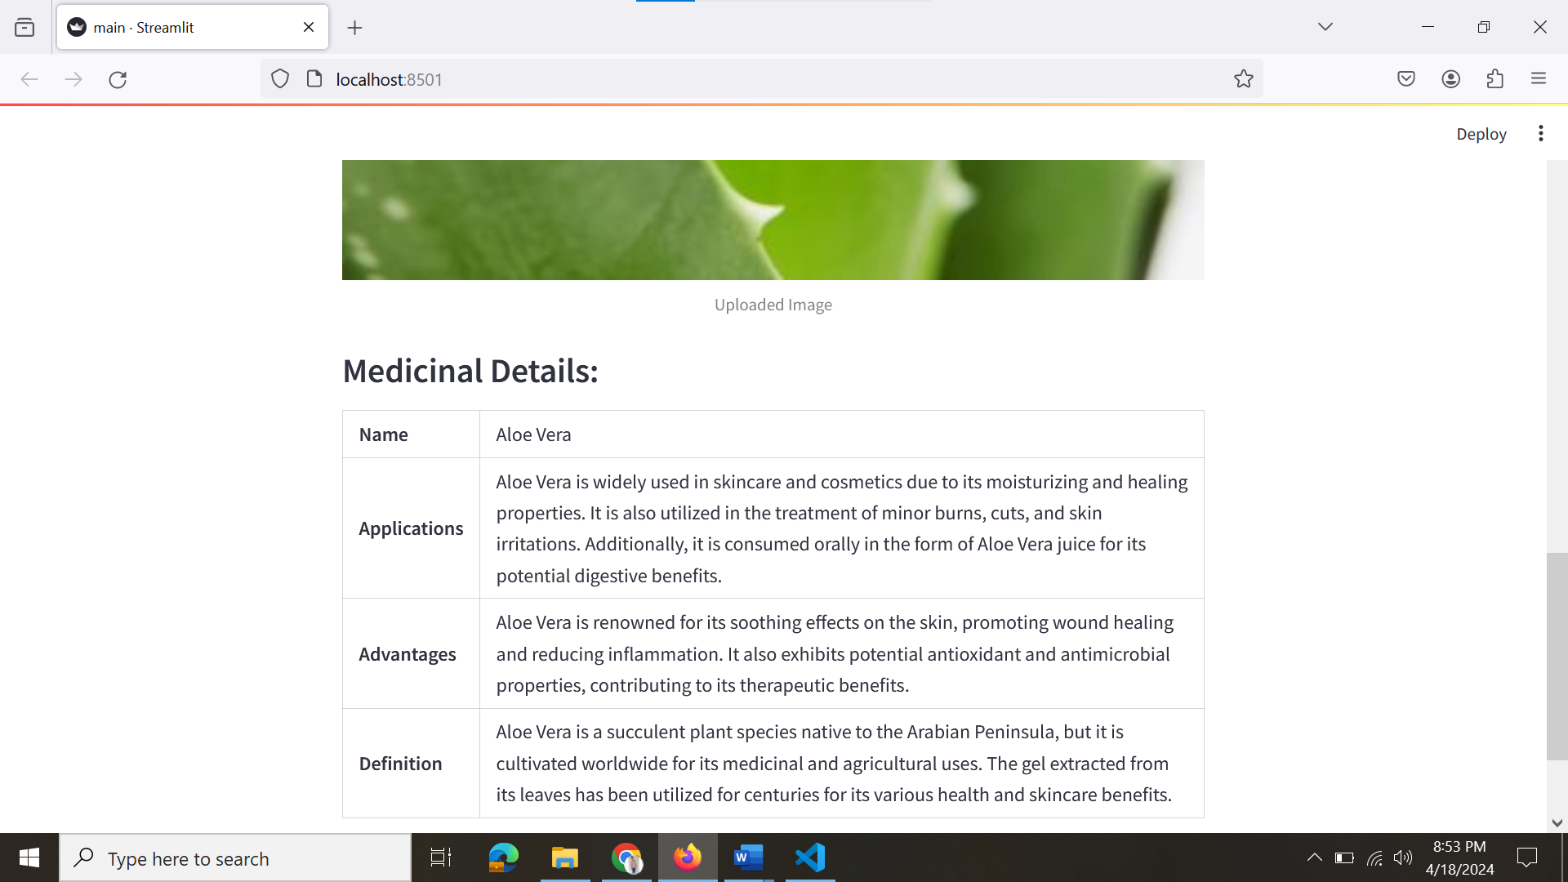
RESULTS AND DISCUSSION

Slide 12
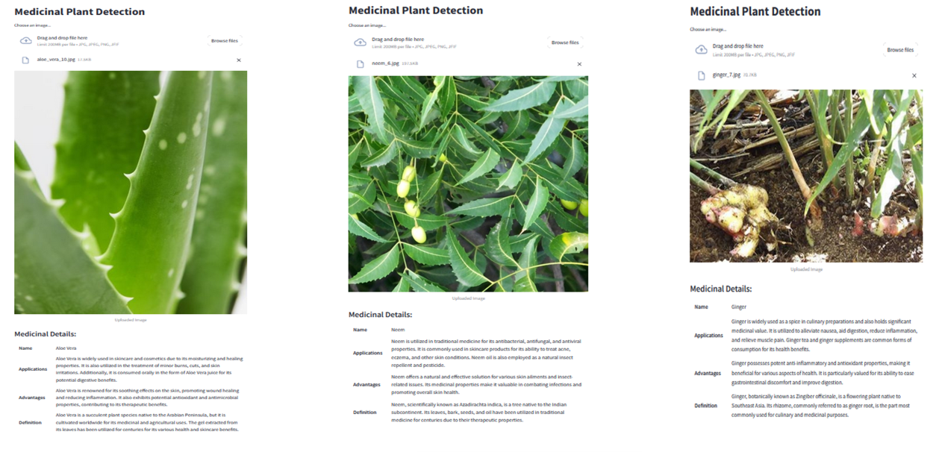
RESULTS AND DISCUSSION

Slide 13
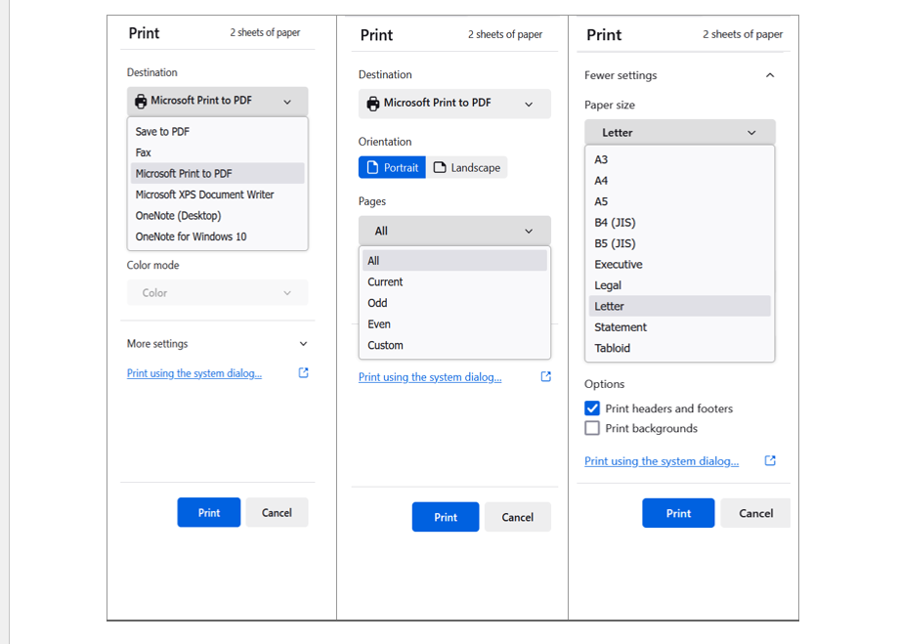
RESULTS AND DISCUSSION

Slide 14
RESULTS AND DISCUSSION
Accuracy of the machine learning model.
Comparison with traditional plant identification methods.
Challenges encountered and lessons learned.
Discussion on the implications of the results for medicinal plant research and healthcare.

Slide 15
CONCLUSION
The developed system represents a significant advancement in automated medicinal plant identification.
Future research will focus on enhancing system accuracy, expanding the medicinal plant database, and exploring broader applications.
This work contributes to the integration of traditional botanical knowledge with modern technology, benefiting healthcare and scientific communities.

Slide 16
REFERENCE
Shah, K. R., & Thakkar, P. M. (2021). Medicinal Plant Identification and Classification Using Machine Learning Techniques: A Review. In 2021 International Conference on Computing, Communication and Intelligent Systems (ICCCIS) (pp. 1-6). IEEE.
Raut, S. K., & Kumari, S. (2020). A Survey on Machine Learning Techniques for Medicinal Plants Identification. In 2020 IEEE 11th Annual Information Technology, Electronics and Mobile Communication Conference (IEMCON) (pp. 0962-0967). IEEE.
Singh, A. K., & Pandey, M. (2019). Review on Machine Learning Techniques for Medicinal Plants Identification. In 2019 International Conference on Power Electronics & IoT Applications in Renewable Energy and its Control (PARC) (pp. 263-268). IEEE.

