Slide 1
Traveling Salesman Problem (TSP) Project
Alex Keller, Ryan Leacock, Jimmy Finnegan, Graham Baker

Slide 2
What is the TSP?
  Given a list of cities and distances between them:
  Find the shortest possible route that visits each city exactly once and returns to the start.
  NP-hard optimization problem.

Slide 3
What is the TSP?
  Given a list of cities and distances between them:
  Find the shortest possible route that visits each city exactly once and returns to the start.
  NP-hard optimization problem.

Slide 4
Why TSP Matters
  Complexity explodes as cities increase.
  Perfect testing ground for studying optimization algorithms.

Slide 5




Real world usage?
Circuit Routing
Logistics
Networking
Robotics

Slide 6
Real world usage?
Logistics
Circuit Routing
Robotics
Networking

Slide 7
Project Overview
  Goal: Implement and compare three TSP algorithms
  Algorithms: Brute Force, Greedy, Christofides.
  Visualize results using SVG path renderings.

Slide 8
Input Format
  Points read from text file.
  Grid coordinates mapped to 800x800 SVG.
  Program outputs optimal or near-optimal path visualizations.

Slide 9

  Checks all possible permutations of cities.
  Guarantees optimal path.
  Time complexity: O(n!).
  Only feasible for small n.
Brute Force Algorithm

Slide 10
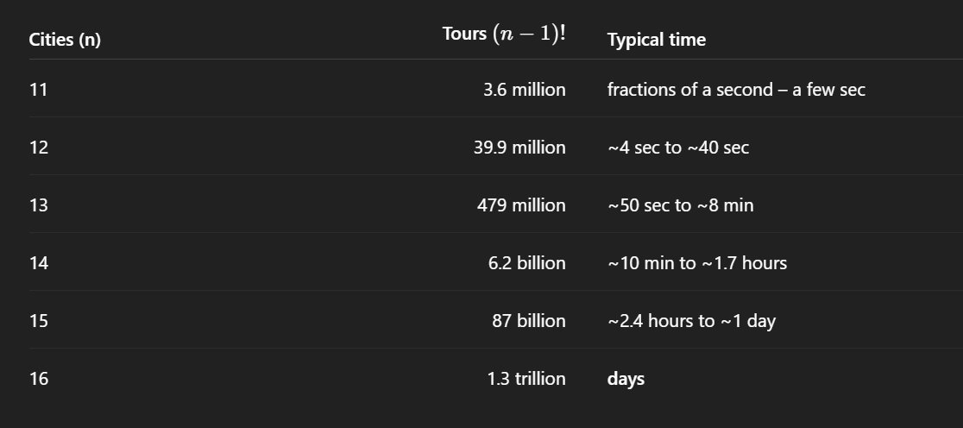
Brute Force Algorithm
  Checks all possible permutations of cities.
  Guarantees optimal path.
  Time complexity: O(n!).
  Only feasible for small n.
Factorial and explosive growth in runtime with small increase in n cities, anything past ~13-14 is impractical

Slide 11
  Checks all possible permutations of cities.
  Guarantees optimal path.
  Time complexity: O(n!).
  Only feasible for small n.
Brute Force Algorithm
Factorial and explosive growth in runtime with small increase in n cities, anything past ~13-14 is impractical

Slide 12

Greedy Algorithm
  Pick a starting city, repeatedly choose nearest unvisited neighbor.
  Time complexity: O(n²).
  Not guaranteed to find optimal, but often decent.

Slide 13
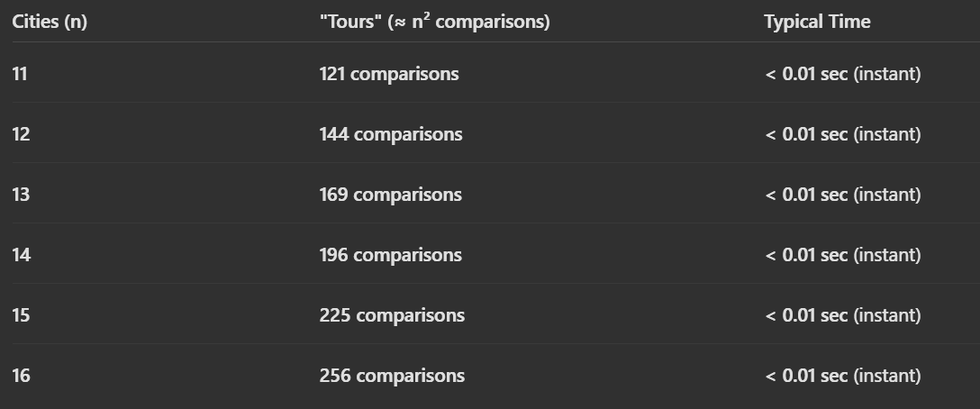
Greedy Algorithm
  Pick a starting city, repeatedly choose nearest unvisited neighbor.
  Time complexity: O(n²).
  Not guaranteed to find optimal, but often decent.
Polynomial growth in runtime: O(n²)

Slide 14
Greedy Algorithm
  Pick a starting city, repeatedly choose nearest unvisited neighbor.
  Time complexity: O(n²).
  Not guaranteed to find optimal, but often decent.
Polynomial growth in runtime: O(n²)

Slide 15

  1. Compute Minimum Spanning Tree (MST).
  2. Match odd-degree vertices.
  3. Build Eulerian cycle.
  4. Shortcut to Hamiltonian cycle.
  Guarantees ≤ 1.5 × optimal length.
Christofides Algorithm
Christofides Algorithm

Slide 16
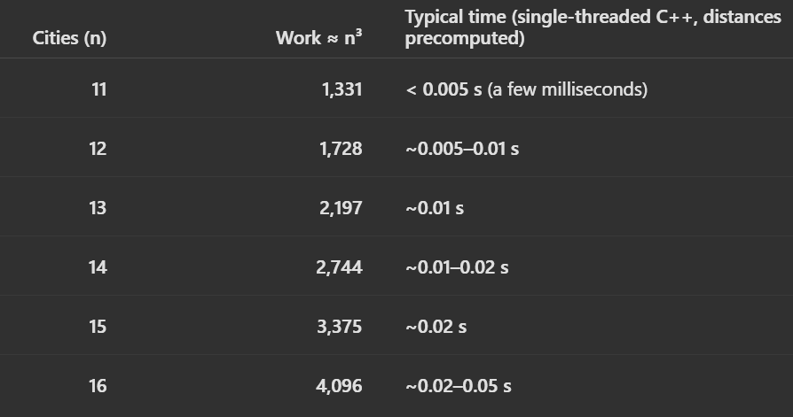
Christofides Algorithm
Polynomial growth in runtime: approximately O(n³).
  1. Compute Minimum Spanning Tree (MST).
  2. Match odd-degree vertices.
  3. Build Eulerian cycle.
  4. Shortcut to Hamiltonian cycle.
  Guarantees ≤ 1.5 × optimal length.

Slide 17
Christofides Algorithm
Polynomial growth in runtime: approximately O(n³).
  1. Compute Minimum Spanning Tree (MST).
  2. Match odd-degree vertices.
  3. Build Eulerian cycle.
  4. Shortcut to Hamiltonian cycle.
  Guarantees ≤ 1.5 × optimal length.

Slide 18
Results
The following table summarizes the raw experimental results, including the number of cities in each dataset as well as the tour length and runtime produced by each algorithm.
n (cities) | algorithm | tour length | runtime (ms)
5 | brute | 1142.95 | 2
 | greedy | 1211.4 | 1
 | christofides | 1142.95 | 1
8 | brute | 1426.29 | 12
 | greedy | 1469.17 | 1
 | christofides | 1433.18 | 1
10 | brute | 1653.38 | 18
 | greedy | 1653.38 | 2
 | christofides | 1653.38 | 2
13 | brute | 1303.74 | 4679
 | greedy | 1353.34 | 3
 | christofides | 1303.74 | 2
20 | brute | N/A | N/A
 | greedy | 2828.28 | 3
 | christofides | 2447.67 | 3
50 | brute | N/A | N/A
 | greedy | 3913.34 | 6
 | christofides | 3987.21 | 7
100 | brute | N/A | N/A
 | greedy | 4933.26 | 11
 | christofides | 4591.5 | 11
Notes:
The table summarizes the raw experimental results, including the number of cities in each dataset as well as the tour length and runtime produced by each algorithm.

Slide 19
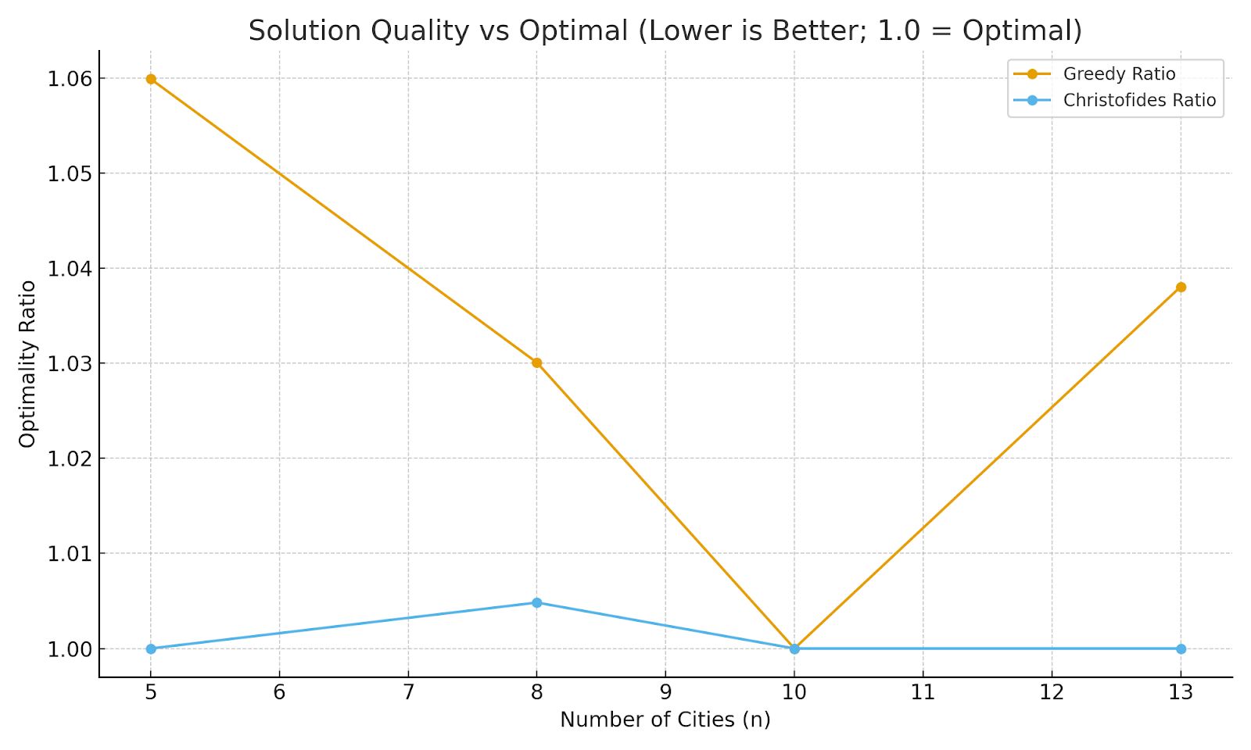
The graph below shows how close each heuristic comes to the optimal tour. Christofides stays at or near a perfect optimality ratio, while Greedy produces slightly longer tours.
Results
The following table summarizes the raw experimental results, including the number of cities in each dataset as well as the tour length and runtime produced by each algorithm.
n (cities) | algorithm | tour length | runtime (ms)
5 | brute | 1142.95 | 2
 | greedy | 1211.4 | 1
 | christofides | 1142.95 | 1
8 | brute | 1426.29 | 12
 | greedy | 1469.17 | 1
 | christofides | 1433.18 | 1
10 | brute | 1653.38 | 18
 | greedy | 1653.38 | 2
 | christofides | 1653.38 | 2
13 | brute | 1303.74 | 4679
 | greedy | 1353.34 | 3
 | christofides | 1303.74 | 2
20 | brute | N/A | N/A
 | greedy | 2828.28 | 3
 | christofides | 2447.67 | 3
50 | brute | N/A | N/A
 | greedy | 3913.34 | 6
 | christofides | 3987.21 | 7
100 | brute | N/A | N/A
 | greedy | 4933.26 | 11
 | christofides | 4591.5 | 11
Notes:
The table summarizes the raw experimental results, including the number of cities in each dataset as well as the tour length and runtime produced by each algorithm.

Slide 20
The graph below shows how close each heuristic comes to the optimal tour. Christofides stays at or near a perfect optimality ratio, while Greedy produces slightly longer tours.
n (cities) | algorithm | tour length | runtime (ms)
5 | brute | 1142.95 | 2
 | greedy | 1211.4 | 1
 | christofides | 1142.95 | 1
8 | brute | 1426.29 | 12
 | greedy | 1469.17 | 1
 | christofides | 1433.18 | 1
10 | brute | 1653.38 | 18
 | greedy | 1653.38 | 2
 | christofides | 1653.38 | 2
13 | brute | 1303.74 | 4679
 | greedy | 1353.34 | 3
 | christofides | 1303.74 | 2
20 | brute | N/A | N/A
 | greedy | 2828.28 | 3
 | christofides | 2447.67 | 3
50 | brute | N/A | N/A
 | greedy | 3913.34 | 6
 | christofides | 3987.21 | 7
100 | brute | N/A | N/A
 | greedy | 4933.26 | 11
 | christofides | 4591.5 | 11

Slide 21


Comparing the algorithms
Greedy
Fast but only an approximation
Christofides
Brute Force
Very good balance of speed AND accuracy
Exact but slow

Slide 22
Brute Force
Greedy
Christofides
Comparing the algorithms
Exact but slow
Fast but only an approximation
Very good balance of speed AND accuracy

Slide 23

SVG Visualization System
  Draws red circles for cities.
  Draws lime arrows for directed tour.
  Same visual style across all algorithms.

Slide 24

Challenges Faced
  Matching odd-degree nodes in Christofides.
  Building Eulerian tours.
  Ensuring correct scaling and rendering in SVG.
  Debugging cyclic path generation.

Slide 25

Results & Findings
  Brute Force matches theoretical expectations.
  Greedy varies heavily with starting city.
  Christofides consistently close to optimal.

Slide 26

Conclusion
  We implemented three TSP solvers successfully.
  Generated consistent visual outputs.
  Christofides offers best practical performance.
  Project demonstrates algorithmic trade-offs clearly.
Questions?

Slide 27
Questions?
Conclusion
Conclusion
  We implemented three TSP solvers successfully.
  Generated consistent visual outputs.
  Christofides offers best practical performance.
  Project demonstrates algorithmic trade-offs clearly.

