Slide 1


NFL
Scorecard Overview January 2026

Slide 2






Enabling The Digital Fan & Operations Experience
Exploring experience and technology to create a frictionless physical + digital journey
Fan Experience
Physical and digital interactions experienced by fans / visitors throughout their journey
DIFFERENTIATED
EXPERIENCE AND CAPABILITIES
Operations
Capabilities that facilitate venue and team staff to optimize operations and support the fan, team and event experience
AI & Innovation Services
Agentic AI and next generation Innovation enabling the Fan Experience and Team Operations
TECHNOLOGY VISION AND
PLATFORM
Cloud and Edge Platform
Remote and scaled management of devices and experiences plus Edge compute
PHYSICAL + DIGITAL
ENABLEMENT
AND EXECUTION
Network and Connectivity
Wired/wireless communications connecting platforms, devices, and users
Physical Infrastructure and Devices
Devices and sensors collecting interaction and source data

Slide 3
The Seamless Journey Starts Here
Fan and Operational Needs from Start to Finish
1. Research & Buy
2. Transportation
3. Stadium Entry
4. Food & Beverage
5. During Game
6. Restrooms
7. Merchandise
8. After Game
View stadium layout with seating POVs and purchase tickets or additional passes
Real-time info on public transit, parking wayfinding, and where to meet friends
Identify correct entry gate and pass through security with speed
Discover, order, pay, and pick up or deliver food fast with 3rd-party integration
Custom replays, fantasy league tracking, social sharing, and betting
Find closest restroom with shortest line
Discover and purchase items; ship items not in stock
A safe & smooth exit, rideshare matching, and traffic coordination
Augmented-reality seat previews
Instant facial recognition and wait time predictions by gate
Instant replays with options to highlight star players
Ability to browse on mobile and pick-up in stadium Pro Shop
Edge computer processing updates transport flows instantly
Personalized menu and order recommendations
Crowd density and wait-time predictions
Transition from stadium to city WiFi without a hitch
Technology Enablers
A.I. chatbots answer questions and create custom packages
Stadium WiFi and Bluetooth enable mobile ticketing
WiFi to support 100,000 people at any given time
Inventory is constantly refreshed and marked as “going fast”
Integration across stadium mobile app and transit apps
Centralized order flow and monitoring across concessionaires
Stadium wayfinding to find the fastest route and limit congestion
Cloud-based egress modeling to ensure safety
Network
Edge & Cloud
Data & AI
Apps
Monitoring

Slide 4

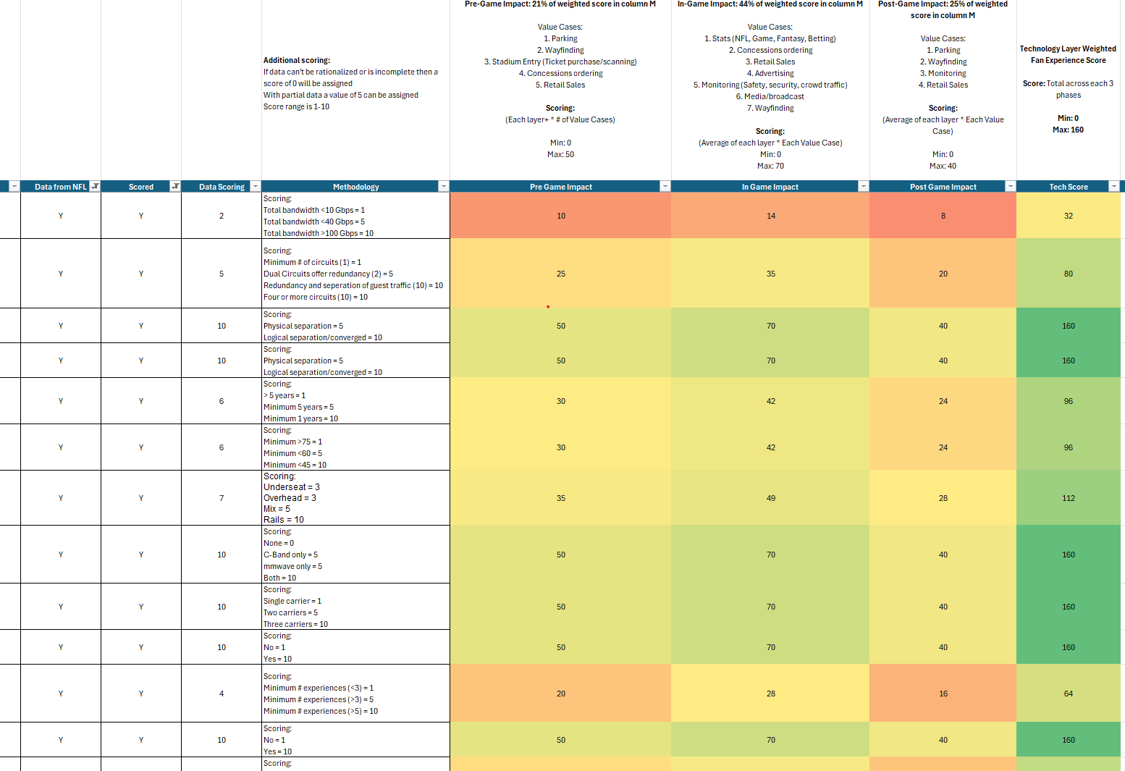



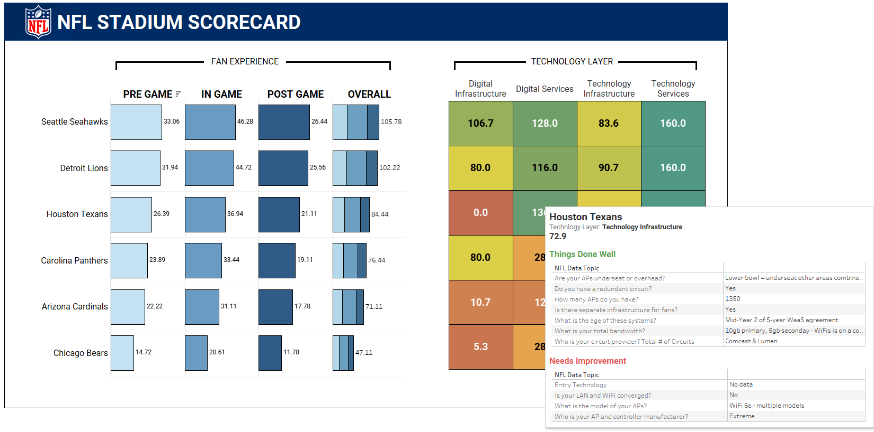


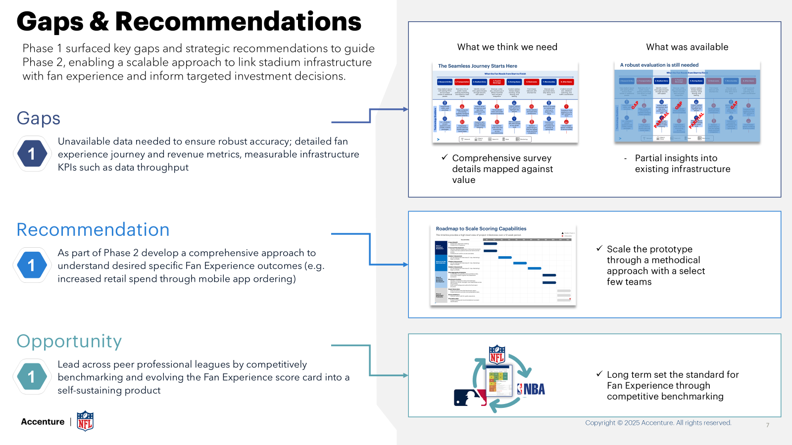

Phase 1 Methodology Overview
From Input to Impact: Scoring Simplified
Rationalized Data:
Responses were rationalized to data points where necessary (e.g. total bandwidth across all circuits, AP per user against stadium capacity) using industry knowledge + best practices
Technology Areas
Scoring Process
Input
Rationalized Data
Technology Infrastructure
Scoring XLS
Survey question by the NFL
Weighting Factors
Technology Services
Scoring (Scores From 0-10 Based On Methodology)
Digital Infrastructure
Tableau Dashboard
Data Visualization
Responses by NFL teams
Digital Services
Recommendations
AI & Innovation
For each topic scoring methodology includes:
If data can't be rationalized or is incomplete, then a score of 0 will be assigned
With partial data a value of 5 can be assigned
Score range is 1-10

Slide 5
Phase 1 Methodology Scoring Overview
2
GAME PHASES
3
Low
Pre-Game | In-Game | Post-Game
Stadium entry, parking, etc | Concessions, wayfinding, etc | Exit management, retail, etc
Medium
High
1
TECH LAYER
Digital Infrastructure | Broadband networks, cloud hosting, etc
Digital Service | SaaS, mobile applications, etc
Technology Infrastructure | Wi-Fi, DAS, Fiber, etc
Technology Service | Broadcast, 5G services, etc
AI / Innovation | New technology, POCs, etc
Tech layer capability ratings
3
(1) Technology layers weighted against impact to the (2) three phases of an NFL game and given a low, medium, high (3) capability score across each phase

Slide 6
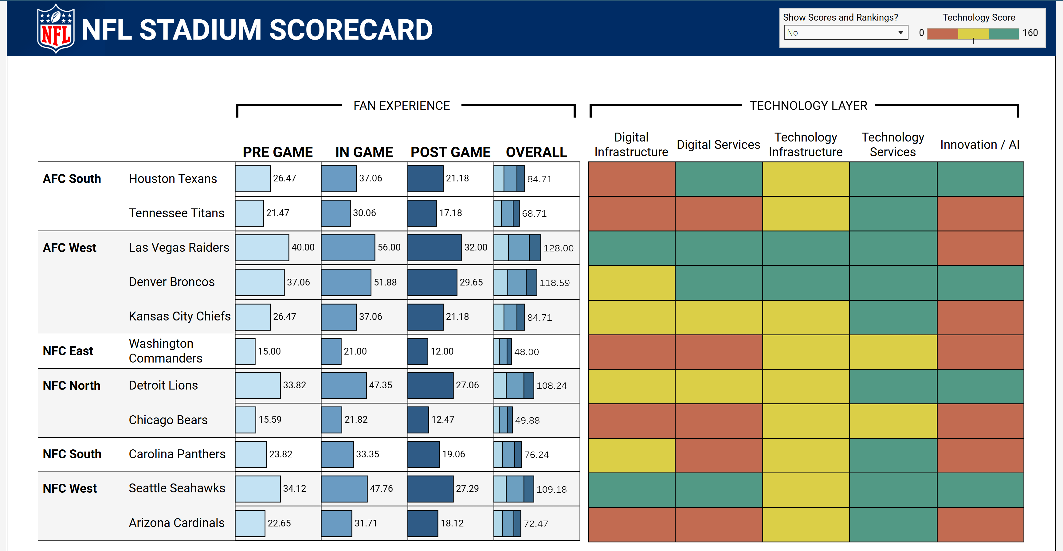


Phase 2 Scope Overview
Opportunity areas through benchmarking
Phase 2 builds on Phase 1 by refining strategic vision and business logic, integrating cross-team input for an NFL-wide view. Benchmarking global stadiums will uncover performance gaps and provide recommendations tied to a single technology layer
1
2
NFL Focus Areas
Fan Survey Improvements
3
4
Operational Efficiency
Sustainability & Innovation
Prototype dashboard based on survey 1.0 data
Phase 2 Scope:
Update strategic vision and guiding principles for benchmarking
Develop single technology layer survey (e.g. Infrastructure)
Refine methodology and survey by iterating with 3 NFL teams
Build and launch a scoring dashboard and send out for all 32 teams
5
6
Connectivity & Infrastructure
Engagement & Personalization
7
8
Transaction & Commerce
Immersive Experiences
Copyright © 2025 Accenture. All rights reserved.
6

Slide 7
Team Structure
Steering Committee
Steering Committee
Guidance, definition and validation
Participation in steering meetings & key stakeholder conversations
Quality control
Delivery Lead
Project management, scope control, resources planning and reporting
Risk mitigation and issue resolution
Work with NFL lead on escalations and issue resolution
Delivery Team
Define objective & goals
Conduct initial analysis and lead delivery of program per agreed scope
Communicate continuously with NFL lead and stakeholder for feedback and direction
NFL / Team Business Stakeholders
Participate in workshops and interviews
Provide information as needed
Inform scorecard assessment activities for refinement
Subject Matter Advisors (SMA)
Contribution with deep knowledge in different subjects within project scope
Participation in workshops during the project
NFL Leadership
Accenture Leadership
NFL Teams
Accenture Delivery Team
IT and Infrastructure
Delivery Lead
Business Operations
Survey Designer
Stadium Operations
Dashboard Engineer
Marketing
Dashboard Analyst
Fan Experience
SMAs

Slide 8
Pricing and Assumptions
Survey Phase 2 Scope / Pricing
USD $395k / 8 weeks
Key Assumptions
Data is readily available
Data does not need to be rationalized and fits into scoring survey/methodology
Available data is easily correlated to outcomes (no rationalization required)
No additional legal or privacy concerns from teams or required agreements
NFL team’s key personnel are available to provide data and support correlations
Data sufficient to infer directional investment decisions
Accenture provided platforms will be used for development, build, hosting of survey data and dashboard (e.g. Tableau, Alteryx)
If required migration of platform (e.g. dashboard, tools, etc) to NFL systems will be in a future phase
NFL will support gathering of survey data as needed
Once survey is “Live” Accenture is not responsible to collect data
Scope:
Update strategic vision and guiding principles for benchmarking
Develop single technology layer survey (e.g. Infrastructure) – maximum 15 questions
Refine methodology and survey by iterating with 3 NFL teams
Build and launch a scoring dashboard and send out survey for all 32 teams
Not in scope:
International team benchmarks
Internal NFL integrations (e.g. fan experience)
Additional technology layers (e.g. Tech services, Innovation, etc) will be excluded and proposed as future phases of work
Detailed business cases are not in scope
Support/Run/Maintain is not in scope

Slide 9
Changes to scope
Phase 2 Scope:
Update strategic vision and guiding principles for benchmarking
Develop single technology layer survey (e.g. Infrastructure)
Refine methodology and survey by iterating with 3 NFL teams
Build and launch a scoring dashboard and send out for all 32 teams
New Additional Scope:
Develop four technology layer surveys
AI Innovation
Digital Services
Technology Services
Technology Infrastructure (Physical+Digital)
Max 100 survey questions* (increase from 20 in single layer)
Integrate with voice of the fan
Benchmark against 3 international teams**
Updated Scope:
Update strategic vision and guiding principles for benchmarking
Develop four technology layer surveys (e.g. Infrastructure)
Integrate with voice of the fan
Benchmark against 3 international teams
Refine methodology and survey by iterating with 3 NFL teams
Build and launch a scoring dashboard and send out for all 32 teams
*Survey questions increase in complexity and risk of response delay to gather information **NFL must provide data. If no available data then benchmark will be subjective based on research

Slide 10
Pricing and Assumptions
Survey Phase 2 Scope / Pricing
USD $470k / 8 weeks
Key Assumptions
Data is readily available
Data does not need to be rationalized and fits into scoring survey/methodology
Available data is easily correlated to outcomes (no rationalization required)
No additional legal or privacy concerns from teams or required agreements
NFL team’s key personnel are available to provide data and support correlations
Data sufficient to infer directional investment decisions
Accenture provided platforms will be used for development, build, hosting of survey data and dashboard (e.g. Tableau, Alteryx)
If required migration of platform (e.g. dashboard, tools, etc) to NFL systems will be in a future phase
NFL will support gathering of survey data as needed
Once survey is “Live” Accenture is not responsible to collect data
Scope:
Update strategic vision and guiding principles for benchmarking
Develop four technology layer surveys (e.g. Infrastructure)
Integrate with voice of the fan
Benchmark against 3 international teams
Refine methodology and survey by iterating with 3 NFL teams
Build and launch a scoring dashboard and send out for all 32 teams
Not in scope:
Detailed business cases are not in scope
Self service to Support/Run/Maintain is not in scope

Slide 11
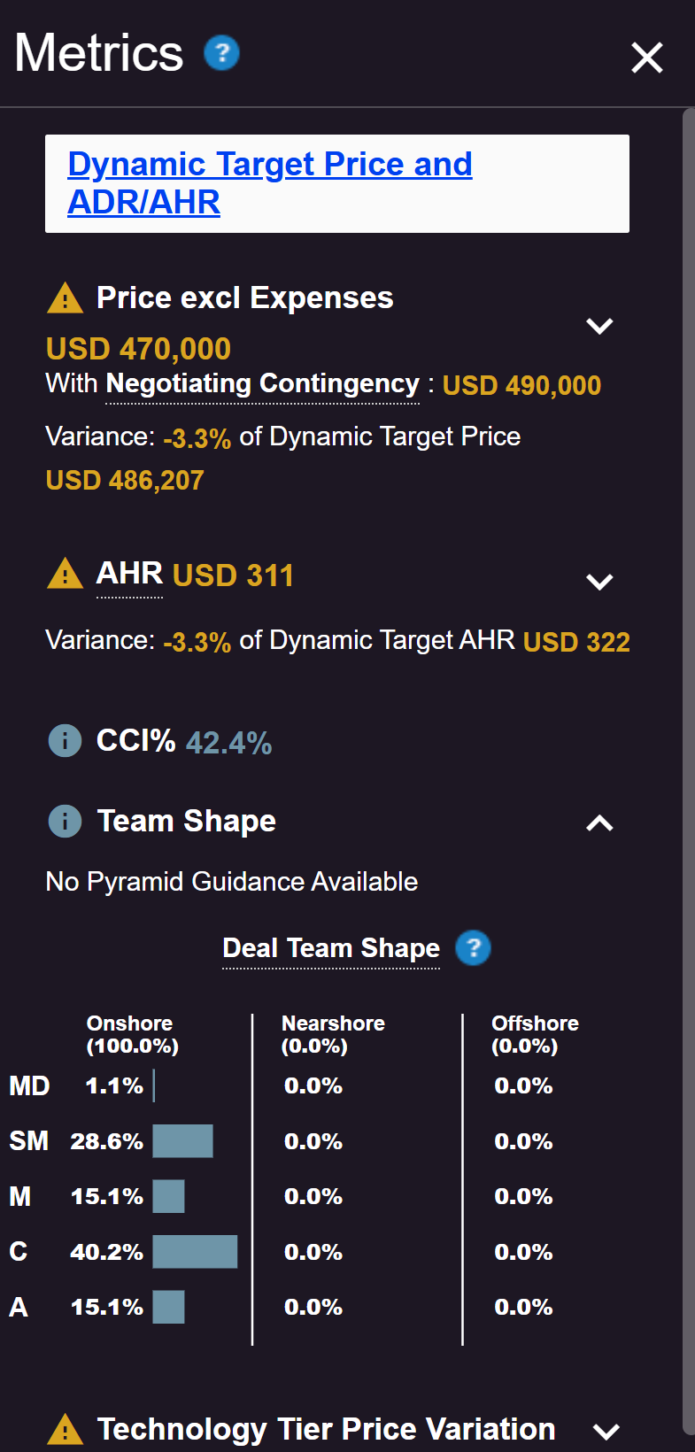
Metrics

