Slide 1


Protocol Compliance in Popular RTC Applications
Peiqing Chen*, Peng Qiu*, Anonymous, Zaoxing Liu
Internet Measurement Conference (IMC) 2025, Madison, WI

Slide 2







Real-Time Communication (RTC) applications & protocols
STUN/TURN
RTP
RTCP
QUIC

Slide 3





RTC protocol stack
Round trip time
Packet loss
Network jitter
Client A
Client B
Step 1
Step 2
Meanwhile
STUN/TURN
RTP or QUIC
RTCP
Set up connection
Media packets transmission
Monitor performance metrics

Slide 4




The implementations of RTC protocols are noncompliant
Standard protocol
e.g. RFC protocol specification
The RTC applications don’t strictly follow the standards.
Actual implementations
Unknown extra attribute
Missing attribute
Invalid field

Slide 5



Significance of compliance study
EU DMA (Digital Markets Act)
A more compliant implementation may help engineers:
Major RTC applications must support cross-platform voice and video calls between individual users by 2028.
Lower app development overhead
Lower interoperation cost
Compliance measurement helps understand interoperation challenges
Clarification: Noncompliance implementations does not degrade App performance.

Slide 6
In this paper we study…
How popular RTC applications implement the RTC protocols differently.

Slide 7
Outline
Message-level protocol compliance definition
RTC calling traffic collection & Message extraction
Quantitative analysis results on collected traffic
Case studies

Slide 8
Message-level measurement
UDP datagram
IP packet
STUN message
RTP message
Message is a complete application protocol data unit, consisting of a header and payload.

Slide 9



Determine compliance of a message
Public protocol specifications
Message type definition
If all follows
Header Field Validity
Compliant
Attribute Type Validity
IETF RFC
WebRTC documentation
If any not follows
Attribute Value Validity
Noncompliant
Syntax & Semantic Integrity
IANA
Notes:
Internet Assigned Numbers Authority

Slide 10

2 metrics for compliance of an application
Compliance by traffic volume
Compliance by message type
STUN/TURN
STUN/TURN
…
…
RTCP
RTCP
…
…
RTP
RTP
…
…
Noncompliant message
Noncompliant message type
Compliant message
Compliant message type
Straightforward.
Mainly reflects RTP compliance. Under represents compliance of other protocols.
Unbiased representation of all protocols.

Slide 11
Outline
Message-level protocol compliance definition
RTC calling traffic collection & Message extraction
Quantitative analysis results on collected traffic
Case studies

Slide 12

Experiment setup
Network:
Wi-Fi (P2P enabled)
Wi-Fi (relay mode)
Cellular
Traffic summary:
90 1-on-1 calls across 6 RTC applications, ~10 hours in length
6 million UDP datagrams
Traffic collected between Feb-Sep 2025
Caller
Callee
RVI
(Remote Virtual Interface)
RVI
Traffic collector
6 popular RTC mobile apps

Slide 13
Extract Messages from UDP datagrams
Challenge: Datagram may contain proprietary protocol headers with unknown length
Solution: design our custom DPI (Deep Packet Inspection) that can locate RTC messages in any position in a UDP datagram
Our Custom DPI
Proprietary protocol header
UDP datagram
STUN message
Proprietary protocol header
STUN message
RTP message
RTP message
Notes:
Listen to what

Slide 14
Outline
Message-level protocol compliance definition
RTC calling traffic collection & Message extraction
Quantitative analysis results on collected traffic
Case studies

Slide 15
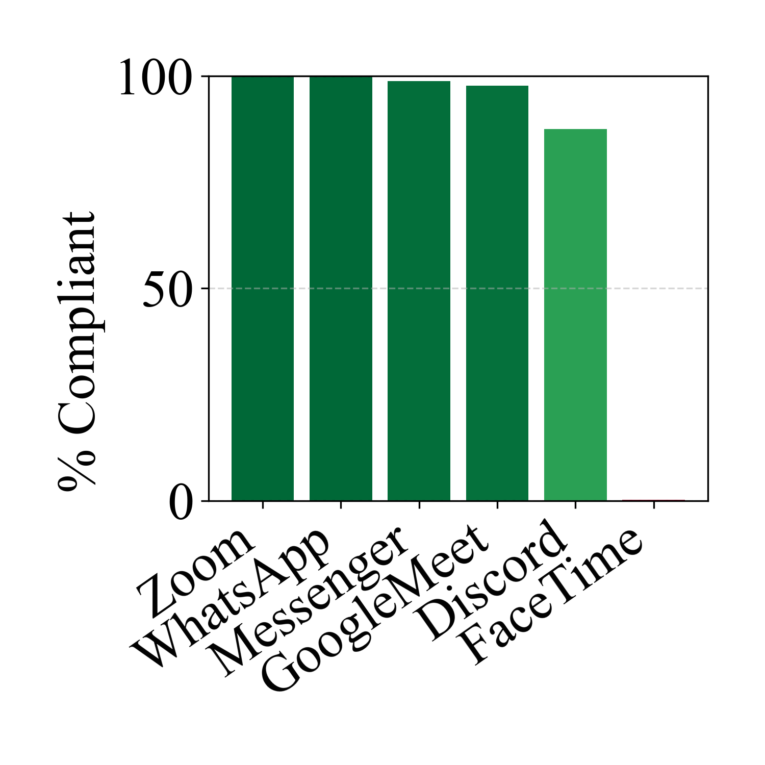
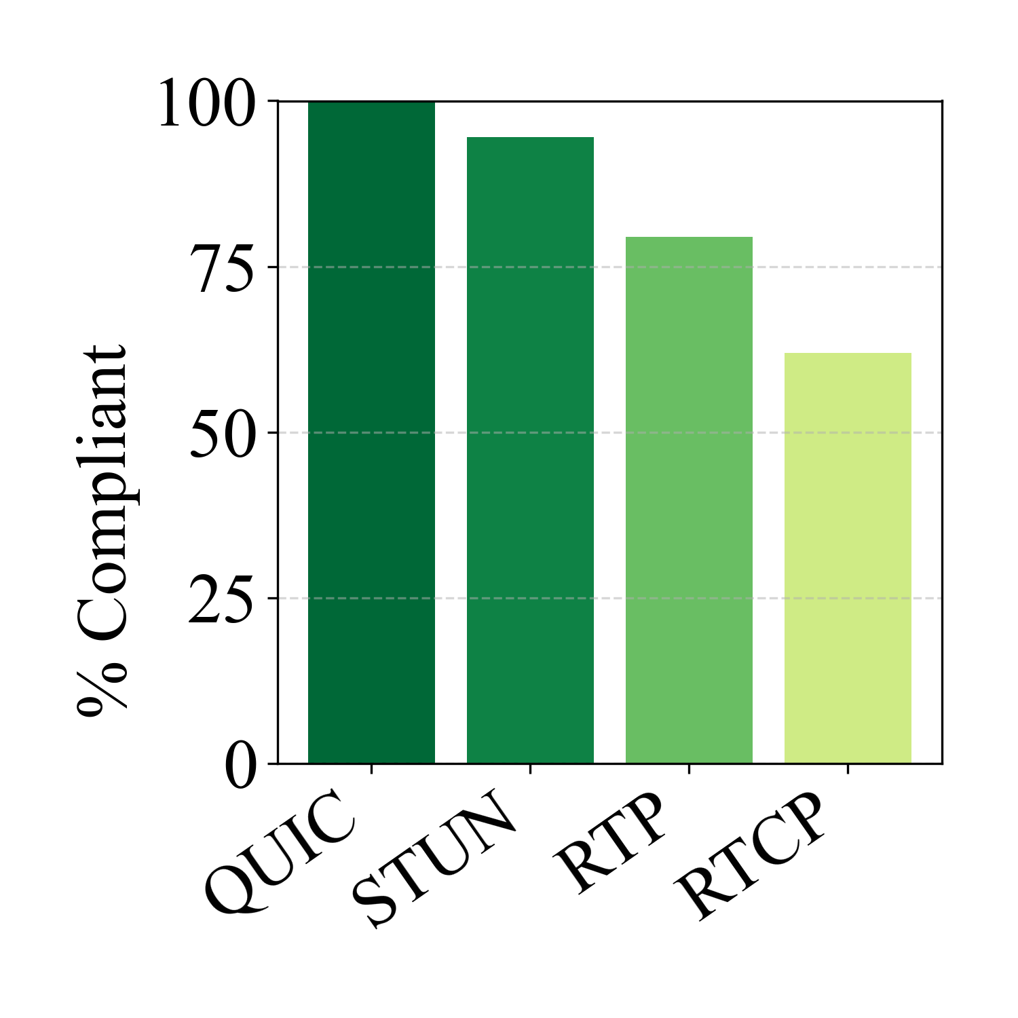

Results: Compliance ratio by traffic volume
$$\frac{\# compliant msgs}{total \# of msgs}$$
By traffic volume:
Zoom, WhatsApp, Messenger, and Google Meet are the most compliant RTC applications.
QUIC and STUN are the most compliant RTC protocols.

Slide 16
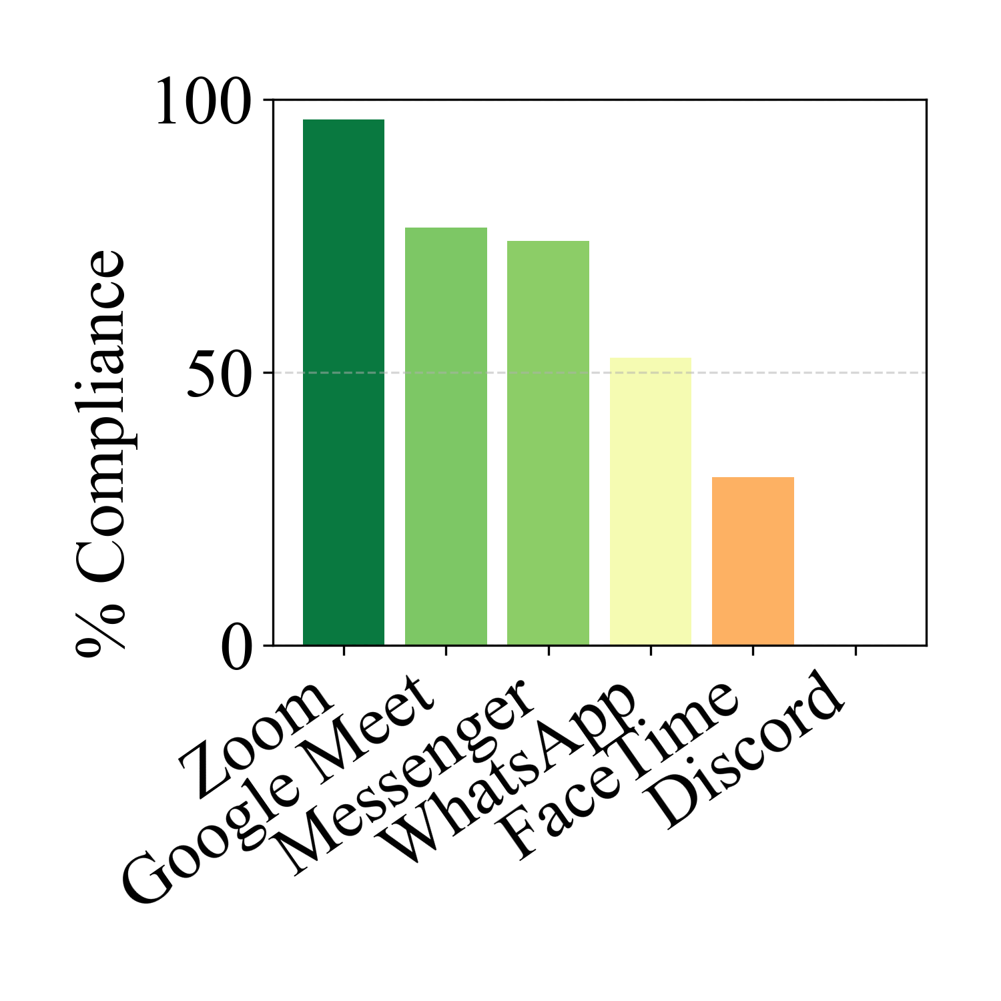
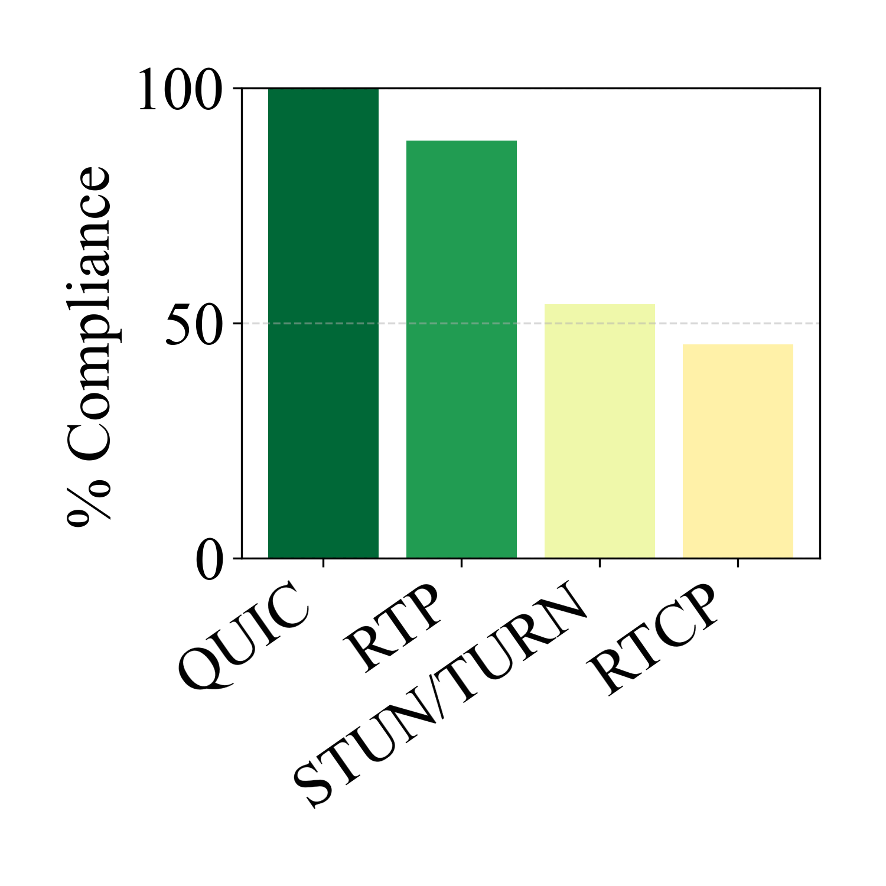

Results: Compliance ratio by message type
$$\frac{\# compliant msg types }{total \# of msg types }$$
By message type, we have a different result:
Zoom is the most compliant RTC application.
QUIC and RTP are the most compliant RTC protocols.

Slide 17
Outline
Message-level protocol compliance definition
RTC calling traffic collection & Message extraction
Quantitative analysis results on collected traffic
Case studies

Slide 18
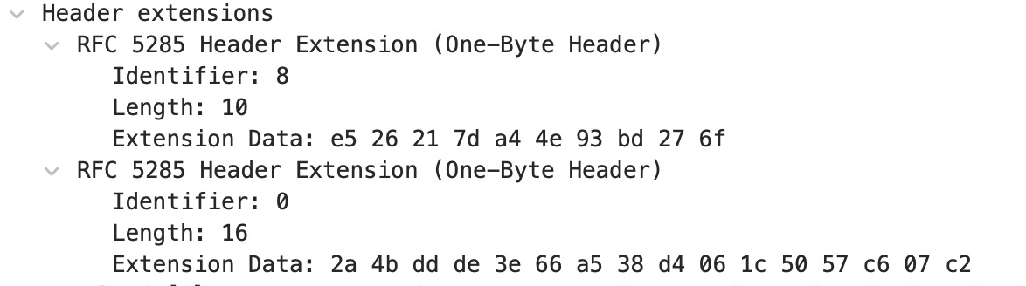
Discord uses reserved identifier in RTP header extension
An RTP header extension allows adding extra metadata (e.g., audio level, frame markers) to RTP packets beyond the standard header. The identifier (ID) specifies which type of extension it is, so the receiver knows how to interpret the extension data.
Discord RTP header extension example
RFC 8285 – RTP header extensions
Each distinct extension MUST have a unique ID. The ID value 0 is reserved for padding and MUST NOT be used as a local identifier.
An extension element with an ID value equal to 0 must not have an associated length field greater than 0
A standard parser will ignore this extension data.
Repurposing reserved field values

Slide 19
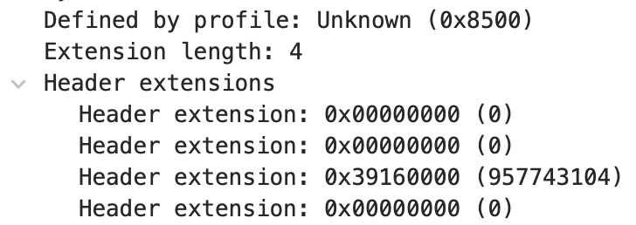
FaceTime introduces undefined profile identifier for RTP header extensions
FaceTime header extension example
The profile identifier specifies which format or set of rules defines how the RTP header extension should be interpreted.
A standard parser cannot parse these header extensions.
Proprietary profiles for header extension parsing

Slide 20

Discord adds one extra direction byte in RTCP messages
Each Discord RTCP message of message type 200, 204, 205 and 206 adds one extra byte at the end of the RTCP message. 0x80 marking client to relay server, 0x00 marking relay server to client.
RTCP
0x00
RTCP
0x80
Relay server
Relay server
Discord client
Discord client
Additional indicators are added

Slide 21
Facetime and Zoom have proprietary protocol headers
UDP datagram
Proprietary protocol header
RTC message(s)
Facetime
Zoom
90% of datagrams contain 8~19 bytes proprietary protocol headers when using relay mode.
Each RTP and RTCP is preceded by a 24~39 byte proprietary header.
Many popular RTC apps add additional features on top of the standards.

Slide 22


Interoperation – long long journey across the ocean…
Share the same protocol standard
Design adaptors for each protocol / application
Other solutions…

Slide 23
Conclusion & Future work
This work provides the first message-level measurement of protocol compliance in RTC applications.
No application fully follows all the protocol specifications.
Future work:
RTC protocols and application interoperability
The compliance study between WebApps and MobileApps
Protocol compliance study of group calls
Measurement tools open-sourced at: https://github.com/RTC-Measurement-Project/rtc_code

