Slide 1
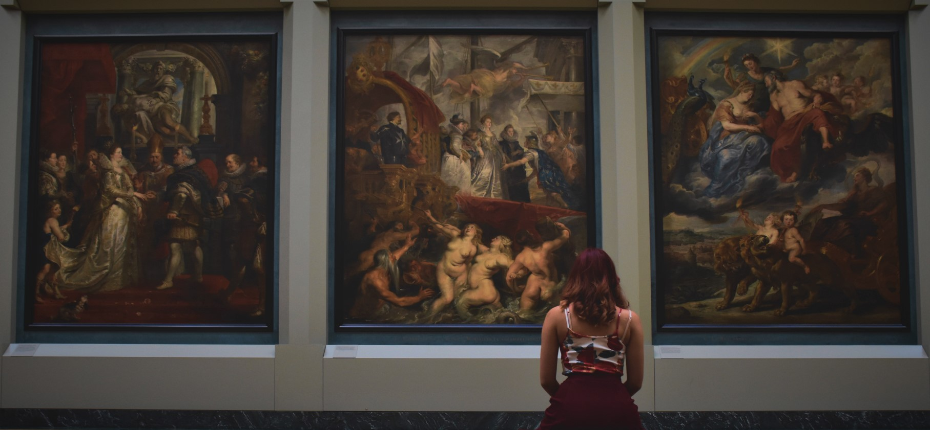
ARTIEZ
Online Art Gallery

Slide 2



GROUP MEMBERS
William Corotan
Omar Tan
Ramuel Deluna
Elias Sapungen

Slide 3
OBJECTIVES
Promote the arts and provide a space for artists to showcase their work to a wider audience.
Connect artists with potential buyers and collectors who are interested in purchasing their work.
Ensure a high-quality experience for both artists and buyers, with a user-friendly interface, clear navigation, and professional presentation of the artwork.
Encourage innovation in the arts, by providing opportunities for emerging artists to showcase their work and promoting experimentation and new forms of artistic expression.

Slide 4


PROCESS FLOW

Slide 5
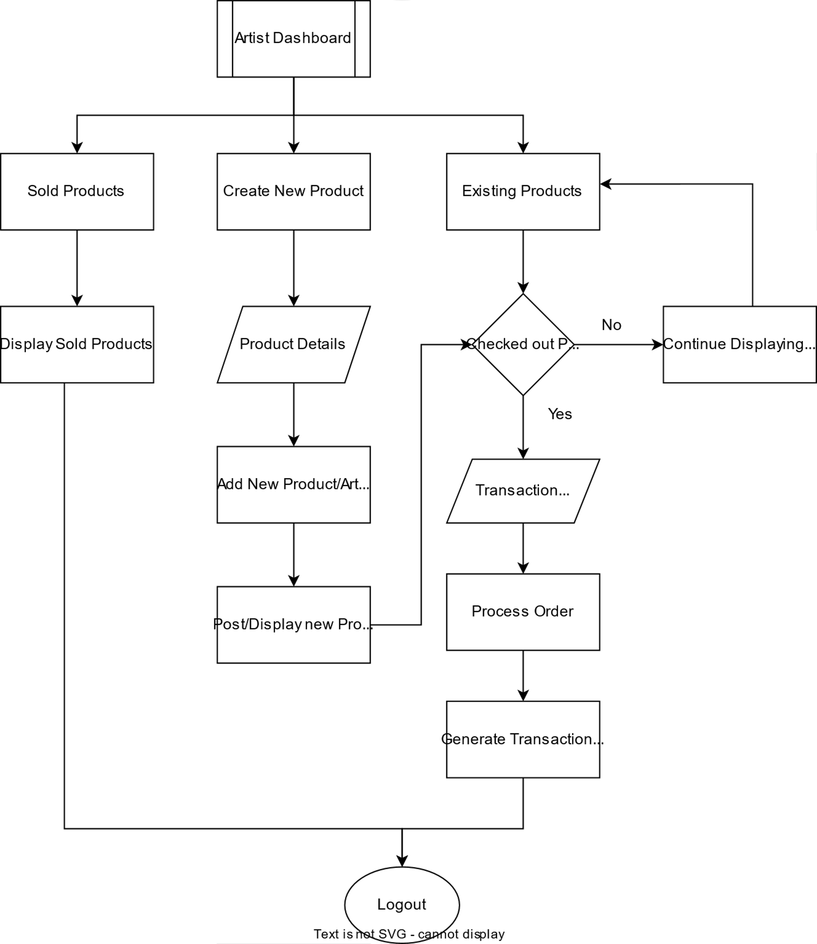

Slide 6
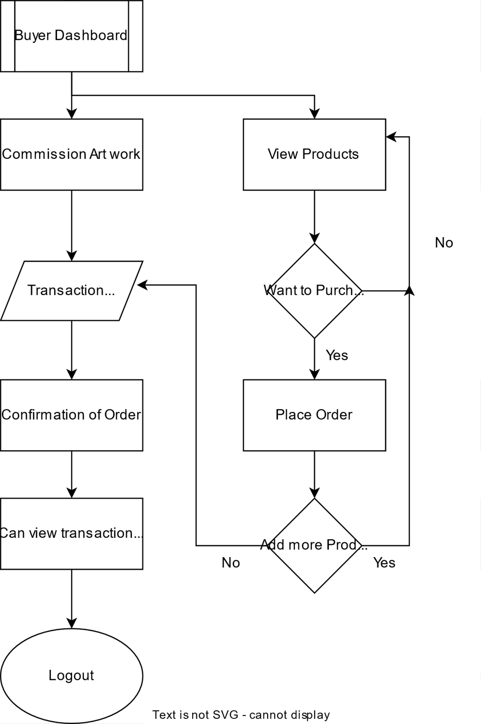

Slide 7
WEBSITE DEVELOPMENT PLAN
TASK NAME | JAN-23 | JAN-25 | JAN-28 | FEB-3 | FEB-4 | FEB-11 | FEB-18
PLANNING
RESEARCH
DATABASE
BACK-END
FRONT-END

Slide 8
LIVE DEMO

Slide 9
FUTURE PLAN

