Slide 1
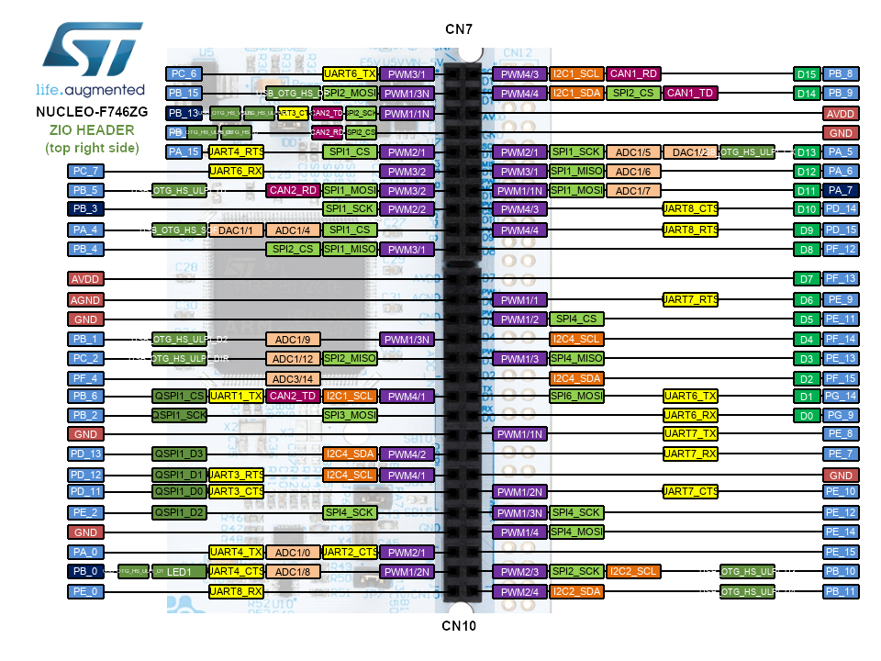
ADC to DAC
DAC PA4 -- CN7 ADC PA0 -- CN10
DAC PA4
ADC PA0

