Slide 1
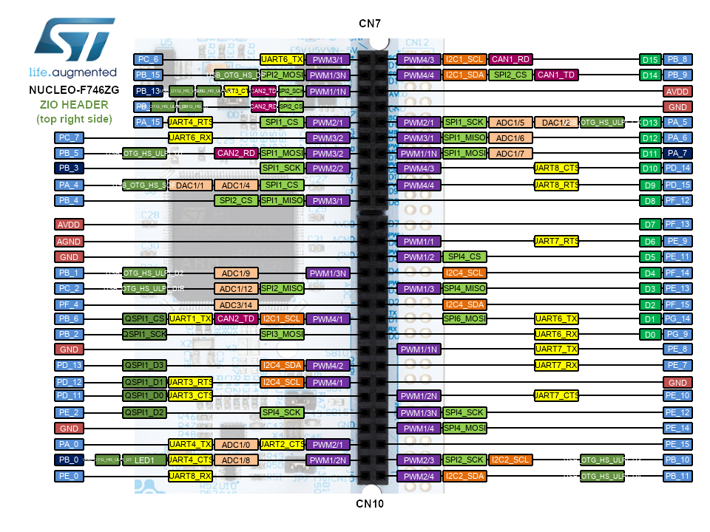
I2C connection
I2C1_SCL PB6 (CN10) ; I2C1_SDA PB9 (CN7) ; address 10
I2C2_SCL PB10 (CN10); I2C2_SDA PB11 (CN10) address 22
I2C1_SDA PB9
I2C1_SCL PB6
I2C2_SCL PB10
I2C2_SDA PB11

