Slide 1
UART connection
UART-4
TX
RX
TX
UART-5
RX

Slide 2
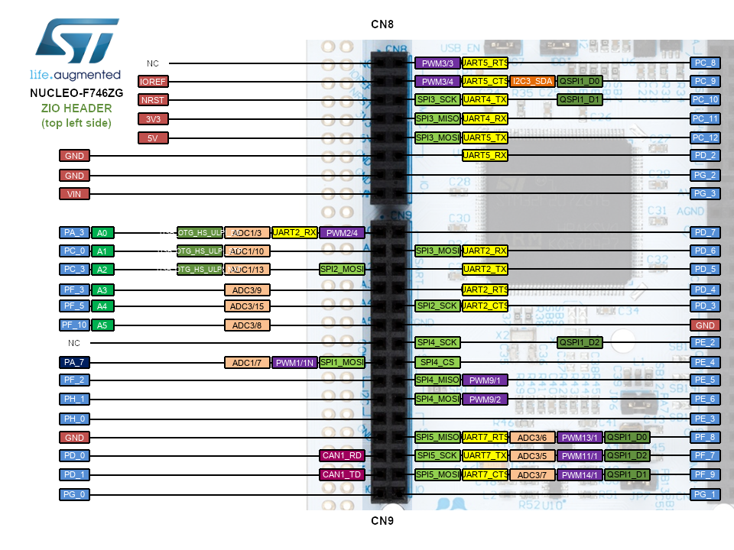
UART connection
PC_10 UART4-TX (port CN8); PC_11 UART4-RX (port CN8)
PC_12 UART5-TX (port CN8); PD_2 UART5-RX (port CN8)
PC_10 UART4-TX
PD_2 UART5-RX

Slide 3
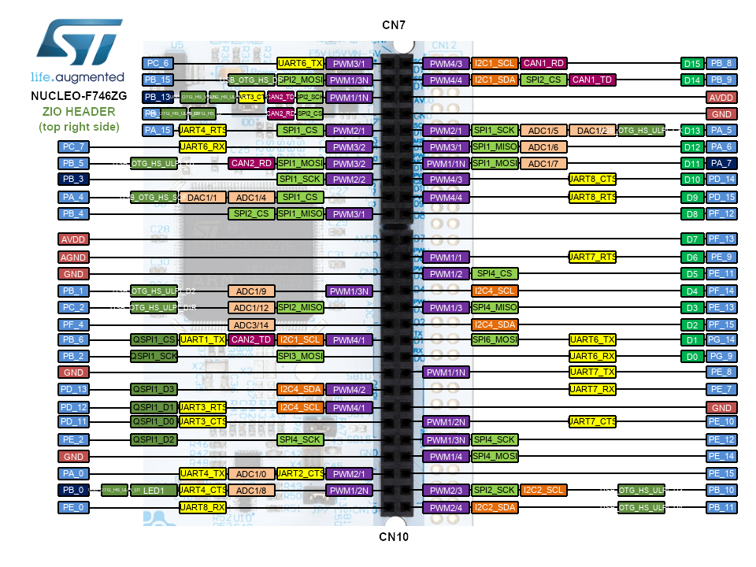
I2C connection
I2C1_SCL PB6 (CN10) ; I2C1_SDA PB9 (CN7) ; address 10
I2C2_SCL PB10 (CN10); I2C2_SDA PB11 (CN10) address 22
I2C1_SDA PB9
I2C1_SCL PB6
I2C2_SCL PB10
I2C2_SDA PB11

Slide 4
SPI
* SPI1
* PA5 SCK (CN7)
* PB5 MOSI
* PA6 MISO
*
* SPI2
* PB10 SCK (CN10)
* PC2 MISO (CN10)
* PC3 MOSI (CN9)
PA5 SCK
PA6 MISO
PB5 MOSI
PC3 MOSI
PC2 MISO
PB10 SCK

