Slide 1
Identifying whether an author has written a given paper or not (A proposed model to suggest the correct author for a newly written research article)
a

Slide 2
Research Issue in Research Publication (Indexing)
Google Scholar
Google Scholar is a freely accessible web search engine .
Released in beta in November 2004, the Google Scholar index includes most peer-reviewed online academic journals and books, conference papers, theses and dissertations, preprints etc.
It listed 160 million documents as of May 2014.
DBLP
DBLP is a computer science bibliography website. Starting in 1993 at the University of Trier, Germany.
DBLP listed more than 3.66 million journal articles, conference papers, and other publications on computer science in July 2016
All important journals on computer science are tracked. Proceedings papers of many conferences are also tracked.
ResearchGate
ResearchGate is a social networking site for scientists and researchers to share papers, ask and answer questions, and find collaborators.
It is the largest academic social network in terms of active users, although other services have more registered users.

Slide 3
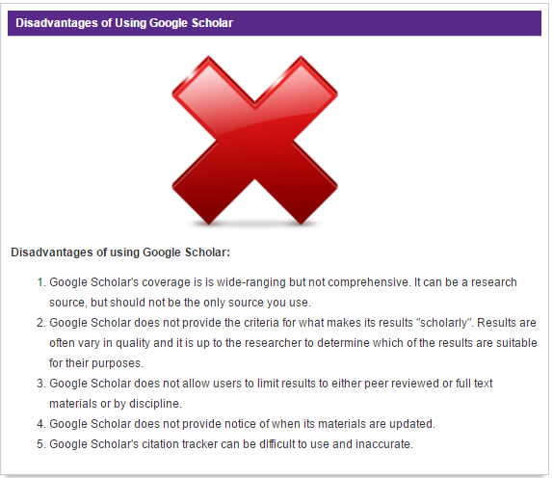

Slide 4
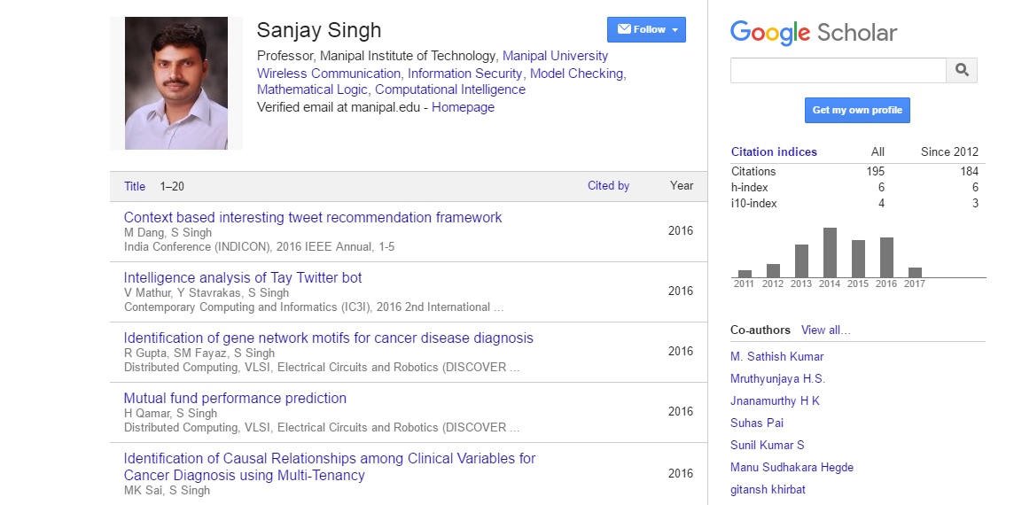
Issue in Google Scholar citation

Slide 5
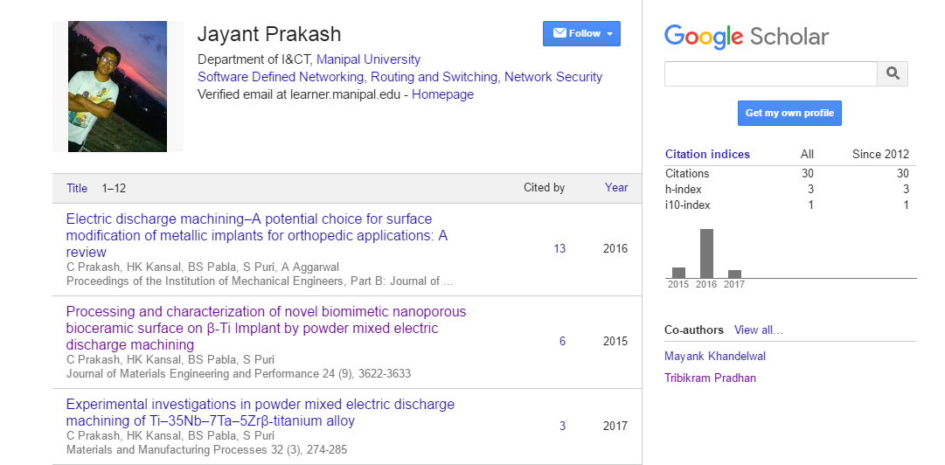
Issue in Google Scholar citation Continued…

Slide 6
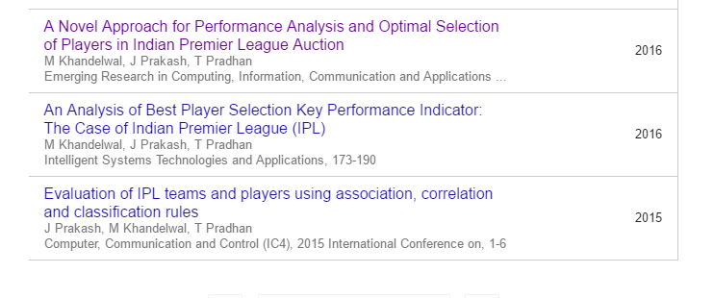
Issue in Google Scholar citation Continued…

Slide 7
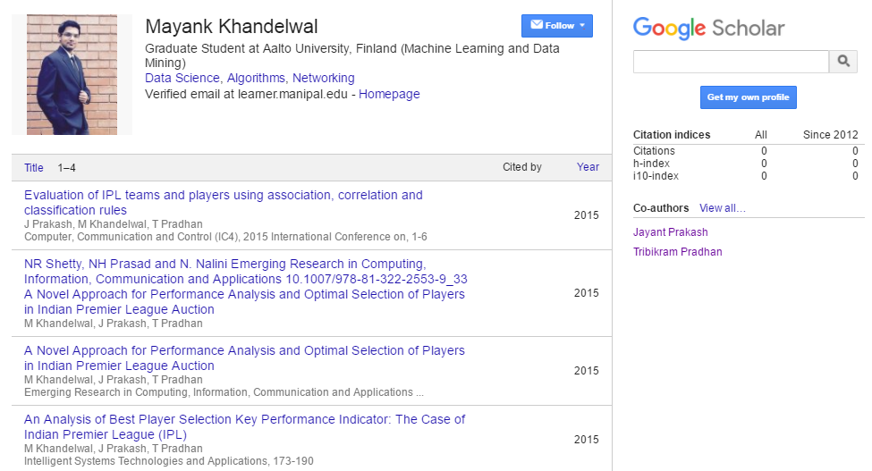
Issue in Google Scholar citation Continued…
a

Slide 8
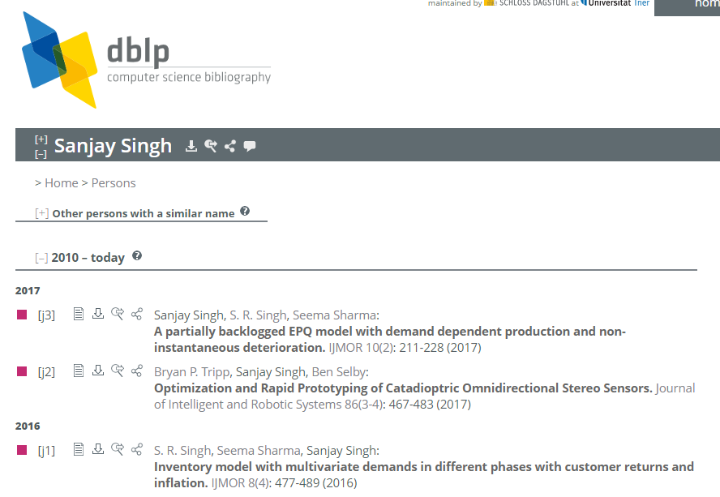
Issue in DBLP Indexing

Slide 9
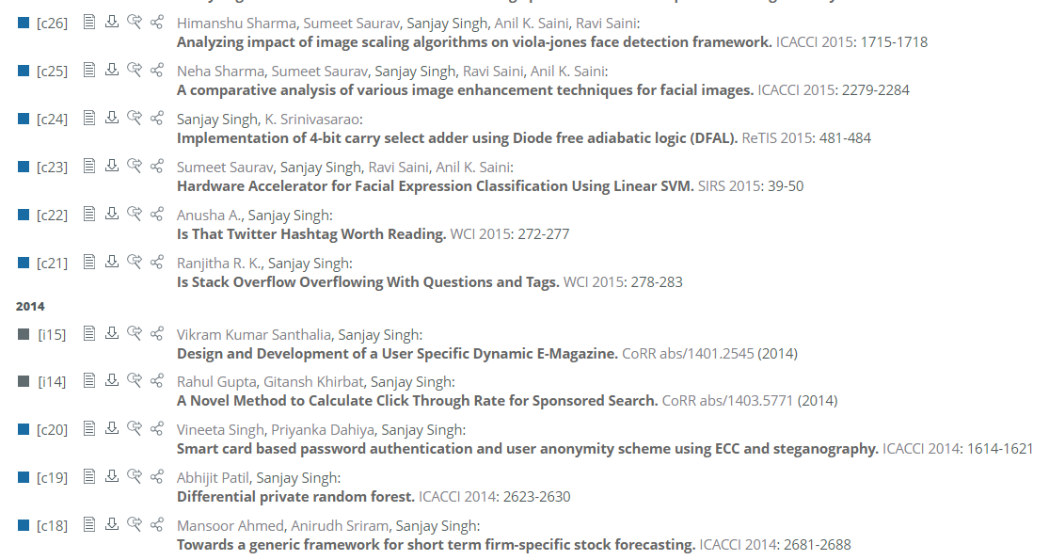
Issue in DBLP Indexing Continued...

Slide 10
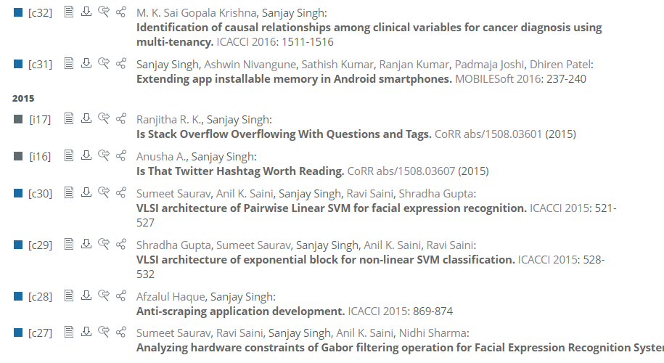
Issue in DBLP Indexing Continued...

Slide 11
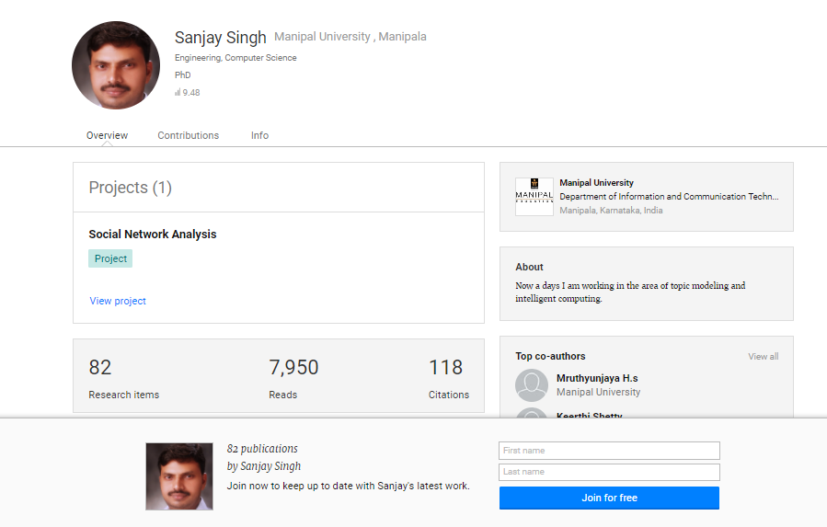
Issue with Research Gate

Slide 12
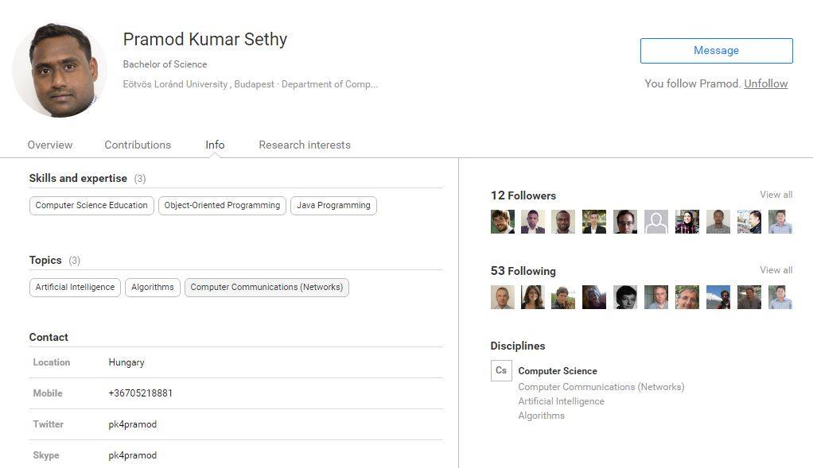
Issue in Research Gate Continued…

Slide 13
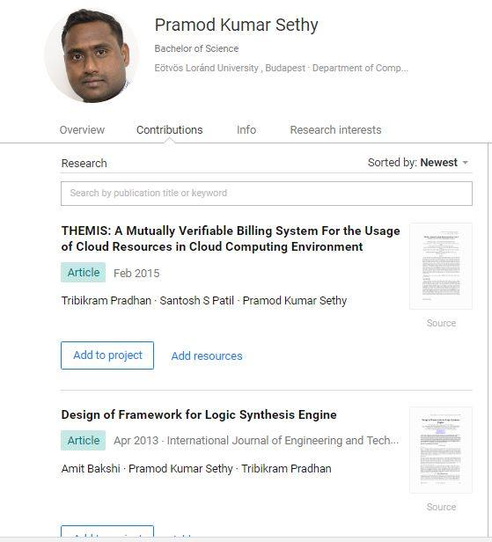
Issue in Research Gate Continued…

Slide 14
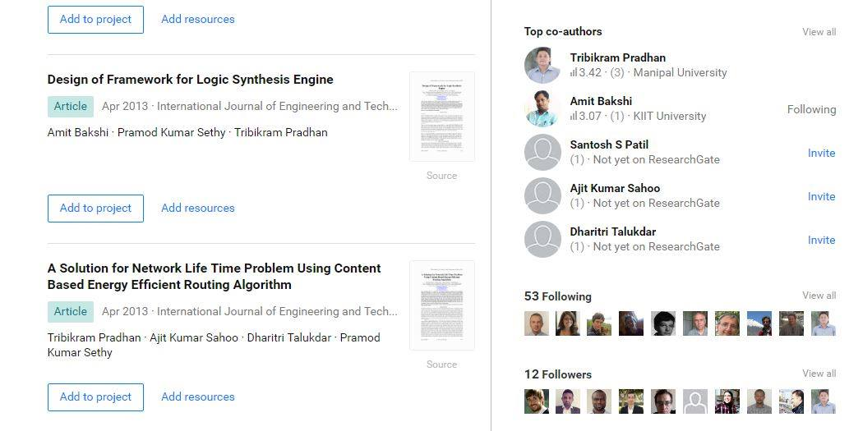
Issue in Research Gate Continued…

Slide 15




How to Resolve the issue and how can we do better .

Slide 16
Demerits in Existing Approach
Other Indexing Databases like Google Scholar and Research Gate focus on producing more results in a very less span of time and focus less on accuracy as compared to producing faster results.
Time vs. Accuracy
We focus more on producing more accurate results without compromising faster results .
Proposed a classifier system to identify the exact author for a given paper.
The above system consists of a set of models to overcome the identified issues to get a better result.
Writing code from scratch which are more time efficient and suit are requirements rather than using existing naïve algorithms already present on the Internet.

Slide 17
Problem Statement
Phase I:
To identify which author proﬁles in a given dataset should be merged because they represent the same author (To remove duplicates).
Phase II:
To identify the author of a newly written paper(Exact Author with affiliation).

Slide 18
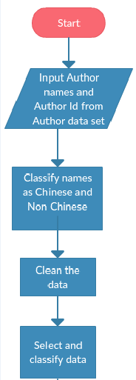
Methodology Used for Phase I

Slide 19
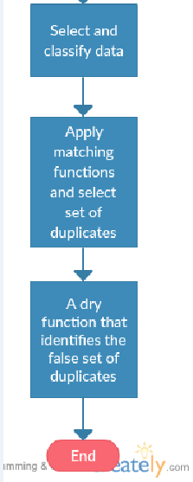
Methodology Used for Phase I continued..

Slide 20
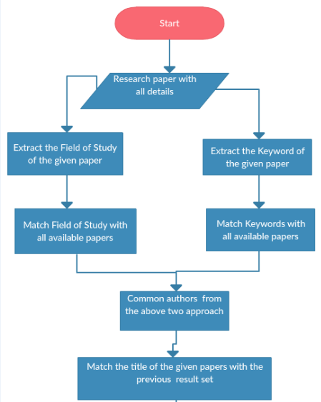
Methodology Used for Phase II
a

Slide 21
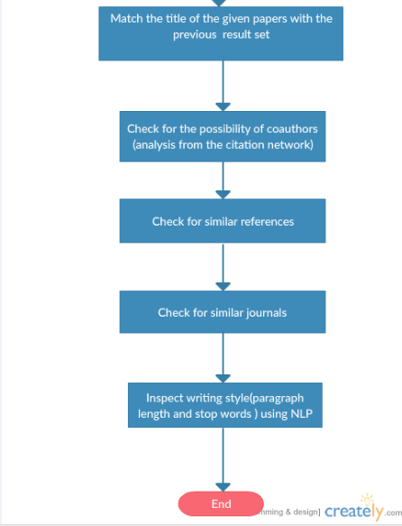
a
Methodology Used for Phase II continued..

Slide 22
Detailed Steps used:
Phase I:
Using different approaches to classify Asian and Chinese names.
Removing noisy data and misspelled data using various techniques such as Edit distance, Minoskivi distance, etc.
Classifying on the basis of middle and last names and other such techniques to avoid ambiguity .
Phase II:
Grouping shortened names and similar names together and segregating them according to various author-paper features and other techniques such as Gradient Boost Trees(GBT Tree) and deep features engineering.
Apply Latent Dirichlet Allocation (LDA) techniques to extract the topics of individual authors from their corresponding papers.
Apply Word2vec to calculate the keyword similarity of Newly written papers with all other existing papers.
Study the various author and paper features and using similarity, style of writing and other such NLP techniques classify whether the paper is written by given author or not.

Slide 23
Features taken into consideration
Field of study of the author.
Keywords of the paper.
Title of the paper
Co – authors citation network
Abstract Analysis of the paper
References Analysis
Journal and Conference Similarity
Venue of the paper published
Year of the published paper
Writing style analysis using Document Summarization.
Other NLP Approach

Slide 24
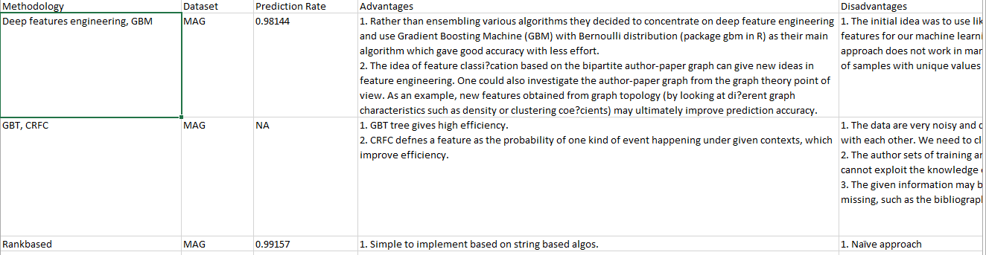
Work Done till Date
Proper analysis of existing research papers and the approach used by them along with their advantages and disadvantages.

Slide 25
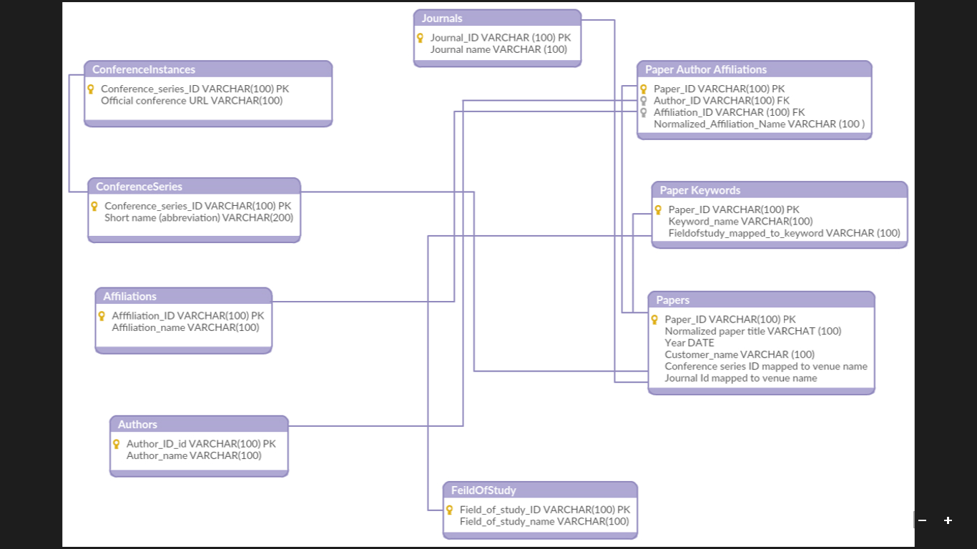
a
Schema and running queries on text files to create data according to our requirements:

Slide 26
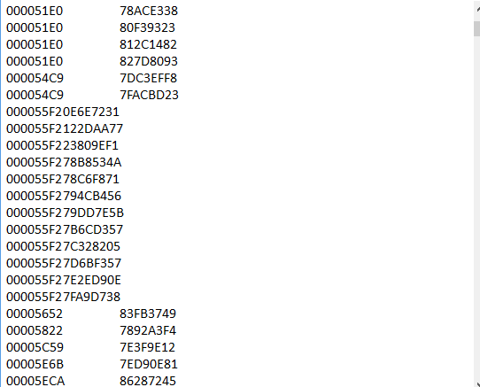
a
PHASE I(Data Processing)
Reducing the data and converting it to JSON format for better processing.
Removing duplicate and overwritten data.

Slide 27
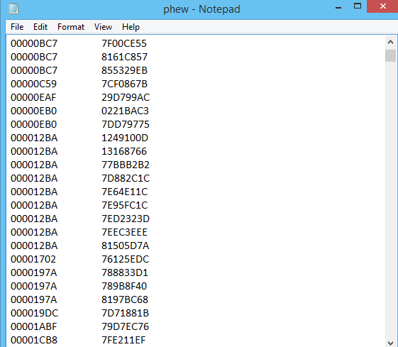
a
Splitting data into training (60%) and testing (40%) using random generator function for measurement of accuracy.
Classifying probable authors on the basis of their field of study.
Sorting the whole data.

Slide 28
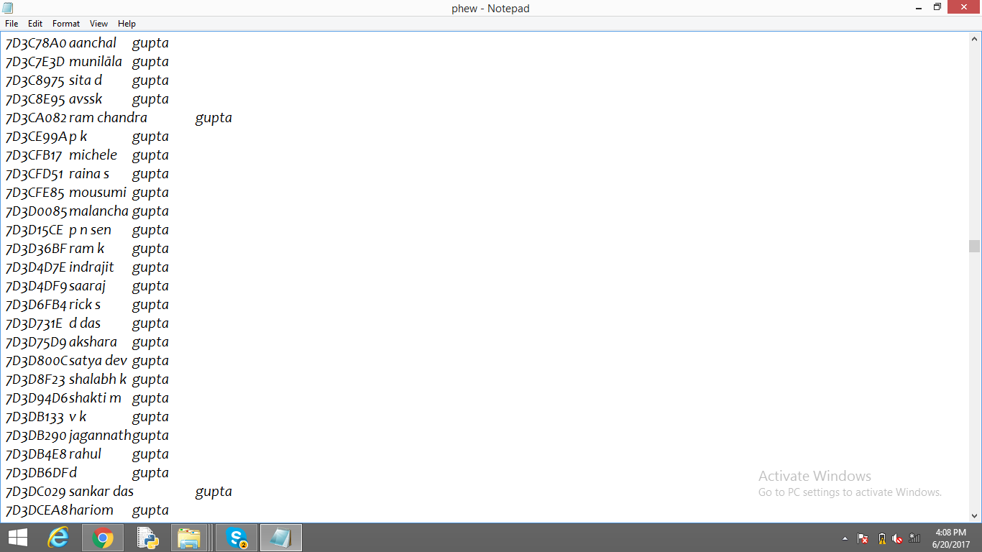
Group author names according to last name.

Slide 29
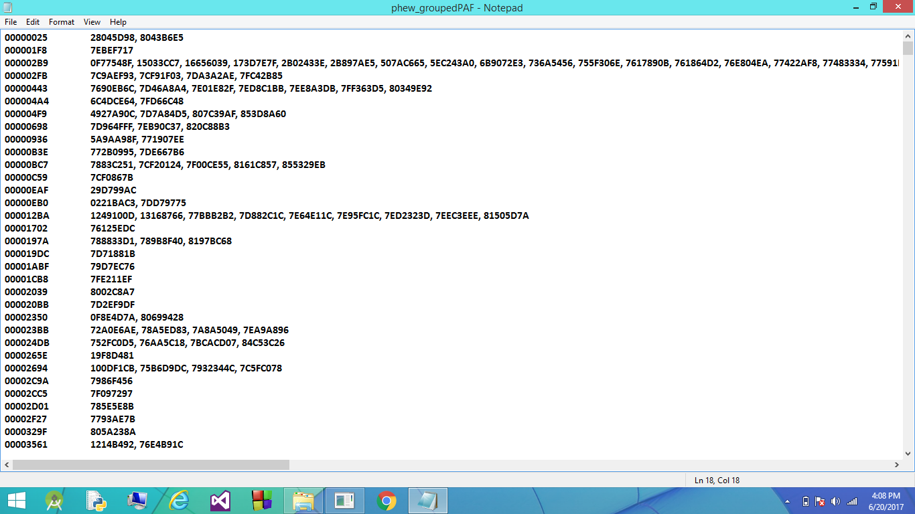
a
Predicting authors on the basis of their Affiliations.

Slide 30
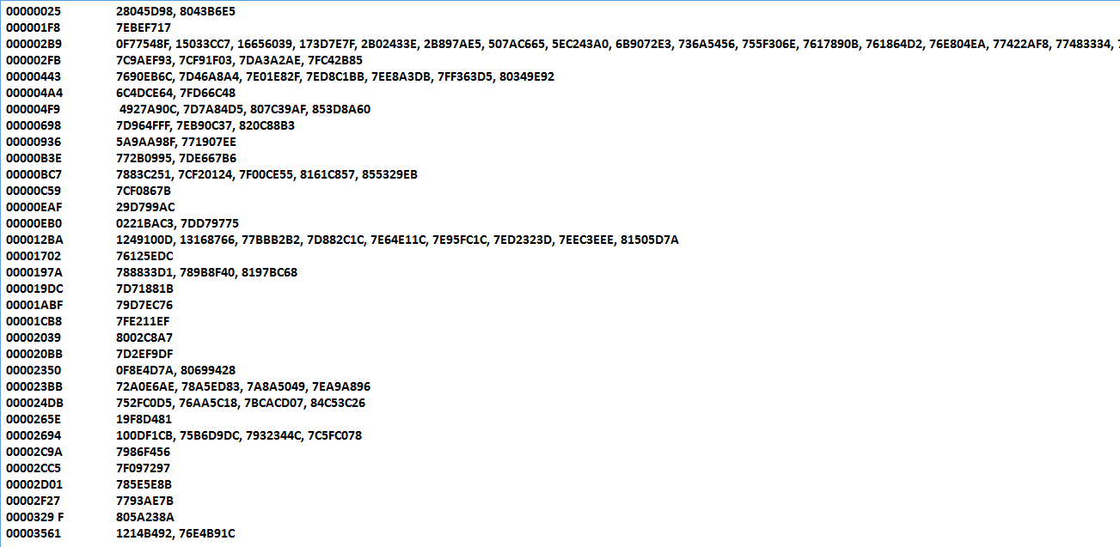
a
Predicting authors and their probable co-authors.

Slide 31
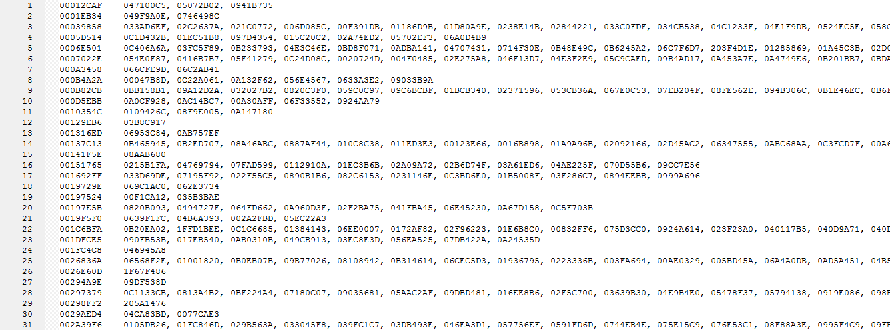
a
Grouping similar Fields of Study

Slide 32
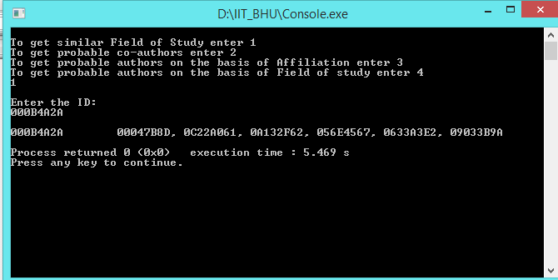
a
Providing a user interface for the project

Slide 33
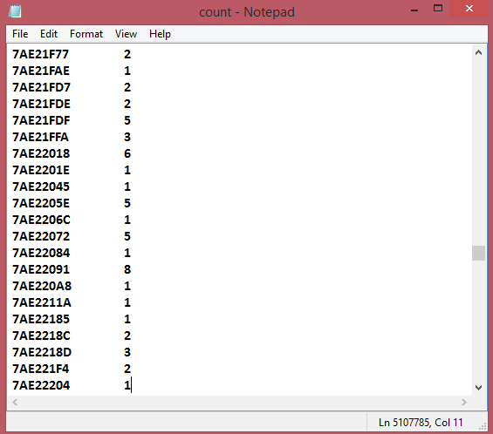
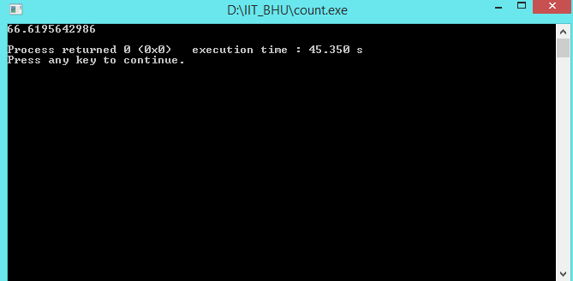
Measured recall based on affiliation and field of study

Slide 34
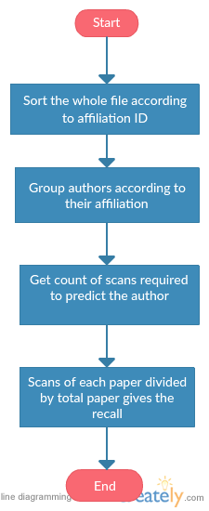
Method of measuring recall.

Slide 35
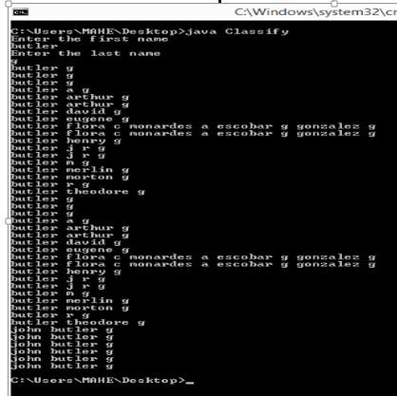
Grouped similar names to improve recall.

Slide 36
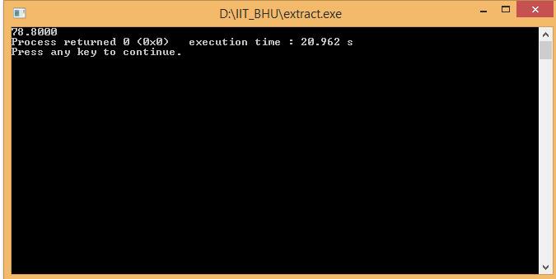
Calculated precision using 10 fold division model. (Accuracy obtained 78.8%)

Slide 37
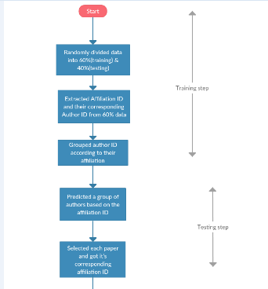
Calculated precision using 10 fold division model.

Slide 38
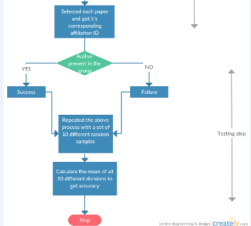
Calculated precision using 10 fold division model.

Slide 39
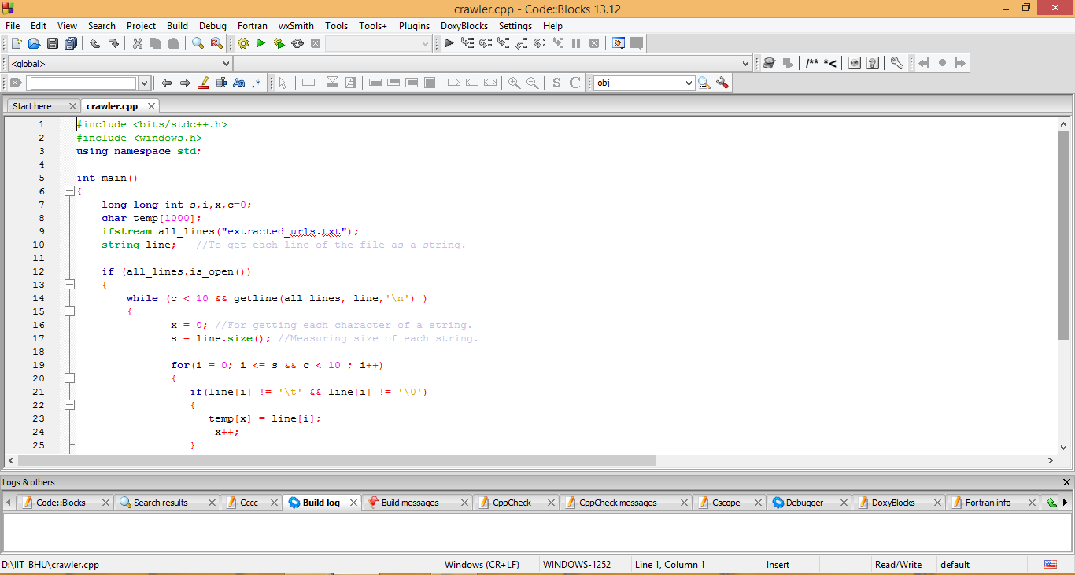
Built a web crawler to extract missing data and improve precision.

Slide 40
Future plans:
To work more on Phase II and get more refined data. [DONE]
To use more advanced techniques such as Information Retrieval(IR), Machine Learning(ML), Optimization Algorithms , GBT Tree and Natural Language Processing(NLP) to get more accurate results.
To work on graph based approach.(Neo4j for graph Database).
To testify the obtain results using testing and validation data to improve our techniques and evaluate the accuracy. [DONE]
To use Tensor Flow API to improve precision.
To use Wget to download research papers.

