Slide 1
Python Testing and Debugging
Alexey Lavrov
November 14th, 2018

Slide 2
Agenda
Motivation
Testing
Assertions
unittest module
Test coverage
Debugging
Simple print
Colorful print
pdb module
Summary

Slide 3
Motivation

Slide 4

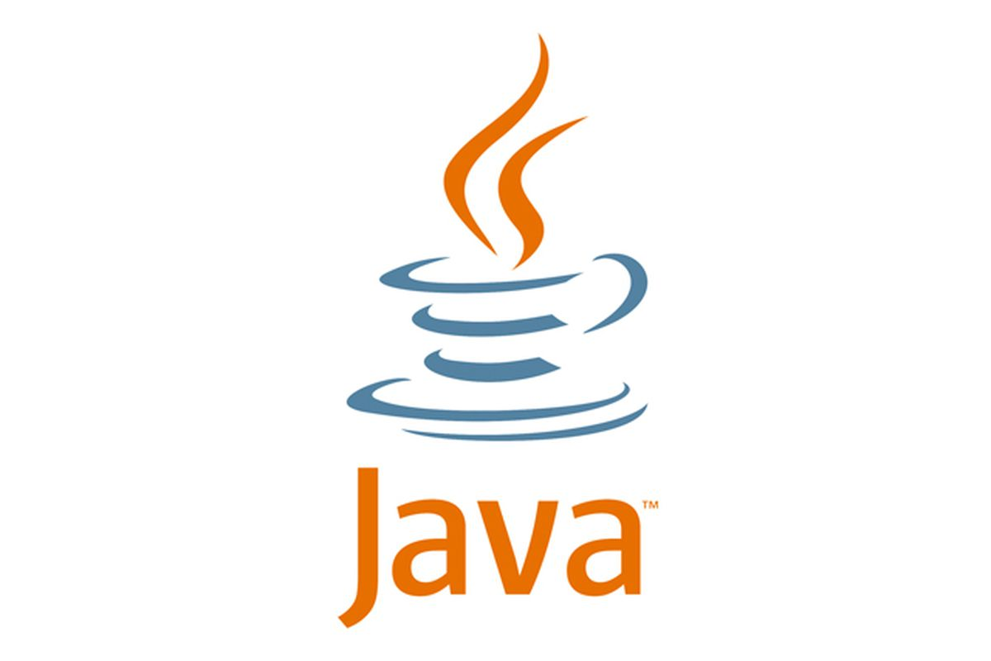
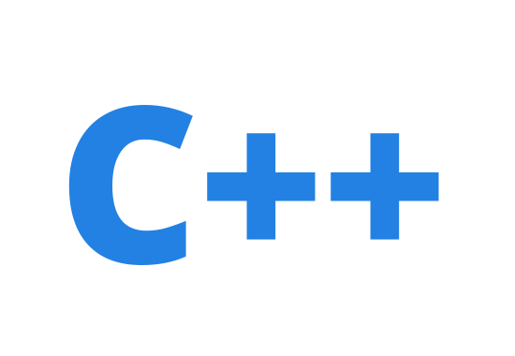
Is It Hard to Write Python Programs?
simple syntax
runs through interpreter
concise
build-in memory management
dynamically typed
Image Credits: https://www.python.org/static/community_logos/python-logo-master-v3-TM-flattened.png
https://www.theverge.com/2013/1/13/3873592/oracle-updates-java-security-exploits-in-the-wild

Slide 5
Code
All the code used for the presentation is available on github:
git clone git@github.com:RTKarbon/python_debugging_testing.git

Slide 6
Remove Odd Numbers: Version 1
Function: remove odd numbers from a list
def removeOddNumbersV1(l):
for i in range(len(l)):
if l[i] % 2 != 0:
del l[i]
return l
Does it have a bug?

Slide 7
And It Doesn’t Work…
def removeOddNumbersV1(l):
for i in range(len(l)):
if l[i] % 2 != 0:
del l[i]
return l
Traceback (most recent call last):
File "./program_with_bugs.py", line 34, in <module>
main()
File "./program_with_bugs.py", line 21, in main
removeOddNumbersV1(numbers_l)
File "./program_with_bugs.py", line 8, in removeOddNumbersV1
if l[i] % 2 != 0:
IndexError: list index out of range

Slide 8
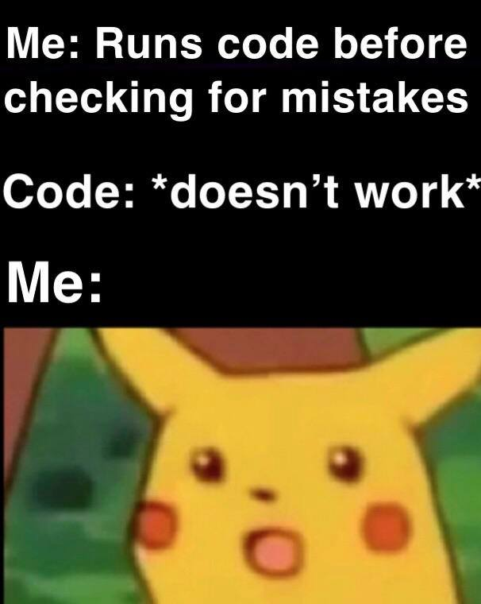
And It Doesn’t Work…
def removeOddNumbersV1(l):
for i in range(len(l)):
if l[i] % 2 != 0:
del l[i]
return l
Traceback (most recent call last):
File "./program_with_bugs.py", line 34, in <module>
main()
File "./program_with_bugs.py", line 21, in main
removeOddNumbersV1(numbers_l)
File "./program_with_bugs.py", line 8, in removeOddNumbersV1
if l[i] % 2 != 0:
IndexError: list index out of range

Slide 9
Remove Odd Numbers: Version 2
def removeOddNumbersV2(l):
for n in l:
if n % 2 != 0:
l.remove(n)
return l
Doesn’t crash!
But does it mean that it works correctly?

Slide 10
Testing

Slide 11
When Testing is Good?
Always! In particular
at the very beginning of a project
when modifying functionality of your code
experimenting with a third-party code

Slide 12
Simple Test
numbers_l = [1, 2, 3, 4, 5, 6]
print "Original list: %s" % str(numbers_l)
even_l = removeOddNumbersV2(numbers_l)
print "List with only even numbers: %s" % str(even_l)
Output:
Original list: [1, 2, 3, 4, 5, 6]
List with only even numbers: [2, 4, 6]

Slide 13
Assertions
Syntax:
assert(<expression>)
stops execution if <expression> is false
Example (see assertion_testing.py):
for tnum in range(test_case_num):
res_l = removeOddNumbersV2(input_l[tnum])
assert(res_l == expected_l[tnum])

Slide 14
Test with Assertion
> python assertion_testing.py
Output:
Running 6 test cases
Traceback (most recent call last):
File "./assertion_testing.py", line 43, in <module>
main()
File "./assertion_testing.py", line 38, in main
assert(res_l == expected_l[tnum])
AssertionError
Have to write an infrastructure around it

Slide 15
unittest

Slide 16
Unit Test Terminology
unit test - verifies one specific aspect of a function behavior
test case - collection of unit tests
full coverage - range of unit tests covering all the possible ways you can use a function

Slide 17
unittest Module
from program_with_bugs import *
import unittest
class RemoveOddNumberTC(unittest.TestCase):
def test_1(self):
even_l = removeOddNumbersV2([1])
self.assertEqual(even_l, [])
if __name__ == "__main__":
unittest.main()
Test case
methods starting with test_* are run automatically

Slide 18
Most Common Used Assert Methods
Method | Checks That
assertEqual(a, b) | a == b
assertNotEqual(a, b) | a != b
assertTrue(x) | bool(x) is True
assertFalse(x) | bool(x) is False
assertIs(a, b) | a is b
assertIsNot(a, b) | a is not b
assertIsNone(x) | x is None
assertIsNotNone(x) | x is not None
assertIn(a, b) | a in b
assertNotIn(a, b) | a not in b
assertIsInstance(a, b) | isinstance(a, b)
assertNotIsInstance(a, b) | not isinstance(a, b)

Slide 19
Testing removeOddNumbers
> python unitest_testing.py
....FF
======================================================================
FAIL: test_5 (__main__.RemoveOddNumberTC)
----------------------------------------------------------------------
Traceback (most recent call last):
File "./unittest_testing.py", line 30, in test_5
self.assertEqual(even_l, [2])
AssertionError: Lists differ: [2, 5] != [2]
First list contains 1 additional elements.
First extra element 1:
5
- [2, 5]
+ [2]

Slide 20
Test Coverage

Slide 21
Test Coverage
Statement testing
Measuring number of exercised lines
Path testing
Testing every possible code path
Boundary testing
use input values just below and/or just above defined limits
if a % 2:
print "even"
else:
print "odd"
if a % 3:
print "divisible by 3"
else:
print "not divisible by 3"

Slide 22
Coverage in Python
coverage module
Install:
> pip install coverage
Report:
> coverage report -m
Name Stmts Miss Cover Missing
---------------------------------------------------
removeOddNumbers.py 12 5 58% 5-8, 19
unittest_testing.py 18 0 100%
---------------------------------------------------
TOTAL 30 5 83%
Collect coverage:
> coverage run unittest_testing.py

Slide 23
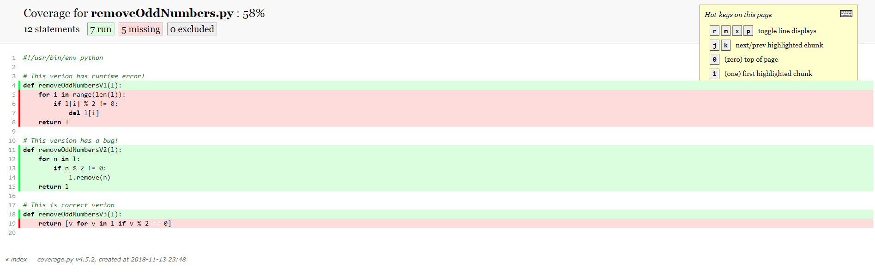
HTML report
> coverage html

Slide 24
More use cases for unittest
testing class methods
setup(), tearDown() methods are executed before and after each test
more on https://docs.python.org/2/library/unittest.html

Slide 25
Debugging

Slide 26
Debugging With print
def removeOddNumbersV1(l):
for i in range(len(l)):
print "index: %d, list: %s" % (i, str(l))
if l[i] % 2 != 0:
del l[i]
return l
Output:
index: 0, list: [1, 2, 3, 4, 5, 6]
removing element 1
index: 1, list: [2, 3, 4, 5, 6]
removing element 3
index: 2, list: [2, 4, 5, 6]
removing element 5
index: 3, list: [2, 4, 6]
Traceback (most recent call last):
File "./program_with_bugs.py", line 35, in <module>
main()

Slide 27
dbglib
printing additional information like file name, line number
convenient for visual parsing
def print_debug(msg, fstream=sys.stdout)
def print_info(msg, fstream=sys.stdout)
def print_success(msg, fstream=sys.stdout)
def print_warning(msg, fstream=sys.stdout)
def print_error(msg, fstream=sys.stdout)
Code example:
import dbglib as dbg
dbg.print_info("This is info")
dbg.print_success("This is success")
dbg.print_warning("This is warning")
dbg.print_error("This is an error")

Slide 28

dbglib
printing additional information like file name, line number
convenient for visual parsing
def print_debug(msg, fstream=sys.stdout)
def print_info(msg, fstream=sys.stdout)
def print_success(msg, fstream=sys.stdout)
def print_warning(msg, fstream=sys.stdout)
def print_error(msg, fstream=sys.stdout)
Code example:
import dbglib as dbg
dbg.print_info("This is info")
dbg.print_success("This is success")
dbg.print_warning("This is warning")
dbg.print_error("This is an error")

Slide 29
Remove Odd Numbers: Version 2
def removeOddNumbersV2(l):
for n in l:
if n % 2 != 0:
l.remove(n)
return l
Doesn’t crash!

Slide 30
Python Interactive Debugger
pdb module
part of Python’s standard library
controlled execution
program inspection
Documentation at: https://docs.python.org/2/library/pdb.html

Slide 31
PDB - Inserting Breakpoint in a Source
import pdb
def test_5(self):
pdb.set_trace()
even_l = tested_function([1, 2, 3, 5])
self.assertEqual(even_l, [2])
python unittest_testing.py
…/repo/unittest_testing.py(30)test_5()
-> even_l = tested_function([1, 2, 3, 5])
(Pdb)

Slide 32
PDB - Breakpoint Control
can specify breakpoints during debugging
Breakpoint at certain line
b <file_name>:line
Breakpoint at certain function
b <file_name>:function
Example:
(Pdb) b removeOddNumbersV3
Breakpoint 1 at /drives/d/PHD/minicourses/python_testing_debugging/repo/removeOddNumbers.py:18
List Breakpoints:
b
Enable/Disable Breakpoint:
disable/enable <breakpoint number>

Slide 33
PDB - List Code
want to see the code where we stopped at
(Pdb) l
25 # even_l = tested_function([1, 2, 3])
26 # self.assertEqual(even_l, [2])
27
28 def test_5(self):
29 pdb.set_trace()
30 -> even_l = tested_function([1, 2, 3, 5])
31 self.assertEqual(even_l, [2])
32
33 # def test_6(self):
34 # even_l = tested_function([1, 3, 5])
35 # self.assertEqual(even_l, [])
Tip: If you forget how to use commands, type help in pdb prompt

Slide 34
PDB - Stepping Through Code
n(ext) | Continue execution until the next line in the current function is reached or it returns
s(tep) | Execute the current line, stop at the first possible occasion
c(ontinue) | Continue execution, only stop when a breakpoint is encountered
unt(il) | Continue execution until the line with a number greater than the current one is reached or until the current frame returns
Example:
python unittest_testing.py
use n or s to see the difference

Slide 35
PDB - Inspecting Program State
after we stopped at certain point at a program, we want to know variable names
Print variable name:
p <variable name>
Display all local/global variables with their values:
locals() / globals()
Display only variable names:
dir()
Example:
(Pdb) locals()
{'l': [1, 2, 3, 5], 'n': 1}
(Pdb) dir()
['l', 'n']
(Pdb) p n
1
(Pdb)

Slide 36
PDB - Calling Stack
want to know how we ended up at a certaing place in a program
similar to a calling stack reported at runtime error
pdb > bt
-> unittest.main()
/usr/lib/python2.7/unittest/main.py(95)__init__()
-> self.runTests()
/usr/lib/python2.7/unittest/main.py(232)runTests()
-> self.result = testRunner.run(self.test)
/usr/lib/python2.7/unittest/runner.py(151)run()
-> test(result)
/usr/lib/python2.7/unittest/suite.py(70)__call__()
-> return self.run(*args, **kwds)
/usr/lib/python2.7/unittest/suite.py(108)run()
-> test(result)
/usr/lib/python2.7/unittest/suite.py(70)__call__()
-> return self.run(*args, **kwds)
/usr/lib/python2.7/unittest/suite.py(108)run()
-> test(result)
/usr/lib/python2.7/unittest/case.py(393)__call__()
-> return self.run(*args, **kwds)
/usr/lib/python2.7/unittest/case.py(329)run()
-> testMethod()
/drives/d/PHD/minicourses/python_testing_debugging/repo/unittest_testing.py(30)test_5()
-> even_l = tested_function([1, 2, 3, 5])
> /drives/d/PHD/minicourses/python_testing_debugging/repo/removeOddNumbers.py(13)removeOddNumbersV2()
-> if n % 2 != 0:

Slide 37
Summary

Slide 38
Summary
every program has a bug
test a function before you start using it
if test fails, check the code first, do not change a test
try simple print first, use pdb if you can’t spot a problem quickly

Slide 39
Questions?

Slide 40
Thank you!

