Slide 1
Survey
Use of Transformers in Medical Segmentation problems

Slide 2
Origin of transformers

Slide 3
Problem Statement
Sequential models, Language modelling used to be modelled using
Recurrent Neural Networks
Gated Recurrent
Long Short term memory etc.
This limited the accuracy of these models since all the above models used fixed input size (e.g. 10 words). This translated into loss of contextual information during prediction and didn’t cater to long range dependencies.

Slide 4
Motivation
To cater to long range dependencies of words, a new method was proposed, the Transformer.
The Transformer is a model architecture avoids recurrence and instead relies entirely on an attention mechanism to draw global dependencies between input and output.
The Transformer allows for significantly more parallelization and can reach a new state of the art in translation quality.
Attention mechanism has an infinite reference window

Slide 5
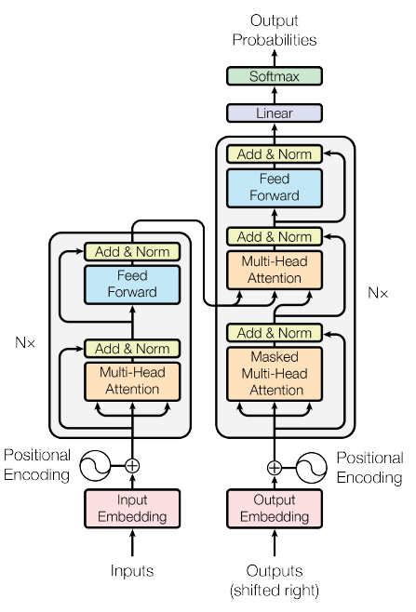
Architecture
Input Embedding
Positional Encoding
Encoder Layer
Multi-headed Attention
Feed Forward

Slide 6
Transformers in segmentation problems

Slide 7
Transformers
Used with CNNS
TransUNet(only encoder)
CoTr (only encoder)
UTNet
Used without CNNS
SwinUNet(only encoder)
Dual Swin TransUNet (DS-TransUNet)
UNetR

Slide 8
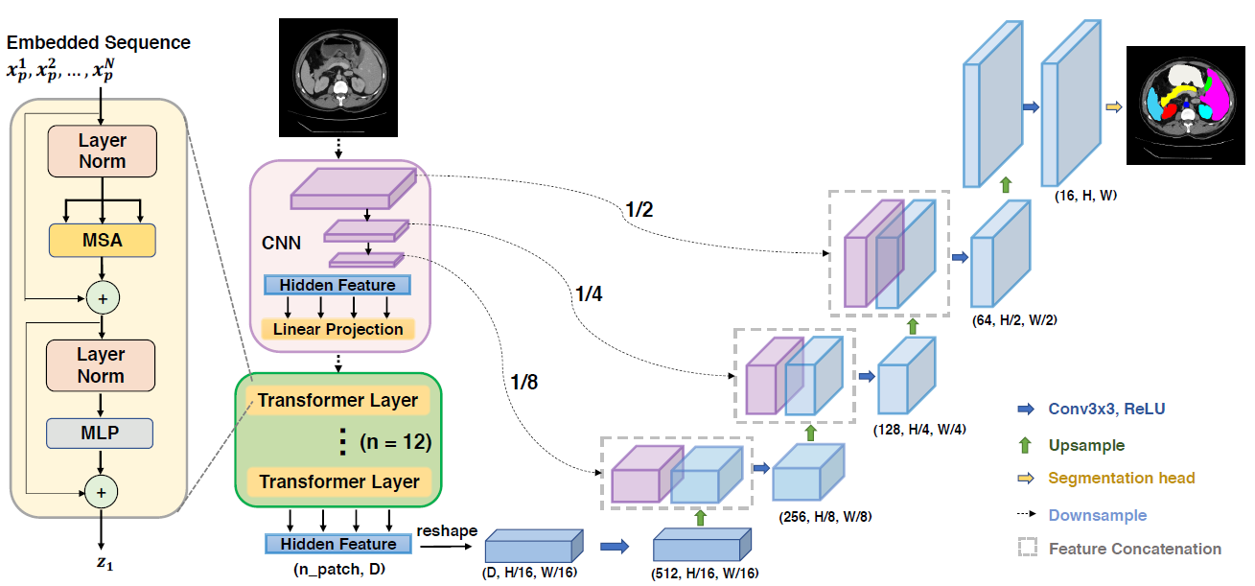
TransUNet (Architecture)

Slide 9
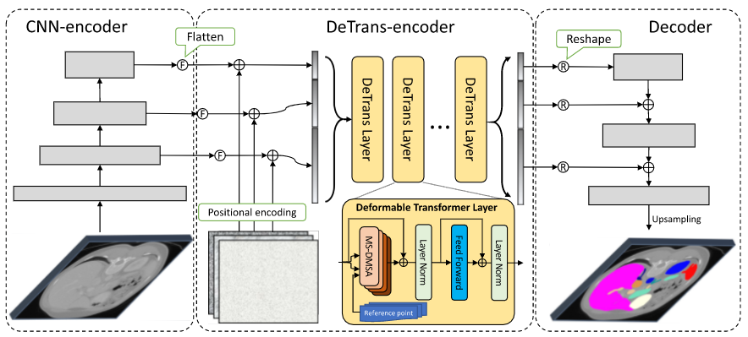
CoTr : Convolutional Neural Network with Transformer

Slide 10
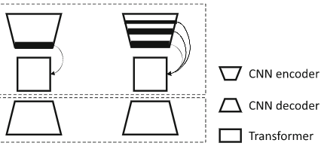
Difference between TransUNet & CoTr
TransUnet:
Transfomer encoder is applied on the last feature map from the CNN encoder.
The decoder has skip connections to the CNN encoder
CoTr:
Transformer encoder takes a concatenation of feature maps from each CNN layer.
The decoder has skip connections from the output of Transformer encoder
TransUNet
CoTr

Slide 11
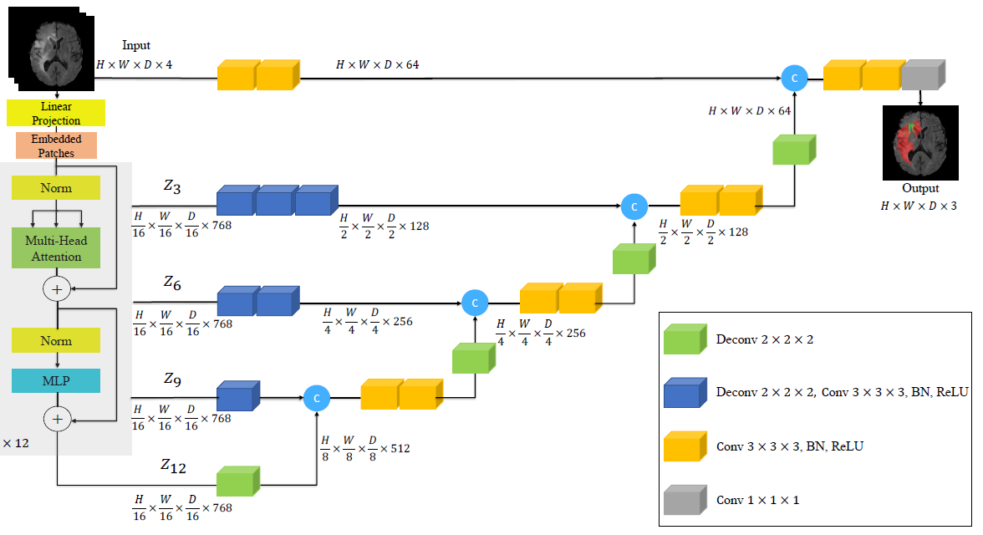
UNetR

Slide 12
Result Comparisons
TransUNet, CoTr and UNetR were tested on BTCV Dataset with the following results:
The results for Brain and spleen tumour segmentation tasks for MSD datasets:
 | Dice Score
TransUNet | 83.8
CoTr | 84.4
UNetR | 85.6
 | Dice
Attention Unet | 66.5
TransBTS | 69.6
TransUNet | 64.4
CoTr | 68.3
UNetR | 71.1

Slide 13
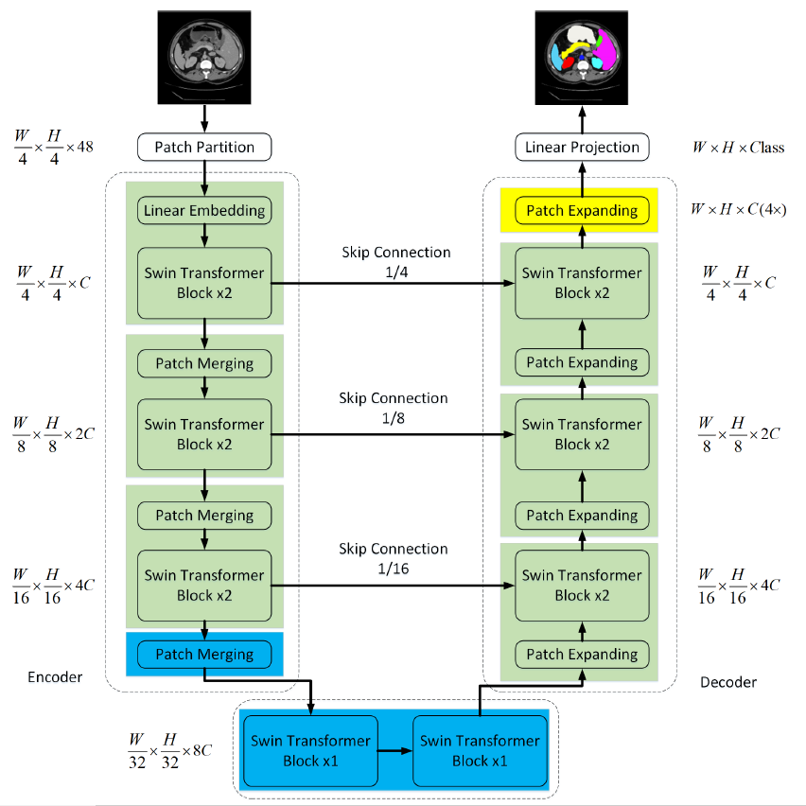
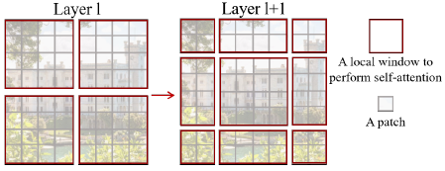
SwinUNet
The swin Transformer computes self attention on local patches to avoid computation complexity when dealing with dense prediction.
These patches merge to form bigger patches in the deeper layers
It also applies shifted windows technique to cater to connections between patches.
The shifted windows technique

Slide 14
Result Comparison with TransUnet
The architecture was tested on multi-organ datasets
Synapse dataset
Automated cardiac diagnosis challenge dataset (ACDC)
and the results compared with TransUNet
 | Dice Score
 | Synapse | ACDC
TransUNet | 77.48 | 89.71
SwinUNet | 79.13 | 90.00

Slide 15
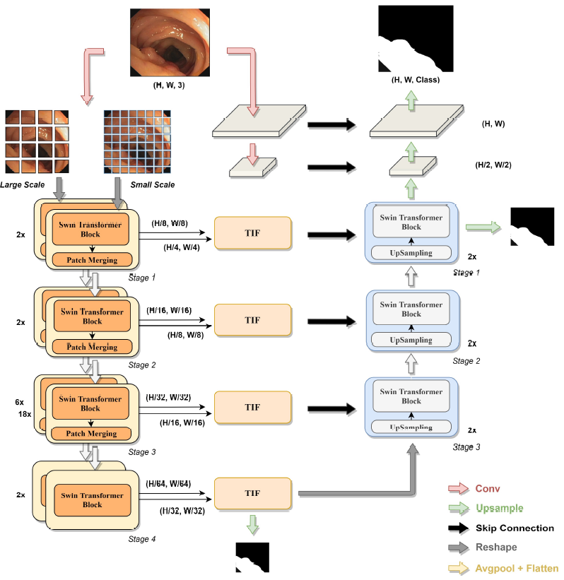
Dual Swin Transformer
The 2D images are divided into 2 patch size, Large scale and small scale.
Swin transformer layers are applied in parallel to both these inputs.
The result from both transformers at each layer is fused using a TIF module.
The result from the TIF module is used as a skip connection to the decoder.
The decoder uses single swin transformers at each layer.
The Dual swin transformer was compared against Swin Unet on the PolyP segmentation task.
 | Dice
SwinUNet | 85.3
Dual Swin Transformer | 86.8

Slide 16
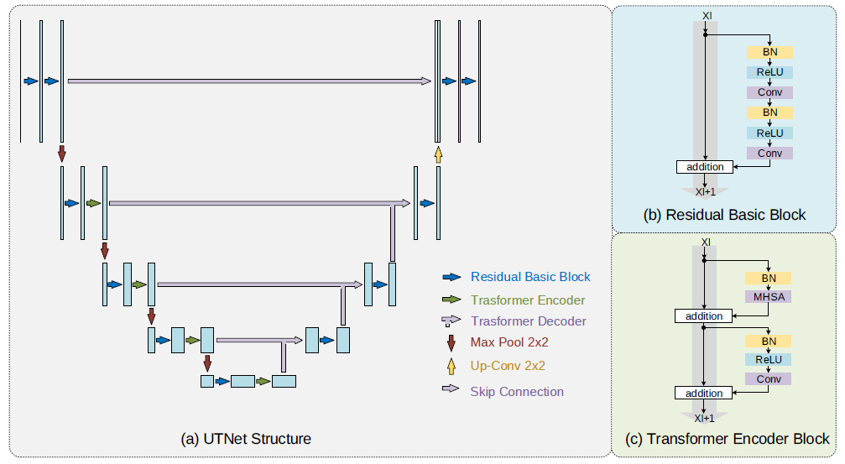
UTNet
The model was tested for medical image segmentation tasks (CMI dataset) and performed the best when compared with purely CNN architectures.
It was not compared with other Transformer architectures.

Slide 17
Thank You

