Slide 1
EMPOWERING THE TRI DHARMA
AI agents—from foundations and theory to a governed academic workspace
DCSE Summer Lecture · 2026
01
CREATED WITH AFK RESEARCH
Notes:
Open by positioning the lecture as a bridge from foundations to implementation. The central claim is that useful academic agents are governed systems, not merely smarter chat interfaces.
[Sources]
- https://peraturan.bpk.go.id/Details/%2039063/uu-no-12-tahun-2012
- [private-local-root]/dcse-summer-ppt/.brain/wiki/concepts/agentic-academic-workspace.md

Slide 2
OPENING
Three outcomes for this lecture
EXPLAIN
DESIGN
IMPLEMENT
Distinguish a language model, an assistant, and an agentic system.
Connect planning, tools, memory, evidence, and human review.
Prototype a repository-based workflow across Tri Dharma.
02
CREATED WITH AFK RESEARCH
Notes:
Set expectations: this is not a product pitch. It is a conceptual and practical lecture that ends with a concrete implementation model.
[Sources]
- Original lecture synthesis; no external claim on this slide.

Slide 3
OPENING
Tri Dharma is one connected mandate
RESEARCH
EDUCATION
COMMUNITY SERVICE
Produce, validate, preserve, and communicate knowledge.
Design learning, assessment, feedback, and scholarly teaching.
Translate expertise into public value with local accountability.
03
CREATED WITH AFK RESEARCH
Notes:
Use the legal and institutional frame only to establish the three obligations. The rest of the lecture asks how one academic workspace can support them without collapsing their distinct responsibilities.
[Sources]
- https://peraturan.bpk.go.id/Details/%2039063/uu-no-12-tahun-2012
- [private-local-root]/dcse-summer-ppt/.brain/wiki/concepts/tri-dharma-workspace-architecture.md

Slide 4
OPENING
The constraint is not ideas.
It is continuity across dozens of small academic workflows.
Files, sources, deadlines, design choices, feedback, and publication decisions are distributed across tools—and across time.
04
CREATED WITH AFK RESEARCH
Notes:
Files, sources, deadlines, design choices, feedback, and publication decisions are distributed across tools—and across time.
[Sources]
- [private-local-root]/dcse-summer-ppt/.brain/wiki/concepts/agentic-academic-workspace.md

Slide 5
OPENING
Isolated prompts reset the work
CONTEXT
EVIDENCE
FOLLOW-THROUGH
The model sees what is in the current conversation, not the whole project history.
Sources and decisions become detached from the outputs they informed.
A useful answer still leaves scheduling, files, review, and publication to the lecturer.
05
CREATED WITH AFK RESEARCH
Notes:
Compare the 3 parts as one system.
[Sources]
- [private-local-root]/dcse-summer-ppt/.brain/wiki/concepts/agentic-academic-workspace.md

Slide 6
OPENING
The key shift:
from a clever chat to a governed workspace.
An agentic workspace gives work a durable home, bounded tools, repeatable workflows, and a visible review trail.
06
CREATED WITH AFK RESEARCH
Notes:
An agentic workspace gives work a durable home, bounded tools, repeatable workflows, and a visible review trail.
[Sources]
- [private-local-root]/dcse-summer-ppt/.brain/wiki/concepts/agentic-academic-workspace.md
- https://airc.nist.gov/airmf-resources/airmf/5-sec-core/

Slide 7
01
FOUNDATIONS
What changes when a language model becomes part of a working system?
07
CREATED WITH AFK RESEARCH
Notes:
Use this divider to reset the room. What changes when a language model becomes part of a working system?
[Sources]
- Original lecture synthesis; no external claim on this slide.

Slide 8
FOUNDATIONS
AI is a stack, not one thing
1
2
3
4
AI
Machine learning
Generative AI
LLM
Systems performing tasks associated with intelligence.
Systems learning patterns from data.
Models producing new content from learned patterns.
A generative model specialized in language sequences.
08
CREATED WITH AFK RESEARCH
Notes:
Keep the distinctions functional. An LLM is a model. An agent is a system built around a model.
[Sources]
- Original lecture synthesis; no external claim on this slide.

Slide 9
FOUNDATIONS
An LLM predicts a useful continuation
INPUT
MODEL
OUTPUT
Instructions, examples, retrieved evidence, and conversation context.
A learned probability distribution over possible token sequences.
A generated continuation—not a database lookup and not a guaranteed fact.
09
CREATED WITH AFK RESEARCH
Notes:
Explain that fluent generation and factual grounding are separate design problems. This is why external tools and evidence matter.
[Sources]
- https://arxiv.org/abs/2302.04761

Slide 10
FOUNDATIONS
A prompt is temporary working context
INSTRUCTION
CONTEXT
OUTPUT CONTRACT
What should be done, for whom, and under which constraints?
What evidence, examples, state, and prior decisions are available now?
What form, quality bar, and review conditions define success?
10
CREATED WITH AFK RESEARCH
Notes:
A stronger prompt improves a single interaction. Persistent project memory and workflows improve continuity across interactions.
[Sources]
- Original lecture synthesis; no external claim on this slide.

Slide 11
FOUNDATIONS
Systems turn models into agents
MODEL
ASSISTANT
AGENTIC SYSTEM
Generates a response from supplied context.
Adds interface, instructions, and selected tools.
Pursues a goal through observation, planning, tool use, and feedback.
No independent action loop
Usually user-steered
Bounded autonomy
11
CREATED WITH AFK RESEARCH
Notes:
Compare the 3 parts as one system.
[Sources]
- https://arxiv.org/abs/2210.03629
- https://arxiv.org/abs/2302.04761

Slide 12
FOUNDATIONS
The minimal agent loop
1
2
3
4
Observe
Plan
Act
Evaluate
Read the request and current environment.
Choose a next step or decompose the task.
Use a tool or produce an artifact.
Check the result, update state, and continue.
12
CREATED WITH AFK RESEARCH
Notes:
The loop is the central mental model for the lecture. Agent quality depends on every part of the loop, not only on the model.
[Sources]
- https://arxiv.org/abs/2210.03629

Slide 13
FOUNDATIONS
Tools convert language into consequences
READ
CREATE
CHANGE
Search, inspect files, retrieve sources, read calendars, or query data.
Draft documents, generate presentations, transform datasets, or write code.
Send messages, update records, publish content, or run external processes.
13
CREATED WITH AFK RESEARCH
Notes:
Risk rises as tools move from reading to creating to changing external state. Permissions and approval gates must rise with it.
[Sources]
- https://arxiv.org/abs/2302.04761

Slide 14
FOUNDATIONS
Memory gives an agent continuity
WORKING MEMORY
PROJECT MEMORY
EVENT HISTORY
The immediate context needed for the current step.
Durable sources, decisions, terminology, and outputs.
What happened, when, through which tool, with what result.
14
CREATED WITH AFK RESEARCH
Notes:
Compare the 3 parts as one system.
[Sources]
- https://arxiv.org/abs/2304.03442
- [private-local-root]/dcse-summer-ppt/.brain/wiki/concepts/agentic-academic-workspace.md

Slide 15
FOUNDATIONS
The environment defines what is possible
AVAILABLE STATE
PERMISSIONS
BOUNDARIES
Files, repositories, applications, databases, and connected services.
What the agent may read, modify, send, schedule, or publish.
Which actions require a person, a policy check, or a separate release path.
15
CREATED WITH AFK RESEARCH
Notes:
Compare the 3 parts as one system.
[Sources]
- https://airc.nist.gov/airmf-resources/airmf/5-sec-core/
- https://www.unesco.org/en/articles/guidance-generative-ai-education-and-research

Slide 16
FOUNDATIONS
Artifacts make agent work reviewable
FILES
HISTORY
PROVENANCE
Drafts, plans, data, slides, and outputs can be inspected directly.
Commits and issue activity show when and why work changed.
Sources in notes and metadata connect claims to evidence.
16
CREATED WITH AFK RESEARCH
Notes:
Compare the 3 parts as one system.
[Sources]
- [private-local-root]/dcse-summer-ppt/.brain/wiki/concepts/agentic-academic-workspace.md
- [private-local-root]/dcse-summer-ppt/.brain/wiki/sources/afk-research-mvp-repository.md

Slide 17
02
THEORY
Planning, acting, remembering, reflecting, and governing the loop.
17
CREATED WITH AFK RESEARCH
Notes:
Use this divider to reset the room. Planning, acting, remembering, reflecting, and governing the loop.
[Sources]
- Original lecture synthesis; no external claim on this slide.

Slide 18
THEORY
ReAct interleaves reasoning and action
1
2
3
4
Reason
Act
Observe
Revise
Form a hypothesis or decide what is missing.
Call a tool or interact with the environment.
Receive new evidence or a tool result.
Update the plan and repeat as needed.
18
CREATED WITH AFK RESEARCH
Notes:
The ReAct paper shows the value of interleaving reasoning traces and actions. In deployed systems, internal reasoning need not be exposed; the important operational pattern is plan–act–observe–revise.
[Sources]
- https://arxiv.org/abs/2210.03629

Slide 19
THEORY
Planning turns goals into tractable steps
DECOMPOSE
ORDER
REPLAN
Break a broad objective into smaller deliverables or checks.
Place dependencies, approvals, and evidence gathering in a safe sequence.
Change course when tools fail, evidence conflicts, or constraints appear.
19
CREATED WITH AFK RESEARCH
Notes:
Compare the 3 parts as one system.
[Sources]
- https://arxiv.org/abs/2210.03629

Slide 20
THEORY
Tool selection is a policy decision
WHEN
WHICH
HOW
Use a tool when the model lacks current state, precision, or the ability to act.
Choose the narrowest tool whose capability and permissions match the step.
Validate arguments, inspect results, and stop loops that do not converge.
20
CREATED WITH AFK RESEARCH
Notes:
Compare the 3 parts as one system.
[Sources]
- https://arxiv.org/abs/2302.04761
- https://airc.nist.gov/airmf-resources/airmf/5-sec-core/

Slide 21
THEORY
Memory is a lifecycle
1
2
3
4
Capture
Organize
Retrieve
Update
Record sources, events, decisions, and artifacts.
Structure knowledge for future retrieval.
Bring only relevant evidence into working context.
Correct, supersede, or archive knowledge as the project changes.
21
CREATED WITH AFK RESEARCH
Notes:
Walk left to right; emphasize that the loop repeats after feedback.
[Sources]
- https://arxiv.org/abs/2304.03442
- https://arxiv.org/abs/2005.11401
- [private-local-root]/dcse-summer-ppt/.brain/wiki/concepts/agentic-academic-workspace.md

Slide 22
THEORY
RAG grounds generation in retrieved evidence
RETRIEVE
AUGMENT
GENERATE
Find relevant passages from an external, updateable knowledge source.
Place those passages and provenance in the model’s context.
Produce an answer conditioned on both model knowledge and retrieved evidence.
22
CREATED WITH AFK RESEARCH
Notes:
RAG improves access to explicit knowledge and provenance. It does not make every retrieved source correct, relevant, or current; retrieval quality remains part of the system.
[Sources]
- https://arxiv.org/abs/2005.11401

Slide 23
THEORY
Reflection converts outcomes into guidance
COMPARE
DIAGNOSE
ADAPT
Did the result satisfy the objective, constraints, and evidence standard?
Was the failure caused by the plan, tool, data, permissions, or model?
Revise the next step or store a durable lesson for future work.
23
CREATED WITH AFK RESEARCH
Notes:
Compare the 3 parts as one system.
[Sources]
- https://arxiv.org/abs/2304.03442

Slide 24
THEORY
Orchestration can stay simple
SEQUENTIAL
PARALLEL
ROUTED
One step feeds the next. Best when dependencies are clear.
Independent subtasks run together. Best when evidence can be reconciled.
A coordinator selects a specialized workflow. Best for recurring task families.
24
CREATED WITH AFK RESEARCH
Notes:
More agents do not automatically mean better results. Start with the smallest orchestration that makes the workflow observable and testable.
[Sources]
- https://arxiv.org/abs/2210.03629

Slide 25
THEORY
Autonomy should rise with evidence
1
2
3
4
Suggest
Prepare
Execute
Monitor
Draft options; a person chooses.
Create artifacts; a person reviews.
Act within narrow, reversible limits.
Run repeatedly with logs, thresholds, and stop conditions.
25
CREATED WITH AFK RESEARCH
Notes:
Walk left to right; emphasize that the loop repeats after feedback.
[Sources]
- https://airc.nist.gov/airmf-resources/airmf/5-sec-core/
- https://www.unesco.org/en/articles/guidance-generative-ai-education-and-research

Slide 26
THEORY
Failure is usually systemic
KNOWLEDGE
ACTION
GOVERNANCE
Hallucinated facts, stale evidence, weak retrieval, missing context.
Wrong tool, malformed arguments, unintended writes, repeated loops.
Unclear ownership, hidden provenance, privacy leakage, premature publication.
26
CREATED WITH AFK RESEARCH
Notes:
Compare the 3 parts as one system.
[Sources]
- https://arxiv.org/abs/2302.04761
- https://airc.nist.gov/airmf-resources/airmf/5-sec-core/
- https://www.unesco.org/en/articles/guidance-generative-ai-education-and-research

Slide 27
THEORY
Keep the human at the decision boundary
AREA
AGENT PREPARES
HUMAN DECIDES
Research
Search, organize, draft, compare
Validate sources, interpretation, and claims
Education
Prepare materials, examples, feedback drafts
Approve objectives, assessment, grades
Community
Adapt formats and draft public assets
Confirm consent, context, accessibility
Publication
Assemble a reviewed export
Approve the exact release
27
CREATED WITH AFK RESEARCH
Notes:
The division of labor is explicit: preparation may be delegated; accountability is not.
[Sources]
- [private-local-root]/dcse-summer-ppt/.brain/wiki/concepts/human-in-the-loop-academic-agent.md
- https://www.unesco.org/en/articles/guidance-generative-ai-education-and-research
- https://airc.nist.gov/airmf-resources/airmf/5-sec-core/

Slide 28
THEORY
Evaluate the whole agent system
QUALITY
PROCESS
RISK
Correctness, relevance, clarity, and traceable evidence.
Task completion, tool reliability, recovery, cost, and time.
Privacy, bias, security, reversibility, and human oversight.
28
CREATED WITH AFK RESEARCH
Notes:
A model benchmark is not an evaluation of an academic workflow. Test the artifact, the process, and the governance together.
[Sources]
- https://airc.nist.gov/airmf-resources/airmf/5-sec-core/
- https://www.oecd.org/en/publications/policies-supporting-responsible-and-systematic-genai-adoption-in-higher-education_c4e5621f-en.html

Slide 29
03
ACADEMIC DESIGN
Map one agentic workspace to the distinct responsibilities of Tri Dharma.
29
CREATED WITH AFK RESEARCH
Notes:
Use this divider to reset the room. Map one agentic workspace to the distinct responsibilities of Tri Dharma.
[Sources]
- [private-local-root]/dcse-summer-ppt/.brain/wiki/concepts/tri-dharma-workspace-architecture.md

Slide 30
ACADEMIC DESIGN
Three obligations need three operational homes
.BRAIN
.SCHEDULE
.DESIGN
Sources, knowledge, questions, syntheses, and research outputs.
Recurring prompts, teaching rhythms, checks, and planned follow-ups.
Visual rules, templates, examples, and consistent audience-facing artifacts.
Research continuity
Operational continuity
Communication continuity
30
CREATED WITH AFK RESEARCH
Notes:
Compare the 3 parts as one system.
[Sources]
- [private-local-root]/dcse-summer-ppt/.brain/wiki/concepts/tri-dharma-workspace-architecture.md
- [private-local-root]/dcse-summer-ppt/.brain/wiki/sources/afk-research-mvp-repository.md

Slide 31
ACADEMIC DESIGN
One source, three reviewed outcomes
1
2
3
4
Ingest
Synthesize
Transform
Review
Capture the source and its provenance.
Extract concepts, claims, and open questions.
Adapt for research, teaching, or community use.
Apply domain, privacy, and release checks.
31
CREATED WITH AFK RESEARCH
Notes:
This is a workflow hypothesis, not a proven one-click MVP capability. The important word is reviewed: reuse should preserve provenance and responsibility.
[Sources]
- [private-local-root]/dcse-summer-ppt/.brain/wiki/concepts/tri-dharma-workspace-architecture.md
- [private-local-root]/dcse-summer-ppt/.brain/wiki/syntheses/afk-research-presentation-to-mvp-gap.md

Slide 32
ACADEMIC DESIGN
Research workspace: evidence before output
RAW
WIKI
OUTPUT
Immutable captures and provenance records.
Maintained concepts, claims, questions, and syntheses.
Drafts and artifacts that link back to evidence.
32
CREATED WITH AFK RESEARCH
Notes:
Compare the 3 parts as one system.
[Sources]
- [private-local-root]/dcse-summer-ppt/.brain/wiki/concepts/agentic-academic-workspace.md
- [private-local-root]/dcse-summer-ppt/.brain/wiki/sources/afk-research-mvp-repository.md

Slide 33
ACADEMIC DESIGN
Education workspace: repeatable preparation
DESIGN
PRODUCE
REVIEW
Start from learning outcomes, misconceptions, and authentic tasks.
Generate examples, slides, activities, rubrics, and feedback drafts.
Check pedagogy, accessibility, integrity, and student data handling.
33
CREATED WITH AFK RESEARCH
Notes:
Compare the 3 parts as one system.
[Sources]
- https://www.unesco.org/en/articles/guidance-generative-ai-education-and-research
- https://www.oecd.org/en/publications/policies-supporting-responsible-and-systematic-genai-adoption-in-higher-education_c4e5621f-en.html
- [private-local-root]/dcse-summer-ppt/.brain/wiki/concepts/tri-dharma-workspace-architecture.md

Slide 34
ACADEMIC DESIGN
Community workspace: translate with context
CONTEXT
FORMAT
FEEDBACK
Identify community goals, language, constraints, and consent.
Choose accessible media, visual conventions, and distribution channels.
Record questions and outcomes as new evidence for the project.
34
CREATED WITH AFK RESEARCH
Notes:
Compare the 3 parts as one system.
[Sources]
- [private-local-root]/dcse-summer-ppt/.brain/wiki/concepts/tri-dharma-workspace-architecture.md
- [private-local-root]/dcse-summer-ppt/.brain/wiki/concepts/human-in-the-loop-academic-agent.md

Slide 35
ACADEMIC DESIGN
GitHub becomes the coordination backbone
ISSUES
COMMITS
REVIEWS
Turn goals and open questions into visible, assignable work.
Preserve incremental changes and the reasoning attached to them.
Create explicit checkpoints before sensitive changes or releases.
35
CREATED WITH AFK RESEARCH
Notes:
Compare the 3 parts as one system.
[Sources]
- [private-local-root]/dcse-summer-ppt/.brain/wiki/sources/afk-research-mvp-repository.md
- [private-local-root]/dcse-summer-ppt/.brain/wiki/concepts/agentic-academic-workspace.md

Slide 36
ACADEMIC DESIGN
Separate private work from public release
PRIVATE SOURCE
REVIEWED EXPORT
PUBLIC RELEASE
Raw data, student information, internal notes, unpublished research, and full history.
Only selected files, checked for rights, privacy, accuracy, and context.
Separate history and explicit human approval for each publication.
36
CREATED WITH AFK RESEARCH
Notes:
Compare the 3 parts as one system.
[Sources]
- [private-local-root]/dcse-summer-ppt/.brain/wiki/concepts/human-in-the-loop-academic-agent.md
- [private-local-root]/dcse-summer-ppt/.brain/wiki/syntheses/afk-research-presentation-to-mvp-gap.md
- https://www.unesco.org/en/articles/guidance-generative-ai-education-and-research

Slide 37
04
IMPLEMENTATION
Build the workspace carefully—and separate the MVP from the vision.
37
CREATED WITH AFK RESEARCH
Notes:
Use this divider to reset the room. Build the workspace carefully—and separate the MVP from the vision.
[Sources]
- [private-local-root]/dcse-summer-ppt/.brain/wiki/sources/afk-research-mvp-repository.md
- [private-local-root]/dcse-summer-ppt/.brain/wiki/syntheses/afk-research-presentation-to-mvp-gap.md

Slide 38
IMPLEMENTATION
AFK Research: what exists today
IMPLEMENTED
COMPOSED
VISION
A private GitHub-hosted setup CLI, workspace scaffolding, bundled skills, managed updates, and Schedule Runner infrastructure.
Research ingestion, presentations, design, and scheduled prompts can be assembled through installed skills and tools.
One-command Tri Dharma transformation, automatic grading, and automatic public portfolio updates remain unverified.
38
CREATED WITH AFK RESEARCH
Notes:
Anchor this slide to snapshot commit 6c76a25. The deck distinguishes repository evidence from the broader product narrative.
[Sources]
- [private-local-root]/dcse-summer-ppt/.brain/wiki/sources/afk-research-mvp-repository.md
- [private-local-root]/dcse-summer-ppt/.brain/wiki/syntheses/afk-research-presentation-to-mvp-gap.md

Slide 39
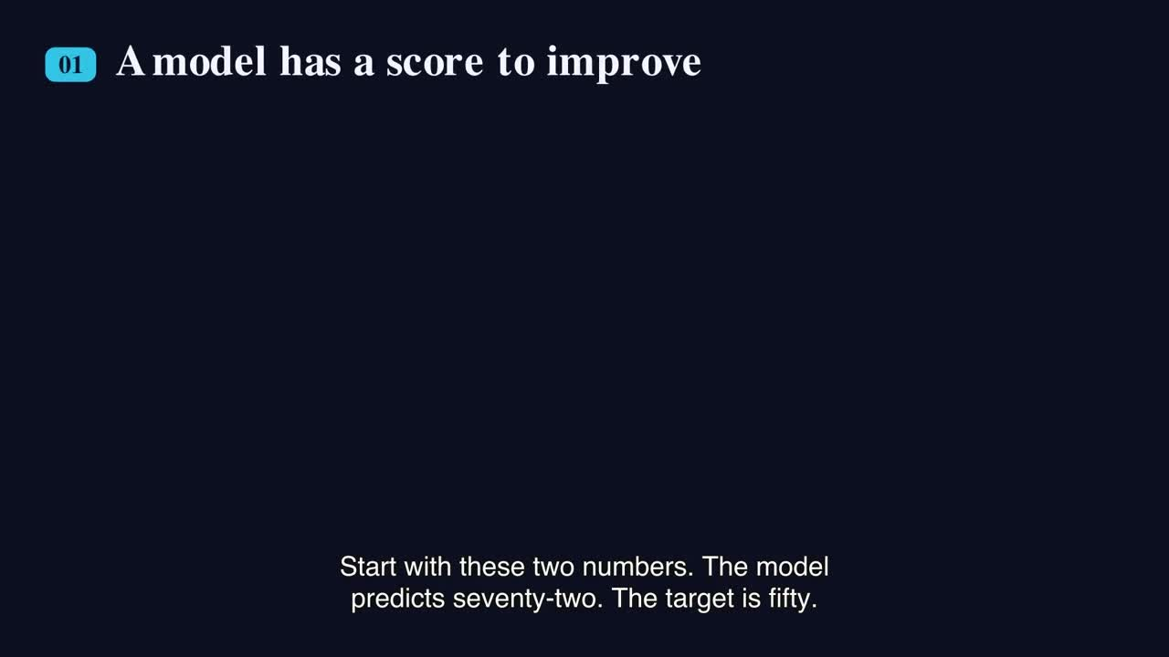
AFK RESEARCH · PRODUCT MEDIA
IMPLEMENTATION
A STEM concept becomes a playable explanation
PLAYABLE VIDEO OUTPUT
Gradient descent, narrated step by step.
A reusable teaching asset combines visual reasoning, voice, and captions in one sequence.
CLICK TO PLAY
IN SLIDE SHOW
39
CREATED WITH AFK RESEARCH
Notes:
Play the embedded video to show how a difficult technical idea can become a paced, captioned explanation. The media is used directly from the supplied product materials. This remains a product example, not separate proof of a currently shipped first-class CLI feature.
[Sources]
- [private-local-root]/.codex/worktrees/9424/afk-research/.outputs/gradient-descent-video/.outputs/manim/gradient-descent-explained/20260713T145442172Z/final.mp4
- [private-local-root]/Downloads/29 July.pptx (slide 9)
- [private-local-root]/dcse-summer-ppt/.brain/wiki/sources/29-july-presentation.md
- [private-local-root]/dcse-summer-ppt/.brain/wiki/syntheses/afk-research-presentation-to-mvp-gap.md

Slide 40
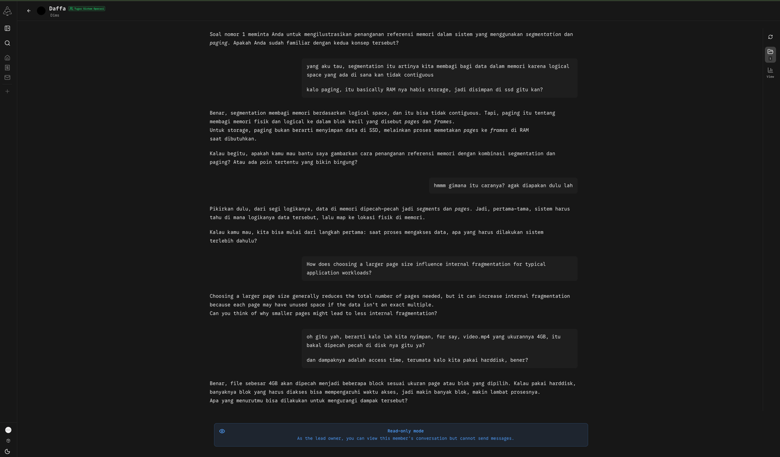
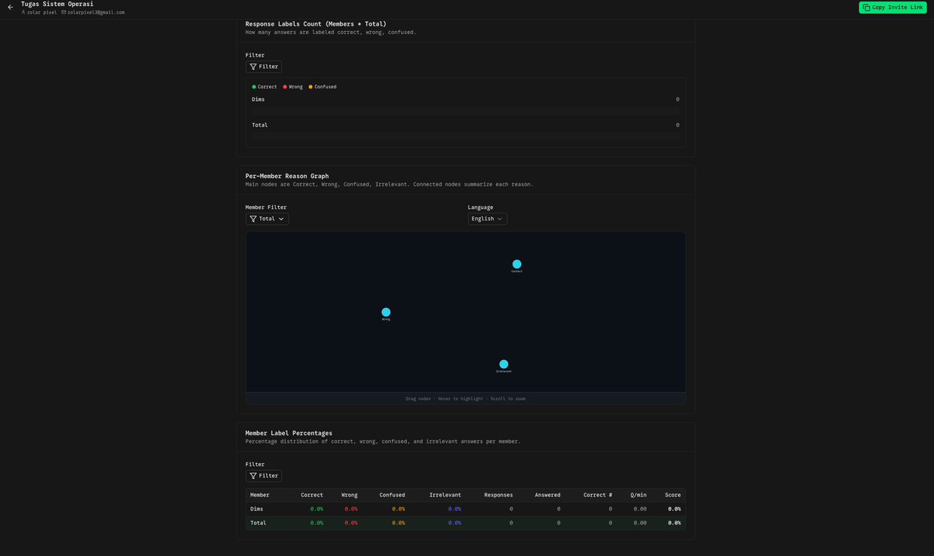
AFK RESEARCH · PRODUCT MEDIA
IMPLEMENTATION
Student dialogue becomes evidence for review
STUDENT–AI DIALOGUE
LECTURER ANALYSIS
WHY IT MATTERS
A product concept connects the learning interaction to a reviewable view—without delegating the assessment decision.
40
CREATED WITH AFK RESEARCH
Notes:
Frame this as richer evidence for formative learning, not automatic grading. The media is used directly from the supplied product materials. This remains a product example, not separate proof of a currently shipped first-class CLI feature.
[Sources]
- [private-local-root]/Downloads/29 July.pptx (slide 10)
- [private-local-root]/dcse-summer-ppt/.brain/wiki/sources/29-july-presentation.md
- [private-local-root]/dcse-summer-ppt/.brain/wiki/concepts/human-in-the-loop-academic-agent.md

Slide 41
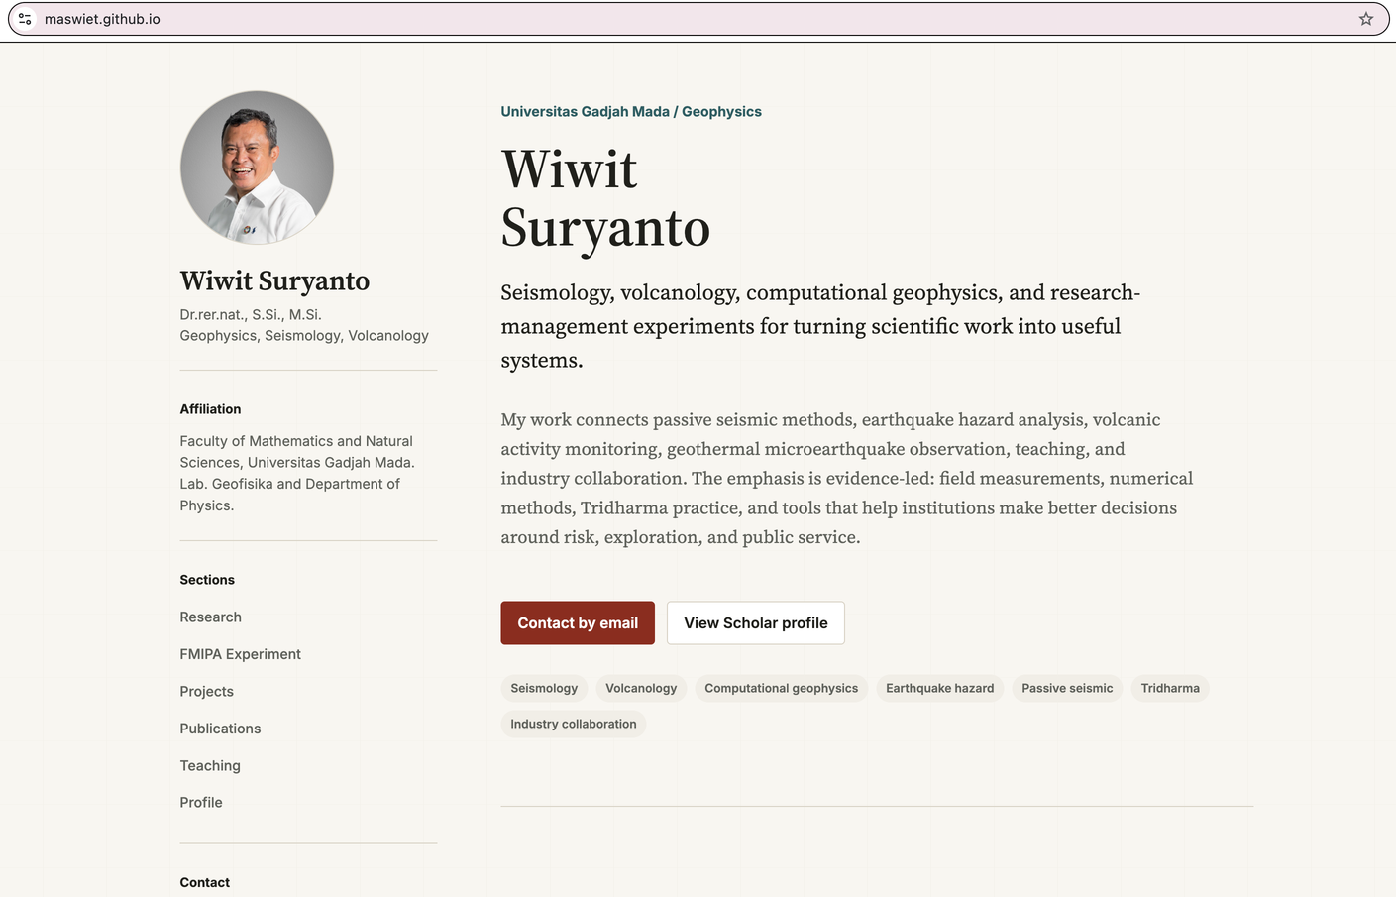
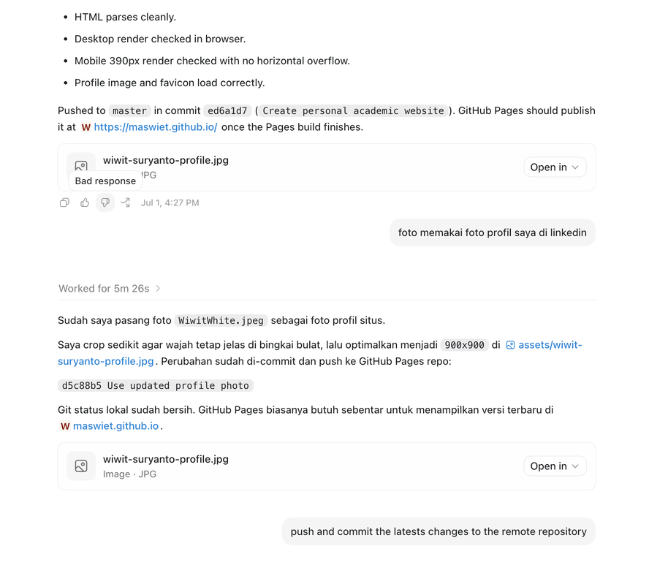
AFK RESEARCH · PRODUCT MEDIA
IMPLEMENTATION
Agents can maintain an academic website
PUBLISHED ACADEMIC PROFILE
AGENT CHANGE LOG
The agent prepares and validates updates; the lecturer retains the release decision.
41
CREATED WITH AFK RESEARCH
Notes:
Connect the website example to the private-source and reviewed-export boundary introduced earlier. The media is used directly from the supplied product materials. This remains a product example, not separate proof of a currently shipped first-class CLI feature.
[Sources]
- [private-local-root]/Downloads/29 July.pptx (slide 11)
- [private-local-root]/dcse-summer-ppt/.brain/wiki/sources/29-july-presentation.md
- [private-local-root]/dcse-summer-ppt/.brain/wiki/concepts/human-in-the-loop-academic-agent.md

Slide 42
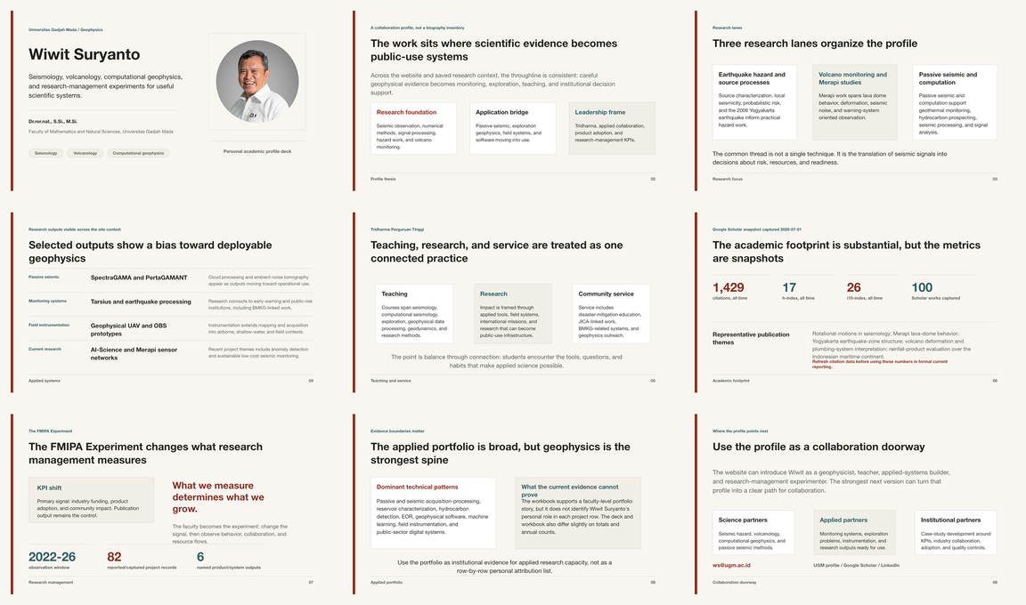
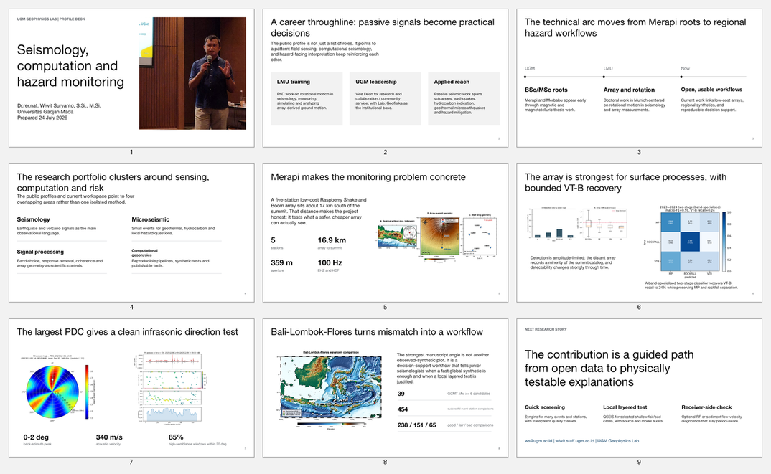
AFK RESEARCH · PRODUCT MEDIA
IMPLEMENTATION
A Design System keeps materials coherent
CONSISTENT ACADEMIC STORY
RICH TECHNICAL CONTENT
WHY IT MATTERS
Shared visual rules keep the family coherent while each course or research topic preserves its own evidence.
42
CREATED WITH AFK RESEARCH
Notes:
Emphasize coherence and reuse: the Design System guides the family while each artifact remains editable. The media is used directly from the supplied product materials. This remains a product example, not separate proof of a currently shipped first-class CLI feature.
[Sources]
- [private-local-root]/Downloads/29 July.pptx (slide 12)
- [private-local-root]/dcse-summer-ppt/.brain/wiki/sources/29-july-presentation.md

Slide 43
IMPLEMENTATION
The implemented architecture is layered
1
2
3
4
5
Project
Installer
Workspaces
Skills
History
An existing GitHub-backed worktree.
CLI verifies, plans, applies, and checks setup.
.brain plus optional .design and .schedule.
Reusable workflows for agents to follow.
Issues, commits, manifests, and logs.
43
CREATED WITH AFK RESEARCH
Notes:
Walk left to right; emphasize that the loop repeats after feedback.
[Sources]
- [private-local-root]/dcse-summer-ppt/.brain/wiki/sources/afk-research-mvp-repository.md
- [private-local-root]/dcse-summer-ppt/.brain/raw/2026-07-27_afk-research-mvp/README.md

Slide 44
IMPLEMENTATION
Start with verifiable prerequisites
RUNTIME
REPOSITORY
CHOICES
Node.js 18.18 or newer and npm.
An existing Git worktree with a reachable GitHub origin.
Decide whether the project needs Design, Schedule, Claude Code, or Sandcastle support.
44
CREATED WITH AFK RESEARCH
Notes:
Compare the 3 parts as one system.
[Sources]
- [private-local-root]/dcse-summer-ppt/.brain/raw/2026-07-27_afk-research-mvp/README.md

Slide 45
IMPLEMENTATION
Preview before applying setup
# 1. Preview
npx --yes --package github:ORG/AFK-RESEARCH-REPO \
afk-research init --dry-run --yes
# 2. Apply after review
npx --yes --package github:ORG/AFK-RESEARCH-REPO \
afk-research init --design --schedule
VERIFY
The target project and GitHub remote must already exist.
PREVIEW
Dry run shows planned files and dependencies without writing.
CHOOSE
Optional workspaces are explicit setup decisions.
45
CREATED WITH AFK RESEARCH
Notes:
Read the command as a safety workflow, not as a magic incantation. Preview, verify, choose features, then apply.
[Sources]
- [private-local-root]/dcse-summer-ppt/.brain/raw/2026-07-27_afk-research-mvp/README.md

Slide 46
IMPLEMENTATION
The workspace has a readable anatomy
.BRAIN/
.DESIGN/
.SCHEDULE/
Raw provenance, maintained wiki knowledge, indexes, logs, and durable outputs.
Named Design Systems with DESIGN.md, tokens, templates, and examples.
Task Prompts, runner guidance, and machine-local operational state.
46
CREATED WITH AFK RESEARCH
Notes:
Compare the 3 parts as one system.
[Sources]
- [private-local-root]/dcse-summer-ppt/.brain/wiki/sources/afk-research-mvp-repository.md
- [private-local-root]/dcse-summer-ppt/.brain/raw/2026-07-27_afk-research-mvp/README.md

Slide 47
IMPLEMENTATION
Implement a research workflow
1
2
3
4
Capture
Extract
Query
Validate
Save the source and provenance without rewriting it.
Create source notes, concepts, claims, and questions.
Answer from maintained knowledge with precise citations.
Inspect original evidence before making consequential claims.
47
CREATED WITH AFK RESEARCH
Notes:
Walk left to right; emphasize that the loop repeats after feedback.
[Sources]
- [private-local-root]/dcse-summer-ppt/.brain/wiki/concepts/agentic-academic-workspace.md
- [private-local-root]/dcse-summer-ppt/.brain/wiki/sources/afk-research-mvp-repository.md

Slide 48
IMPLEMENTATION
Implement a teaching workflow
1
2
3
4
Define
Retrieve
Generate
Review
Set learning outcomes and audience assumptions.
Bring relevant evidence and prior decisions into context.
Create lecture materials, examples, activities, and notes.
Check accuracy, pedagogy, accessibility, and integrity.
48
CREATED WITH AFK RESEARCH
Notes:
Walk left to right; emphasize that the loop repeats after feedback.
[Sources]
- https://www.unesco.org/en/articles/guidance-generative-ai-education-and-research
- https://www.oecd.org/en/publications/policies-supporting-responsible-and-systematic-genai-adoption-in-higher-education_c4e5621f-en.html
- [private-local-root]/dcse-summer-ppt/.brain/wiki/concepts/tri-dharma-workspace-architecture.md

Slide 49
IMPLEMENTATION
Implement a community workflow
1
2
3
4
Listen
Adapt
Approve
Learn
Record community needs, language, and constraints.
Translate expertise into appropriate formats.
Check consent, rights, privacy, and local relevance.
Capture feedback as evidence for the next iteration.
49
CREATED WITH AFK RESEARCH
Notes:
Walk left to right; emphasize that the loop repeats after feedback.
[Sources]
- [private-local-root]/dcse-summer-ppt/.brain/wiki/concepts/human-in-the-loop-academic-agent.md
- [private-local-root]/dcse-summer-ppt/.brain/wiki/concepts/tri-dharma-workspace-architecture.md

Slide 50
IMPLEMENTATION
Schedule recurring work, not judgment
GOOD CANDIDATES
REQUIRE REVIEW
RUNNER CONTROLS
Status checks, inbox triage, reminders, source monitoring, and draft preparation.
Grades, student feedback, research conclusions, external messages, and publication.
Readiness checks, explicit start/stop, logs, wake handling, and task-level prompts.
50
CREATED WITH AFK RESEARCH
Notes:
Compare the 3 parts as one system.
[Sources]
- [private-local-root]/dcse-summer-ppt/.brain/wiki/sources/afk-research-mvp-repository.md
- [private-local-root]/dcse-summer-ppt/.brain/raw/2026-07-27_afk-research-mvp/README.md
- [private-local-root]/dcse-summer-ppt/.brain/wiki/concepts/human-in-the-loop-academic-agent.md

Slide 51
IMPLEMENTATION
Managed updates preserve project ownership
1
2
3
4
Compare
Update
Preserve
Sidecar
Read intended managed files and current hashes.
Replace only unchanged installer-owned files.
Keep user-edited files and unknown local skills.
Write the new generated alternative beside conflicts.
51
CREATED WITH AFK RESEARCH
Notes:
This is the strongest concrete example of human ownership in the MVP: the setup does not silently overwrite project-authored edits.
[Sources]
- [private-local-root]/dcse-summer-ppt/.brain/wiki/concepts/managed-file-reconciliation.md
- [private-local-root]/dcse-summer-ppt/.brain/wiki/sources/afk-research-mvp-repository.md

Slide 52
ADOPTION
A 30-day adoption path
WEEK 1 · BASELINE
WEEK 2 · PROTOTYPE
WEEK 3–4 · GOVERN
Choose one low-risk workflow and define evidence, owner, and success criteria.
Create the workspace, run manually, and record every failure.
Add review gates, evaluate outputs, then automate only stable preparation steps.
52
CREATED WITH AFK RESEARCH
Notes:
The adoption principle is deliberately conservative: prove a bounded workflow before increasing autonomy or connecting external write actions.
[Sources]
- https://airc.nist.gov/airmf-resources/airmf/5-sec-core/
- https://www.unesco.org/en/articles/guidance-generative-ai-education-and-research

Slide 53
REFERENCES
Key references
01
Indonesia · Law No. 12/2012 on Higher Education
05
Lewis et al. · Retrieval-Augmented Generation (2020)
02
Yao et al. · ReAct (2023)
06
UNESCO · Guidance for GenAI in Education and Research (2023)
03
Schick et al. · Toolformer (2023)
07
NIST · AI Risk Management Framework 1.0
04
Park et al. · Generative Agents (2023)
08
AFK Research · private MVP snapshot at 6c76a25
53
CREATED WITH AFK RESEARCH
Notes:
Invite participants to use the speaker-note source blocks throughout the deck for precise links. The AFK Research evidence is private and must not be published without explicit approval.
[Sources]
- https://peraturan.bpk.go.id/Details/%2039063/uu-no-12-tahun-2012
- https://arxiv.org/abs/2210.03629
- https://arxiv.org/abs/2302.04761
- https://arxiv.org/abs/2304.03442
- https://arxiv.org/abs/2005.11401
- https://www.unesco.org/en/articles/guidance-generative-ai-education-and-research
- https://airc.nist.gov/airmf-resources/airmf/5-sec-core/
- https://www.oecd.org/en/publications/policies-supporting-responsible-and-systematic-genai-adoption-in-higher-education_c4e5621f-en.html
- [private-local-root]/dcse-summer-ppt/.brain/wiki/sources/afk-research-mvp-repository.md
- [private-local-root]/dcse-summer-ppt/.brain/wiki/syntheses/afk-research-presentation-to-mvp-gap.md

Slide 54
The lecturer remains the accountable expert.
BUILD THE SYSTEM.
KEEP THE JUDGMENT.
The agent carries context, prepares work, uses bounded tools, and makes the process visible.
54
CREATED WITH AFK RESEARCH
Notes:
Close by resolving the opening tension. The goal is not autonomous academia. The goal is continuity, leverage, and visible evidence while the lecturer retains accountable judgment.
[Sources]
- [private-local-root]/dcse-summer-ppt/.brain/wiki/concepts/human-in-the-loop-academic-agent.md
- https://www.unesco.org/en/articles/guidance-generative-ai-education-and-research
- https://airc.nist.gov/airmf-resources/airmf/5-sec-core/

