Slide 1


Harlem
http://www.findsounds.com/
And “A Raisin in
the Sun”
By Jared and Nicole

Slide 2
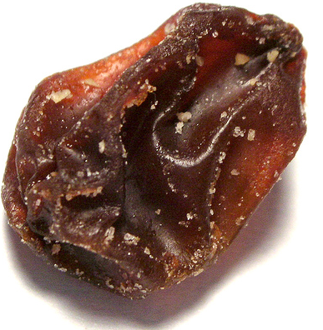
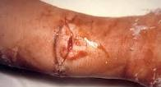
What happens to a dream deferred?
Does it dry up
like a raisin in the sun?
Or fester like a sore—
And then run?

Slide 3

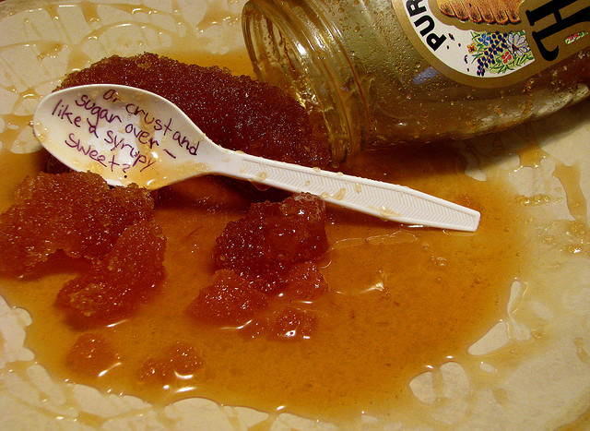
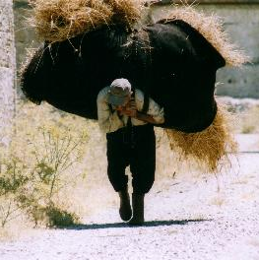
Does it stink like rotten meat?
Or crust and sugar over—
like a syrupy sweet?
Or maybe it just sags like a heavy load.

Slide 4

Or does it explode?

Slide 5

Dreams
The Family:
Wanted to move to a bigger home
Apartment was too small for all of them
Only planned to live there for a year or so
Dream “dried up” over time
Never got a chance to move out

Slide 6
Dreams
Mama:
Wanted a garden of her own
Only had a little plant
Wanted a home with space for it
“Sugared over” quietly.
Her increasing age rendered it less likely every day

Slide 7
Dreams
Beneatha:
Wanted money for med school
Walter wasted this money accidentally
Also wanted to find her “identity”
Aided by her suitor Asagai
Turned to her African roots
Reeked with bitterness and grew stale until nearer to the end

Slide 8
Dreams

