Slide 1
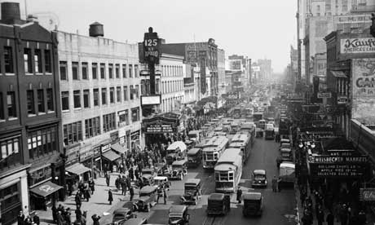

Harlem
And “A Raisin in
the Sun”
By Jared and Nicole

Slide 2
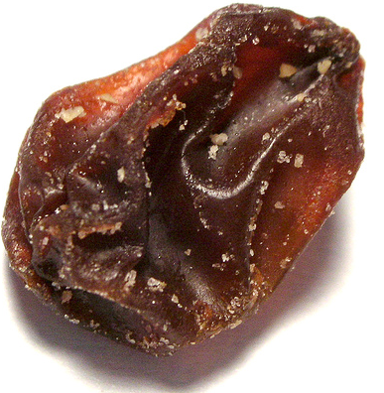

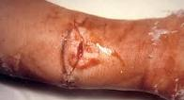
What happens to a dream deferred?
Does it dry up
like a raisin in the sun?
Or fester like a sore—
And then run?

Slide 3
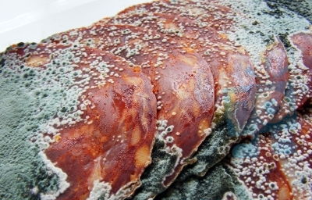
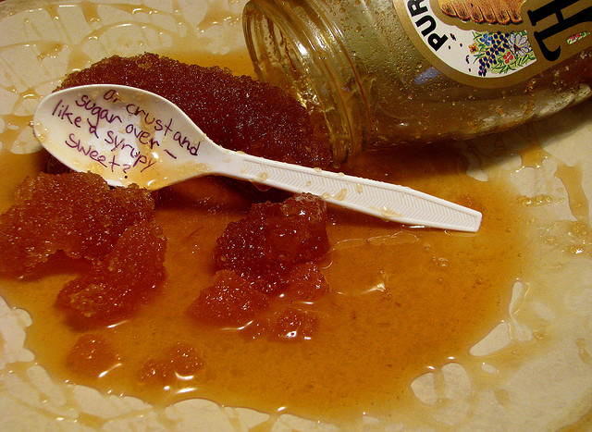
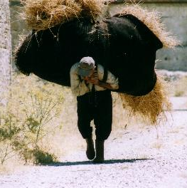
Does it stink like rotten meat?
Or crust and sugar over—
like a syrupy sweet?
Or maybe it just sags like a heavy load.

Slide 4

Or does it explode?

Slide 5

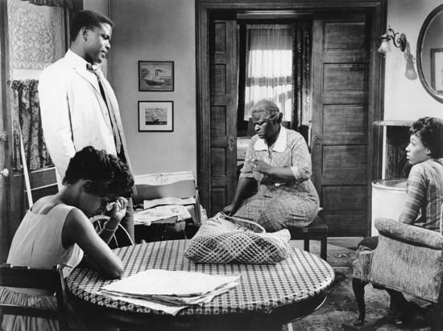
Dreams
The Family:
Wanted to move to a bigger home
Apartment was too small for all of them
Only planned to live there for a year or so
Dream “dried up” over time
Never got a chance to move out

Slide 6

Dreams
Mama:
Wanted a garden of her own
Wanted a home with space for it
Only had a little plant
“Sugared over” quietly.
Her increasing age rendered it less likely every day

Slide 7

Dreams
Beneatha:
Wanted money for med school
Walter wasted this money
Also wanted to find her “identity”
Aided by her suitor Asagai
Turned to her African roots
Got stronger each day, like the smell of rotten meat

Slide 8

Dreams
Ruth:
Wanted a house to raise her family in
Then she could keep her newborn
Much too crowded in the two-bedroom apartment
Wanted Travis to have his own room
Sagged like a heavy load with the loss of the insurance check
Dream was repaired upon choosing to live in the new house in the “white” neighborhood

Slide 9
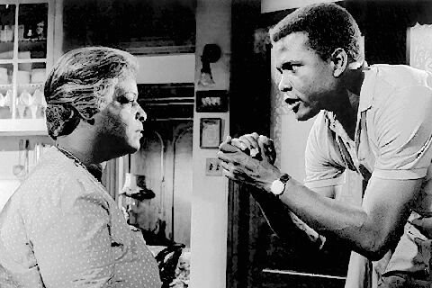
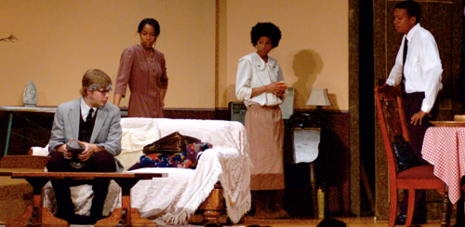
Dreams
Walter:
Wanted to invest Mama’s money in a liquor store
Dream festered like a sore when Mama told him he couldn’t
Began to heal when Mama let him use most of the money
His money, his dream, and his pride ran away with Willy
Regained his pride when he refused to sell the house

Slide 10

THE END

