Slide 1
CUSTOMER SHOPPING BEHAVIOR INSIGHTS
Customer shopping is broad, repeat-led, and under-converted to subscription
3,900 purchases reveal a loyal base — but subscriptions remain a minority behavior.
Notes:
Open with the central tension: customers return, but relatively few subscribe. The analysis points toward conversion and retention design rather than simply chasing larger baskets.

Slide 2
The dataset is large enough to see patterns, not just anecdotes
A broad transaction file supports directional commercial decisions.
SCOPE | READOUT | WHY IT MATTERS
Purchases | 3,900 transactions | Enough volume to see repeat and conversion patterns.
Fields | 18 fields | Customer and purchase dimensions can be read together.
Data quality | 37 missing review ratings | Handled with the category median rather than discarded.
The findings are descriptive patterns in the uploaded report, not causal estimates.
02
Notes:
Establish confidence in the readout without overselling precision. The file is large enough to identify patterns, and the missing review ratings were handled consistently by category median.

Slide 3
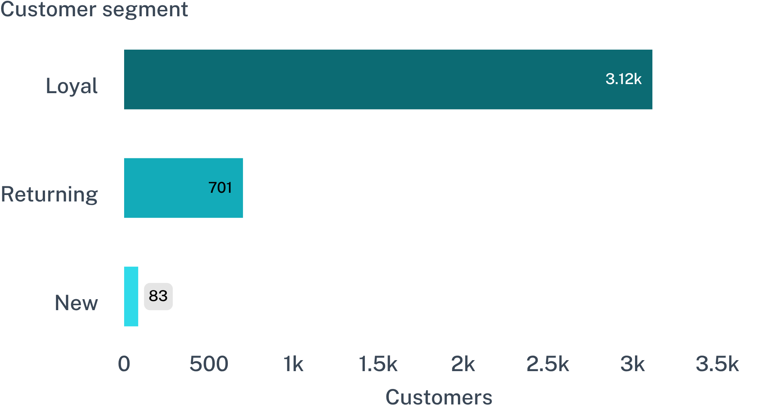
Loyal customers dominate the base
OPERATING IMPLICATION
Retention is the center of gravity.
With 3,116 loyal customers versus 701 returning and 83 new, the base is already signaling repeat behavior.
03
Notes:
Read the bars from loyal to new. The commercial center of gravity is retention: the base is not primarily a one-time acquisition story.

Slide 4
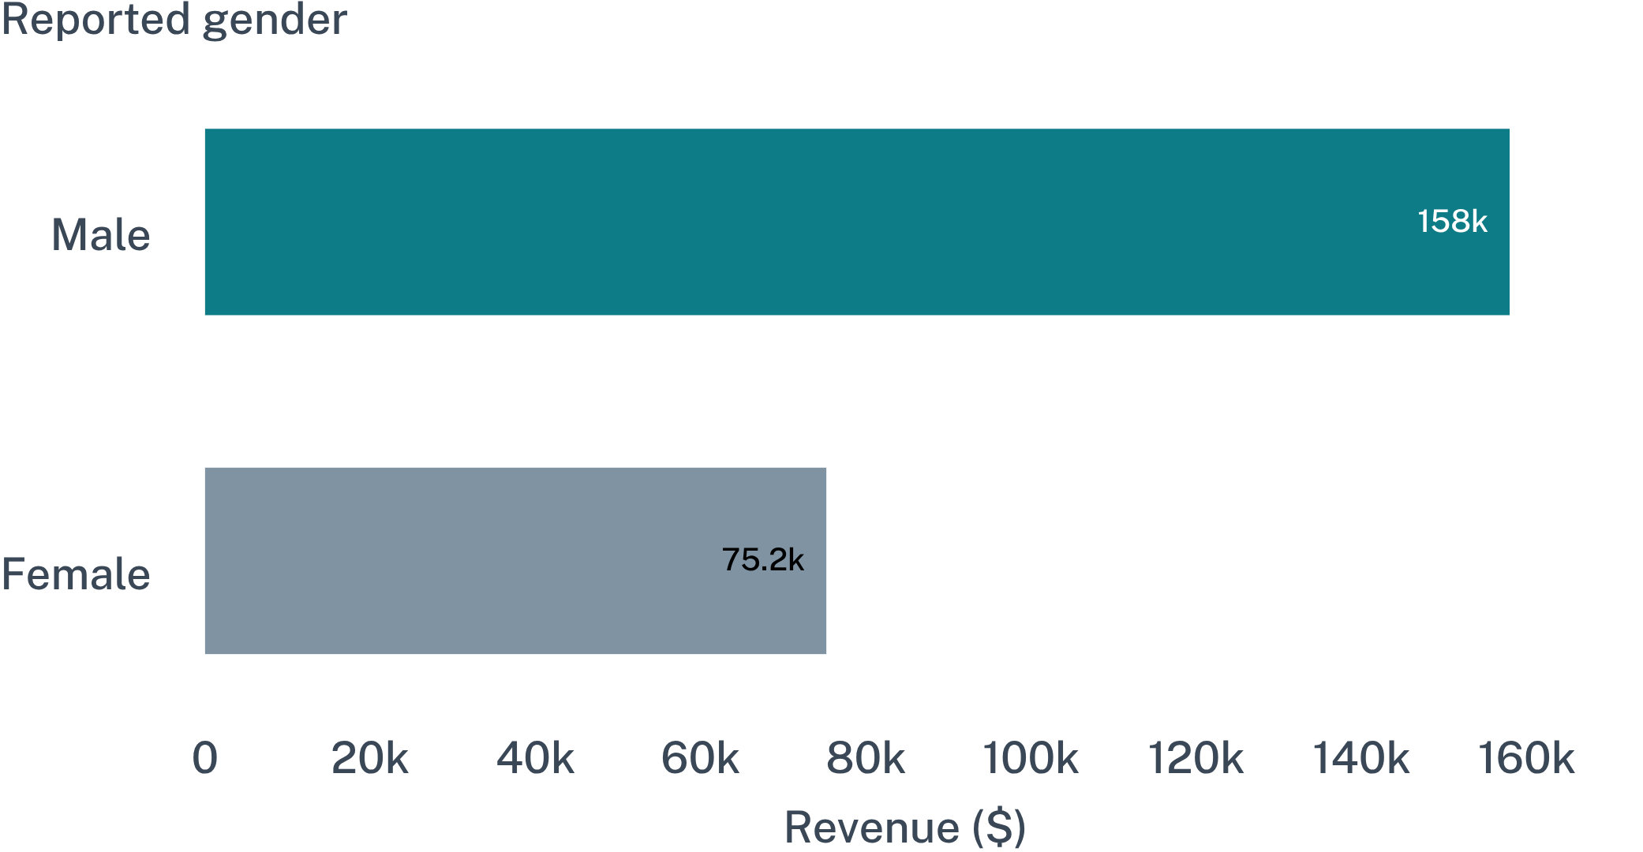
Revenue is concentrated among male customers in this sample
The gap is descriptive, not an explanation of cause.
SAMPLE READOUT
$157,890
Reported revenue from male customers versus $75,191 from female customers.
Use this as a targeting signal to investigate, not as a causal conclusion.
04
Notes:
State the comparison plainly, then add the guardrail: this is a descriptive result in the sample. It tells us where to investigate, not why the difference exists.

Slide 5

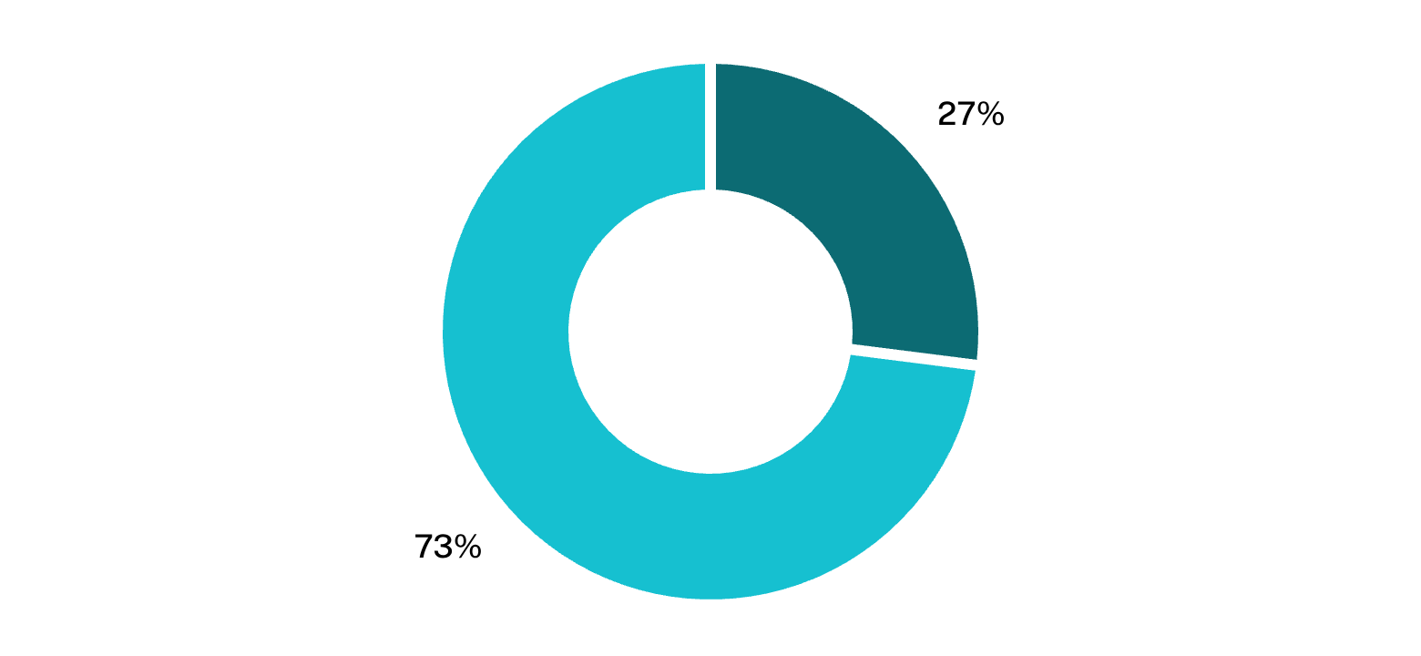
Subscription is the clearest commercial gap
27% subscribed · 73% not subscribed
Subscriber revenue
Non-subscriber revenue
$62,645
$170,436
05
Average spend is nearly flat, so the opportunity is conversion and retention design—not simply a bigger basket.
Notes:
Subscription is the clearest commercial gap: only 27% are subscribed, and most revenue still comes from non-subscribers. The nearly flat average spend points toward conversion and retention design rather than a basket-size thesis.

Slide 6
Discounts are reaching high-value shoppers, but some products lean on them
PRODUCT | DISCOUNT RATE
Hat | 50.00%
Sneakers | 49.66%
Coat | 49.07%
Sweater | 48.17%
Pants | 47.37%
839
discounted purchases above average spend
Discount reach is not confined to low-value shoppers.
The implication is tighter discount governance: protect margin while testing where incentives genuinely change behavior.
06
Notes:
Lead with the 839 discounted purchases above average spend. Then show where discount rates are highest. The question is not whether discounts reach valuable shoppers; it is whether each product is earning that subsidy.

Slide 7
Product signals point to a focused merchandising story
Start campaigns with products customers already rate highly.
TOP-RATED PRODUCT | AVERAGE RATING
Gloves | 3.86
Sandals | 3.84
Boots | 3.82
Hat | 3.80
Skirt | 3.78
MERCHANDISING IMPLICATION
Use product proof as the campaign starting point.
Build focused tests around the highest-rated products, then pair them with the category and audience signals that convert.
07
Notes:
These are the clearest product-level signals in the report. The recommended move is focused merchandising: use highly rated products as campaign starting points, then test the audience and offer around them.

Slide 8
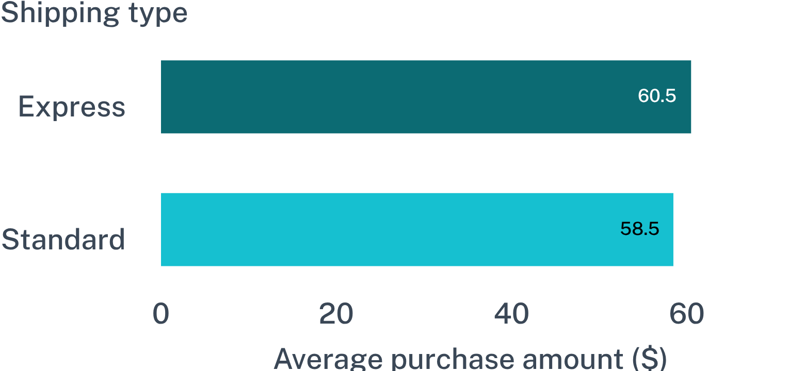
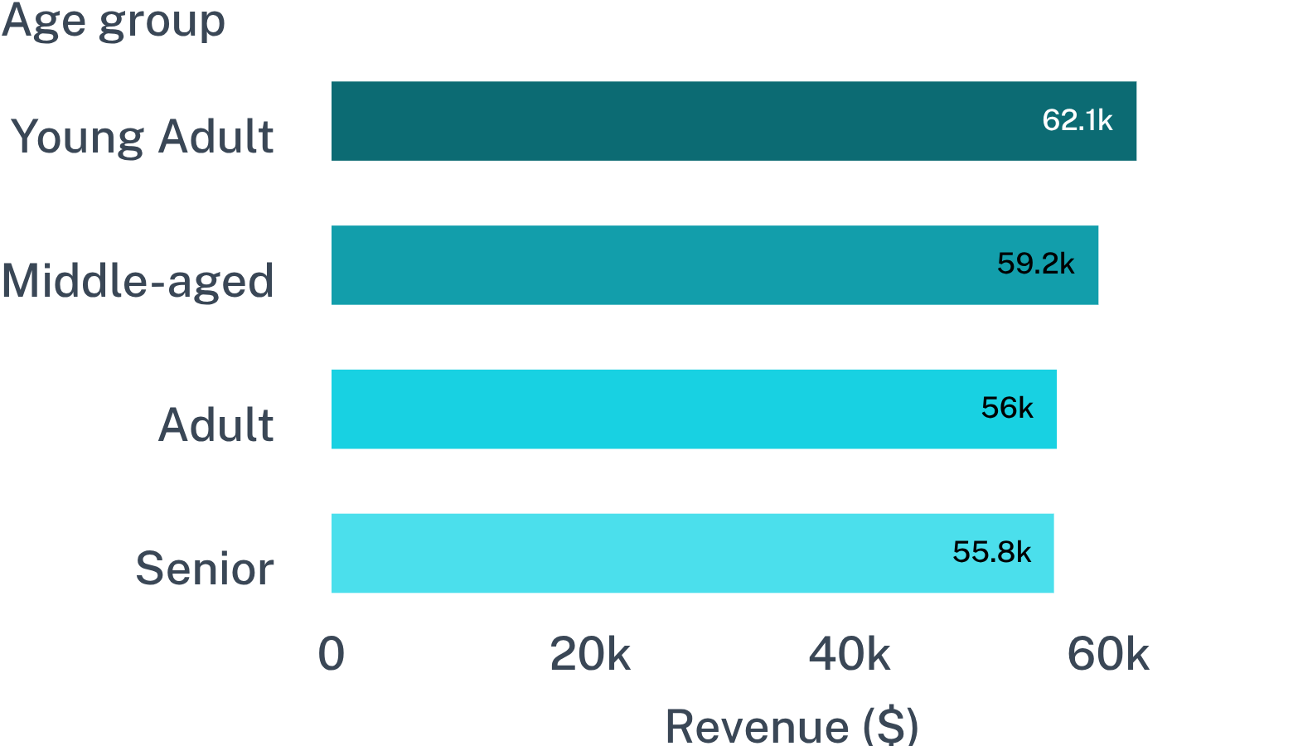
Shipping and age groups offer practical targeting levers
AVERAGE PURCHASE AMOUNT
REVENUE BY AGE GROUP
Express leads Standard: $60.48 versus $58.46.
Practical tests: position express shipping and prioritize the highest-revenue age groups without treating either signal as causal.
08
Notes:
Two usable levers emerge. Express orders carry a slightly higher average purchase amount, while Young Adult and Middle-aged customers lead revenue by age group. These are targeting inputs to test, not causal explanations.

Slide 9

Turn the analysis into four operating moves
01
02
Design subscription benefits
Reward loyalty
Test benefits that make repeat behavior easier to choose.
Build on the large loyal base rather than treating every shopper alike.
03
04
Govern discounts
Target the proof points
Protect margin where products appear to lean on incentives.
Focus campaigns on rated products, high-revenue age groups, and express shipping.
09
Notes:
Translate the evidence into four actions: make subscription more compelling, reward the behavior already present, tighten discount governance, and target campaigns where product, age, and shipping signals are strongest.

Slide 10
NEXT STEP
Test conversion plays against margin and repeat behavior
Define the decision metrics before scaling: subscriber conversion, repeat purchase, product margin, discount lift, and cohort retention.
Conversion — Did the offer move shoppers into subscription?
Economics — Did margin hold after discounts and benefits?
Durability — Did repeat behavior and cohort retention improve?
Notes:
Close on the measurement agenda. The next decision is not whether to run tests; it is whether conversion improves without weakening margin or repeat behavior.

